Slide 1


SSS Postulate

Slide 2
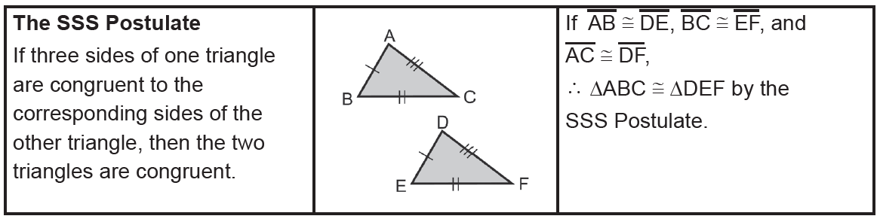
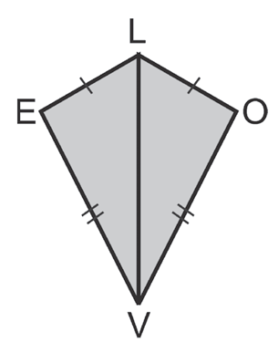
SSS Postulate
We say that two triangles are congruent if the six corresponding parts are congruent. However, we can have congruent
triangles without showing all the corresponding parts of the congruent two triangles. The postulate on the next page will indicate one condition for any two triangles to be congruent.
Example 1:
Use the diagram on the right to show that the triangles are congruent. Does it give enough information? Explain.
Solution:
From the diagram, you know that LE ≅ LO and VE ≅ VO. By reflexive property, you know that LV ≅ LV.
Thus, enough information is given. Because corresponding sides are congruent, you can use the
SSS Postulate to conclude that ΔLEV ≅ ΔLOV.
Rex Curriculum Resource
WWW.REX.COM.PH

Slide 3
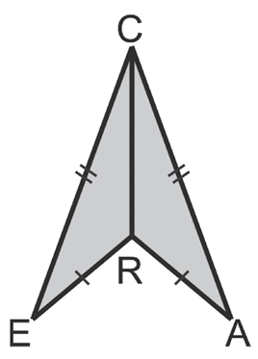
Activity:
CHECKPOINT 1:
Use the diagram below to show that the triangles are congruent. Does it give enough information? Explain.
Rex Curriculum Resource
WWW.REX.COM.PH

Slide 4
Activity:
CHECKPOINT 1:
Use the diagram below to show that the triangles are congruent. Does it give enough information? Explain.
Answer:
1. The 2 triangles are congruent by the SSS Postulate.
Rex Curriculum Resource
WWW.REX.COM.PH

Slide 5
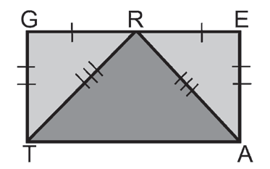
SSS Postulate
Example 2:
Which triangles are congruent based on the markings in the given figure below
Solution:
Applying the SSS Postulate, GR ≅ ER, GT ≅ EA, and RT ≅ RA. Thus, ΔGRT ≅ ΔERA.
Rex Curriculum Resource
WWW.REX.COM.PH

Slide 6
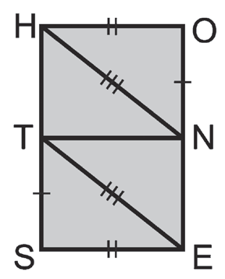
Activity:
CHECKPOINT 2:
Which triangles are congruent based on the markings
in the given figure below?
Rex Curriculum Resource
WWW.REX.COM.PH

Slide 7
Activity:
CHECKPOINT 2:
Which triangles are congruent based on the markings
in the given figure below?
ANSWER:
2. ΔNOH ≅ ΔTSE
Rex Curriculum Resource
WWW.REX.COM.PH

Slide 8
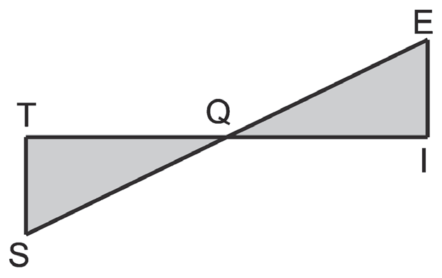
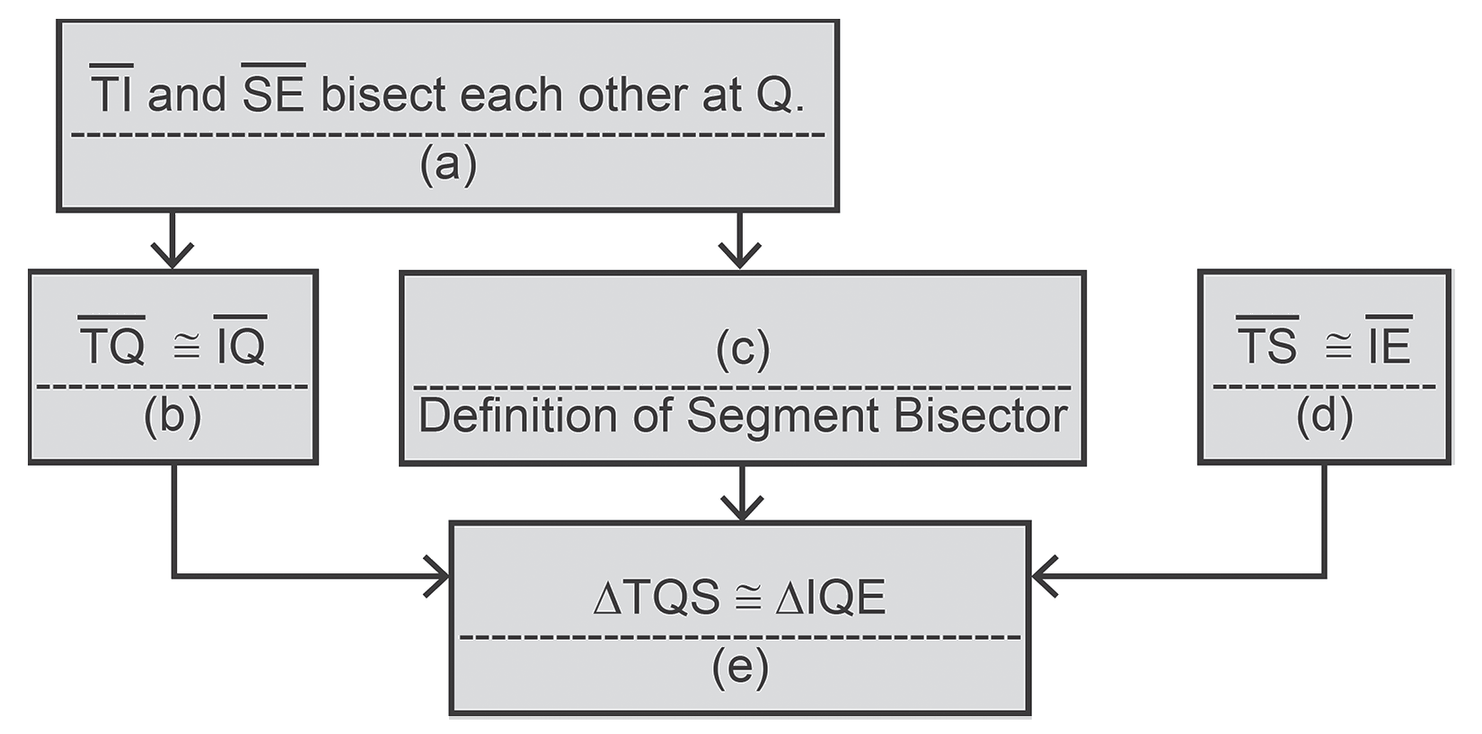
SSS Postulate
Example 3:
Fill in the missing statements and reasons.
Given: TI and SE bisect each other at Q.
TS ≅ IE
Prove: ΔTQS ≅ ΔIQE
Proof:
Solution:
a. Given
b. Definition of Segment Bisector
c. SQ ≅ EQ
d. Given
e. The SSS Postulate
Rex Curriculum Resource
WWW.REX.COM.PH

Slide 9
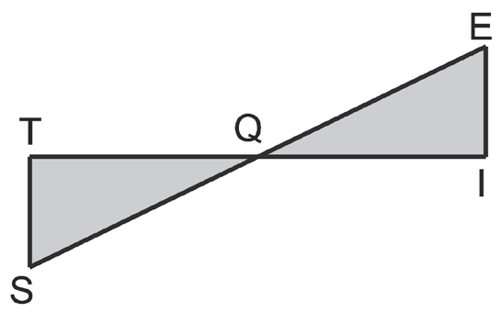
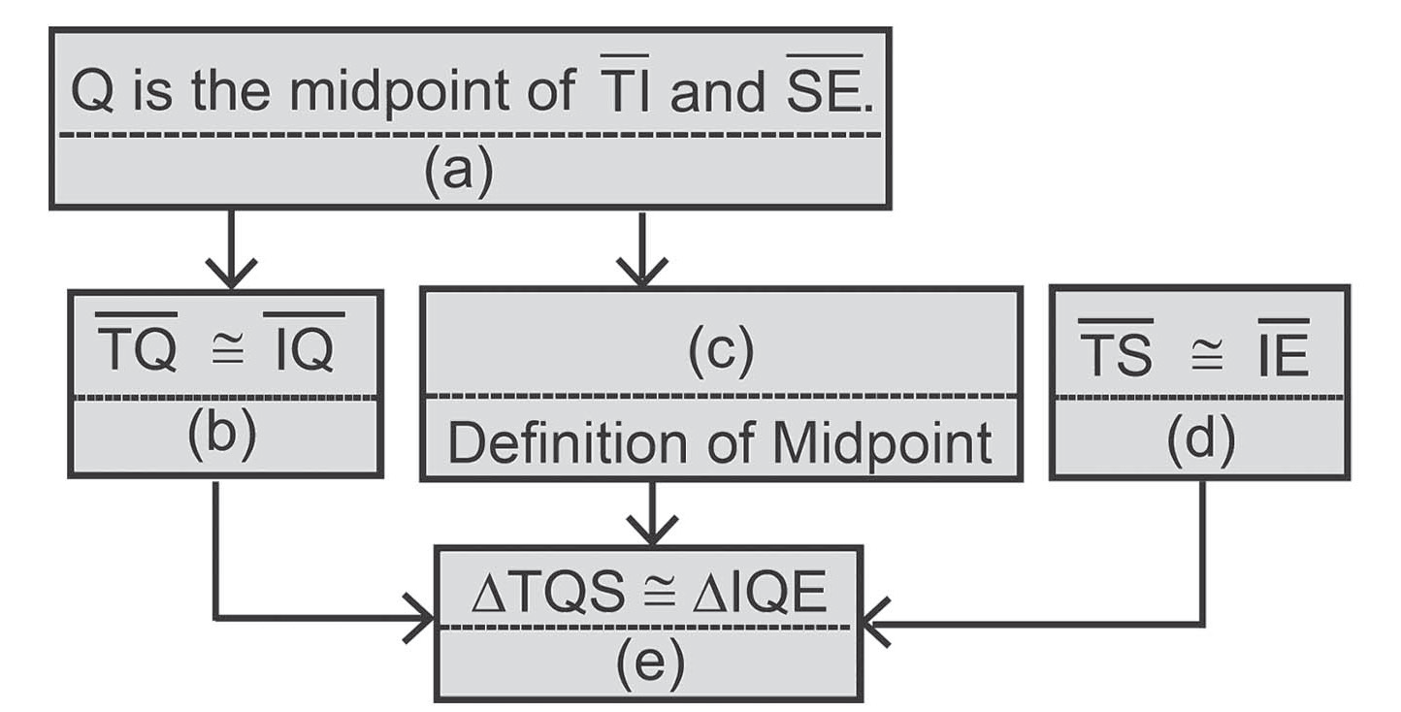
Activity:
CHECKPOINT 3:
Fill in the missing statements on the diagram below and reasons.
Given:
Q is the midpoint of both
TI and SE, TS ≅ IE
Prove:
ΔTQS ≅ ΔIQE
Rex Curriculum Resource
WWW.REX.COM.PH

Slide 10
Activity:
CHECKPOINT 3:
Fill in the missing statements on the diagram below and reasons.
Given:
Q is the midpoint of both
TI and SE, TS ≅ IE
Prove:
ΔTQS ≅ ΔIQE
ANSWER:
a. Given
b. Definition of midpoint
c. SQ ≅ QE
d. Given
e. SSS Postulate
Rex Curriculum Resource
WWW.REX.COM.PH

Slide 11


