Slide 1
Law of Sines

Slide 2
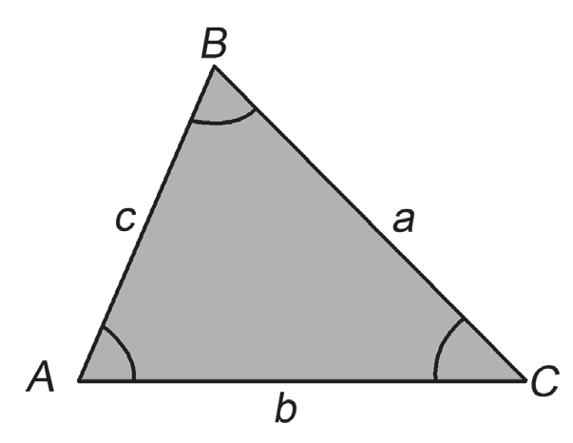
Law of Sines
In this lesson, you will learn how to solve for the measures of oblique triangles. An oblique triangle is a triangle that does not have right angles. It can be an acute triangle or an obtuse triangle. Before proceeding to the discussion, let us do the next activity.
Investigation: Prepare your pencil, ruler, and protractor, and do the activity below.
Draw any three oblique triangles. The labeling of the sides of the triangle with reference to the vertices is important.
(a) The length of the side of the triangle opposite vertex A
(which is BC) is labeled a.
(b) The length of the side of the triangle opposite vertex B
(which is AC) is labeled b.
(c) The length of the side of the triangle opposite vertex C
(which is AB) is labeled c.

Slide 3
Law of Sines
Complete the following table.
Triangle | a | b | c | ∠A | ∠B | ∠C | a/sin A | b/sin B | c/sin C
1
2
3

Slide 4

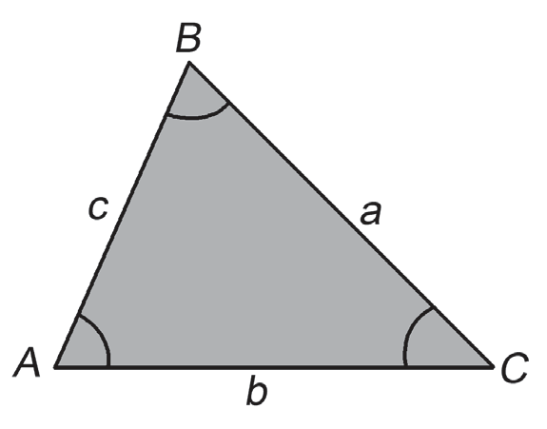
Law of Sines
From the activity, you can conclude that in any oblique triangle,
where A, B, and C are the three interior angles of ΔABC opposite
the sides whose lengths are a, b, and c, respectively. This is
known as the Law of Sines.
To solve an oblique triangle means to find all its unknown sides and angles. Four cases may arise when solving an oblique triangle. The Law of Sines can be used to solve oblique triangles in the following cases:

Slide 5
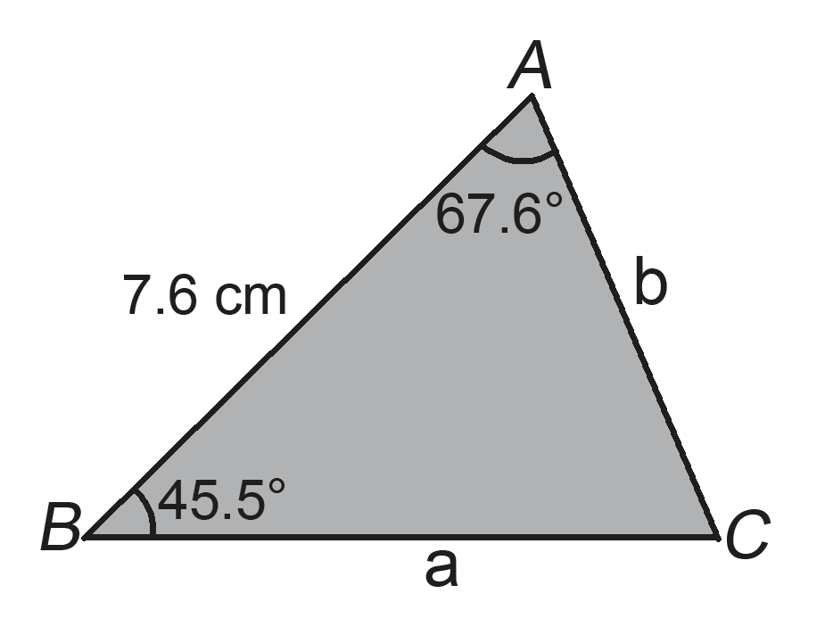
Law of Sines
Case 1: Given two angles and one side
Case 2: Given two sides and a nonincluded angle
Study the following examples.
Example 1: In ΔABC, m∠A = 67.6°, m∠B = 45.5°, and AB =
7.6 cm. Find:
(i) m∠C (ii) BC (iii) AC
Solution:
(i) m∠C = 180° − 67.6° − 45.5° = 66.9°
To find the length of BC or a, use the Law of Sines since the measurements of ∠A, ∠C, and AB or c are known. To find the length of AC, use the Law of Sines as well since the values of ∠B, ∠C, and AB or c are known.

Slide 6
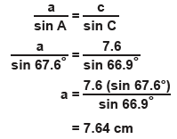
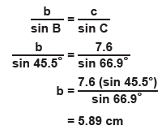
Law of Sines
(ii) Using the Law of Sines,
Thus, BC = 7.64 cm.
(iii) Using the Law of Sines,
Thus, AC = 5.89 cm.
Case 2 is sometimes called the ambiguous case. If sides b, c, and ∠B (i.e., Case 2: Given two sides and a nonincluded angle) are given, take note of each of the following cases that may arise.

Slide 7
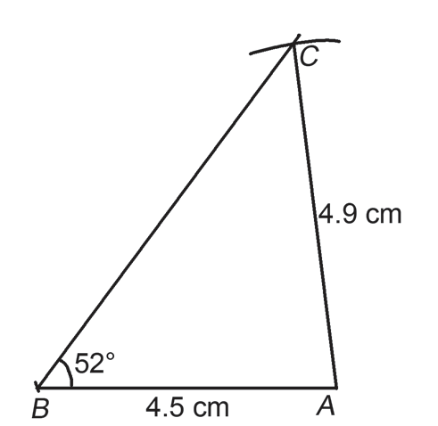
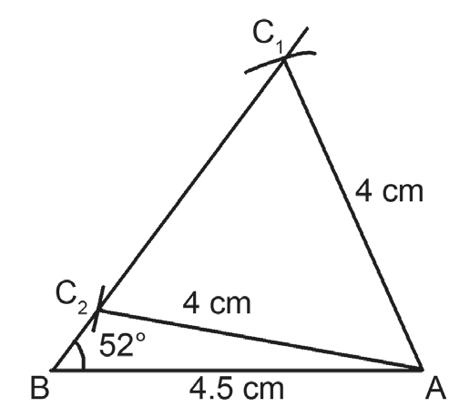
Law of Sines
Case 2.1: b > c
For example, construct ΔABC such that m∠ABC = 52°, AC = 4.9 cm, and AB = 4.5 cm.
When b > c, one triangle can be constructed. Therefore, there is only one value of m∠ACB.
Case 2.2: b < c
For example, construct ΔABC such that m∠ABC = 52°, AC = 4 cm, and AB = 4.5 cm.
When b < c, two triangles can be constructed. Therefore, there is only one value of m∠ACB.

Slide 8
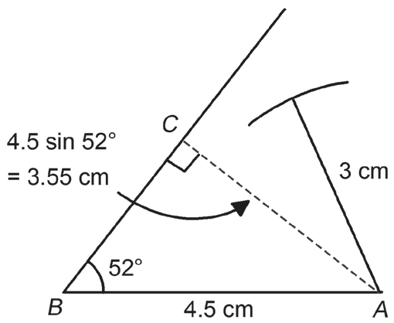
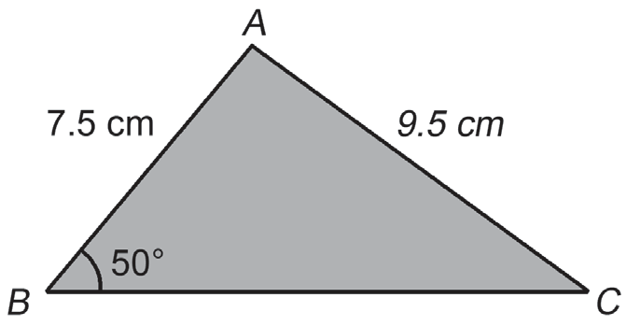
Law of Sines
Case 2.3: b < c sin B, where c sin B is the perpendicular distance
from A to the line through B
For example, construct ΔABC such that m∠ABC = 52°, AB = 4.5 cm
and AC = 3 cm.
When b < c sin B, no triangle can be constructed.
Study the following examples.
Example 2: In ΔABC, m∠B = 50°, AB = 7.5 cm, and
AC = 9.5 cm. Find (i) m∠C, (ii) m∠A, and (iii) BC.

Slide 9
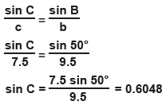
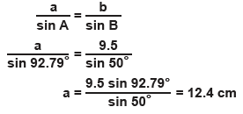
Law of Sines
(i) Using the Law of Sines:
(ii) Using the fact that the sum of the measures of the angles in a triangle is 180°:
m∠A = 180° − 50° − 37.21° = 92.79°
(iii) Using the Law of Sines:
Thus, BC = 12.4 cm.
Hence,
m∠C = sin⁻¹ (0.6048) = 37.21° or 180° − 37.21° = 142.79°
Since c < b, m∠C < m∠B, m∠C
cannot be 142.79°.
Thus, m∠C = 37.21°.

Slide 10


Law of Sines
Example 3: In ΔABC, m∠ABC = 55°, AB = 16.3 cm, and AC = 14.3 cm. Solve for m∠ACB, m∠BAC, and BC.
Solution:
Solve for sin∠ACB:
Using the Law of Sines, you have Thus, sin∠ACB = 0.9337
Also, since sin∠ACB is positive, ∠ACB can be acute or obtuse. Thus, you have m∠ACB = sin⁻¹ (0.9337) = 69.02° or m∠ACB = 180° − 69.02° = 110.98°.
Note that c > b, thus, m∠C > m∠B, i.e., m∠ACB > 55°; hence, both answers are possible.
When m∠ACB = 69.02°, m∠BAC = 180° − 55° − 69.02° = 55.98°.
When m∠ACB = 110.98°, m∠BAC = 180° − 55° − 110.98° = 14.02°.

Slide 11
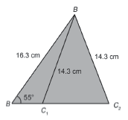


Law of Sines
Notice that it is possible to construct two different triangles from the given information. Thus, a set of information that will give two sets of solutions is said to be ambiguous. Hence, for ambiguous cases, two sets of solutions are obtained.
Case 1: when m∠ACB = 69.02° and m∠BAC = 55.98°
Using the Law of Sines,
Thus, m∠ACB = 69.0°, ∠BAC = 56.0°, and BC = 14.5 cm.
Case 2: when m∠ACB = 110.98° and m∠BAC = 14.02°
Using the Law of Sines,
Thus, m∠ACB = 111.0°, m∠BAC = 14.0°, and BC = 4.23 cm.

Slide 12
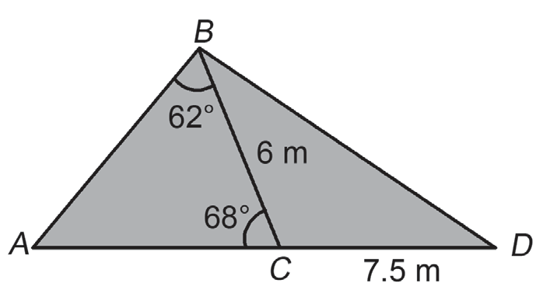

Law of Sines
Example 4: In the figure on the right, A, C, and D are the three points along a straight road, where m∠ABC = 62°, m∠ACB = 68°, BC = 6 m, and CD = 7.5 m. Find the length of AC.
Solution:
Using Law of Sines, you have:
Thus, the length of AC is 6.92 m.

