Slide 1
Law of Cosines

Slide 2
Law of Cosines
Investigation: Law of Cosines
Draw any three oblique triangles. Label the parts of the triangles and measure the parts of the triangles.
∆ | a | b | c | m∠A | m∠B | m∠C
1
2
3

Slide 3
Law of Cosines
Complete the table below based on the parts of the triangles.
∆ | a² | b2+c2-2bc cos A | b² | m∠A | m∠B | m∠C
1
2
3

Slide 4
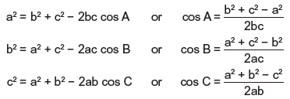
Law of Cosines
From the investigation, you can conclude that:
where A, B, and C are the three interior angles of ΔABC opposite the sides whose lengths are a, b, and c, respectively. This is called the Law of Cosines.
The Law of Cosines is used to solve oblique triangles if the following are given:
Case 3: Given 2 sides and 1 included angle
Case 4: Given 3 sides

Slide 5
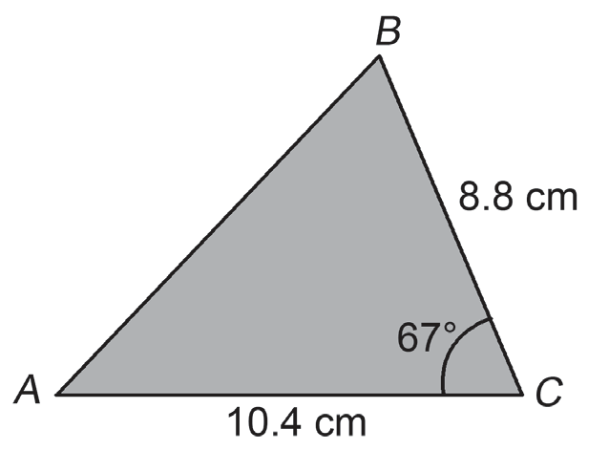
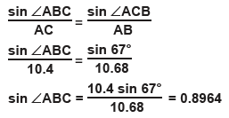
Law of Cosines
Example 1: In ΔABC, BC = 8.8 cm, AC = 10.4 cm, and m–ACB = 67°. Find:
(i) AB (ii) m∠ABC (iii) m∠BAC
Solution:
(i) Using the Law of Cosines, (ii) Using the Law of Sines,
c² = a² + b² − 2ab cos C
AB² = (8.8)² + (10.4)² − 2(8.8)(10.4)(cos 67°)
= 114.1
Thus, AB =√114.1 = 10.68 cm.

Slide 6
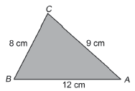

Law of Cosines
Hence, m∠ABC = sin−1 (0.8964 ) = 63.69° or m∠ABC = 180° − 63.69° = 116.31°. Since AC < AB, m∠B < m∠C; hence, m∠B cannot be 116.31°. Thus, m∠ABC = 63.69°.
(iii) m∠BAC = 180° − 63.69° − 67° = 49.31°
Example 2: In ΔABC, AB = 12 cm, BC = 8 cm, and AC = 9 cm. Find the size of the smallest angle.
Solution:
The smallest angle is the angle opposite to the shortest side,
i.e., m∠BAC. Using the Law of Cosines,
Thus, the smallest angle is 41.8°.

Slide 7
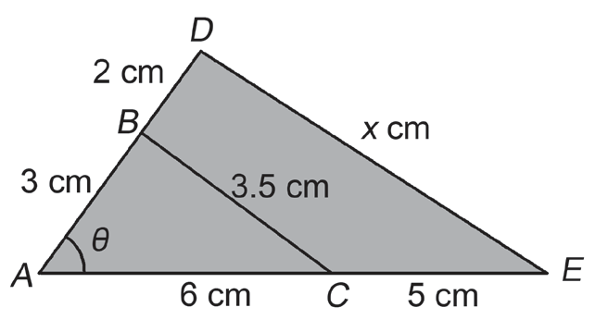


Law of Cosines
Example 3: The figure shows two triangles ABC and ADE. Find the value of (i) cos θ and (ii) x.
Solution:
(i) Using the Law of Cosines in ΔABC,
(ii) Using the Law of Cosines in ΔADE, we have the following:
Thus, x = 6.78 cm.

