Slide 1
Quadratic Inequalities

Slide 2
Quadratic Inequalities
Quadratic Inequality
An equation states that two algebraic expressions are equal while an inequality states that two algebraic expressions are not equal in a particular way. Quadratic inequality is an inequality of degree 2 which can be expressed in terms of the symbols <, >, ≤ or ≥ , that is, ax² + bx + c > 0,
ax² + bx + c ≥ 0, ax² + bx + c < 0, or ax² + bx + c ≤ 0.Some inequalities can be reduced to a quadratic inequality.

Slide 3


Quadratic Inequalities
Example: Reduce the inequality expressed by into a quadratic inequality,
if possible.
Notice that x² - 4x + 4 is a perfect square trinomial that is equal to (x - 2)², then
Thus, by simplifying the radical expression, we can have x(x - 2) ≤ 4 and that leads to x² - 2x ≤ 4. Therefore, we have a quadratic inequality x² - 2x - 4 ≤ 0.

Slide 4
Quadratic Inequalities
Solving Quadratic Inequality
The set of all solutions of an inequality is called the solution set of the inequality. The process that we have to perform in solving for the solution set of the given quadratic inequality is as follows:
1. Express the quadratic expression as a product of two binomials. (Use methods in solving quadratic equation in the form ax² + bx + c = 0.)
2. Apply properties of inequality that is to show two cases that determine the solution set of the quadratic inequality.
3. Choose few values of x that satisfy the inequality.
4. Substitute the value and verify if it satisfies the given quadratic inequality.
The examples below illustrate how we solve for the solution set of a quadratic inequality.

Slide 5
Quadratic Inequalities
Example 1: Solve x2 + x ≥ 12.
Solution:
Rewrite the given inequality and use any methods in solving a quadratic equation, which will lead to (x + 4)(x - 3) ≥ 0. Apply property (vi) of inequality; we will have Cases 1 and 2.
Case 1: x + 4 ≤ 0 and x – 3 ≤ 0 (i.e., both factors must be positive)
i.e., x ≤ -4 and x ≥ 3
For x to satisfy both inequalities, x ≥ 3.

Slide 6
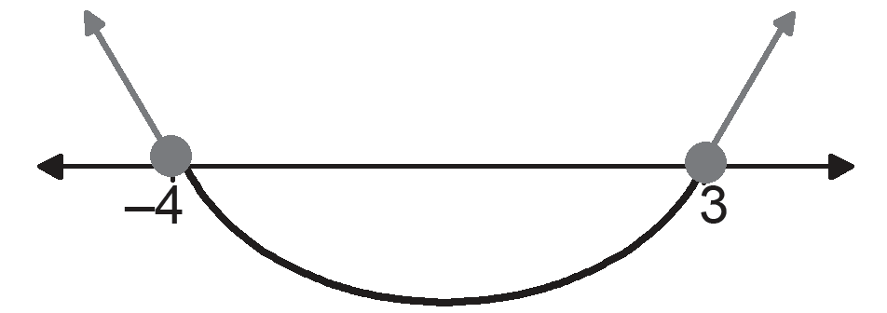
Quadratic Inequalities
Case 2: x + 4 ≤ 0 and x - 3 ≤ 0 (i.e., both factors must be negative)
i.e., x ≤ -4 and x ≤ 3
For x to satisfy both inequalities, x ≤ -4.
Hence, the solution set or the range of values of x of the inequality x² + x ≥ 12 is x ≤ -4 or x ≥ 3.

Slide 7
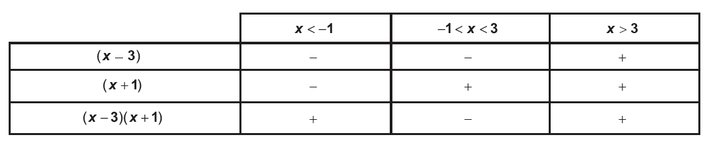
Quadratic Inequalities
Example 2: Solve (x - 3)(x + 1) > 0.
Solution:
Let us use the test of signs method. First, we solve the equation (x - 3)(x + 1) = 0, which gives x = 3 and x =-1 (these numbers are called critical numbers). These numbers give rise to three ranges of values: x < -1; -1 < x < 3; and x > 3. Set up a table of signs, such as the table below.

Slide 8
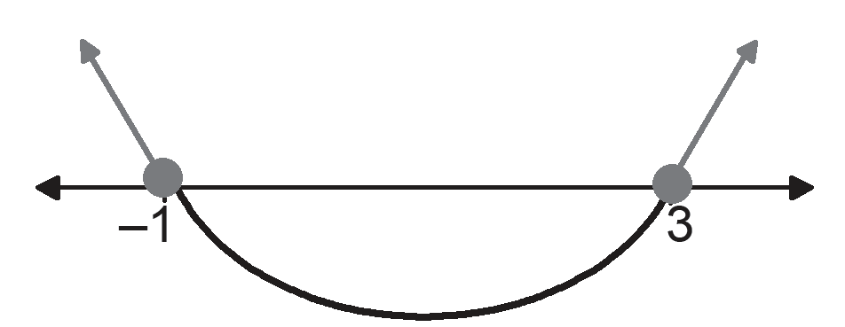
Quadratic Inequalities
In the test of signs method, we are only concerned with the sign of the value after substituting a selected point that satisfies the range of values. For example, in x < -1, if we choose x = -2, we will observe that x - 3 would be equal to -5. We will only take the sign of the value. We will do this up to the last interval.
Here, we want to determine the range of values of x satisfying (x - 3)(x + 1) > 0. Note that using inequality property (v) the solution set are the factors with signs that are either both negative or both positive, or we could just simply look at the last row and select the interval that satisfies the inequality. Therefore, x ≤ -1 and x ≥ 3 are the range of values of x.

Slide 9
Quadratic Inequalities
TAKEAWAYS:
• An equation states that two algebraic expressions are equal while an inequality states that two algebraic expressions are not equal in a particular way.
• The set of all solutions of a quadratic inequality is called the solution set of the inequality.
• A quadratic inequality is second degree equation that uses an inequality sign instead of an equal sign.

