Slide 1
Solving Problems Involving Quadratic Inequalities

Slide 2
Solving Problems Involving Quadratic Inequalities
In solving problems involving quadratic inequalities, the following steps are suggested:
1. Read the problem carefully to determine what is given and what is being asked.
2. Assign variables to represent each unknown in terms of the same variable.
3. Identify the underlying mathematical concept to solve the problem.
4. Select a strategy that will facilitate a better understanding of the given problem.
5. Translate the problem into a mathematical statement.
6. Solve the equation and answer the question asked in the problem.
7. Check your solution. Determine whether the values obtained meet the conditions given in the problem.

Slide 3
Solving Problems Involving Quadratic Inequalities
Example 1: Determine the range of the length of the larger leg of a right triangular lot of legs whose measures are x and x - 3 to ensure a lot area of at least 54 square meters and at most, 104 square meters. To ensure a lot area of at least 54 square meters and at most 104 square meters, the lengths of the legs of a right triangular lot are x and x - 3. Determine the range of the length of the larger leg.

Slide 4

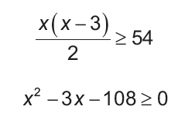
Solving Problems Involving Quadratic Inequalities
Solution:
Note that the larger leg measure x meters and the area of a right triangular lot are determined by
If the area is at least 54 m², then:
Solving for the inequality, we have x ≥ 12 or x ≤ -9.

Slide 5
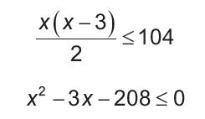
Solving Problems Involving Quadratic Inequalities
Cont.
And if the area is at most 104 m², then:
Solving for the inequality, we have x ≥ -13 and x ≤ 16.
Therefore, the range of the length of the larger leg is 12 ≤ x ≤ 16 meters.

Slide 6
Solving Problems Involving Quadratic Inequalities
Example 2: The profit P that a company earns for selling x number of dolls can be modeled by P(x) 50x2 2,000x 6,000. How many dolls must be sold for a profit of at least ₱10,000?

Slide 7
Solving Problems Involving Quadratic Inequalities
Solution:
Since P(x) ≥ 10,000, then:
-50x2 + 2,000x - 6,000 ≥ 10,000
Simplifying the inequality, we have:
-25x2 + 1,000x - 3,000 ≥ 5,000
-25x2 + 1,000x - 8,000 ≥ 0
Dividing all of the terms by 25,
-x2 + 40x - 320 ≥ 0
Writing the related equation, we have:
-x2 + 40x - 320 = 0

Slide 8
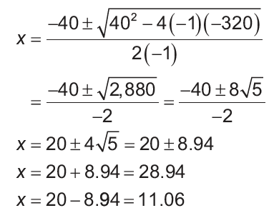
Solving Problems Involving Quadratic Inequalities
Cont.
Using the quadratic formula to solve for x,

Slide 9
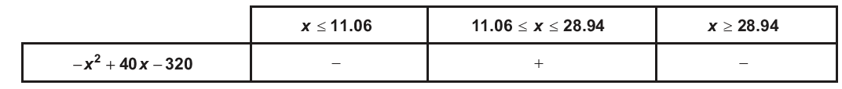
Solving Problems Involving Quadratic Inequalities
We have, x = 28.94 and x = 11.06. Now, we will use these critical numbers and construct ranges of values for our test of signs table, as shown below.
The range of all possible values of x is 11.06 ≤ x ≤ 28.94. Since we are talking of a number of dolls the solution set is 12 ≤ x ≤ 28. Therefore, to make a profit of at least ₱10,000, at least 12 and at most 28 dolls must be sold by the company.

