Slide 1
Solving Problems Involving Measures of Position

Slide 2
Solving Problems Involving Measures of Position
In solving measures of position, you can use the same procedures on how other real-life problems are solved. George Polya (1945) provided an effective mathematical method on how one should solve a problem. In his four-step problem-solving strategy, Polya emphasized that solving real-life problems uses four phases:
1) understand the problem,
2) devise a plan,
3) carry out the plan, and
4) look back.
Let us illustrate this method in solving real-life problems involving measures of position. Using Polya’s problem-solving strategy, you will be able to understand how it helps to solve problems involving measures of position.

Slide 3
Solving Problems Involving Measures of Position
Example 1: Mr. Tan, a bank manager, is interested in the amount of time it takes his teller to serve the depositors. On a particular day, he asked his secretary to record the service time (in minutes) for 25 customers. The number of minutes are as follows: 15, 9, 8,11, 7, 6, 9, 12, 13, 14, 5, 5, 7, 8, 9, 12, 5, 7, 7, 8, 9, 10, 5, 7, 10. According to Mr. Tan, the record shows that at most, 12% of the record of service denote inefficiency in working. Greater than what time is considered inefficient?
Solution:
Step I. Understand the problem: Since, at most, 12% of the service time greater than a certain value is considered inefficient, the problem wants us to determine P88.
Step II. Devise a plan: Locate P88 using the concept of measures of position and then determine its exact value.
Step III. Carry out the plan: The location of P88 is at 0.88(25+1)=22.88th place, which means that P88 is between the 22nd and 23rd service time values, that is, 12 minutes and 13 minutes, respectively. Thus, P88=12+0.88(13-12)=12.88 minutes. Therefore, at most, 12% of the service time greater than 12.88 minutes is considered inefficient.
Step IV. Look back. Note that there are 3 service times greater than 12.88, taking the percentage of the 3 service times against the 25 service times, it is 3/25x100%=12%, hence, it satisfies the given condition that there is at most, 12% service time greater than 12.88 minutes.

Slide 4
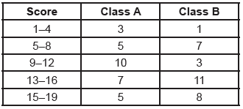
Solving Problems Involving Measures of Position
Example 2: The scores in a 20-item Science quiz in class A and B with an equal number of students are as follows:
Using the concept of measures of position, determine which of the following class is more likely to have a score gap problem? Justify your answer.
Solution:
Step I. Understand the Problem: You need to determine the interquartile range of the scores of the two classes and compare the values to decide which class is more likely to have a score gap problem.
Step II. Devise a Plan: Determine the lower and upper quartiles of the two classes and then find the interquartile range.
Step III. Carry out the plan: Construct another column for the cumulative frequency of each class.

Slide 5
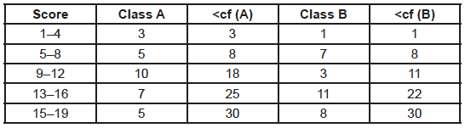
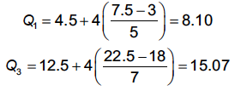
Solving Problems Involving Measures of Position
Pertaining to the table above, the Q1 and Q3 of class A is in the intervals 5–8 and 13–16, respectively. Solving for Q1 and Q3 of class A:
Thus, the interquartile range is 15.07-8.10=6.97.

Slide 6
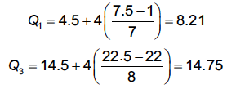
Solving Problems Involving Measures of Position
For class B, Q1 and Q3 is in the intervals 5 – 8 and 16 −19 , respectively. Solving for Q1 and Q2 of class B:
Thus, the interquartile range is 14.75-8.21=6.54.
Therefore, class A is more likely to have a score gap problem than class B since the interquartile of class B, which is 6.54, is quite smaller than that of class A, which is 6.97.
Step IV. Look Back: Check if the computations are carried out accurately and correctly.

Slide 7
Solving Problems Involving Measures of Position
Example 3: Two stores A and B record their 7-day sales of a certain product. The record of their sales is shown below. Determine which store has a lesser tendency to have a sales gap problem.
Solution:
Step I. Understand the Problem: You need to determine the interquartile range based on the record of sales of the two stores and compare the values of their interquartile range to determine which store has a lesser tendency to have a sales gap problem.
Step II. Devise a Plan: Determine the lower and upper quartiles of the two ungrouped data and then find the interquartile range.
Step III. Carry out the plan: For Store A, arrange the sales in ascending order: 15, 18, 23, 24, 24, 31, 33. Then, locate the lower and upper quartiles, which is at the 2nd place and 6th place, thus, Q1 = 18 and Q3 = 31. Hence, the interquartile range IR=31-18=13 .
For Store B, arrange the sales in ascending order: 18, 20, 21, 24, 26, 26, 27. Hence the value of Q1 is 20 and Q3 is 26. Therefore, IR=26-20=6 . Since the interquartile range of store B is lesser than the interquartile range of Store A, Store B has a less tendency to have a sales-gap problem.
Step IV. Look Back: Check if the computations are carried out accurately and correctly.
Store A | 24 | 15 | 23 | 18 | 33 | 24 | 31
Store B | 26 | 18 | 24 | 20 | 26 | 27 | 21

