Slide 1
Understanding the Meaning of Ratio

Slide 2

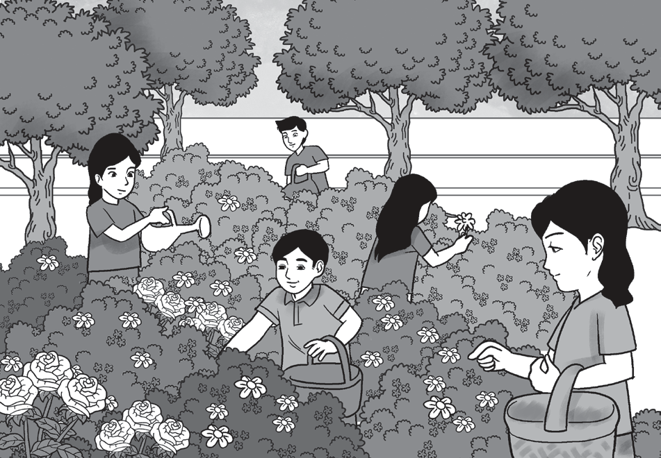

Understanding the Meaning of Ratio
A ratio is a comparison of numbers or quantities. It deals with the relationships between quantities relative to each other. It can be written in three ways:
Example 1:
Observe the two pictures.
1. What is the ratio of the butterflies
to the dragonflies?
2. What is the ratio of the girls to
the boys?
3. What is the ratio of the boys to the
butterflies?

Slide 3
Understanding the Meaning of Ratio
Cont.
Solution:
1. Since there are 4 butterflies and 5 dragonflies, the ratio of butterflies to dragonflies is 4 : 5.
As you noticed, 4 and 5 have no common factor other than 1, so this ratio is in the simplified form.
Also, the quantities should not be interchanged. You cannot write the ratio of butterflies to dragonflies as 5 : 4. The ratio 4 : 5 is not the same as the ratio 5 : 4.
2. Since there are 3 girls and 2 boys, the ratio of girls to boys is 3 : 2.
3 and 2 have no common factor other than 1, so this ratio is also in the simplified form.
3. Since there are 2 boys and 4 butterflies, the ratio of boys to butterflies is 2 : 4.
2 and 4 have a common factor which is 2, so this ratio is not yet in its simplified form.

Slide 4
Understanding the Meaning of Ratio
Cont.
To write a ratio in a simplified form, you may follow the following steps.
• Find the greatest common factor (GCF) of the two numbers.
• Divide the two numbers by the GCF.
Let us simplify the ratio 2 : 4.
• The GCF of 2 and 4 is 2.
• 2 ÷ 2 = 1 and 4 ÷ 2 = 2.
The resulting ratio is 1 : 2 as these numbers have no factor other than 1.
Therefore, the simplified form of 2 : 4 is 1 : 2.

Slide 5
Understanding the Meaning of Ratio
Example 2:
Simplify the ratio 12 : 14.
• The GCF of 12 and 14 is 2.
• 12 ÷ 2 = 6 and 14 ÷ 2 = 7.
The resulting ratio is 6 : 7 as these numbers have no factor other than 1.
Therefore, the simplified form of 12 : 14 is 6 : 7.

Slide 6
Understanding the Meaning of Ratio
Represent each of the following with a ratio. Answers
Simplify if necessary.
1. The ratio of 2 driver to 15 passengers 1. 2:15 or 2/15 or 2 is to 15
2. The ratio of 5 men to 7 women 2. 5:7 or 5/7 or 5 is to 7
3. The ratio of 2 teachers to 60 students 3. 2:60 = 1:30 or 1/30 or 1 is to 30
4. The ratio of 2 books to 6 pencils 4. 2:6 = 1:3 or 1/3 or 1 is to 3
5. The ratio of 16 nurses to 240 patients 5. 16:240 = 1:15 or 1/15 or 1 is to 15

