Slide 1
Graphs of Quadratic Functions

Slide 2
Graphs of Quadratic Functions
To graph a quadratic function in vertex form f(x) = a(x - h)² + k:
1. Determine whether the parabola opens upward or downward. If a > 0, it opens upward. If a < 0, it opens downward.
2. Determine the vertex of the parabola. The vertex is (h, k).
3. Find any x-intercept by replacing f(x) with 0. Solve the resulting quadratic equation for x.
4. Find the y-intercept by replacing x with 0. Solve the resulting equation for y.
5. Plot the intercepts and vertex. Connect these points with a smooth curve.

Slide 3
Graphs of Quadratic Functions
The table below summarizes the characteristics of the graph represented by y = a(x - h)² + k.
y = a(x - h)² + k | a is positive | a is negative
Direction of Opening | Upward | Downward
Vertex | (h, k) | (h, k)
Axis of Symmetry | x = h | x = h

Slide 4
Graphs of Quadratic Functions
Example 1: Graph the quadratic function f(x) = -2(x - 3)2 + 8.
Solution:
In f(x) = -2(x - 3)² + 8, a = -2, h = 3, and k = 8. Since the quadratic function is its vertex form, it is easier to identify a, h, and k.
Step 1: Determine how the parabola opens. The coefficient of x² is -2. Thus, a < 0. This negative value tells us that the parabola opens downward.
Step 2: Find the vertex. The vertex of the parabola is (h, k). Because h = 3 and k = 8, the parabola has its vertex at (3, 8).

Slide 5
Graphs of Quadratic Functions
Step 3: Find the x-intercepts. Replace f(x) with 0 in f(x) = -2(x - 3)2 + 8. Thus,
0 = -2(x - 3)2 + 8 Set f(x) to 0.
2(x - 3)2 = 8 Add 2(x - 3)2 on both sides.
(x - 3)2 = 4 Divide both sides by 2.
x - 3 = ±2 Apply the square root method.
x - 3 = -2 or x - 3 = 2 Express as two separate equations.
x = 1 x = 5 Add 3 on both sides.

Slide 6
Graphs of Quadratic Functions
Step 4: Find the y-intercept. Replace x with 0 in f(x) = -2(x - 3)² + 8.
Thus, f(0) = -2(0 - 3)² + 8 = -2(9) + 8 = -10.
The y-intercept is -10. The parabola passes through (0, -10).
Step 5: Graph the parabola.
The vertex is at (3, 8), the x-intercepts are 1 and 5, then the y-intercept is -10. The graph is shown on the right with its axis of symmetry, x = 3.

Slide 7
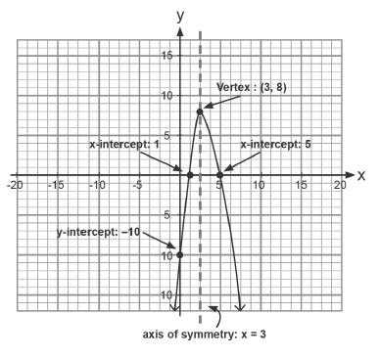
Graphs of Quadratic Functions
• The domain contains all the real numbers because
the graph continues down toward the left and down
toward the right.
• The range contains all real numbers less than or
equal to 8 because the maximum y-value of the
function is 8 and the graph continues to extend downward.

Slide 8

Graphs of Quadratic Functions
The following steps can be followed in graphing a quadratic function in
general form f(x) = ax² + bx + c:
1. Determine the coordinates of the vertex by finding the x-coordinate from the formula
Substitute the x-coordinate into the original quadratic function and solve for y to determine the y- coordinate of the vertex.
2. Determine the table of values by choosing at least two x-values that are greater than the x-coordinate of the vertex and two corresponding x-values that are less than the x-coordinate of the vertex.
3. Graph the function by plotting the vertex and the set of ordered pairs from the table of values. Next, connect the points with a smooth curve.

Slide 9
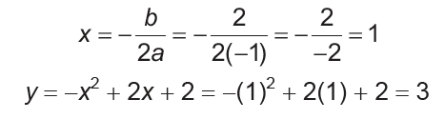
Graphs of Quadratic Functions
Example 2: Graph the quadratic function: f(x) = -x² + 2x + 2.
Solution:
The parabola opens downward because a < 0.
In f(x) = -x2 + 2x + 2, the coefficients are a = -1, b = 2, and c = 2.
Step 1: Find the coordinates of the vertex.
The vertex is (1, 3). The axis of symmetry is x = 1.

Slide 10
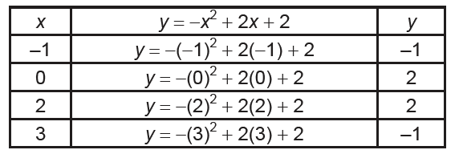
Graphs of Quadratic Functions
Step 2: Set up a table of values using x-values that are less than and greater than the x-coordinate of the vertex.

Slide 11
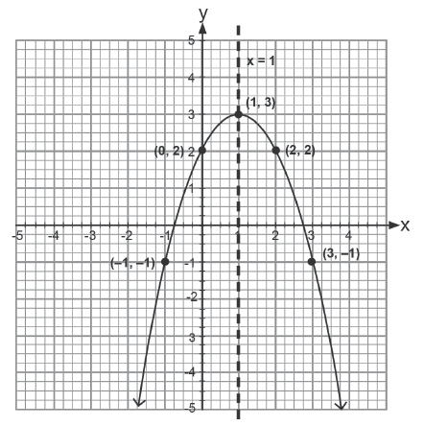
Graphs of Quadratic Functions
Step 3: Graph the vertex and the points found in the table. Connect the points with a smooth curve and graph the axis of symmetry.

