Slide 1
Vertex Form of Quadratic Functions

Slide 2
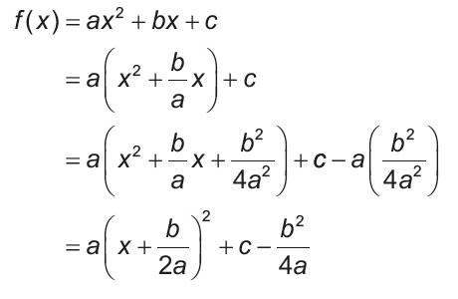
Vertex Form of Quadratic Functions
Quadratic functions are frequently expressed in the form f(x) = ax² + bx + c where a, b, and c are real numbers and a ≠ 0. To find the vertex of a parabola whose equation is written in this form, we use completing the square method as shown below:
Factor a.
Complete the square.
Compare this equation with a quadratic function written in the vertex form f(x) = a(x - h)² + k.

Slide 3
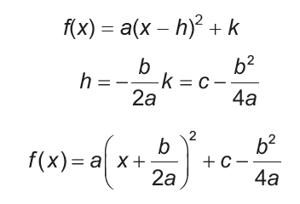
Vertex Form of Quadratic Functions
Cont.
Vertex Form:
Substitute the value of h
and k in the vertex form.

Slide 4


Vertex Form of Quadratic Functions
Cont.
Note that the x-coordinate or h of the vertex is
The y-coordinate or k can be found by evaluating the function at
The vertex of the parabola whose equation is given by f (x) = ax² + bx + c is at

Slide 5
Vertex Form of Quadratic Functions
Example 1: Write f(x) = (x + 3)² - 5 in a general form.
Solution:
f(x) = (x + 3)² – 5 x² + 6x + 9 - 5 x² + 6x + 4
Thus, the general form of f(x) = (x + 3)² - 5 is f(x) = x² + 6x + 4.

Slide 6
Vertex Form of Quadratic Functions
Example 2: Write f(x) = x² - 4x - 5 in vertex form. Identify the vertex and the axis of symmetry.
Solution:
By completing the square,
f(x) = x² - 4x - 5
= x² - 4x + 4 - 4 - 5
= x² - 4x + 4 - 9
= (x - 2)² - 9.
Thus, the vertex form of f(x) = x² - 4x - 5 is f(x) = (x - 2)² - 9 with vertex at (2, -9) and axis of symmetry of x = 2.

Slide 7
Vertex Form of Quadratic Functions
Answer the following: Answers
a. Write f(x) = (x + 4)² - 3 in a general form. a. f(x) = x² + 8x + 13
b. Write f(x) = x² - 6x - 6 in vertex form. b. f(x) = (x - 3)² - 15

