Slide 1
Equation of Quadratic Functions

Slide 2

Equation of Quadratic Functions
The equation of a quadratic function can be determined when its corresponding table of values, its zeros, or its graphs are given as shown in the following examples.
Example 1: Find the quadratic function represented by the table of values below.

Slide 3
Equation of Quadratic Functions
Solution:
The general quadratic form is y = ax² + bx + c. To find the values of a, b, and c, we need to form three equations by substituting the values of x and the corresponding values of y in y = ax² + bx + c. Let us do the following steps in forming the quadratic function using the table of values.

Slide 4
Equation of Quadratic Functions
Step 1: Select any three ordered pairs from the table of values. In this example let us choose (3, 7), (2, 2), and (-1, 1)
For x = -3 and y = 7, For x = -2 and y = 2,
7 = a(-3)² + b(-3) + c 2 = a(-2)² + b(-2) + c
7 = 9a - 3b + c Equation 1 2 = 4a – 2b + c Equation 2
1 = a(-1)2 + b(-1) + c
1 = a – b + c Equation 3

Slide 5
Equation of Quadratic Functions
Step 2: Eliminate c by subtracting Equation 2 from Equation 1, and Equation 3 from
Equation 1.
Subtract Equation 2 from Equation 1 Subtract Equation 3 from Equation 1
7 = 9a - 3b + c Equation 1 7 = 9a - 3b + c Equation 1
2 = 4a - 2b + c Equation 2 -1 = a - b + c Equation 3
5 = 5a - b Equation 4 8 = 8a - 2b Equation 5

Slide 6
Equation of Quadratic Functions
Step 3: Solve for a by eliminating b in Equations 4 and 5, and solve for b by substituting the acquired a in either Equation 4 or Equation 5.
-10 = -10a + 2b Equation 4 x (-2)
8 = 8a - 2b Equation 5
-2 = -2a Add Equation 4 and Equation 5
a = 1
Solving for b by substituting a = 1 in Equation 4.
5 = 5a - b Equation 4
5 = 5(1) - b
5 = 5 - b
b = 0

Slide 7
Equation of Quadratic Functions
Step 4: Solve for c by substituting a and b in either Equation 1, Equation 2, or Equation 3.
Solving for c in Equation 1
7 = 9a - 3b + c Equation 1
7 = 9(1) - 3(0) + c
7 = 9 - 0 + c
C = -2
Thus, the quadratic function is:
y = ax² + bx + c
y = 1(x)² + (0)x + (-2)
y = x² - 2 or f(x) = x² - 2

Slide 8
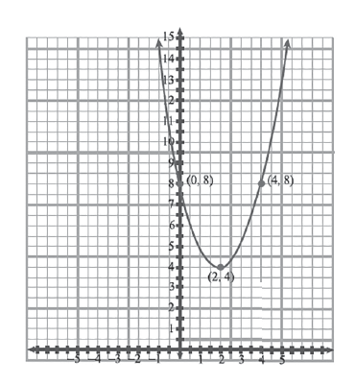
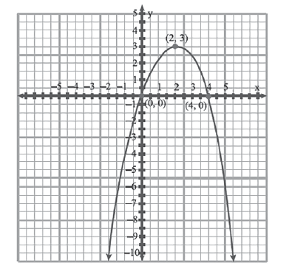
Equation of Quadratic Functions
Example 2: Find the equation of the parabola shown below. Express it in general form.
a. b.

Slide 9
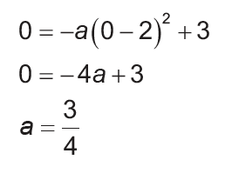
Equation of Quadratic Functions
Solution:
a. The vertex of the parabola is (2, 3) and passes through point (0, 0). Since the graph opens downward, a will have a negative value. Since the parabola has vertex (h, k) or (2, 3), the equation must have the form:
y = -a(x - h)² + k
y = -a(x – 2)² + 3
Because the parabola passes through point (0, 0), it follows that f(0) = 0. Thus, we have:

Slide 10
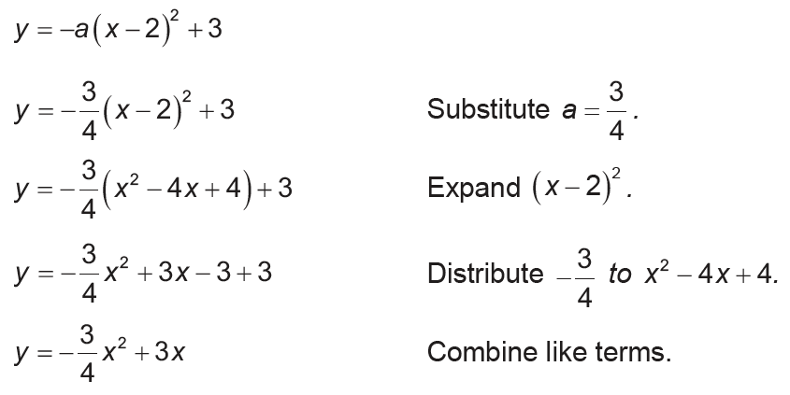
Equation of Quadratic Functions
Cont.
This implies that the equation is:

Slide 11
Equation of Quadratic Functions
b. The vertex of the parabola is (2, 4) and passes through point (4, ). Since the parabola opens upward, the sign of a is positive. The equation must have the form:
y = a(x - h)² + k
y = a(x – 2)² + 4
Because the parabola passes through point (4, 8), it follows that f(4) = 8. Thus, we have:
8 = a(4 – 2)² + 4
8 = 4a + 4
a = 1

Slide 12
Equation of Quadratic Functions
Cont.
This implies that the equation is:
y = 1(x – 2)² + 4
y = x² - 4x + 4 + 4
y = x² - 4x + 8

Slide 13
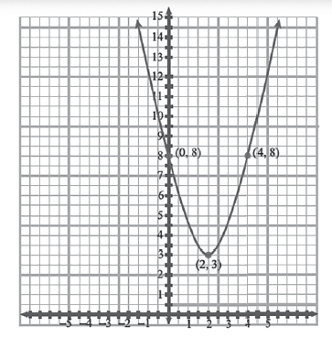

Equation of Quadratic Functions
Try this.
Find the equation of the given parabola. Answer:
Express it in general form.

