Slide 1
Effects of Changing the Values of a, h, and k on the Graphs of a Quadratic Function

Slide 2
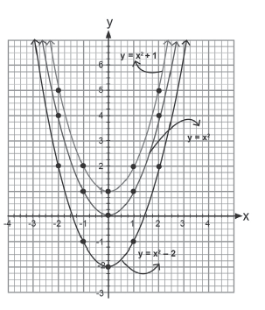
Effects of Changing the Values of a, h, and k on the Graphs of a Quadratic Function
The equations of the families of parabolas are closely related. Hence, changing a parameter in an equation results in a different parabola in the family.
The graphs of y = x2, y = x2 + 1, and y = x2 - 2 on one set of axes are shown at the right. The values of k in these equations are 0, 1, and -2, respectively.
The graphs are: all the same shape, all open upward, and all have their vertex on the y-axis.

Slide 3
Effects of Changing the Values of a, h, and k on the Graphs of a Quadratic Function
The graph of y = x² + 1 is translated one unit upward as compared to the graph of y = x² while the graph of y = x² - 2 is translated two units downward as compared to the graph of y = x².
In general, changing the value of k in y = a(x - h)² + k translates the parabola
Vertically.
If k > 0, the parabola is translated k units upward.
If k < 0, the parabola is translated k units downward.

Slide 4
Effects of Changing the Values of a, h, and k on the Graphs of a Quadratic Function
Example 1: Compare the graph of the first equation to the graph of the second equation.
a. y = x² - 7, y = x² b. y = x² + 10, y = x²

Slide 5
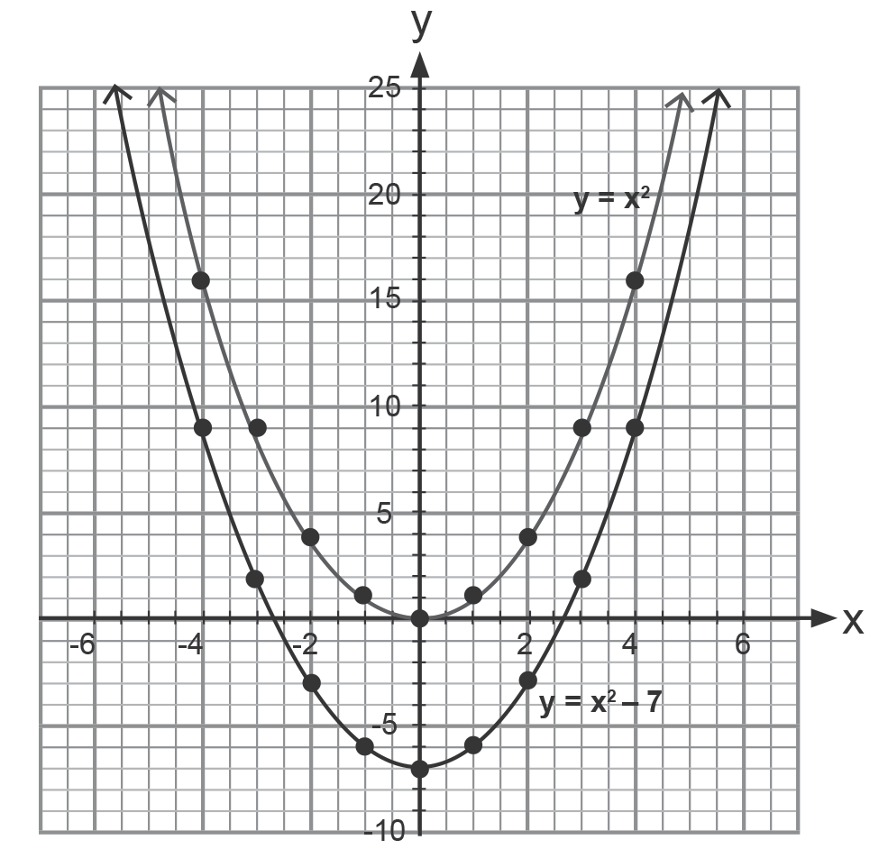
Effects of Changing the Values of a, h, and k on the Graphs of a Quadratic Function
Solution:
a. y = x² - 7, y = x²
The graph of y = x² - 7 is translated
7 units downward.

Slide 6
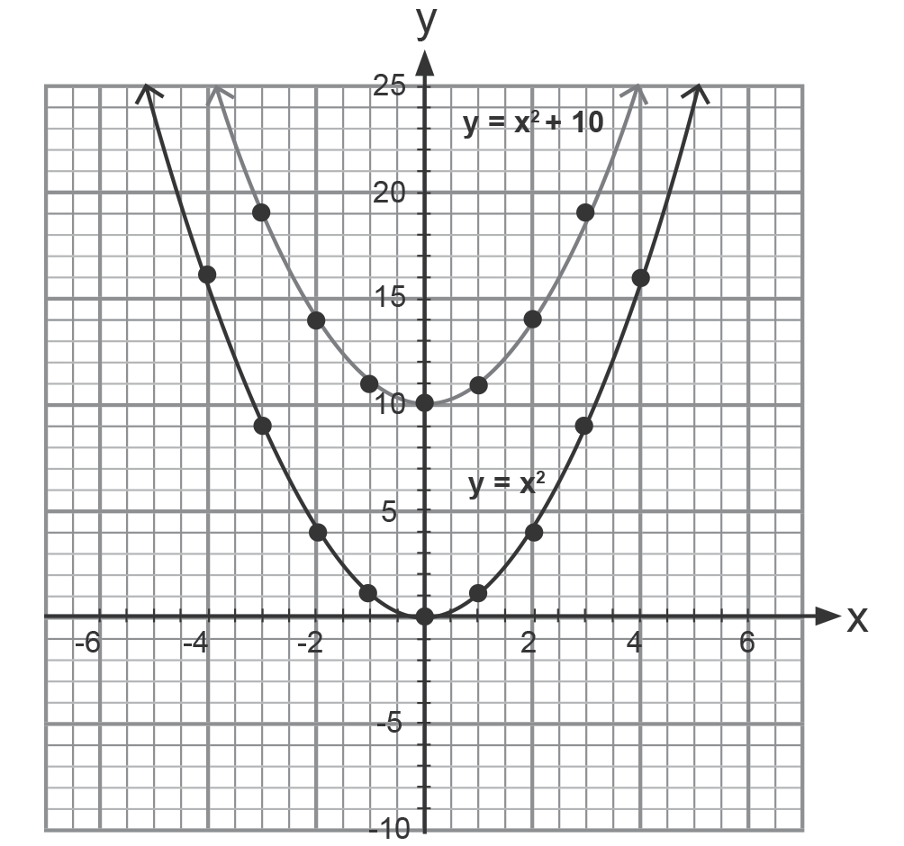
Effects of Changing the Values of a, h, and k on the Graphs of a Quadratic Function
Solution:
b. y = x² + 10, y = x²
The graph of y = x² + 10 is translated
10 units upward.

Slide 7
Effects of Changing the Values of a, h, and k on the Graphs of a Quadratic Function
Remember:
Changing the value of h in y = a(x - h)² + k translates the graph horizontally.
If h > 0, the graph translates h units to the right.
If h < 0, the graph translates h units to the left.

Slide 8
Effects of Changing the Values of a, h, and k on the Graphs of a Quadratic Function
Example 2: Compare the graph of the first equation to the graph of the second equation.
a. y = (x - 3)² + 9, y = x² + 9 b. y = (x - 5)² - 4, y = x²

Slide 9
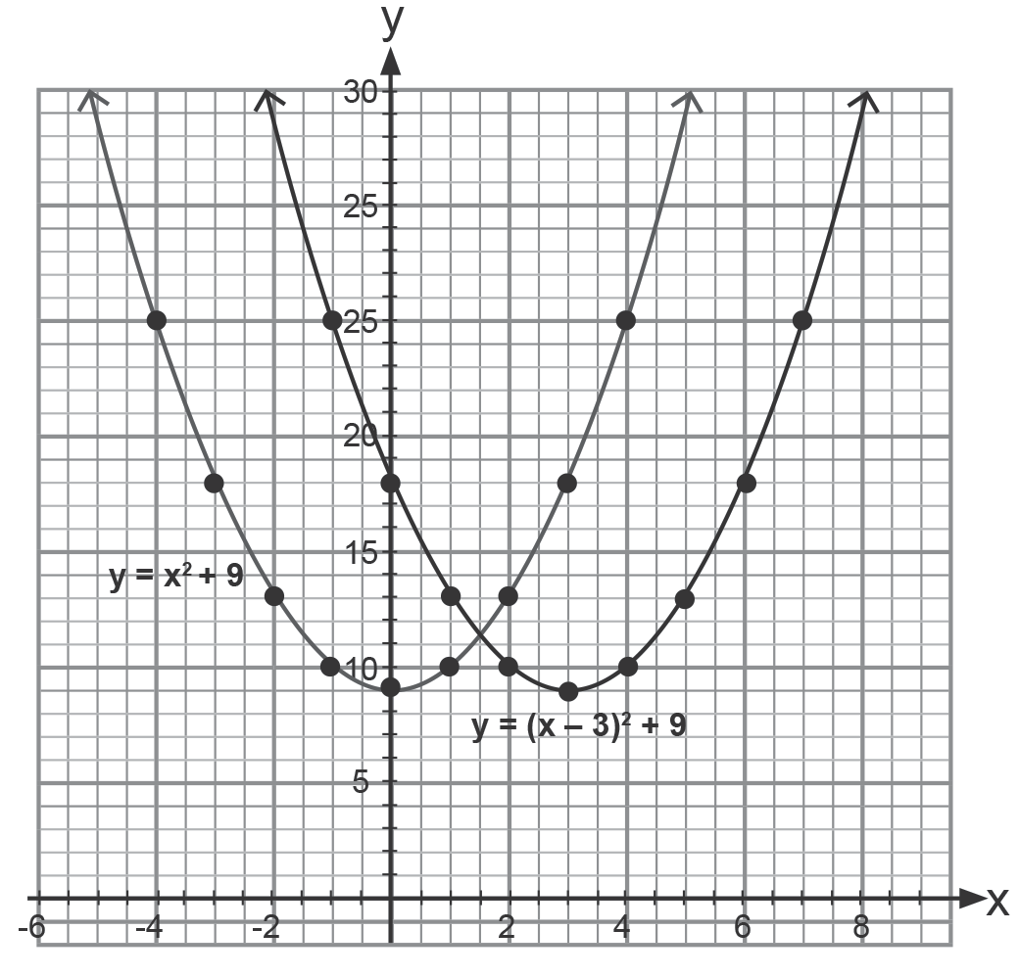
Effects of Changing the Values of a, h, and k on the Graphs of a Quadratic Function
Solution:
a. y = (x - 3)² + 9, y = x² + 9
The value of h in y = (x - 3)2 + 9 is 3. Hence,
its graph is translated 3 units to the right of
the graph of y = x2 + 9.

Slide 10
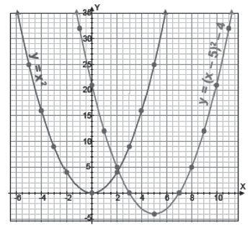
Effects of Changing the Values of a, h, and k on the Graphs of a Quadratic Function
Solution:
b. y = (x - 5)² - 4, y = x²
The value of k in y = (x - 5)² - 4 is -4. Hence,
its graph is translated 4 units downward. The
value of h in y = (x - 5)² - 4 is 5. Hence,
its graph is translated five units to the right.
The graph of y = (x - 5)² - 4 is translated 4
units downward and 5 units to the right of the
graph of y = x².

Slide 11
Effects of Changing the Values of a, h, and k on the Graphs of a Quadratic Function
Remember:
The value of a in y = a(x - h)² + k determines the direction of the opening and the shape of the graph.
If a > 0, the graph opens upward.
If a < 0, the graph opens downward.
If |a| < 1, the graph is wider than the graph of y = x².
If |a| > 1, the graph is narrower than the graph of y = x².

Slide 12

Effects of Changing the Values of a, h, and k on the Graphs of a Quadratic Function
Example 3: Compare the graph of the first equation to the graph of the second equation.
a. y = 3x², y = x²
b. y = 4x², y = -4x²

Slide 13
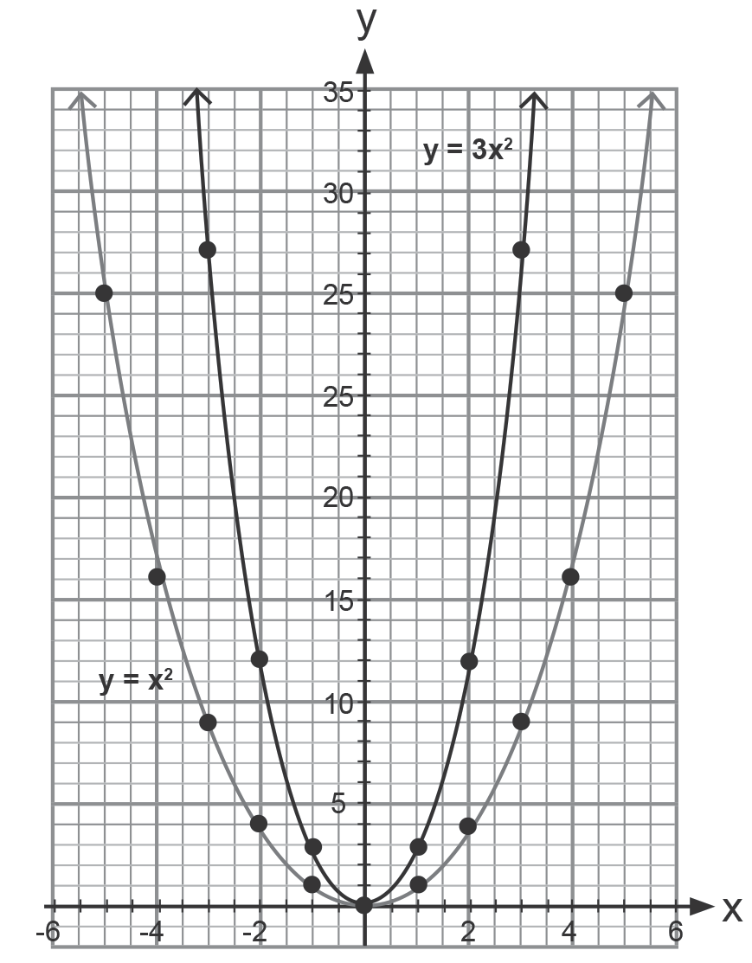
Effects of Changing the Values of a, h, and k on the Graphs of a Quadratic Function
a. y = 3x², y = x²
Solution:
The graphs of y = 3x² and y = x² open
upward. The graph of y = 3x² is narrower
than the graph of y = x².

Slide 14
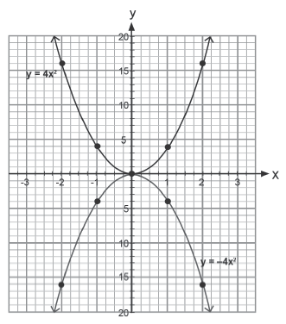
Effects of Changing the Values of a, h, and k on the Graphs of a Quadratic Function
b. y = 4x², y = -4x²
Solution:
The graphs of y = 4x² and y = -4x² where the
values of a have the same absolute value
which is 4 have the same shape. The graph
of y = 4x² opens upward and the graph of
y = -4x² opens downward.

Slide 15


Effects of Changing the Values of a, h, and k on the Graphs of a Quadratic Function
Solution:
The graphs of
and y = x² - 10
open upward. The graph of
is wider than the graph of y = x² - 10.

Slide 16
Effects of Changing the Values of a, h, and k on the Graphs of a Quadratic Function
KEY TAKEAWAYS
The quadratic function:
f(x) = a(x - h)2 + k, a ≠ 0
is written in the vertex form or standard form. The graph is a parabola whose vertex is at point (h, k). The parabola is symmetric to the line x = h. If a > 0, the parabola opens upward; if a < 0, the parabola opens downward. The value of h translates the graph horizontally, and the value of k translates the graph vertically.

