Slide 1
Chemical Changes in Matter

Slide 2
Chemical Changes in Matter
Chemical change - is brought about by temperature and when materials react with other materials when they are mixed. In a chemical change, there is a change in the composition of new material.
Some pieces of evidence of chemical change are the formation of gas and precipitates, the change in color, the change in temperature, and, specifically, the formation of new substances.
Chemical change is the formation of precipitates.
Example: curdling of milk
When vinegar was mixed with milk, precipitates were formed. The formation of precipitates is also a sign of a chemical change. Milk has a protein substance called casein. When casein in milk is combined with vinegar, instead of mixing thoroughly, the molecules move around and join together to form a plasticlike structure called casein plastic.
Example of chemical changes are:
Burning, cooking, decaying, and rusting

Slide 3
Chemical Changes in Matter
Other examples:
When you heat the sugar in the pan, you will see bubbles in the pan until the sugar gets totally burned. When the sugar is heated, it is turn into a new material called carbon.
When the hard-boiled egg was in the glass of vinegar, bubbles came out. Bubble formation means that there is a formation of gas. These bubbles that came out from the shell are carbon dioxide.
The eggshells contain calcium carbonate. The vinegar is acetic acid. When calcium carbonate is mixed with acetic acid, carbon dioxide is formed, resulting in the formation of bubbles.

Slide 4
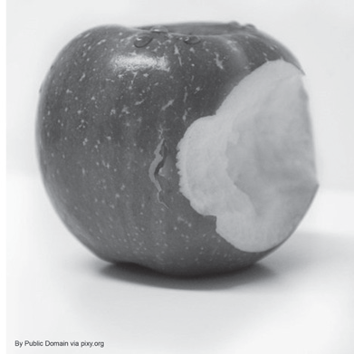
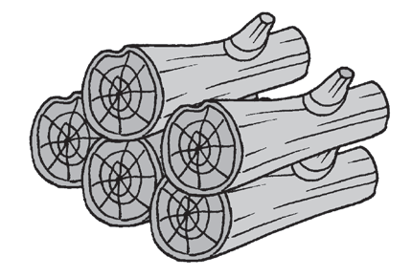

Chemical Changes in Matter
Activity
Directions: Read each item carefully. Choose the best answer from among the given choices.
1. Karen was eating her favorite apple. Her friends called her up to play so she immediately put the apple on the table. After playing, she planned to eat her apple again. She noticed that the apple had a brown surface on the bite area. (Refer to the image.) Which of the following describes the change that happened with the apple?
A. chemical change C. both physical and chemical changes
B. physical change D. neither physical change nor chemical change
2. Study the pictures on your right. What change took place?
A. chemical change C. both physical and chemical changes
B. physical change D. neither physical change nor chemical change
BEFORE AFTER

Slide 5

Chemical Changes in Matter
3. Study the image of the burning candle on the right. Physical and chemical changes are shown. Which of the following illustrates chemical change?
A. None, because the melting of the candle and burning of the flame exhibit physical change.
B. Both the burning and the melting of the candle illustrate chemical change.
C. The melting of the candle illustrates chemical change.
D. The burning flame illustrates chemical change.
4. Which of the following indicates that a chemical reaction has occurred?
A. change in form, size, and shape
B. production of heat and light
C. change in appearance
D. change in phase

Slide 6
Chemical Changes in Matter
5. Which shows a chemical change in matter?
A. cracking a peppercorn
B. sharpening of a pencil
C. burning of leaves
D. twisting a rod

Slide 7
Chemical Changes in Matter
Answer Key
1. A
2. A
3. D
4. C
5. B

