Slide 1
Ability of a Material to Absorb Water

Slide 2
Ability of a Material to Absorb Water
Absorption - is the ability of a material to make water move into the material from a source.
There are two kinds of materials when it comes to absorption. These are absorbent and nonabsorbent materials.
Absorbent- is the material that absorbs water easily is called an absorbent.
Examples: Sponge, black and white newspaper sheet, and cotton handkerchiefs
Nonabsorbent - is the one that does not absorb liquid.
Examples: colored newspaper sheet and the silky handkerchief

Slide 3
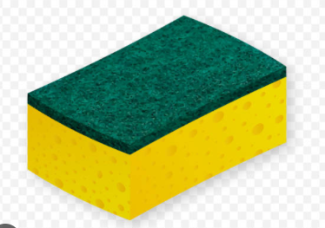
Ability of a Material to Absorb Water
Holes or pores allow liquid to get inside the materials and occupy the spaces, replacing the air in them. These kinds of materials like sponges are called porous
The ability of a porous material to absorb liquid is called porosity. It can also be described as the ability of a certain material to absorb or hold water or any liquid or moisture to a certain extent.
https://www.istockphoto.com/illustrations/kitchen-sponge

Slide 4

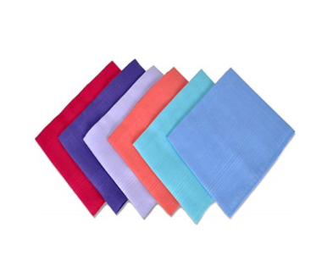
Ability of a Material to Absorb Water
Capillarity is the upward movement of water (or any liquid) through the hair-like structure (capillary) present in the material, It can also be described as the ability of a certain material to absorb or hold water or any liquid or moisture to a certain extent.
https://www.shutterstock.com/search/clip-art-newspaper
https://www.shutterstock.com/search/clip-art-newspaper

Slide 5
Ability of a Material to Absorb Water
Activity
Directions: Read the following materials. Show a thumbs up if the material is absorbent, then thumbs down if not.
Foam | Book sheets | Rubber mat | Yarn | Plastic cup
1 2 3 4 5
Tissue paper | Spoon and fork | Paper bills | Paper bag | Rug
6 7 8 9 10

Slide 6

Ability of a Material to Absorb Water
Answer Key
1. 6.
2. 7.
3. 8.
4. 9.
5. 10.

