Slide 1
Useful and Harmful Effects of the Changes in Matter

Slide 2
Useful and Harmful Effects of the Changes in Matter
Changes are beneficial or useful if there are positive effects or value and harmful if the effects are hazardous or toxic.
Examples:
The rotten kamias can be used as a cleaning agent instead of using those with chemical contents. Heating is an example of a chemical change that is useful in cooking.

Slide 3
Useful and Harmful Effects of the Changes in Matter
In contrast, these physical and chemical changes can be harmful to the environment and even to one’s health.
Example:
    Spoiling of food is a chemical change that is harmful to one’s health.
    The smell of the burning and decaying garbage may lead to sickness when inhaled.
    The movement of air and water that carry toxic substances.
Pollution - is the mixing of unwanted materials into the environment.
Three types of Pollution:
Land Pollution
Water Pollution
Air Pollution

Slide 4
Useful and Harmful Effects of the Changes in Matter
Land pollution - Happens when materials are added to the land, which makes it harmful or less productive.
Example: Too much evaporation may lead to drought.
Air pollution - is the contamination of air due to excessive smoke and contaminants.
Example: The burning of fossil fuels produces harmful gases that pollute the air
Water pollution - is the contamination of the bodies of water like rivers, oceans, seas, or lakes.
Example: The improper throwing of disposable materials can lead to waste accumulation and can cause land and water pollution.

Slide 5
Useful and Harmful Effects of the Changes in Matter
To keep our surroundings clean and to prevent or minimize the pollution in our environment, people are encouraged to observe the 5Rs (Reduce, Reuse, Recycle, Repair, and Recover)
Reduce - means to lessen the amount of waste you produce by buying less stuff and buying durable products.
Reuse - means to use items or materials that can still be used.
Recycle - means to turn old objects into their new versions.
Repair - means to fix broken things to make them work and look better again.
Recover - means to collect the smallest leftover materials to generate energy.

Slide 6
Useful and Harmful Effects of the Changes in Matter
Activity
Directions: Read each item carefully. Choose the best answer from among the given choices.
1. Which of the following is NOT a way to help reuse and recycle disposable materials to minimize wastes?
A. making creative scrapbooks using used gift wrappers
B. using unused pages of old notebooks as a scrapbook
C. bringing an eco-bag when buying grocery items
D. throwing garbage in the canal
2. For some reason, different kinds of materials are accumulated in the surroundings. Some of these materials can be useful or harmful to the environment. Accumulation of waste materials is one of the examples of harmful effects of the changes in materials. Which of the following changes are harmful to the environment?
A. classifying materials as biodegradable and non-biodegradable
B. sorting waste materials like recyclable and throwable
C. disposing trash to the sewage canal
D. recycling tin can to a creative case

Slide 7
Useful and Harmful Effects of the Changes in Matter
3. Which of the following changes are harmful to the environment?
A. using eco-bags in buying grocery items instead of plastics bags
B. converting unused pages of notebooks to an art notebook
C. using pesticides to spray harmful insects
D. bringing paper bags when shopping
4. Which of the following changes in materials does NOT provide harmful effects?
A. using plastic bottles as flower pots
B. throwing of garbage in the river
C. cutting of trees
D. burning of tires

Slide 8
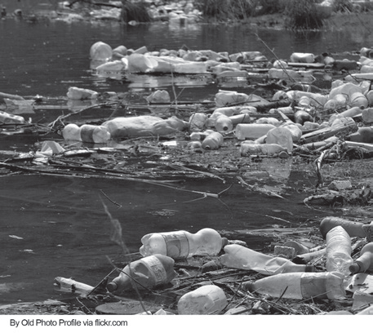
Useful and Harmful Effects of the Changes in Matter
5. Plastics if handled and disposed of improperly have harmful effects. Study the picture on the right. How can plastics affect the environment as shown in the picture?
A. It can cause water pollution.
B. It can cause land pollution.
C. It can cause air pollution.
D. All the choices.

Slide 9
Useful and Harmful Effects of the Changes in Matter
Answer Key
1. D
2. C
3. C
4. A
5. D

