Slide 1
Adaptation of Terrestrial
Animals

Slide 2
Adaptation of Terrestrial Animals
Habitat
- a place where an animal lives.
On land, they are generally found in the forests, grasslands, mountains, deserts, and even in your house.Many make holes in the soil or rest on branches of trees. Some hide in the forest from hunters, their predators, and enemies; others can deal with extremely harsh conditions.
Adaptation is a characteristic of living things that helps them survive in their environment.
WWW.REX.COM.PH

Slide 3
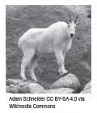
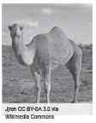
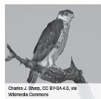
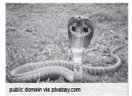

Adaptation of Terrestrial Animals
Terrestrial animals
Animals that live on land, either on the surface of the ground or below ground.
Examples:
Snake Rabbit Mountain goat Camel Eagle
These animals have characteristics or traits that enable them to live on land.They also use their different body structures to be able to adapt to their specific habitat in a special way.
WWW.REX.COM.PH

Slide 4
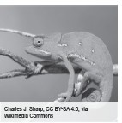


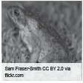
Adaptation of Terrestrial Animals
Terrestrial Animals in Their Habitats
Rainforest Animals
Philippine forests are inhabited by different kinds of animals, wild and tame alike. A wide variety of mammals like wild cats, foxes, and wild boars; birds; and reptiles like snakes and lizards can be found in these habitats. These animals survive in the forest because they get their food and all the things that they need in this place.
WWW.REX.COM.PH

Slide 5
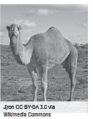
Adaptation of Terrestrial Animals
Desert Animals
The desert is a harsh environment with either very little rainfall or no rainfall for years and extreme temperature.
Despite this harsh condition, the desert is still rich with different kinds of animals.
Many desert animals are active at nighttime and are asleep during the day. Examples are camels, turtles, and snakes.
Some stay deep underground in holes dug by
small animals like squirrels, bobcats, jackrabbits, and coyotes.
Animals like camels, armadillos, and antelopes can survive for a long time without drinking.
WWW.REX.COM.PH

Slide 6
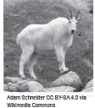
Adaptation of Terrestrial Animals
Mountain Animals
- mountains are a challenging environment for animals to live in with the presence of cliffs and barren rocks. There are ways these animals can deal with extremely cold conditions:
Hibernation is a type of deep sleep that protects animals from cold and reduces the need for food during the season when food supply is low or lacking.
Examples of hibernating animals: bears and snakes.
Migration is the movement of animals in large numbers from
one place to another to find food or more favorable living conditions.
Examples: birds.
These animals return to their habitat when the weather becomes warm and food becomes plentiful.
WWW.REX.COM.PH

Slide 7

Adaptation of Terrestrial Animals
Grassland Animals
-are areas dominated by grass, shrubs, and herbaceous plants that become natural habitats for a large number of grass eating animals.
Examples: zebras, rabbits, sheep and antelopes
They have also become the home of many insects, like butterflies, grasshoppers, moths, and beetles, and other invertebrates, such as caterpillars and snails.
WWW.REX.COM.PH

Slide 8
Adaptation of Terrestrial Animals
Body Structures and Behavioral Adaptation of Terrestrial Animals in Their Habitat
To make themselves suited to their environment or in the place where they live, terrestrial animals use diff erent specialized body structures and behavioral adaptation.
Specialized Structures That They Use in Feeding
Birds like pelicans, kingfishers, ducks, and woodpeckers use their beaks in obtaining their food.
Leeches use their suckers in seeping the blood of their host.
Big animals, such as lions, wild boars, tigers, and the likes, use their strong fangs and molars in tearing flesh and breaking the bones of their prey.
Insects like butterflies use their proboscises in obtaining nectars from flowers.
■
■
■
■
WWW.REX.COM.PH

Slide 9
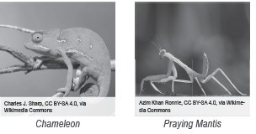
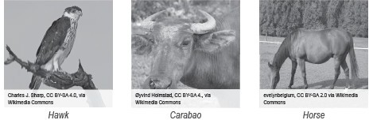
Adaptation of Terrestrial Animals
Disguise or Camouflage as a Means of Luring Their Prey
■
Chameleons change their color depending on where they are hiding.
Praying mantes change their color to green when resting on leaves.
■
Specialized Structures Used for Grasping, Apprehending, and Killing Prey and Self-defense
■
Sharp talons are used by hawks and owls for grasping their prey.
Horns of cows, goats, and carabaos are used to fight enemies. Horses use their hooves, while deer use their antlers for defense.
■
■
WWW.REX.COM.PH

Slide 10
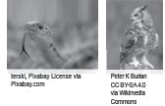
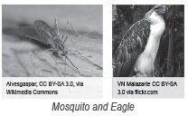
Adaptation of Terrestrial Animals
Keen Senses Used for Hunting Food
Snakes smell using their tongues.
Using their feelers, insect-like female mosquitoes sense the warmth of their
victims for bloodsucking.
■
■
■
Big round eyes are what owls use to see very well in the dark,especially to hunt for prey during the night.
Eagles and hawks use their sharp eyesight to catch
their prey. They can even see small animals at long distances even when they are soaring high.
■
WWW.REX.COM.PH

Slide 11
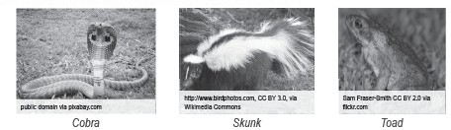
Adaptation of Terrestrial Animals
Poison and Secretion of Distasteful Substances
■
Using their tabular sharp teeth called fangs, snakes like cobras secrete poison called venom.
Chemical sprays with foul odor are released by skunks to help them escape from their predators and enemies.
Larger animals seldom eat toads because they secrete a distasteful substance.
■
■
WWW.REX.COM.PH

Slide 12
Adaptation of Terrestrial Animals
Activity
Write True if the sentence is correct. If not, identify the incorrect word and replace it with the correct one. Write your answers on the blank.
1. A praying mantis changes its color to green when resting on a leaf.
2. Leeches use their antennae to suck blood from their hosts.
3. Lions and boars use their fangs in breaking the bones of their prey.
4. Eagles use their big round eyes to hunt for food.
5. Butterflies use their beak to sip nectar from flowers.
WWW.REX.COM.PH

Slide 13
Adaptation of Terrestrial Animals
Answer Key:
True
antennae – suckers
True
big round eyes- sharp eyes
beak- proboscis
WWW.REX.COM.PH

Slide 14


