Slide 1
Adaptation of Aquatic
Animals

Slide 2
Adaptation of Aquatic Animals
Animals that live in water habitats are called aquatic animals.
Examples: Fish, dolphins, whales, and sea lions, mollusks, jellyfish, and sponges
2 Types of Aquatic Environment
➢
Marine environment
seas and oceans
Freshwater environment
streams, lakes, rivers, and ponds
●
➢
●
WWW.REX.COM.PH

Slide 3
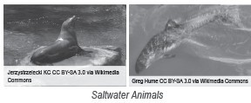
Adaptation of Aquatic Animals
Aquatic Animals in Their Habitat
Marine Animals
Different kinds of animals live in salt water.
Examples: Fish, turtles, dolphins, saltwater crocodiles, and whales like sperm, blue, killer, and humpback.
Whales, dolphins, porpoises, seals, and sea lions have grown small extended parts (ears and flippers) to adapt to their aquatic environment.
The ability to adapt to their habitat depends on the body structures of aquatic animals. Example:
Polar fish, have a natural substance in their blood and tissues that helps prevent ice crystals from forming inside their bodies.
WWW.REX.COM.PH

Slide 4
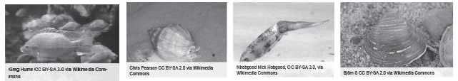
Adaptation of Aquatic Animals
Freshwater Animals
Countless animal species around the world live in streams, rivers, and lakes.
Rivers tend to contain large animals that can survive even with strong currents, along with some animals.
Many kinds of reptiles like snakes and lizards, and even crustaceans, live in, on, and near freshwater habitats. Frogs, turtles, and tortoises are generally found near rivers, ponds, streams, and wetlands. For some animals, water serves as their protection from the intense heat of the Sun. Other animals use water as a place to escape land enemies.
WWW.REX.COM.PH

Slide 5
Adaptation of Aquatic Animals
Body Movements of Aquatic Animals in Their Habitat
The aquatic animals move through water either by swimming or contact at the bottom or other surfaces of water. Mollusks, squids, and oysters move in water using their soft body parts. They use their special characteristics wherein their soft body parts are pressed against the water.
To move in water, fish rely on their skeleton, fins, and muscles. Shrimp crawl and swim with short bursts of their tail. On the other hand, jellyfish swim using a form of jet bursts even without backbones and fins.
Mammals like whales, dolphins, manatees, seals, and sea lions use their flexible bodies and strong muscles to swim.
WWW.REX.COM.PH

Slide 6
Adaptation of Aquatic Animals
Body Structure and Behavioral Adaptation of Aquatic Animals
Octopus, squids, jellyfish, and corals have tentacles for capturing their prey.
Oysters and clams are covered with hard outer shells, so these animals are spared from being eaten by other animals.
Many ocean animals protect themselves from predators by using camouflage. They can blend in with their surroundings.
Many fishes, such as tuna, cod, and sardine, use flight and evasion to protect themselves from predators.They are composed of thousands that move as one, changing direction so
quickly that their movements confuse their predator.
Shrimp and other small crustaceans also use flight and evasion to flee predators.
WWW.REX.COM.PH

Slide 7
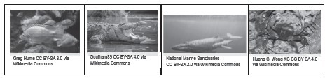

Adaptation of Aquatic Animals
Activity
Directions: Identify the habitats of the animals below. Choose from the options inside the box.
River Ocean Lake
tilapia
crocodile
whale
crab
dolphin
WWW.REX.COM.PH

Slide 8
Adaptation of Aquatic Animals
Answer Key:
tilapia – lake and river crocodile – river and lake whale – ocean
crab – ocean, lake, and river
Dolphin- ocean
WWW.REX.COM.PH

Slide 9


