Slide 1
Adaptation of Terrestrial Plants

Slide 2
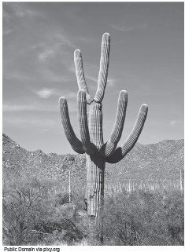
Adaptation of Terrestrial Plants
Plants that grow on land are called terrestrial plants.
Terrestrial plants grow and survive in different habitats due to different structures that enable them to live in certain conditions.
Survival means the ability of an organism to continue to be alive.
Terrestrial plants have different specialized parts that help them to survive in their habitat.
WWW.REX.COM.PH

Slide 3
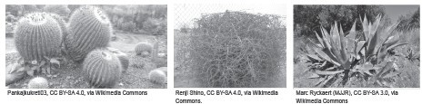
Adaptation of Terrestrial Plants
Plants That Live in Hot and Dry Areas
Plants that live in hot and dry areas are:
exposed to extremely high temperatures and drought.
the soil that they grow in is usually sandy and filled with rocks, making it difficult to hold much water.
plants are directly hit by sunlight and strong winds.
■
■
Plants that commonly grow in hot and dry areas are cacti, tumbleweeds, and agaves.
WWW.REX.COM.PH

Slide 4
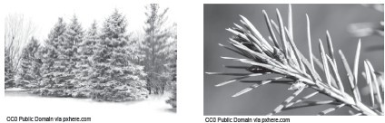
Adaptation of Terrestrial Plants
Plants That Live in Cold Areas
Plants that live in colder regions of Earth have different specialized structures that enable them to survive, just like the pine trees of Baguio City.
WWW.REX.COM.PH

Slide 5
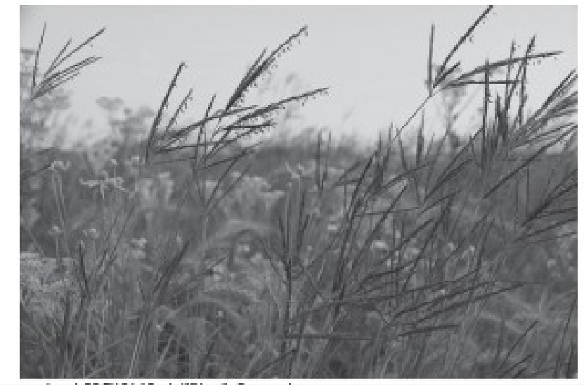
Adaptation of Terrestrial Plants
Plants That Grow in Grassland
Plants that live in grasslands or prairies experience two types of weather.
These weather conditions are the hot summers and cold winters. Plants that live in these areas also have specialized adaptative structures.
Prairie grass has a very deep and thick root system. Even though the root system of the grass is deep, it is said that the roots only pull water up to 10 inches deep in the soil.
WWW.REX.COM.PH

Slide 6
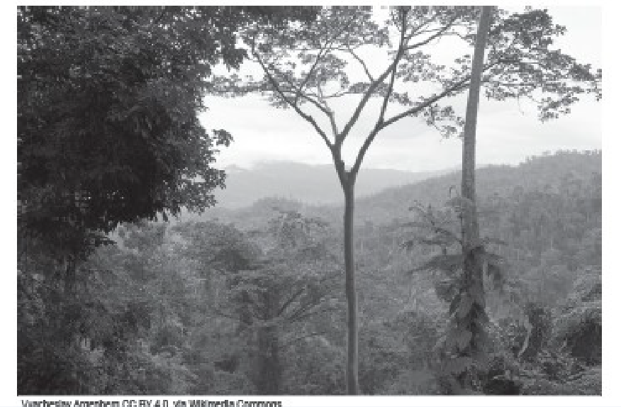
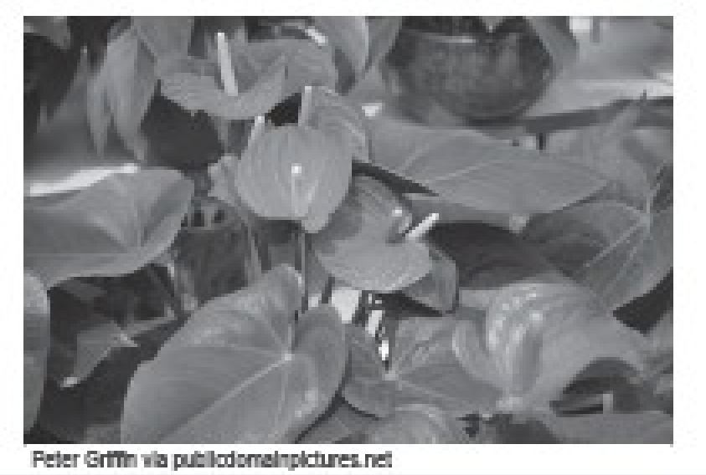
Adaptation of Terrestrial Plants
Plants in Rainforest
Plants that live in rainforests receive heavy rainfall. Plants grow rapidly in these habitats
because of the nutrient-rich soil.
WWW.REX.COM.PH

Slide 7
Adaptation of Terrestrial Plants
Terrestrial Plants
Hot and dry Areas
Cold Areas
Grass lands or Prairie
Rainforest
Specialized Structures
Specialized Structures
Specialized Structures
Specialized Structures
Leaves:
Either absent or have small, thick, and have waxy- coating
Leaves:
Needle like in shape, narrow, and have waxy
Coating
Leaves:
Narrow Leaves
Leaves:
Big and broad leaves that are layered
Stems:
Smooth outer bark (tropical rainforest)
Thick outer bark
( temperate rainforest)
Stems:
Fleshly stem to store water
Stems: Woody stem
Stems:
Soft stems
Root System:
Long and widespread root system
Root System:
Large and deep root system
Root System:
Thick and deep root system
Root System: Shallow roots
WWW.REX.COM.PH

Slide 8
Adaptation of Terrestrial Plants
Directions: Match the description of the plant in Column A with the proper habitat it belongs to in Column B. Write your answer on the blank before the number. Take note that some numbers may have the same answers.
Column A
1. I am a plant that has a fleshy stem that stores water.
Column B
A. Cold Area
●
2. I am a plant that has soft stems that follow the direction where the wind blows.
●
B. Rainforest
3. I am a plant that is also known as succulent and has small thick leaves.
●
C. Grassland
4. I am a plant that has shallow roots and has big, broad leaves.
●
D. Hot and dry area
5. I am a plant that has needle-like leaves and a strong woody stem.
WWW.REX.COM.PH

Slide 9
Adaptation of Terrestrial Plants
Answer Key:
1. D
2. C
3. D
4. B
5. A
WWW.REX.COM.PH

Slide 10


