Slide 1
Adaptation of Aquatic Plants

Slide 2
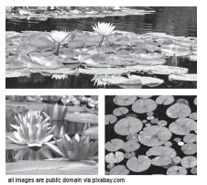
Adaptation of Aquatic Plants
Aquatic Plants
Aquatic plants have roots, stems, and leaves. These parts are fully adapted to their aquatic habitats. The stems of aquatic plants are thinner and more flexible than those of terrestrial plants.This is due to the flow of water in their habitats. The stems are also hollow because of the presence of air pockets.
The leaves of aquatic plants have stomata located on the upper surface that is exposed to air. The stomata are tiny openings on leaves that enable gas exchange. Plants that live in aquatic habitats have a limited supply of oxygen.

Slide 3
Adaptation of Aquatic Plants
The leaves of aquatic plants have little to less amount of cuticle. The cuticle of plants is the thick waxy covering that protects plants from drying out. In aquatic habitats, plants have less cuticle because they are not in danger of quickly drying out. The roots of aquatic plants enable the plants to stay in place. They draw in the nutrients from the water for the plant s to produce food.

Slide 4
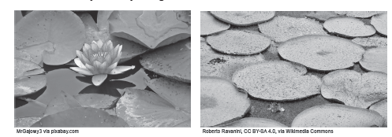
Adaptation of Aquatic Plants
Floating Aquatic Plants
One distinct characteristic of floating plants is the leaves that stay on top of the water surface. This occurs due to the large air spaces in the leaves and stems of the plants. Also, the leaves are broad and they remain flat on the surface of the water.
The roots of floating aquatic plants are not attached to the soil this means that they usually hang in the water. Water lilies and lily pads are examples of floating aquatic plants

Slide 5
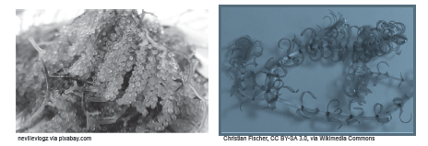
Adaptation of Aquatic Plants
Submerged Aquatic Plants
Some aquatic plants are completely underwater. You can see these plants under the sea or even in aquariums.
The stems of these plants are soft. Their roots hold strongly in the soil. These enable these plants to stay in place. Meanwhile, the leaves of submerged plants, once pulled out of the water, quickly wilt or sag. Umibudo and elodea are examples of submerged aquatic plants.

Slide 6
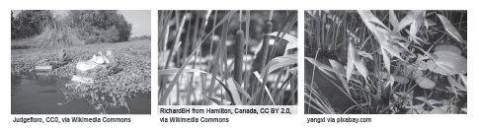
Adaptation of Aquatic Plants
Emergent Aquatic Plants
Emergent aquatic plants usually grow along the shoreline of different bodies of water. They grow close to the water’s edge or in shallow areas. The stems of these plants are usually stiff or firm. Their leaves are narrow and very thin.
Examples of emergent aquatic plants (from left to right: water spinach, cattail, and arrowhead plant)

Slide 7
Adaptation of Aquatic Plants
Activity
Directions: Rearrange the jumbled letters to form the word being described.
No. | Jumbled Letter | Correct word | Definition
1. | omattsa |  | These are openings in the leaf of the plant that aid in gas exchange.
2. | gilatfong |  | Aquatic plants whose leaves are on the surface of the water.
3. | sotor |  | A part of the plants that allows them to draw nutrients from the soil.
4. | umrgbenest |  | Aquatic plants that are completely underwater.
5. | tmgeerne |  | Aquatic plants that grow on shorelines of bodies of water.

Slide 8
Adaptation of Aquatic Plants
Answer Key
No. | Jumbled Letters | Correct word | Definition
1. | omattsa | Stomata | These are openings in the leaf of the plant that aid in gas exchange.
2. | gilatfong | floating | Aquatic plants whose leaves are on the surface of the water.
3. | sotor | roots | A part of the plants that allows them to draw nutrients from the soil.
4. | umrgbenest | submergent | Aquatic plants that are completely underwater.
5. | tmgeerne | emergent | Aquatic plants that grow on shorelines of bodies of water.

