Slide 1
Proper Use and Handling of Materials at Home and
in School

Slide 2
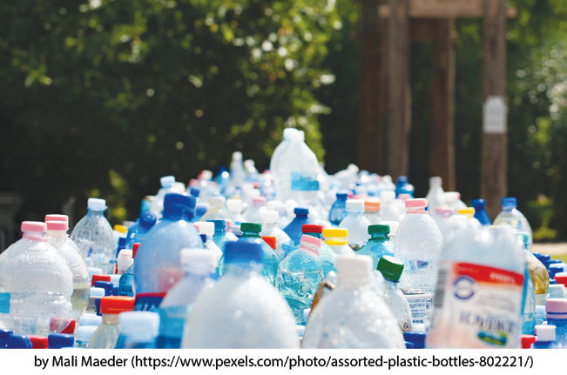
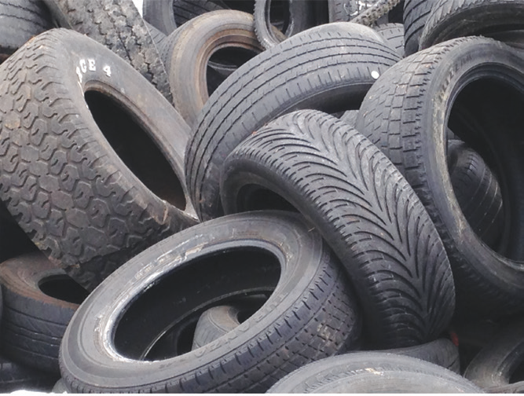
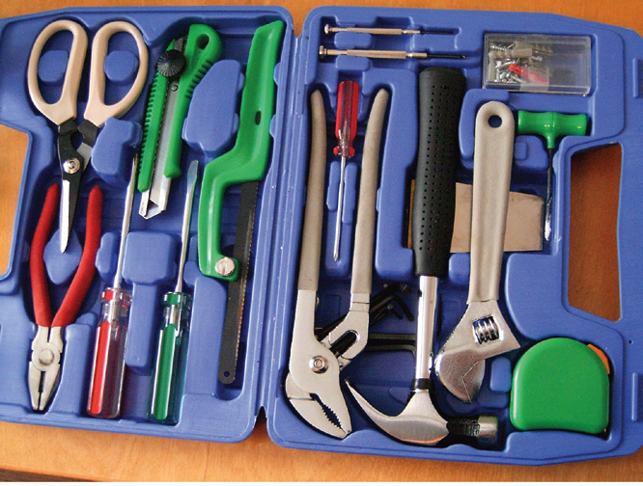
We are surrounded by many different materials. Sometimes the term material is used to refer to substance. Substances are materials with particular physical properties. Some are solids, others are liquids, and still others are gases.
Certain substances have good effects on people, plants, and animals. There are also certain substances that have harmful effects.
Different kinds of materials that can be found at home.

Slide 3
Many different kinds of materials are being used at home or in school. Most of these materials are useful. However, some of them may become harmful. Due to modern technology, many chemical substances have been discovered and used in these materials.
Some of these substances are used in the food we eat. Others are found at home and in school, while others are used in different industries. Most of these materials are useful to people. However, these materials become harmful to people if they are not used properly.

Slide 4

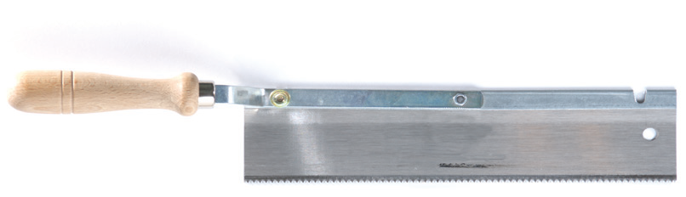

Uses of Different Materials
These are the different materials and their uses. In what ways are these materials useful?
A. Metals: Metals are usually solid, shiny, strong, and malleable. They play a vital role in construction, tool production, and jewelry making.
Electric drills, saw, and pieces of jewelry

Slide 5
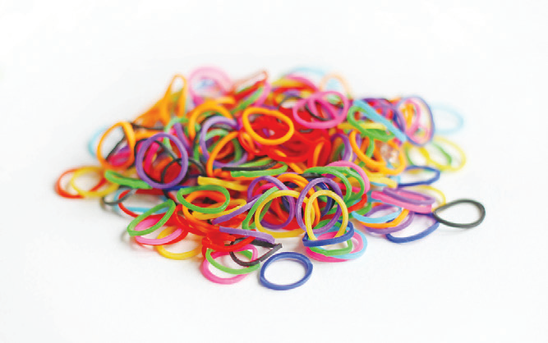
B. Rubber: Rubber is a material that can be stretched. It can be used to make objects like erasers, rubber bands, and tires. Objects made of rubber are flexible. Try to stretch a rubber band. What happens?
Rubber bands

Slide 6
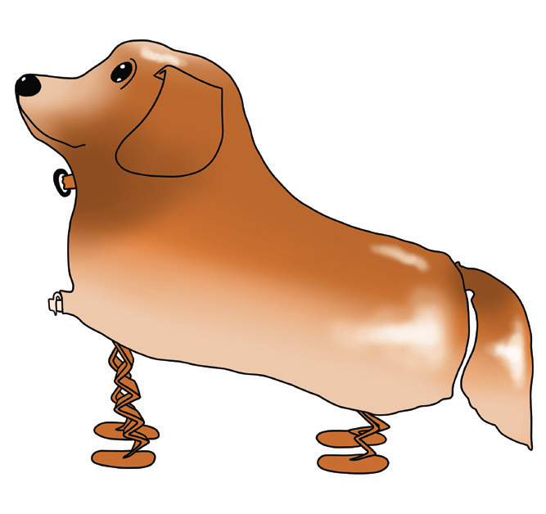
C. Plastics: There are many types of plastics with many different properties. Plastics are durable and waterproof. Some plastics are transparent and light; others are tough and difficult to break. Some plastics are used to form novelty balloons that come in specialized shapes. They can also be used to make objects like plastic bottles, plastic bags, and toys.
Most plastics do not decay. A piece of plastic left outside will stay there for many years. Burning plastic is not a good solution either. Many plastics are made from chemicals that produce poisonous gases when burned.
Walking pet balloon

Slide 7

D. Wood: Wood is an important material that comes from trees. There are many kinds of wood. The denser the wood, the greater the hardness and strength it possesses. There are trees used for furniture due to their strength and durability. They have high quality, so they are expensive. How can you preserve the trees without harming the environment?
Trees

Slide 8
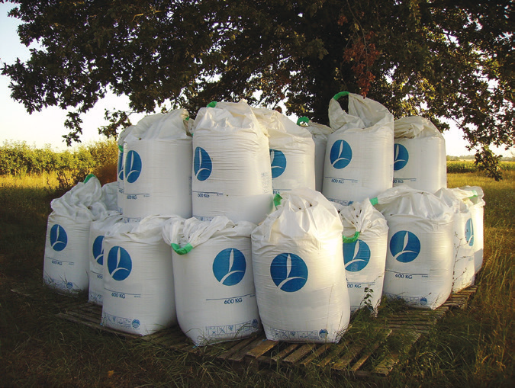
Other Uses of Materials
Fertilizers, Pesticides, and Detergents
Fertilizers contain substances that will make the soil fertile. Pesticides and insecticides are used to kill harmful insects that destroy plants. Some chemicals in detergents/ disinfectant are used for cleaning the toilet and bathroom.
Fertilizer

Slide 9

Vitamins and Medicines
We need vitamins and medicines to stay healthy. Vitamins make your body resistance stronger. Medicines like paracetamol is taken to ease headache and fever.
Medicines

Slide 10
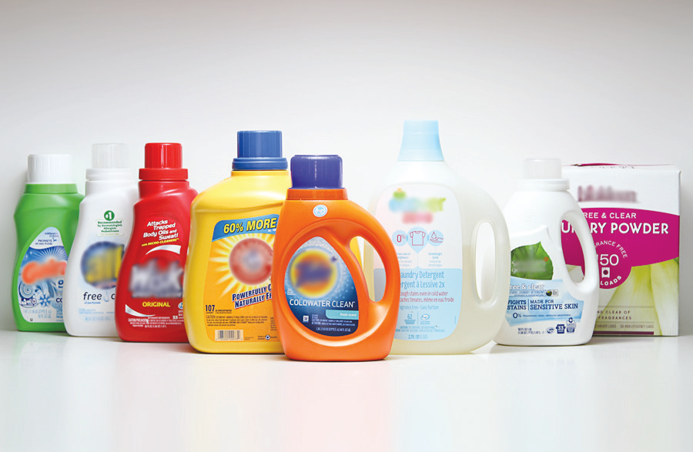
Effects of Some Materials on People and the Environment
The materials that we just discussed are all useful. How do they become harmful? These materials can be harmful both to health and environment if not properly used, handled, and disposed.
1. Cleaning Detergents
Detergent is one of the products used in every home. Detergent contains hazardous substances that is fatal to your body system. When water with detergents flows into a river or lake, plants and animals may die.
Liquid detergents can also cause skin irritations when they are not properly used. They can also cause respiratory diseases when inhaled.
Liquid detergents

Slide 11
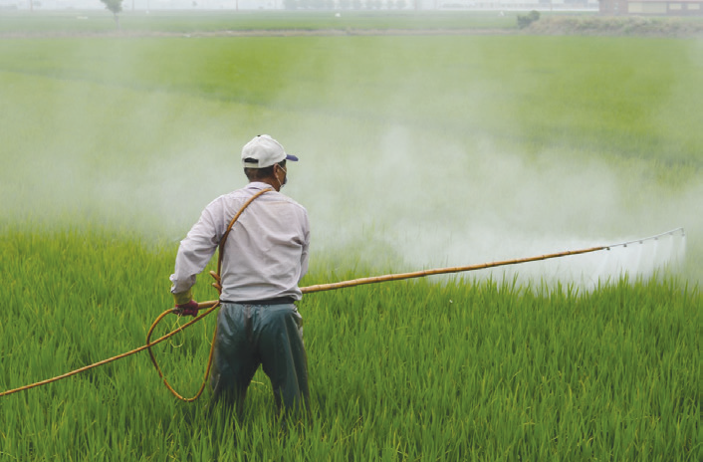
2. Agricultural Chemicals
Farmers use pesticides and insecticides to increase crop production. If not properly handled or used, fertilizers and pesticides can go down to lakes and kill aquatic plants and animals. These chemicals can also poison people and cause other serious diseases.
A farmer in the field using pesticides.

Slide 12
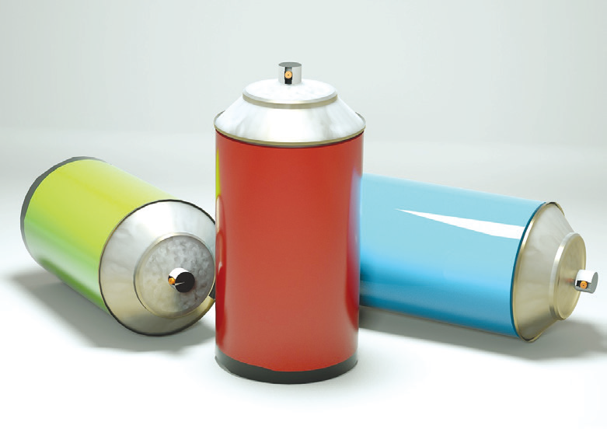
3. CFCs or Chlorofluorocarbons
The CFCs or chlorofluorocarbons are used as propellants in aerosols and fire extinguishers. Now, they are also used in making polystyrene grains as packaging materials.
The CFCs have harmful effects in our health and environment. They break down the ozone layer in the earth’s atmosphere. This layer protects people, plants, and animals from harmful ultraviolet rays. Because CFCs are known to be harmful chemicals, there is now a move to decrease and eventually end its use.
Spray paint propellant

Slide 13
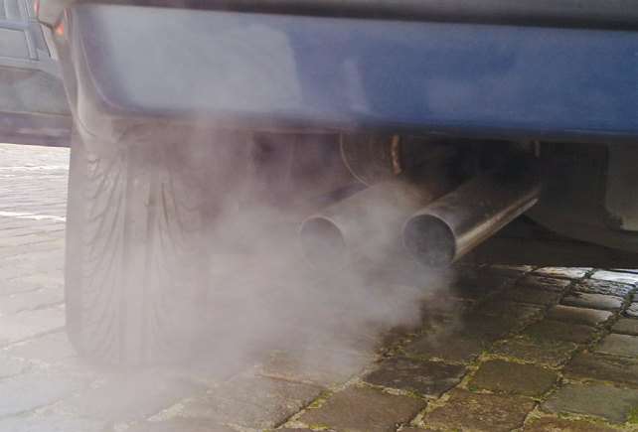
4. Fossil Fuels: Gasoline, Crude Oil, and Coal
Fossil fuels are used to make vehicles run.
Vehicles in the roads produce major pollutants
such as carbon monoxide and nitrogen oxide.
Carbon monoxide takes away oxygen from our
body cells that can cause serious diseases.
Fossil fuels are used in electric power plants to produce electricity. However, as fuels are burned, they release air pollutants like nitrogen oxide and sulfur oxide. When nitrogen oxide and sulfur oxide combine with moisture or rain in the atmosphere, acid rain is produced.
Acid rain harms some of our bodies of water like lakes and streams. It can kill aquatic plants and animals. Acid rain can also dissolve concrete materials, marbles, and stones. Metals can corrode faster than usual. Plastics, rubber, and fabrics can also be damaged.

Slide 14
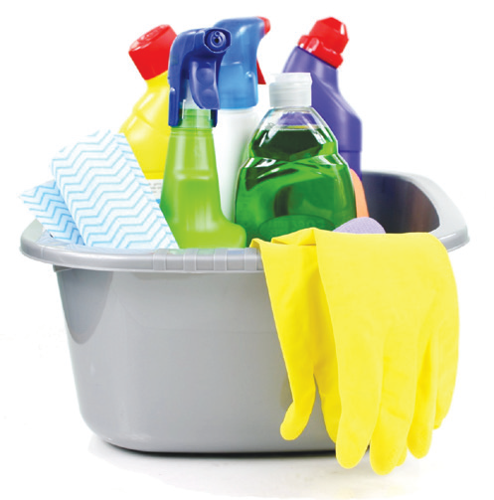
Precautionary Measures in Handling Substances
Considering the harmful effects of certain materials, safety precautions must be taken in handling them. You must be aware of possible dangers that can happen if you do not follow safety rules at home and in school.
Here are some precautionary measures in handling materials or substances that you can observe:
1. Cleaning products, insecticides, and disinfectants should be kept in places where children cannot reach them. When using these chemicals, always wear gloves, and cover your nose and mouth with a mask. Change your clothes and wash your hands thoroughly after using these chemicals. If not properly handled, they can cause physical injuries or even death when ingested.
Proper use of chemicals

Slide 15
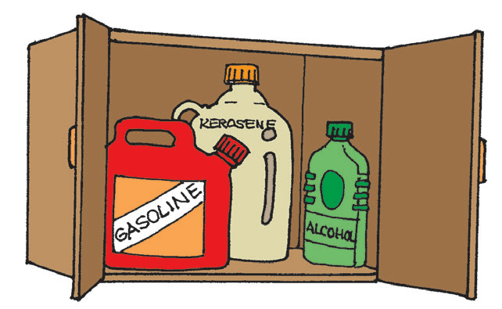
2. Keep flammable items like gasoline, alcohol, and kerosene, away from the stove, fireplace, and other sources of heat.
Tightly cover their containers and store them in locked cupboards or cabinets.
Never use gasoline or paint thinner to start a barbecue fire or bonfire. These can easily catch fire.
Keeping flammable
items away from sources of heat

Slide 16
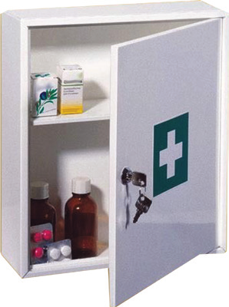
3. Vitamins and medicines should be placed in a medicine cabinet with a lock.
If you take medication, follow the recommended dosage as prescribed by the doctor. Expired medicines and vitamins should be thrown away where children cannot reach them.
Keeping medicines properly

Slide 17
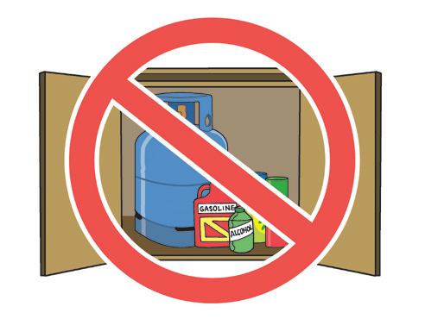
4. Provide designated areas for different household items. Label all household items properly. Keep dangerous chemicals in locked containers. Do you know why the picture at the right is not proper to do?
Improper storage

Slide 18
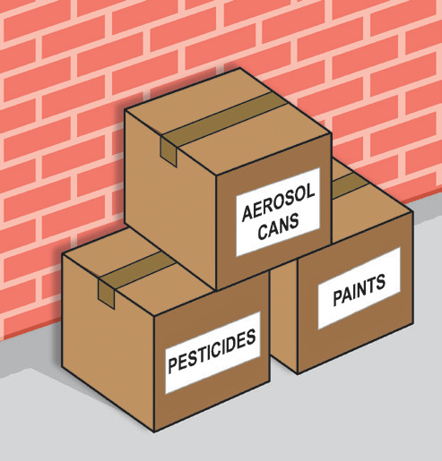
5. Dispose or used materials and dangerous substances properly. Avoid burning plastics.
Disposing household
items properly

Slide 19
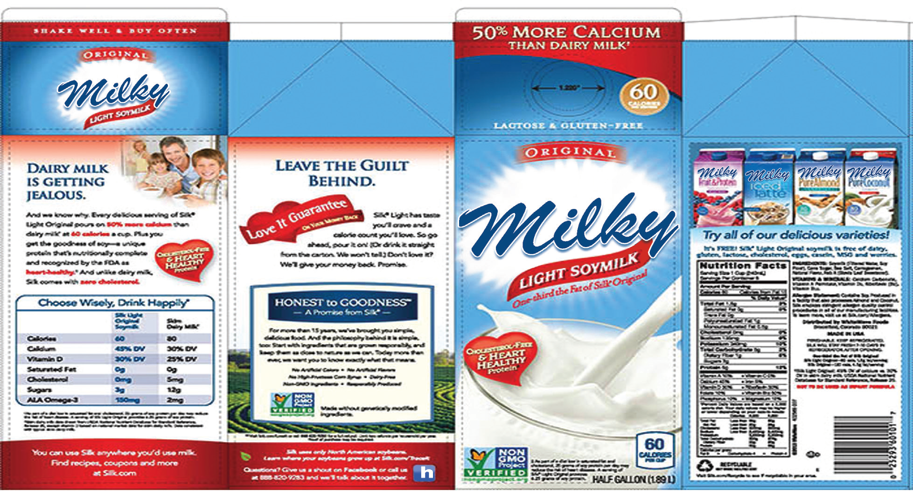
Importance of Reading the Product Label
A product label gives information about a product such as expiration date and instruction on how to use it. It is important to read the product label and follow instructions before using the product for your own safety.

Slide 20
Sample of a product label

Slide 21
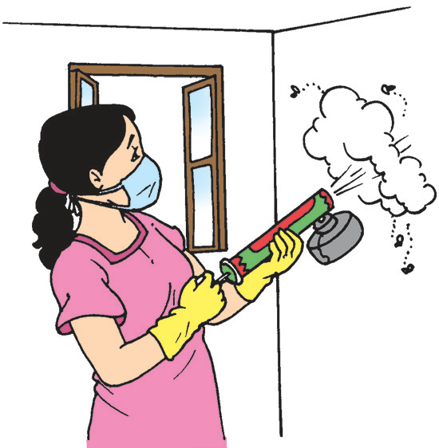
Many product labels have precautionary warnings such as: For External Use Only; Handle with Care; Warning: May irritate your eyes; Caution: It can burn your skin.
Aside from the precautionary warnings written on the label, there are precautionary symbols or signs which every child like you should know.

Slide 22
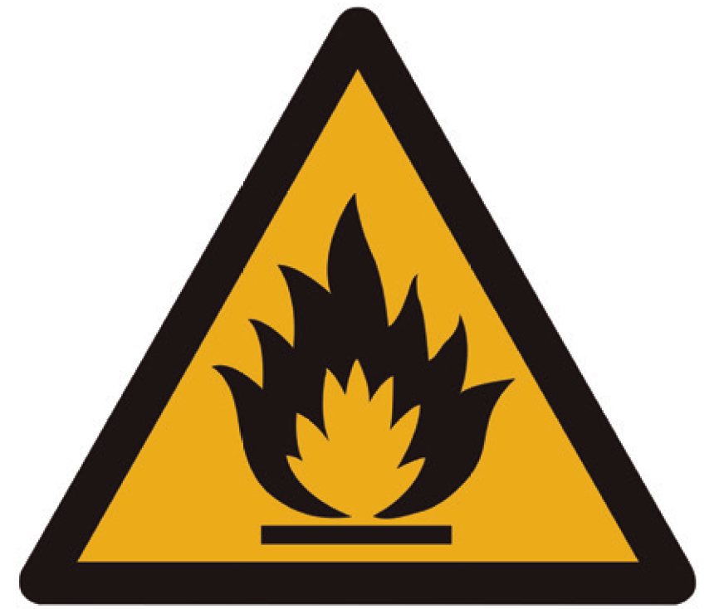
The Important Hazard Symbols
Flammable and Combustible Materials
These materials—whether solids, liquids, or gases—are capable of catching fire in the presence of a spark or open flame under normal conditions.
Flammable

Slide 23
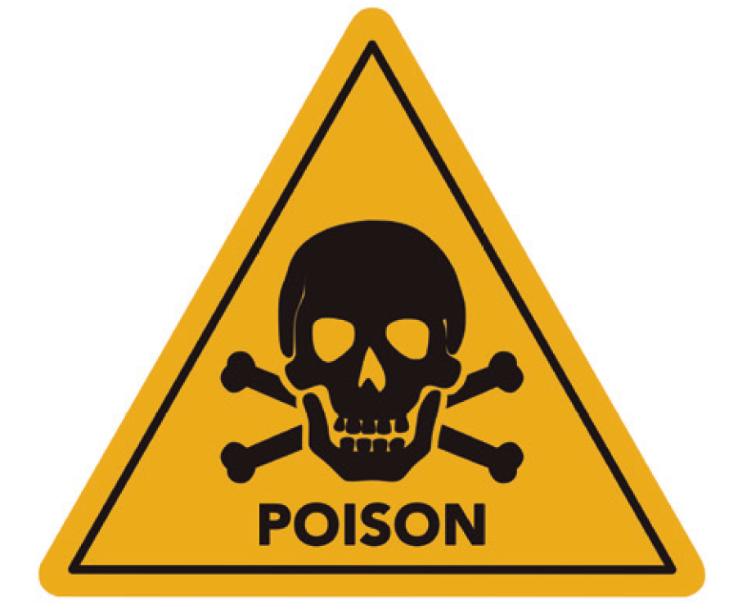
Poisonous and Infectious Materials
These materials can cause death or immediate injury when a person is exposed to a small amount.
Poisonous

Slide 24
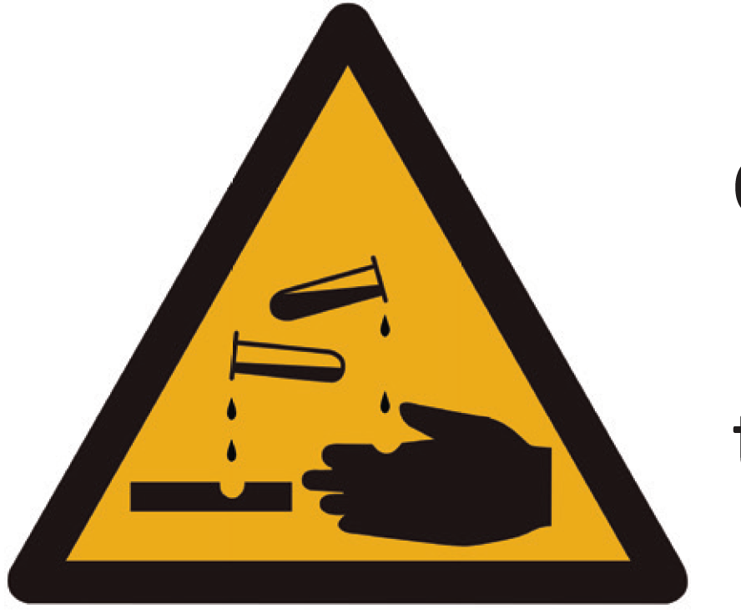
Corrosive Materials
These include caustic and acid materials that can destroy the skin and even metals.
Corrosive

Slide 25
You should be aware of the precautionary warnings, signs, or symbols on the product label. Be very careful in handling harmful or dangerous substances.
What possible dangers can happen if you do not handle materials properly?

