Slide 1
Describing Materials Based on Their Properties

Slide 2
It is important to know the properties of matter in our daily life. Do you know why?
Good examples are the following: looking for the texture of the good shopping bags to carry groceries, observing the color of clothes that would make us feel cool during hot days, choosing the best shape of furniture to fit in the terrace of the house, and using easy to flow liquid for food preparation.

Slide 3
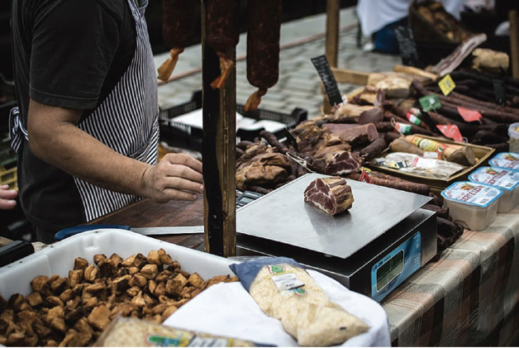
Mass and Weight
The word mass is sometimes interchanged with the word weight because they are related. The mass of an object is reflected by its weight. The more mass an object has, the greater its weight.
Weight is the pull of gravity on matter. Gravity is referred to as the earth’s pull. If you drop a book, it will fall to the floor. Why? The book falls toward the floor because the earth pulls all objects toward it.
Figure 1.2. A vendor weighing meat.

Slide 4
When you weigh an object, you are really measuring the pull of gravity on that object. Gravity controls the weight of an object.
When you go to a market, you see different kinds of fruits,
vegetables, fish, meat, and rice. The vendors weigh them before
they are sold. The vendors use the weighing scale to get their
weight.
Figure 1.2. A vendor weighing meat.

Slide 5
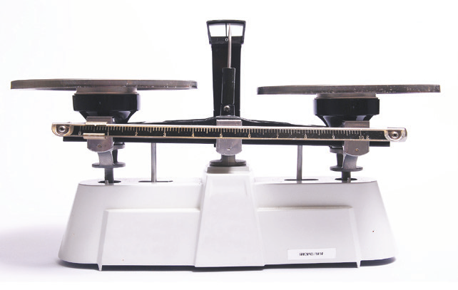
Mass refers to the amount of matter an object contains.
It is not affected by gravity. Since the pull of gravity affects
weight, weight can change. However, the mass of an object
always stays the same.
A weighing balance is used to measure the mass of objects.
The units of mass are grams (g) or kilograms (kg) which are
known as metric measurement.
Figure 1.3. Platform balance

Slide 6
Measuring Volume
We can measure volume. Matter has volume. This means that it has length, width, and height.
The volume of a regular object, like a block of wood, is obtained by multiplying its length, width, and height. Volume is expressed in units called cubic centimeter (cm3) or cubic meter (m3).
If a rectangular block has the following dimensions: length is 4
cm, width is 2 cm, and height is 2 cm, what is its volume?
Formula: V = l x w x h
V = 4 x 2 x 2
V = 16 cm3
The volume of the rectangular block is 16 cubic centimeters.

Slide 7
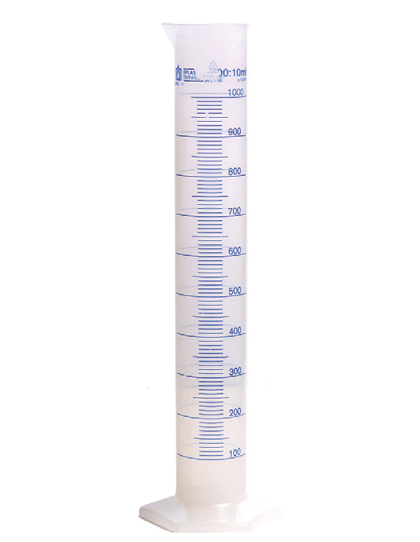
To determine the volume of liquids, we use a laboratory equipment
called graduated cylinder (see Figure 1.4). If you pour the liquid into
the graduated cylinder, the number you see that coincides with the
uppermost level of liquid is its volume. The unit of volume for liquids
is mL or milliliter.
Figure 1.4.
A graduated cylinder

Slide 8
In measuring the volume of irregularly shaped solids, you can use the water displacement method. Water displacement method is a method used to measure the volume of irregularly shaped solids. When a solid material is immersed in a fluid, it pushes out and takes its place. How do you do this?
Measure a definite volume of water in the graduated cylinder. Then, carefully drop a small stone into the graduated cylinder. You will surely observe that the volume of water will rise.

Slide 9
What is the new water level in the graduated cylinder now? If the new water level is 40 mL and the previous water level is 30 mL, what is the volume of the small stone? To get the volume of the stone, subtract the old or previous water level from the water level after the stone was dropped.
In equation, you have:
V = 40 mL – 30mL
V = 10 mL

Slide 10
What To Do
The following objects are presented in the table:
Observe the objects.
Then, pick one and show it to your classmate.
Describe the object based on its properties: color, shape, size, texture, volume, make up, and use.
State your reason why you chose the object.
Cotton Desk School bag Mirror
Lunch box Pencil case Handkerchief Ball
TV Paper

