Slide 1
Comparing Characteristics of Living Things and Nonliving Things

Slide 2
Characteristics of Living Things
1. Cellular Structure
The first and most important characteristic of every living thing is that living things are made up of cells. A cell is the smallest unit of organization in a living thing. Cells are often called the basic building blocks of all living things. According to scientists, life begins from a single cell which then divides or multiplies to give rise to a complex living form.
The human body is composed of trillions of cells. Both plants and animals are made up of one to countless number of cells. Cells enable living things to perform all of life’s functions and activities.

Slide 3
2. Nutrition or Food
All living things take their needs from their environment to get energy in order to grow and stay healthy. Substances that a living thing can use as energy and for growth and repair of damaged tissues are called nutrients.
Green plants are living organisms that can produce their own food. Animals cannot make their own food thus, they obtain their food from the environment.
3. Movement
Living things exhibit some form of movement. Humans and animals can move around. Animals can move from one place to another by walking, flying, or swimming. But you rarely see a plant moving. Plants have parts like buds and leaves that track presence of sunlight.

Slide 4
4. Respiration
Respiration is the process in which air is drawn into the body and gas wastes are eliminated. All living things exchange gases with their environment. Animals take in oxygen and release carbon dioxide. Plants take in carbon dioxide to be able to produce their own food.
5. Excretion
All living things produce substances that may be harmful if allowed to stay in the body. These harmful substances are excreted. The removal of these wastes is called excretion.
In humans, these wastes include carbon dioxide, excess salt and water, and undigested waste food or feces.

Slide 5
6. Growth
Growth is the process wherein living things increase in size. Living things grow. When living things are fed, they gain energy. Some of this energy is used for growth.
7. Sensitivity
Living things react to changes around them. They may react when touched or when exposed to light, heat, cold, or sound. For example, if you touch the leaflets of makahiya plant, you will notice that they will close. Another example is the movement of leaves of plants directed toward light.
8. Reproduction
Reproduction is the process by which living things produce new organisms of their own kind. All living things produces offspring. Humans produce babies, cats produce kittens, and birds lay eggs. Plants also reproduce. Many make seeds which can germinate and grow into a new plant.

Slide 6
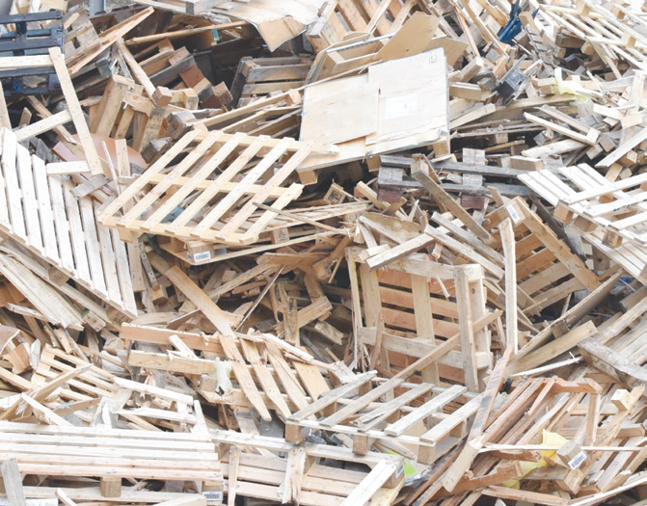
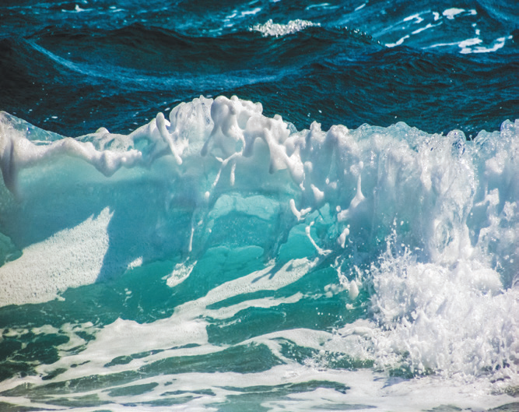
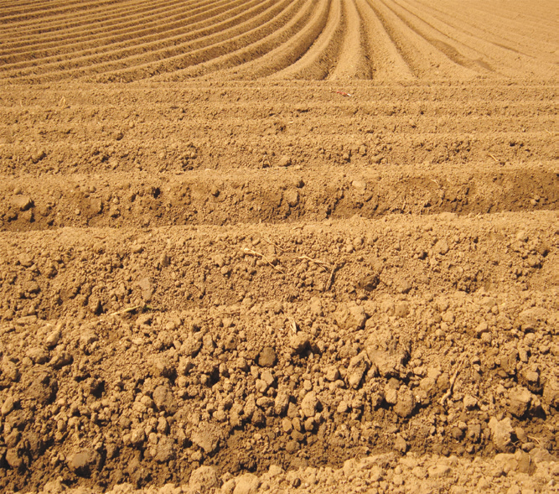
Nonliving Things
Nonliving things are things that do not have the ability to carry out the life functions mentioned above. They do not have life. Examples are metals, air, water, and soil.

Slide 7
Characteristics of Nonliving Things
The most important characteristic of nonliving things is the absence of cellular function. Cell is the basic building block of life. Some living organisms are made of one cell. Others are made of many cells in order to be alive. Because of the absence of cells, nonliving things cannot functionally perform activities.
Nonliving things cannot move by themselves. They have no methods of movement. They remain immobile or motionless. They do not need a supply of energy from their environment to sustain themselves.
3. Nonliving things cannot grow so they do not need food, water, air, and shelter to stay alive.
4. Nonliving things cannot multiply. They cannot reproduce, and they do not live or die.

