Slide 1
How Living Things Reproduce and Grow

Slide 2
One of the characteristics of living things is reproduction. Reproduction is the process of producing new offspring. All living things reproduce. Reproduction ensures that their kind will continue as time passes on. Mango trees create other mango trees. Species of bacteria create the same species of bacteria.
Species means a set of animals or plants in which the members have similar characteristics and can breed with each other. Offspring may differ from their parents for they have inherited a blend of their parents’ characteristics, or they may be the exact copies of them.

Slide 3
How Living Things Reproduce
There are two main types of reproduction: sexual reproduction and asexual reproduction.
Sexual Reproduction
In sexual reproduction, two organisms or individuals (plants or animals) of the species are involved. These two organisms are male and female. Cells from the male and cells from the female unite or join together to make one new cell. That is why you have two parents. The two sex cells of the parents unite and each of them passes on traits to the offspring. This is the reason why you have similar traits with your mother and with your father, but you are not identical to either of them.

Slide 4
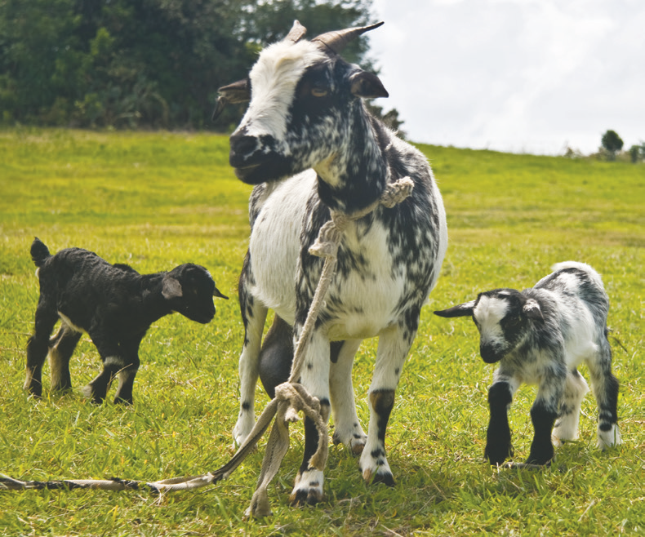
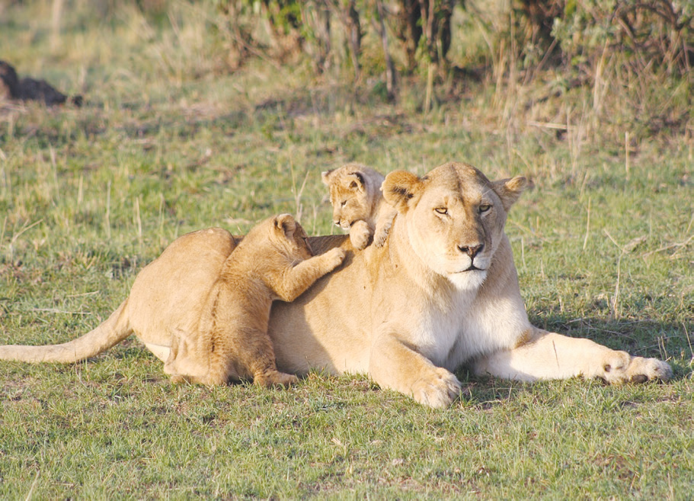
Mammals like goats, lions, and other organisms use this kind of reproduction.

Slide 5
Asexual Reproduction
Only one individual organism is needed to reproduce in asexual reproduction. There is only one parent in this type of reproduction. With genes from only one parent, the new organism formed is identical or the exact duplicate of that parent. They have all the same traits because their genes are handed down the same.

Slide 6
Hereditary Traits
Do you know why cats give birth to kittens but not puppies? Have you realized that you have black straight hair like your mother and brown eyes like your father? Have you ever thought why, when a certain plant grows into mature plant, it has the characteristics exactly like its parent plant?
Hereditary traits are characteristics that are pass down from one generation to the next. It explains why off spring resemble their parents. Characteristics such as body height and weight, eye color, and fur color are results of the genetics of the parents.
Just like animals, hereditary traits can also be handed down in plants. A parent plant and its off spring will share similar characteristics like leaf shape, color of flower, and stem structure. With this, the off spring plant will usually look like a smaller version of its parent.

Slide 7
How You Grow to Look Like Your Parents
Your parents are a great influence on how you look. If they are tall, then you will probably be tall. If they are short, then you will probably be short. But you can grow to be taller than your parents.
How Young Animals Reproduce and Grow
Some animals, like the housefly, undergo changes before they look like their parents. The changes in form and structure that occur from egg to adult is called metamorphosis. This means that the fertilized eggs change from one form to another several times. Finally, they reach the final stage where they form and shape become similar to their parents.

Slide 8
How Seeds Grow into New Plants
When a seed is planted under favorable conditions—proper temperature, enough moisture, and oxygen—the seed germinates. The seed needs air, water, and warmth in order to germinate. The swelling of the seed as it receives enough water marks the start of the process of germination.
The roots come out of the seed coat. They grow downward into the soil and begin to absorb water through the root hairs. The leaf bud is pushed and grows a stem. Few leaves grow out of the stem. When the leaves of the young plant become green and can produce enough food, the cotyledons fall off. The young plant is called a seedling.

Slide 9
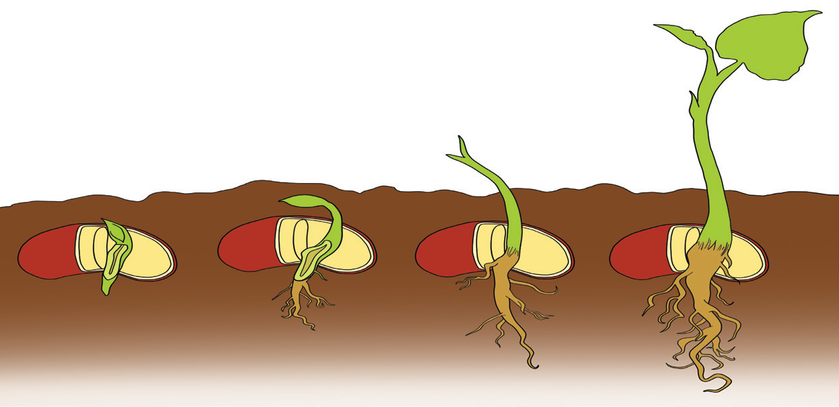
The seed germinates and grow into a new plant that has the characteristics and traits inherited from its parent plant.

