Slide 1
How Living Things Depend on the Environment to Meet Their Basic Needs

Slide 2
Living organisms have basic needs to survive. They depend on each other and on their environment to meet their basic needs for survival.
Basic Needs of Animals and Plants
We all need air, water, food, shelter, and care in order to live and grow. However, there is a little difference in the quality and the amount of the basic needs of animals and humans.

Slide 3
Basic Needs of Animals and Humans
Food
Animals and people need food to live and grow healthy. Like you, every animal must eat to stay alive. The food that animals eat helps keep them strong and well. You must have noticed that animal feeds are composed of different materials that provide different kinds of nutrients.
But there is a difference between the food of animals and that of humans. We do not eat uncooked rice but birds do. Many of the food that we eat are cooked first. All the food that we eat must be clean and sanitary. Otherwise, we get sick.

Slide 4
Water
Animals and humans need water to stay alive. They need water to replace the water that is lost from their bodies as they work. They will die of dehydration if they do not drink enough water.
Animals in the forest find water for themselves. Animals living with you at home are given water to drink. Animals use water not only for drinking but also for cooling themselves during hot days. Animals can drink water directly from a river or a pond. Many of them do not get sick. But some animals get sick when they drink dirty water. Both humans and animals need clean water to drink to avoid getting sick.

Slide 5
Air
All living things must have air to stay alive. They need oxygen. Animals need oxygen to be able to use the food that they eat. Both humans and animals need clean air to breath. Dirty air in the environment can make both humans and animals sick.

Slide 6
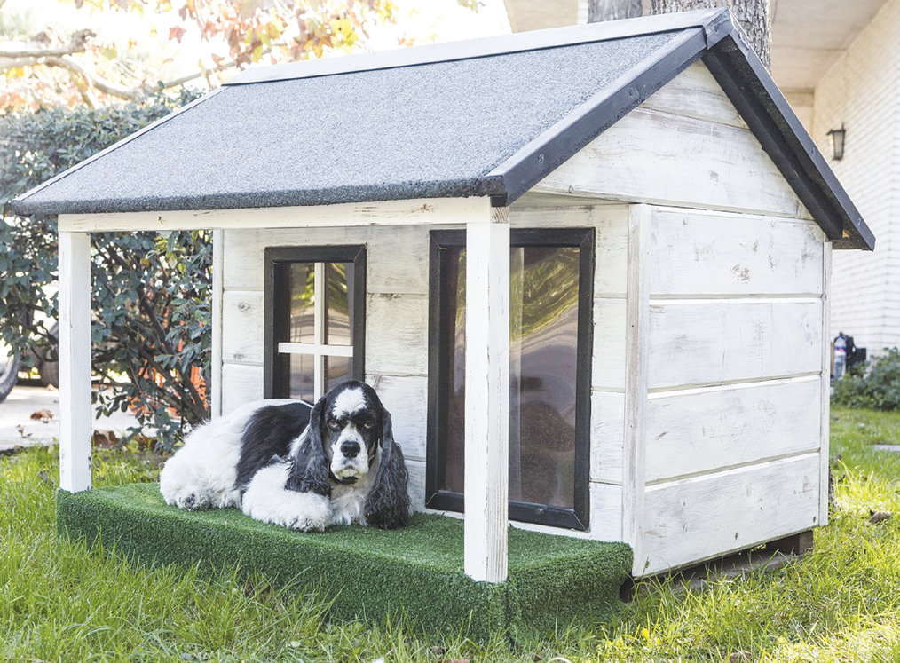
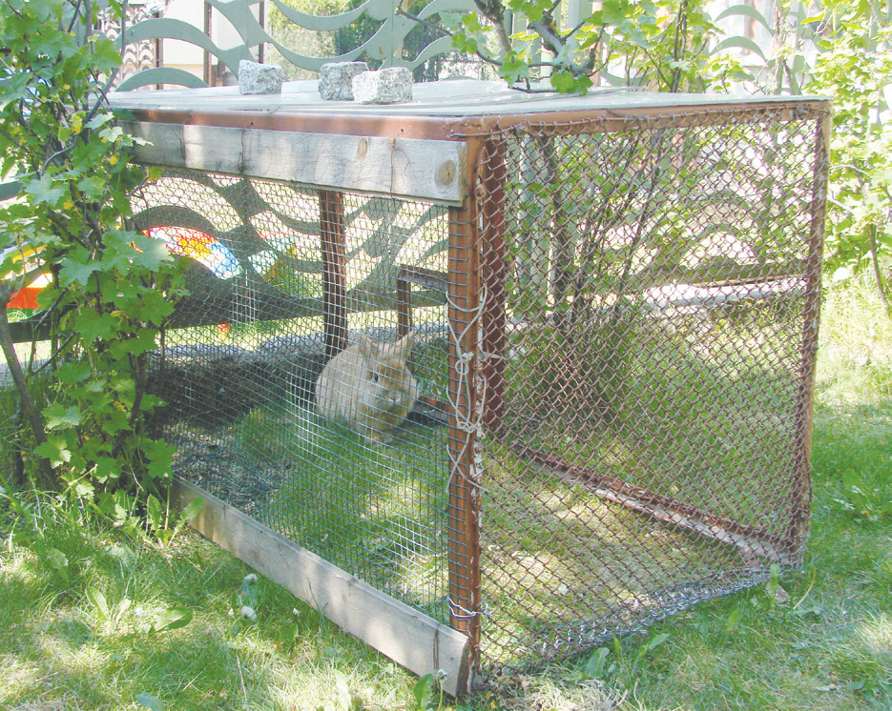
Suitable Habitat

Slide 7
Animals need suitable shelter to protect themselves and their young from bad weather and from their enemies. Animals live where they find protection. Many of them build nests or burrows for their young ones.
Note that there is a big difference between the shelter of animals than that of humans. Our houses are much bigger than the houses of some animals. Our houses have usually separate spaces for sleeping, cooking, eating, and playing.

Slide 8
What Plants Need
Plants get energy from the sun. Certain cells in the leaves of green plants change this light energy into a form of energy that plants can use.
Plants manufacture their own food. That makes them different from most living things. Plants also need air, water, and care to live and grow well.

Slide 9
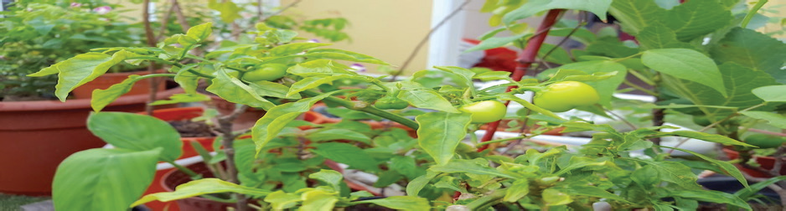
Plants exposed to sunlight

