Slide 1
Conservation of the Interaction of Living Things With Their Environment

Slide 2
An ecosystem is a system where living things interact with their environment. The living things in the ecosystem will get the materials they need from the ecosystem.
All living things need energy and certain materials to live and grow.
Where Do Plants Get Energy?
Plants get energy from the sun. Plants use light energy from the sun to change carbon dioxide and water into simple sugar. Oxygen and extra water are the by-products. They escape through the holes of the leaves.
Plants combine with minerals from the soil to develop its parts such as leaves, stems, and roots. Plant parts are used as food for humans and animals. Since plants can make food in the form of sugar on their own, they are called producers.
The plant process of making food is called photosynthesis, which makes plants special and vital among living things.

Slide 3
Where Do Animals Get Food?
Animals cannot make their own food. They must eat food from the environment. Since animals eat food from the environment, they are called consumers.
Plants produce the materials that animals depend on such as food as source of their energy. When a cow eats part of a plant, it is consuming the energy from the materials that the plant has stored. Without plants, animals will die.

Slide 4
What Do Animals Eat?
Carabaos, cows, and horses eat grass and leaves. Rabbits eat grass, carrots, and beans. Butterflies and bees suck nectar from flowers for their food. All of these animals eat plants. Animals that eat plants are called herbivores.
Eagles eat small birds and snakes. Lions and tigers neat meat of other animals. Big fish eat small fish. Frogs eat insects. These animals that eat the meat of other animals are called carnivores.
Most carnivores directly kill and eat other animals. They are called predators. The animal that is killed and eaten by predators is called the prey.

Slide 5
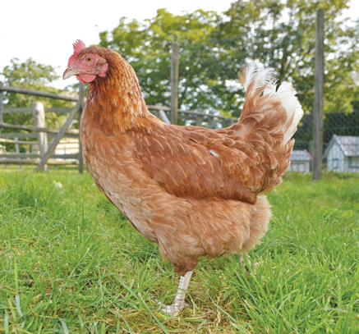
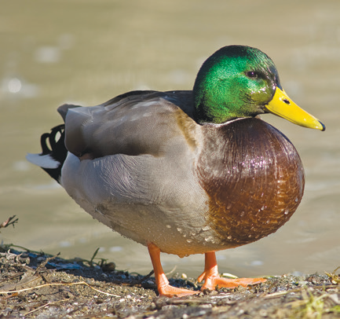
Some animals eat both plants and the meat of other animals. They are called omnivores. Humans eat both plants and the meat of other animals. Thus, humans are omnivores.
Chicken, ducks, fish, cats, and mice are other examples of omnivores.

Slide 6
There are also some animals that eat decayed or decaying plants and animals. These animals are called scavengers. The vulture, raven, earthworm, and snail are scavengers.
Animals that eat only insects are special types of carnivores called insectivores. Frogs, lizards, moles, spiders, and praying mantises all feed on insects, so they are insectivores.

Slide 7
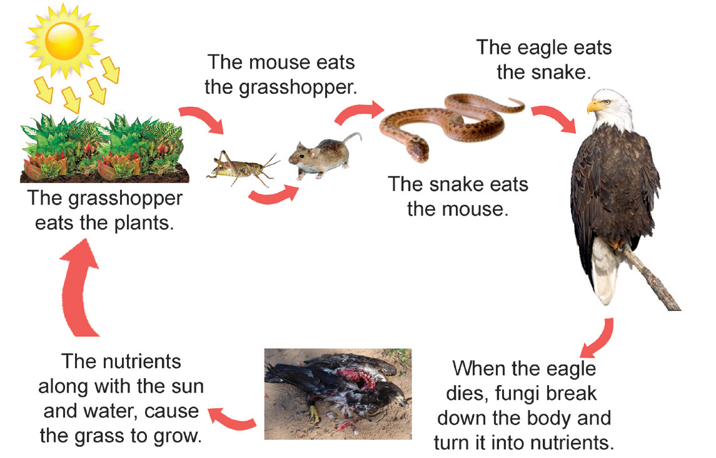
Living Things and Nonliving Things Interact With Each Other
Living things are always interacting with each other and with the nonliving things in their environment.
All plants, animals, and other living things that live together in one place make up a community. In all communities, producers make food. Animals and humans eat the producers or other animals. Energy and materials are passed from one living thing to another. This flow of energy is called a food chain.
The sun is the primary source of energy on earth. The energy from the sun is stored in plants. It is then taken by animals. This energy flow is called a food chain.

Slide 8
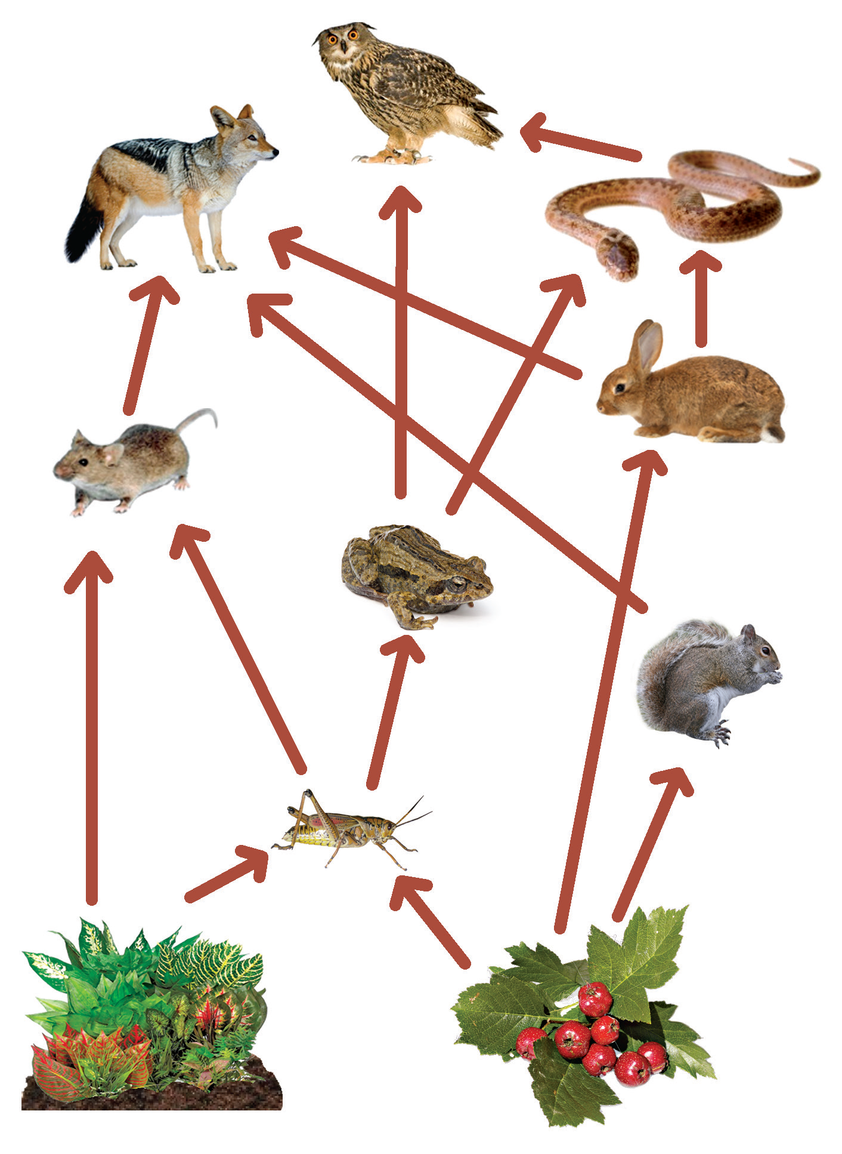
Food Chain and Food Web
What kinds of food have you eaten during the past two days? You might have eaten many different kinds of food. Most animals also eat different kinds of food. Because most animals eat more than one food, they belong to more than one food chain. All food chains that are connected in a community make up a food web.
The diagram shows several food chains. This shows that organisms eat more than one kind of food. Make a series of food chains. Start with grass or any plant and draw arrows to animals that eat it. Add more animals that eat the other animals. You may crisscross when necessary.

Slide 9
How Can People Affect the Food Web?
Each part of the food web depends on the other parts. If one part of the food web changes, the rest of the food web changes in some way.
People can change the food web in many ways. Taking trees out of the community is one way. Animals that need the trees for their homes or food are forced to move away. The food web in the community will change.
People can also change the food web when they add harmful substances to water, air, and soil. An example is the bad habit of the improper disposal of garbage. Polluted surroundings will harm humans, plants, and animals.

Slide 10
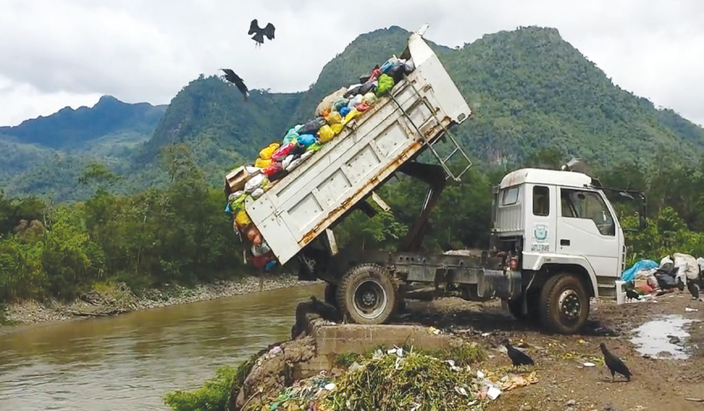
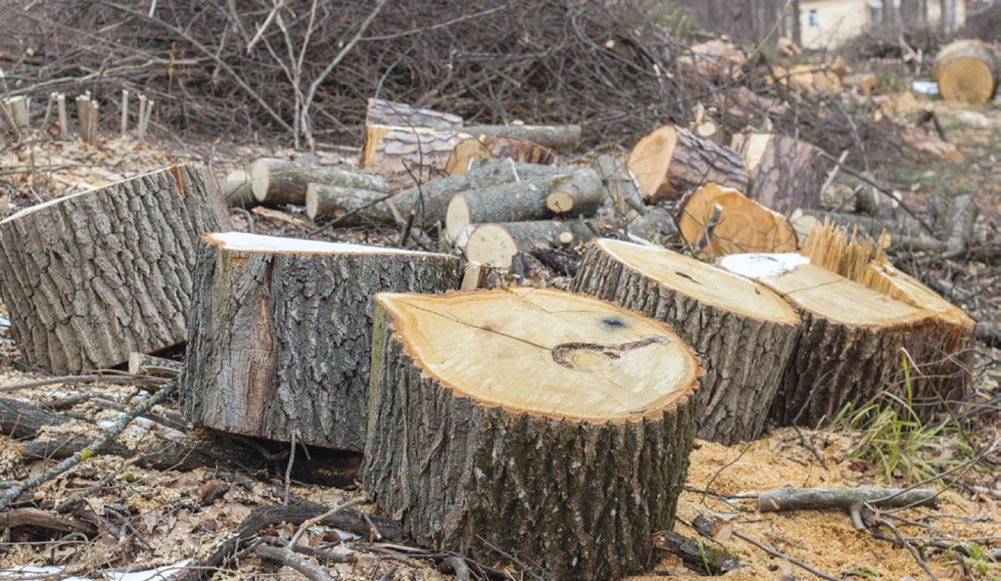
Now, we know that people, plants, and animals all depend on their environment to provide them everything they need for them to survive. We need to continue to protect and conserve our environment.

Slide 11
Conserving and Protecting the Environment
Participate in tree planting campaigns in your barangay so that trees that are cut down would be replaced.
Dispose of wastes properly at home, in school, and the neighborhood to keep the surroundings clean.
Religiously practice the 3 Rs for the conservation of our natural resources.

Slide 12
Reduce
Use less and buy less paper materials to save trees. Use both sides of the paper. Buy and use only what you need.
Reuse
Bring reusable cloth sacks when shopping for groceries and household needs. This practice minimizes the need for plastic and paper bags. This will mean less garbage that will go to the landfill.
Recycle
Dispose of certain materials like papers, cans, plastic, or aluminum at a special facility that will break them down for use in a new product. Some local governments and private organizations collect recyclable materials in their districts.

