Slide 1
Caring for and Protecting
the Animals

Slide 2
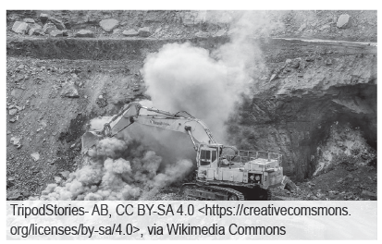
Caring for and Protecting the Animals
Our planet serves as a home for human beings and a haven for animals and other living organisms. However, with the rampant human activities such as wide-scale mining, urbanization, deforestation, and even conflicts such as war, terrorism, and similar activities, the different environments that serve as homes for a variety of organisms have been greatly affected.
Mining can cause widespread damage to the environment.

Slide 3
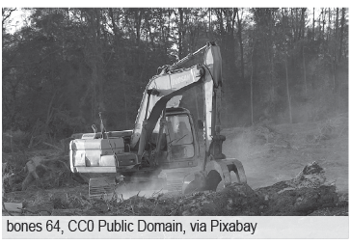
Caring for and Protecting the Animals
In the presence of destructive human activities, we must take proper action to prevent causing more harm to animals and their habitats. The destruction of habitats would lead to a decline in their population, bringing them to the brink of being threatened or endangered. With their nesting grounds destroyed, they would have difficulty looking for a haven for their off spring, and their young would be more exposed to their predators. Moreover, their food source will also be affected since they will be displaced from their natural habitats. These are just some of the many impacts of human activities on animals that could explain why we should look into ways of saving and protecting the animals.
Habitat loss can greatly affect animal population.

Slide 4
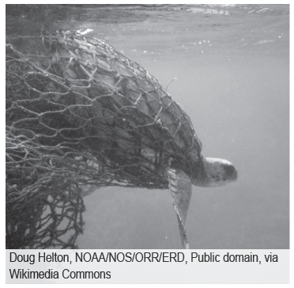
Caring for and Protecting the Animals
In our simple ways, we can participate in the activities that will promote the safety and welfare of these animals. One way to take good care of the animals is to be responsible for our garbage. We should not throw our trash at any place, especially non-biodegradable plastics. These plastics can be mistaken as food by freshwater and marine animals. Once eaten, these plastics can upset their stomach and even cause death.
We should not also use plastic straws as they can also harm the animals that live in aquatic environments. Fishing nets must also be disposed of appropriately as they can entangle marine animals such as turtles. Being responsible for our garbage disposal will greatly help in conserving animals. Always remember that if you have trash with you, do not just throw it anywhere. Rather, place it in the proper trash bin.
A turtle trapped in a fishnet

Slide 5
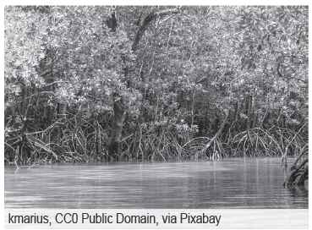
Caring for and Protecting the Animals
We should also set an excellent example of taking good care of the animals by being more aware of their significance in the ecosystem. By learning more about them, you can provide more information in taking care of these animals especially to the people around you. By being aware of the declining population of certain animals, the community could think of ways to look into progress and development without compromising the lives of these animals. Once everyone in the community has developed an appreciation for the significance of the different animals in the environment, we could take the necessary actions to avoid further harm to their natural habitats.
The mangrove swamps have
high biodiversity. We must take
good care of them for the sake of
their animal inhabitants.

Slide 6
Caring for and Protecting the Animals
These animals provide most of the humans’ needs, such as food and services. There are several animals that serve as food for humans. These animals include those that belong to the poultry and livestock category. Poultry animals include chickens, turkeys, ducks, and other similar fowls. On the other hand, livestock animals include cows, goats, sheep, and the like. Animals also provide service to humans.
Horses are used to carry light equipment and even served as a form of transportation, especially during the old times. However, even though they provide these services to humans, we must observe proper animal care. Aside from providing services to humans, some animals serve as companions, such as cats and dogs. With this, it is just right that we should look after their welfare for them to have a comfortable and happy life.

Slide 7
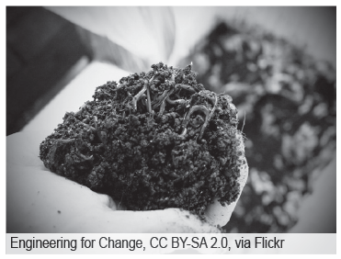
Caring for and Protecting the Animals
In terms of agriculture, we use earthworms for vermiculture. Vermiculture is the use of earthworms as a means to cultivate and aerate the soil. Through this process, the farmers will be able to use agricultural soil effectively and grow crops more efficiently.
Vermiculture

Slide 8
Caring for and Protecting the Animals
Activity
Directions: Analyze and complete the given statements by choosing from the options inside the box.
Poultry Vermiculture
Mining
Livestock Habitat loss
1. Animals that includes cow, goats and sheep are examples of __________.
2. __________is the use of earthworms as a means to cultivate and aerate the soil.
3. __________can cause widespread damage to the environment.
4. Animals like chickens, turkeys and ducks are examples of__________.
5. __________ can greatly affect animal population.

Slide 9
Caring for and Protecting the Animals
Answer Key
1. Animals that includes cow, goats and sheep are examples of livestock.
2. Vermiculture is the use of earthworms as a means to cultivate and aerate the soil.
3. Mining can cause widespread damage to the environment.
4. Animals like chickens, turkeys and ducks are examples of poultry.
5. Habitat loss can greatly affect animal population.

