Slide 1
How the Sense Organs Help Us

Slide 2
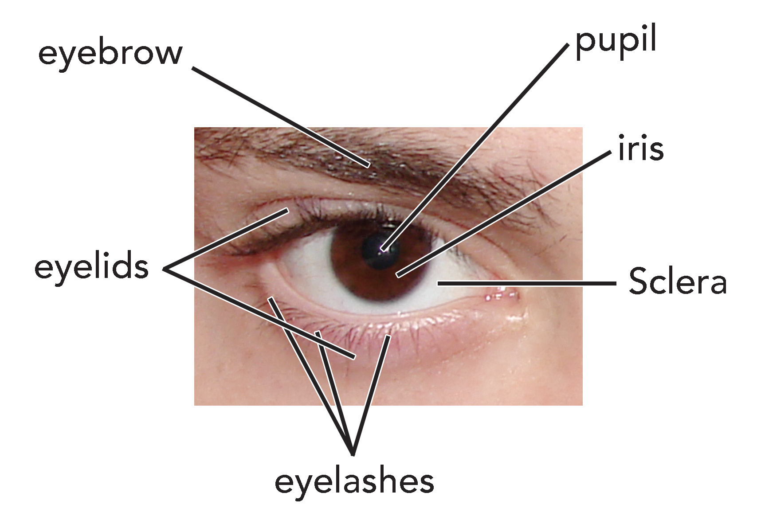
The Eyes
The importance of our eyes. Will help us see things around us. They help us describe the colors, sizes, and shapes of different objects. Our eyes are sense organs for seeing.
Parts of the Eye
You have two eyes. Both eyes have the same parts.
Look at the eyes of your classmates. The colored part you see is the iris. The iris of your eye may be black, brown, green, blue, grey, violet, or even red. At the center of the iris is an opening where light passes through. This is called the pupil. The lens is found at the back of the pupil. The sclera is the white tough wall of the eye. The retina is the lining at the back of the eyeball made up of sensitive cells that pick light. The cornea is the clear layer at the front center of the eye.

Slide 3
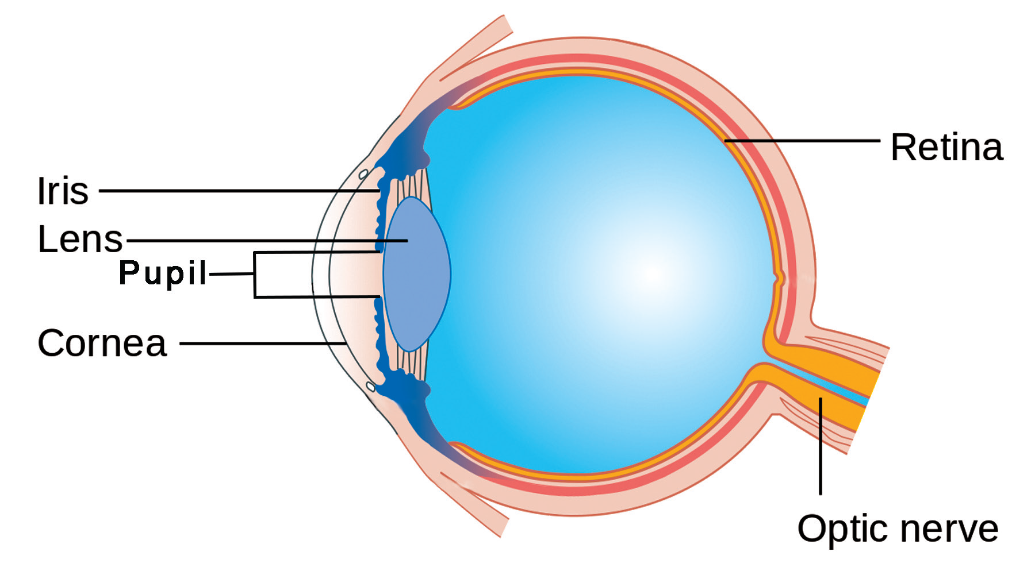
Behind the retina is the optic nerve which sends messages about the things you see to the brain. These messages are processed in the brain. Through this, you can see what is going on around you.
Your eyes need light in order to see. Young children usually have normal eyesight, but this may change as they get older.
Caring for the Eyes
You have to take care of your eyes so that they can function well. What are the Dos and Don’ts in taking care of your eyes?
1. Always read under a good light. Reading in dim light can be harmful to the eyes.
2. When reading, do not hold your book too close to your eyes.
3. Avoid reading when you are lying down or when you are in a moving vehicle.
4. Rest your eyes by closing them or by looking afar after reading.

Slide 4
Avoid looking directly at the Sun. Too much light is harmful to the eyes. Wear sunglasses that block harmful radiation from the Sun.
Watch television at a safe distance. Watching television at a very close distance may harm your eyes.
Wear proper eye protection when you are doing hazardous activities.
Eat foods that are rich in Vitamin A like squash, carrot, and papaya to have good and healthy eyes. Vitamin A helps the eyes see clearly.
When your eyes are not functioning well, visit an eye doctor. An eye doctor treats eye diseases and conditions.
Avoid playing with sharp objects that can harm your eyes.

Slide 5
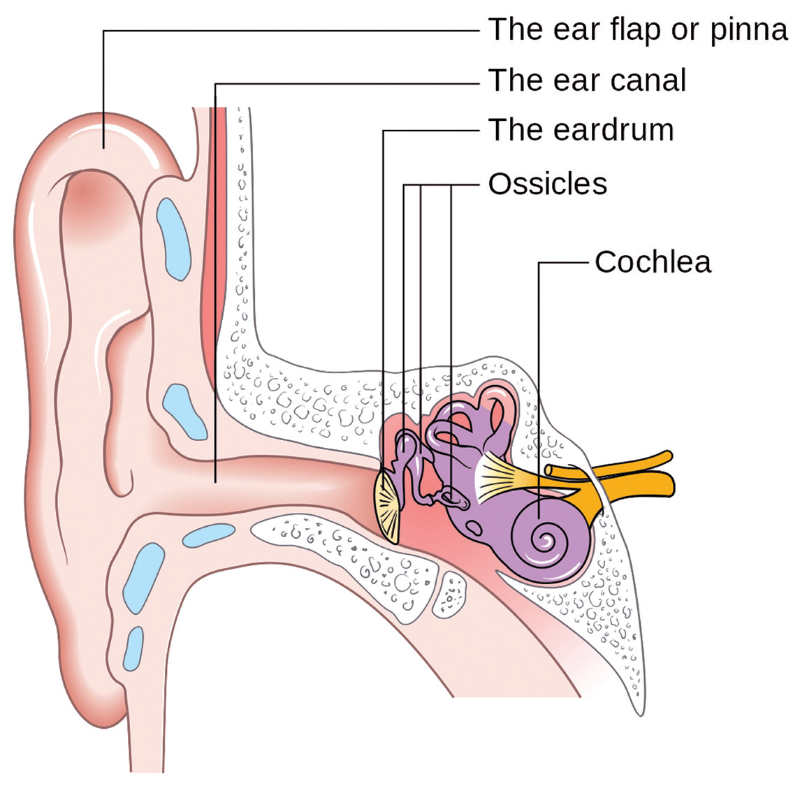
Your ears are very important. They are the organs for hearing. They are specifically made to receive sound waves. Sound waves are produced by vibrating objects. Your ears convert the sound waves into a sensation we call sound.
Parts of the Ear
You have two ears. Each of your ears has the same parts. The picture on the right side shows the parts of the ear.
The ear has three important parts: the outer ear, middle ear, and inner ear.
Sounds travel to your ears through the ear canal. The part of your ear outside your head makes up the outer ear.

Slide 6
Outer Ear
The outer ear is called the pinna. It is the part that you can see on both sides of your head. The pinna is shaped just right to collect sound waves. Girls wear their earrings on the lower part of the pinna.
Middle Ear
The middle ear contains three tiny bones: the hammer, stirrup, and anvil found in the ossicles. These bones move when the eardrum vibrates. The vibrations move or travel through the fluid that fills the inner ear. The eardrum is a thin membrane that covers the end of the ear canal.
Inner Ear
The inner ear also called as the cochlea is the part of the ear that looks like a shell of a snail. The inner ear has many nerve endings. The auditory nerves pick up the sound messages and send them to the brain. Then, the brain sends messages of what sound the person is hearing.

Slide 7
Caring for the Ears
Your ears are important. They should be properly taken care of. Here are some of the ways of caring for your ears:
Clean your outer ears regularly with soap and water. You should ask your parent to help you clean the inside of your ears.
Do not insert any object inside your ears. You might lose your sense of hearing.
When your ears hurt, see a doctor immediately.
Lower the volume of the radio or any music player when listening to it especially when using headset or earphones.
Avoid catching cold. Germs in your throat might go to the ears and cause infection.

Slide 8
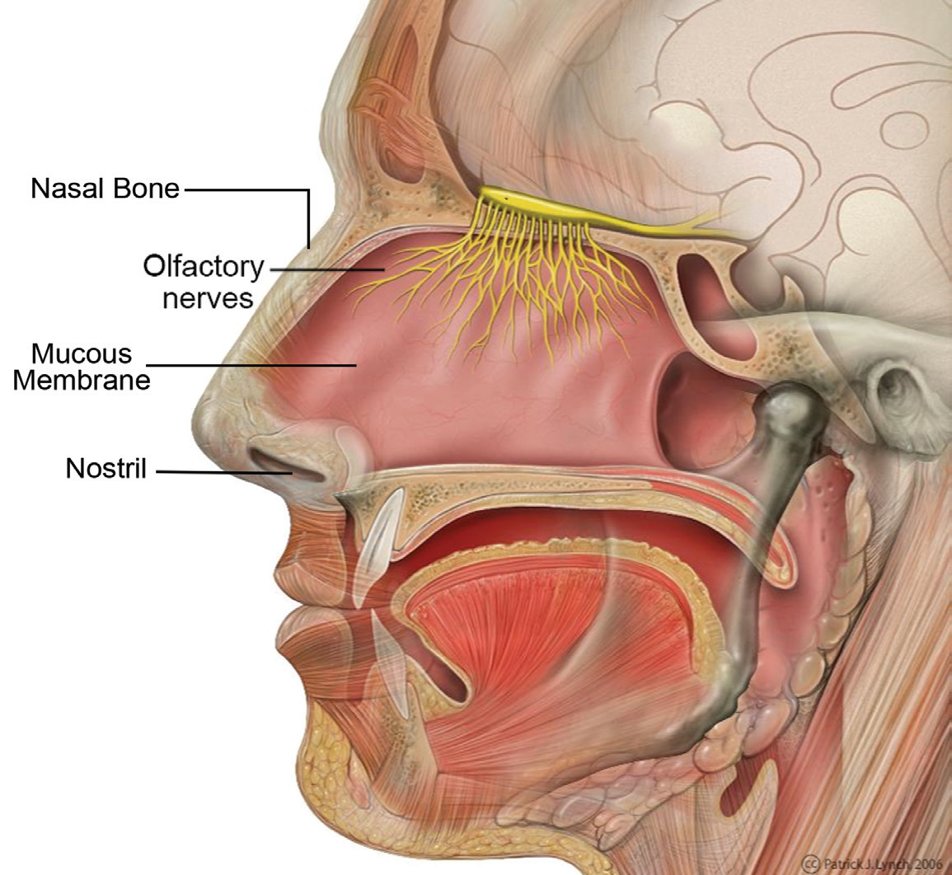
Some fruits like the jackfruit, ponkan, and ripe mango have pleasant smell. Some flowers like the sampaguita, ilang-ilang, and rose have pleasant smell, too. Other things do not have odor. They are described as odorless.
Parts of the Nose
The nose is the sense organ for smelling. You smell through your nose. Your nose helps you describe what you smell.
The nasal bone divides the nose into two openings called nostrils. The nostril is where the air passes. Inside each nostril are tiny hairs that trap solid particles that enter the nose. Another important part of the nose is the mucous membrane. This membrane secretes mucus. The mucus traps some solid particles and kills germs that get inside the nose.

Slide 9
When you breathe, air passes through the upper part of the nose lined with olfactory nerves. These nerves send messages to the brain. The brain then interprets these messages, telling you what you smell.
The nose is the sense organ that helps you tell the odor of a thing.
There are times when you might lose your sense of smell. This happens when you have a cold. The passages in your nose may be blocked. Your sense of smell also gives you a warning that there is danger around. The smell of burning wood tells you that something is on fire. The strong smell of some materials tells you if they are poisonous to your body.

Slide 10
Caring for the Nose
Take good care of your nose. You cannot smell and breathe without your nose.
Here are some ways to take care of your nose:
Avoid putting objects inside your nose.
Always clean your nose with a clean handkerchief or tissue paper.
Cover your nose to protect it from dust, smoke, or poisonous gases. When you have colds, you may find yourself sneezing or coughing. You should cover your nose with a clean handkerchief when you sneeze or cough. This will prevent others from catching the cold, too. Blow your nose gently.
Consult a doctor when you have a problem with your nose.

Slide 11
The tongue helps you taste the food. The different tastes are sweet, sour, salty, and bitter. Your tongue also helps in chewing and swallowing your food. It also helps you talk.
Parts of the Tongue
The tongue is located inside the mouth or buccal cavity. Your tongue has many parts. These parts are the sides, tip, back, and surface.
The rough surface of the tongue is covered with taste buds. The taste buds are the parts that really taste food.
These taste buds are connected by nerve cells to your brain. The nerve cells help detect and bring signals to the brain. Because of these, all parts of the tongue can detect the different tastes.
Not all foods taste exactly the same to people. One kind of food may taste good to some but may not taste good to others. Aside from the tongue, the mouth also contains the teeth. The teeth are used for biting and chewing the food that we eat

Slide 12
Caring for the Tongue and Teeth
Here are some ways of caring for your tongue and teeth:
Calcium is good for the teeth. Eat enough food rich in calcium like milk, cheese, and leafy vegetables. Avoid eating too many sweets.
Brush your teeth after every meal. Tiny bits of food left between your teeth can cause tooth decay. Floss your teeth at least twice a day and always before sleeping.
Lightly brush your tongue and then clean it with water to avoid the build-up of bacteria.
Visit the dentist at least once a year. The dentist has instruments for cleaning your teeth thoroughly. He or she can also treat toothaches.
Avoid drinking very hot beverages or eating very hot food. This will help you avoid having burns in your tongue.
Consult a doctor when you have tongue and teeth problems.

Slide 13
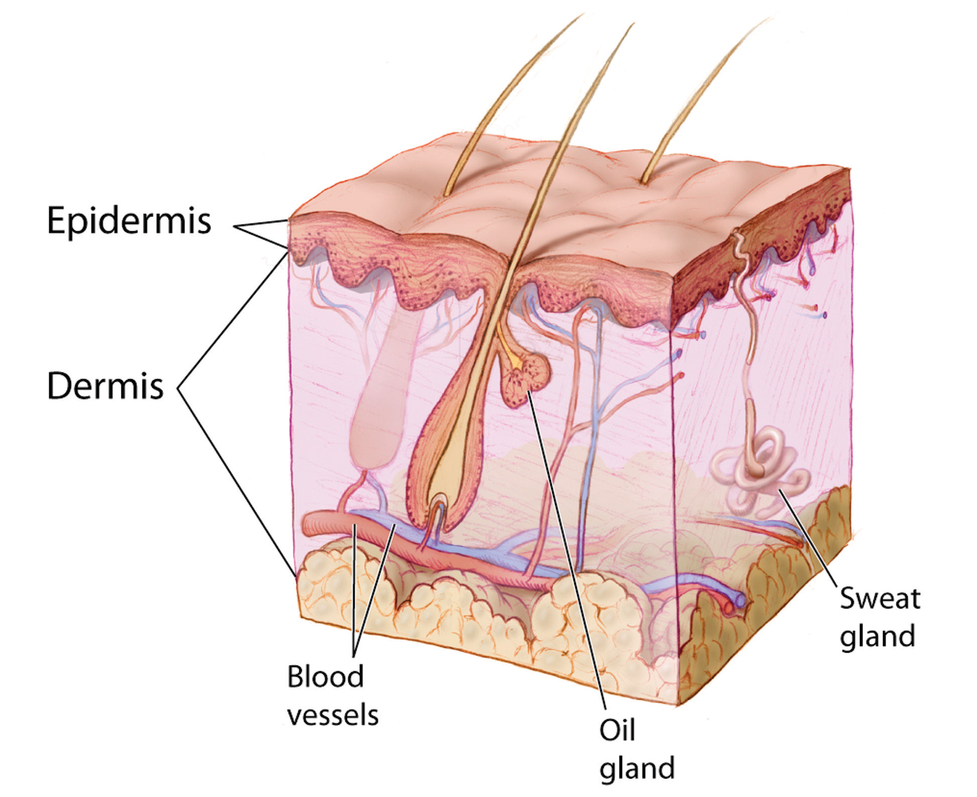
Your whole body is covered and protected by a special covering called the skin. The skin is very sensitive. It helps you know whether what you are touching is hot or cold, smooth or rough, and soft or hard. You can also feel the pain or the pressure that objects may give you through your skin.
Parts of the Skin
Use a magnifying lens to observe your skin. What do you see? The outer layer of the skin is the epidermis. Beneath the skin is a thicker layer called the dermis. It has blood vessels which look like tiny tubes. When you feel hot, your blood vessels become enlarged. This makes your face red. When you feel cold, your blood vessels become smaller. This makes you look pale.

Slide 14
The dermis also contains oil glands and sweat glands. Perspiration or sweat is produced from the sweat glands and comes out through openings in the skin called pores.
The dermis also includes the nerve receptors or nerve endings. These nerves are connected to the brain. They send messages to your brain. Then, the brain tells you what you are feeling or touching.
The skin on different parts of your body has different numbers of nerve endings. Your face and hands have many nerve endings. Your back and legs have fewer nerve endings.

Slide 15
Caring for the Skin
Dirt and germs can cause skin diseases. These are the ways to take care of your skin:
Wash your hands with soap and water after playing or working.
Wash your hands before and after eating. It will prevent the spread or transfer of germs from your hands to your food and into your body. Cleanliness helps in protecting you from skin diseases and other infectious diseases.
Sharp objects can harm you. Be careful when you cut things with a knife or a pair of scissors. Cuts and wounds should be treated right away to prevent infection.
Wipe your hands and face with clean face towel or handkerchief.
Avoid long exposure to the Sun. It can cause sunburn. Use cream or oil that blocks sunlight when you stay under the Sun for a long time. Avoid other burns by being careful near hot objects, hot water, or fire.
Doing physical exercise, eating nutritious food, and getting enough sleep will help keep your skin healthy.
Consult a dermatologist or a skin doctor if you have skin problems.

