Slide 1
Sense Organs and How to Care for Them

Slide 2
A. Sense of Sight: Eyes
Structure of the Eye
When you feel your closed eyes with your fingers, you notice that your eyes feel like balls. That is why they are called eyeballs. Each eyeball is set in a protective cavity in your skull. This cavity is called socket or orbit. Most of your eyeball is hidden inside your head. It is held in place by muscles. These muscles let your eyes rotate slightly up, down, and sideways. Eyelids protect the front of the eyeball.
As you look at your eyes in the mirror, you will notice the eyelashes at the border of each eyelid.
The eyebrows and the eyelashes protect the eyes from sweat, dust, and other foreign particles.
Anything that touches the eyelashes causes the lids to blink in a protective reflex action. Tear glands keep the eyes moist for the eyelids to close and open easily.

Slide 3
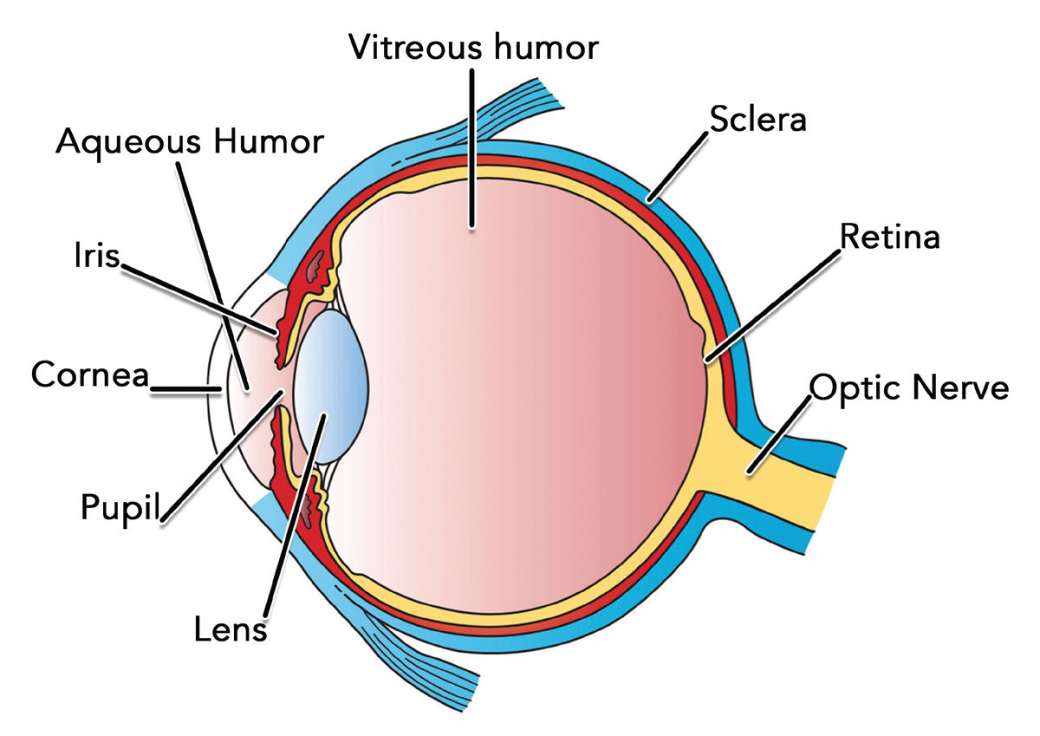
Anything that touches the eyelashes causes the lids to blink in a protective reflex action. Tear glands keep the eyes moist for the eyelids to close and open easily.
The walls of the human eye are composed of three basic layers: the outer layer, middle layer, and inner layer.

Slide 4
Outer Layer
The tough outermost layer is the sclera. The sclera is the outer white layer of the eye. The three pairs of muscles that move the eye are attached to the sclera. Light enters the eye through the cornea, the transparent part of the coat of the eyeball.
Middle Layer
The middle layer of the eye is the choroid layer. This layer contains numerous tiny blood vessels that nourish the eyes. The frontal part of this layer is the iris. The iris contains a pigment called melanin that gives color to the eye. The small opening in the middle of the iris is called the pupil. The pupil allows the light rays to enter the eye.
In bright light, the opening of the pupil becomes smaller so that lesser amount of light enters the eye. In dim light, the pupil is opened wider so that more light passes the eye.

Slide 5
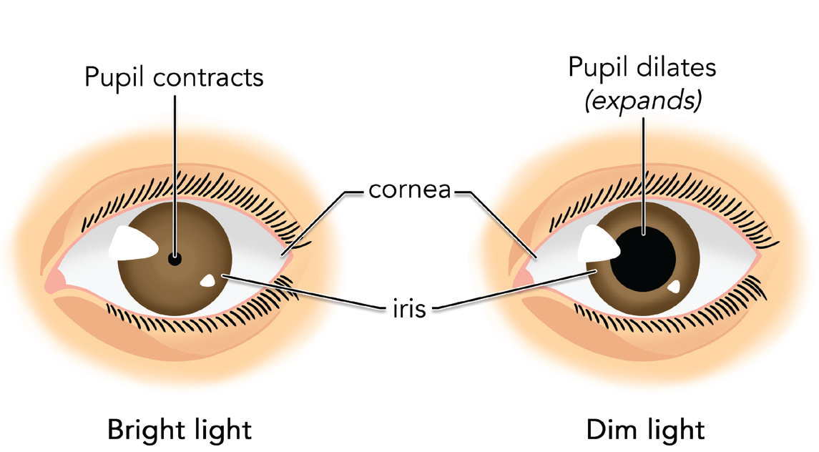
Light that enters the pupil strikes the part called the lens. The lens gathers light. When you look at near objects, the shape of the lens becomes thicker. When you look at distant objects, the lens becomes thinner. The lens is located behind the iris.
The eyeball is a hollow sphere that is divided into two cavities. The cavity between the cornea and the lens is filled with a transparent watery fluid called aqueous humor. The large cavity behind the lens is filled with a colorless, jellylike liquid called vitreous humor.

Slide 6
Inner Layer
The inner layer is a screen of light-sensitive cells called retina. Ciliary muscles attached to the choroid layer hold the lens in place. These muscles also change the shape of lens, allowing the eye to focus on objects whether close or far away. At the rear of the eye, the retina is attached to the optic nerve which carries impulses from the light-sensitive cells to the brain.
The innermost layer of the retina contains the light-sensitive cells: the rods and cones. Rods are sensitive to weak light but not to color. Cones are sensitive to color but require bright light to function.

Slide 7
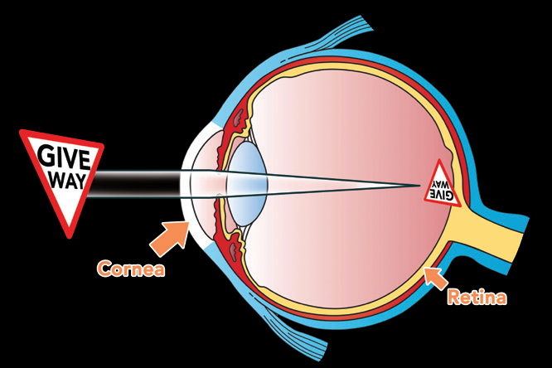
How do you see?
Your eyes need light in order to see. You cannot see objects around if there is no light. When you look at something, the light rays reflected from the object enter the eye. The light is refracted by the cornea and passes through the aqueous humor and pupil to the lens.
Pupil of the eyes in bright light and dim light retina. The image of the object in the retina is inverted. As the image is formed, the optic nerves send the message to the brain. It is the brain that interprets and corrects the inverted image into an upright position.

Slide 8
Common Eye Ailments
Among the most common ailments of the eyes are:
Conjunctivitis or Sore Eyes
It is an inflammation of the conjunctiva, a thin membrane that lines the white of the eye and the inside of the eyelids. Conjunctivitis is also called sore eyes. It is caused by bacteria, virus, allergies, or environmental pollutants such as dust and smoke. A person with conjunctivitis has red, swollen, and teary eyes.
For your protection, stay away from persons who have sore eyes. Avoid using their personal things like towels and handkerchiefs. Conjunctivitis can be spread easily by direct contact. In case you have sore eyes, avoid rubbing your eyes with your hands. Use sunglasses to protect your eyes from too much light.
Sty
This is an infection or inflammation of the glands that are connected to the eyelashes along the margin of the eyelid. A sty is similar to a pimple and is usually caused by bacterial infection. The eyelid swells and becomes reddish. You may apply hot compress over the infected eye to ease the pain.

Slide 9
Common Eye Defects
Some common defects of the eyes are:
Strabismus or Squint
This is an eye defect in which the two eyes cannot focus on the same object because of lack of coordination of the eye muscles. One or both eyes may turn toward the nose (cross-eyed) or outward (wall-eyed). In most cases, strabismus can be corrected if treated early in childhood. Treatment may involve the use of eyeglasses, eye exercise, and surgery.
Astigmatism
This is an eye condition in which the horizontal and vertical images do not focus on the same point, making the vision blurred or distorted. The lens or cornea of the eye has a surface that is not evenly curved. Astigmatism can be corrected by the use of appropriate eyeglasses.

Slide 10
Color Blindness
This eye defect is common among males. It is hereditary and usually involves the inability to distinguish between the colors red and green. At present, there is no known cure yet for color blindness.
Myopia or Nearsightedness
This is an eye condition wherein the image of the object is focused in front of the retina because the eyeball is too long. A nearsighted person has good near vision but poor distant vision. Correction involves the use of eyeglasses that are thinner in the middle than at the outer edge.
Hyperopia or Farsightedness
This is a condition in which the image of the object is focused behind the retina. This defect occurs because the eyeball is shorter than normal. A farsighted person has good distant vision but poor near vision. Correction involves the use of eyeglasses that are thicker in the middle than at the outer edge.

Slide 11
Proper Care for the Eyes
Desirable habits can help prevent or control these ailments and disorders as well as keep our eyes healthy.
1. per nutrition
Eat food that are rich in vitamin A such as green leafy vegetables, carrots, squash, and yellow fruits. People with deficiency in vitamin A usually suffer from eye diseases.
2. Preventing eye damage
Wear safety glasses or goggles when working and using power tools such as electric saws, grinding wheels, and the like, to protect the eyes from particles that get into the eyes.
Never look directly at the sun or at a very bright light. Keep fingers and pointed objects away from your eyes.

Slide 12
3. Good health habits
Read and work under a light bright enough for you to see clearly. Avoid reading when lying down or in a moving vehicle. When doing long reading, rest your eyes from time to time.
Do not get too close to the screen while watching television. Do not rub your eyes to avoid irritating them.
4. Regular check-up of the eyes by a doctor
If there is something wrong with your eyes, consult an ophthalmologist. An ophthalmologist is a medical doctor who treats eye diseases. An optometrist examines the eyes for eye defects and corrects them by means of eyeglasses. An optician makes eyeglasses ordered by the ophthalmologist or optometrist.

Slide 13
5. First-aid treatment for the eyes
Any foreign material which enters the eyes is dangerous. Keep the victim’s head face down. Wash the eye gently with running water. Splashing water from a basin can also wash the foreign material away. When you have thoroughly cleansed the injured eye of the foreign material, dry it using a clean towel. If the particle does not come out of the eye, bring the patient to the hospital as soon as possible.
Any foreign material that does not come out or sticks to the cornea should be removed by a health expert.
If chemicals enter the eye, they should be washed out immediately with large amount of water. A physician should be consulted at once.
Let us take extra care for our eyes. Practice desirable habits to keep our sense of sight healthy and fit.

Slide 14
B. Sense of Hearing: Ears
The ear is the sense organ for hearing. It enables you to hear and recognize a sound. The sound produced by any object is caught by your outer ear, and it is passed on to the nerves in the inner ear that carry messages to the brain. The brain tells you what you hear.
Parts of the Ear and How Each Works
The human ear has two functions: one is hearing and the other is maintaining the balance of the body or equilibrium. The three parts of the ear are the outer ear, the middle ear, and the inner ear.

Slide 15
Outer Ear
The outer ear collects sound waves and sends them to the middle ear. It is the visible part of the ear.
The three parts of the outer ear are the pinna or auricle, the auditory canal, and the tympanic membrane.
1. Pinna or Auricle
The pinna, also called auricle, is a flap of skin supported largely by the cartilage. It is the curved part of the ear attached to the side of the head; its shape makes it efficient in collecting and capturing sound waves.
The soft tissue that hangs from the lower part of the auricle is the earlobe.
2. External Auditory Canal
The auditory canal serves as the passageway of sound waves into the ear. It is composed of glands which secrete ear wax. This waxy substance traps dust and other foreign bodies to prevent them from reaching the middle ear. The sound waves that pass through the auditory canal go to the eardrum.
3. Tympanic Membrane (Anterior Eardrum)
This part separates the outer ear from the middle ear at the end of the auditory canal that is very sensitive to sound.

Slide 16
Middle Ear
The middle ear is a hollow air-filled cavity. It consists of the portion of the tympanic. cavity and the three little bones: hammer (malleus), anvil (incus), and stirrup (stapes). Also situated in the middle ear is the Eustachian tube.
The portion of the tympanic cavity causes the eardrum to vibrate with complex patterns when sounds come
in through the auditory canal. It is the vibration of the eardrum that sends sound waves deeper into the ear.
The three tiniest bones of the body are the hammer, anvil, and stirrup. These bones form a chain across the middle ear, linking the eardrum to another membrane. The hammer is attached to the eardrum; the anvil connects the hammer to the stirrup; and the stirrup is connected to the oval window.
The Eustachian tube leads to the back of the nose down to the throat to allow the passage of air into and out of the middle ear.

Slide 17
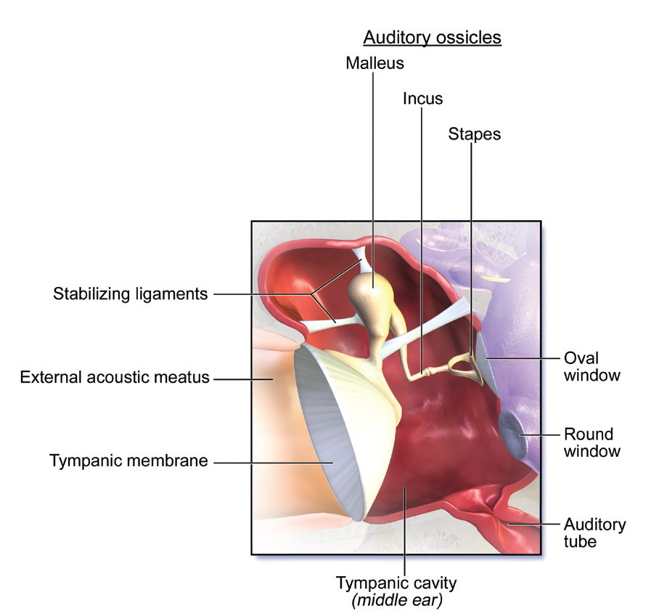
The middle ear

Slide 18
Inner Ear
The inner ear consists of the cochlea and the semicircular canals. It is located deep in the skull.
The cochlea is the coiled tube which is shaped like the shell of a snail. It is filled with a fluid and separated
by membranes. Lining one of the membranes are specialized hair cells that are sensitive to vibration.
Thecochlea contains the actual organ of hearing called organ of Corti. This organ receives the sound waves and transmits them to the brain.
The semicircular canals enable the body to maintain balance. They consist of three interconnected loop-shaped tubes at right angles to one another. Like the cochlea, these canals contain fluid and hairlike projections that detect changes in body positions.
The auditory nerve is responsible for sending the message to the brain.

Slide 19
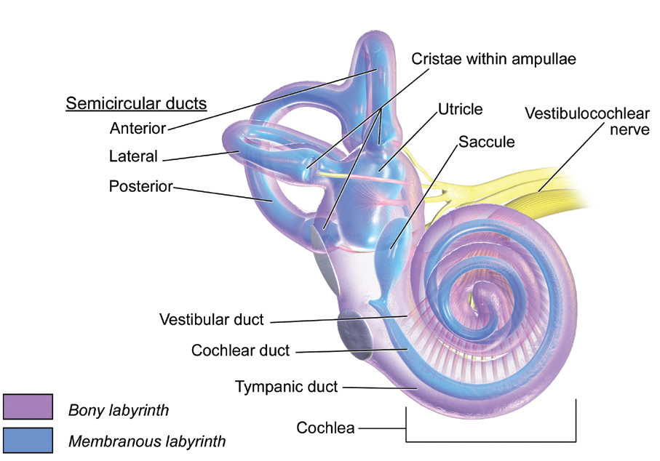
The inner ear

Slide 20
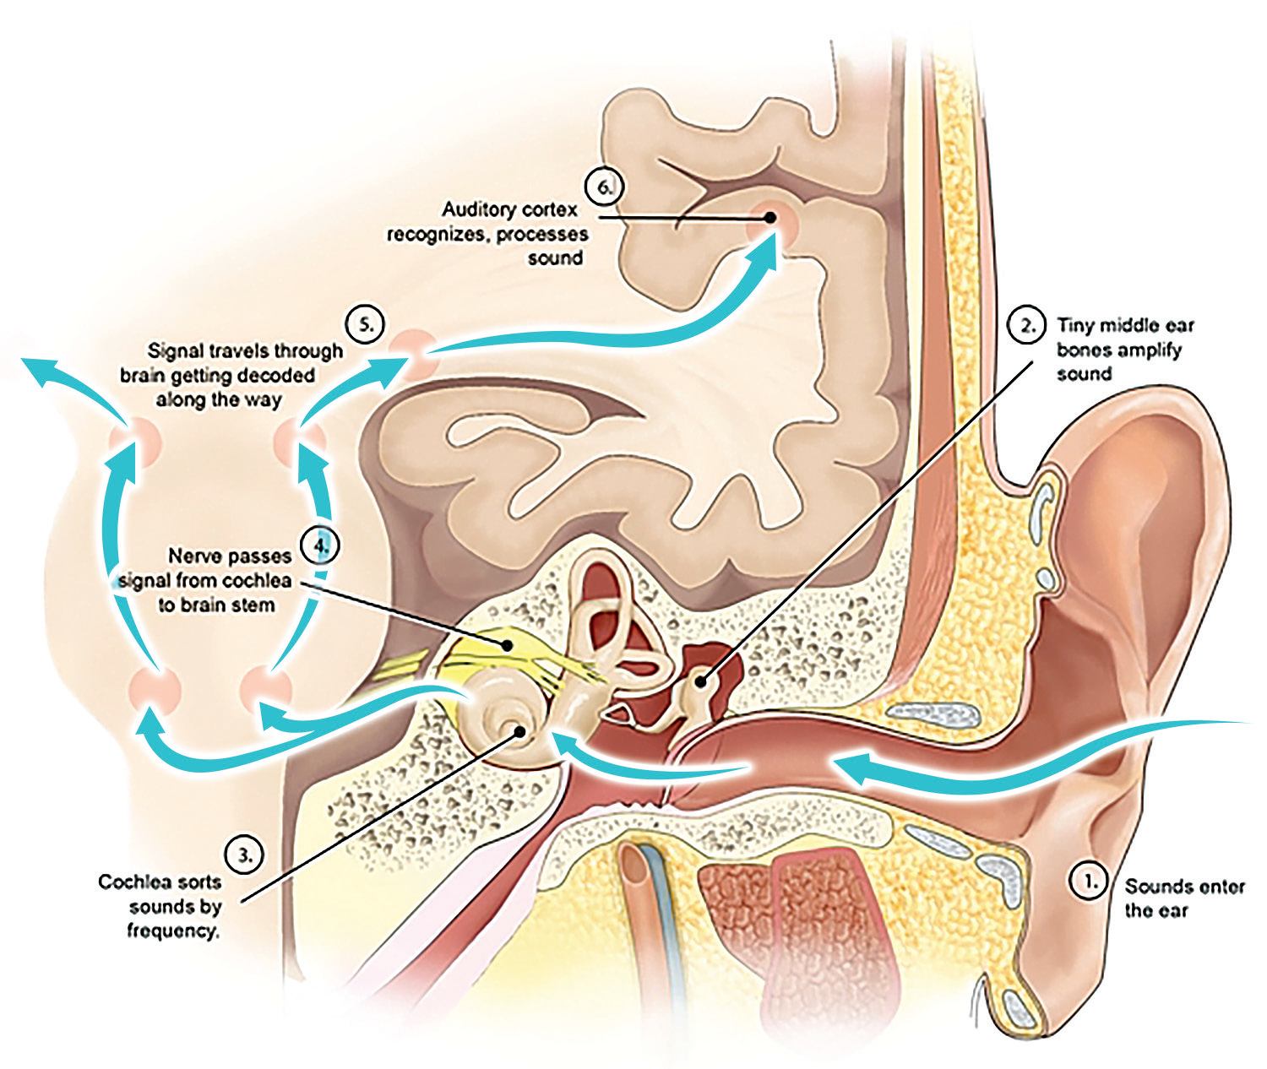
How do you hear?
The pinna collects sound waves produced by vibrating objects. Sound waves travel along the auditory canal and strike the eardrum. The vibration of the eardrum causes the three small bones to move. As they move, they set up a series of vibrations in the membranes between the middle ear and the inner ear. When these membranes vibrate, the fluid in the cochlea moves. The organ of Corti in the cochlea has sensor cells that receive the sound and send it to the brain through the auditory nerve. The brain tells you what you hear.

Slide 21
Common Ear Ailments and Defects
Your ears are delicate organs. They can easily be injured by tiny insects, dirt, and water. You should prevent foreign materials from entering your ear. The most common ailments of the ear are the following:
Ear Infection
This is an infection of the middle ear or outer ear. Symptoms include high fever, abscess, and loss of hearing. A milky discharge with unpleasant odor comes out of the ear of the person with this ailment. He or she can experience severe pain in the ear.
Ear Boil
This is an infection on the outer ear characterized by infection and swelling. The person suffers from earache. Earache is not necessarily associated with ear disease. Occasionally, it is caused by impacted teeth, ear wax, sinusitis, or prolonged exposure to loud noise.

Slide 22
Deafness
This is the result of an injury in the middle and inner ear. When the eardrum breaks, the person may become partially or totally deaf. Deafness is the loss of hearing. Most diseases of the ear that involve an inflammation, infection, or allergic condition are treated by specially trained doctors called otolaryngologist.
Proper Care for the Ears
Your ears are as important as your eyes. They help you become aware of what is happening around you, so take good care of your ears. Here are some ways of caring for your ears:
Clean your outer ear with a clean washcloth.
Do not use your fingers, hairpins, or toothpicks in removing earwax. These objects can injure your eardrum and cause loss of hearing. The earwax prevents dust and other foreign materials from entering the inner ear. Ask assistance from an adult when cleaning your middle ear.

Slide 23
Stay away from exploding firecrackers. The strong force of the air may enter your ear and press too hard on your eardrum, causing it to break.
When swimming or diving, protect the eardrums by wearing a cap or using earplugs.
When affected by ear diseases, see an otolaryngologist, a specially trained doctor for ear diseases.
Know the first-aid treatment for ear injury. If the ear is injured and the person is unconscious, lay him flat on his stomach and place a clean pad underneath the injured ear. Then, seek medical help immediately.

Slide 24
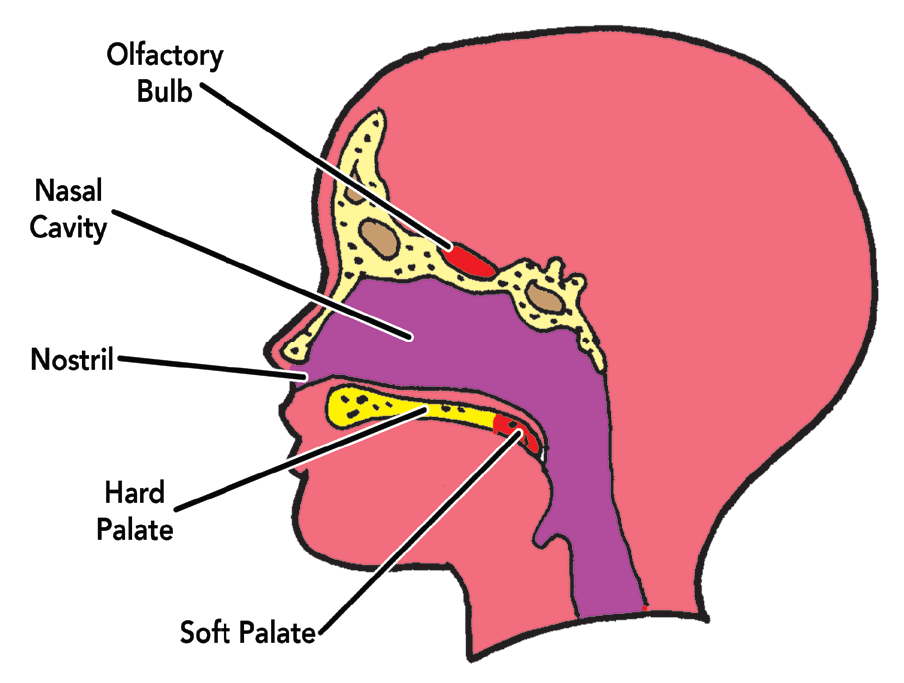
C. Sense of Smell: Nose
Your nose is your organ for smelling. Objects with a particular odor can be identified through their smell. Objects around us may have pleasant or unpleasant odor, or they could be odorless.
An odor is a chemical given off by an object. When this chemical gets into the nose, the nerves send signals to the brain which tells you what you just smelled.

Slide 25
Parts of the Nose and How Each Works
The nose is also part of the respiratory system. You inhale the air that carries the odor of an object through your nose. The nose is divided into the external and internal parts.
External Part
The external part is your nose. Your nose is made up of bone and cartilage. They give shape to your nose. Odors of objects are carried by the air to your nose. When you breathe, the odors enter the two openings of your nose called nostrils. Nostrils serve as entrance to your nasal cavities.

Slide 26
Internal Part
The interior part of the nose is divided into two major passages called nostrils. Each nostril has the respiratory region, which is used for breathing, and the olfactory region which is used for smelling.
The nasal cavities are lined with small, hair-like structures called cilia. These cavities also contain mucous membranes that secrete a sticky fluid called mucus. As you inhale, air that enters the nose is filtered by the cilia, moistened by the mucus, and warmed by the blood within the blood vessels.
The olfactory region, which is located within the mucous membrane, contains olfactory cells. These are the nerve cells sensitive to odor. Stimulation of these cells by the odor from the environment results in the sensation of smell. The odor carried by the air stimulates the nerve cells. The messages are then carried by the nerve cells to the brain where they are interpreted.

Slide 27
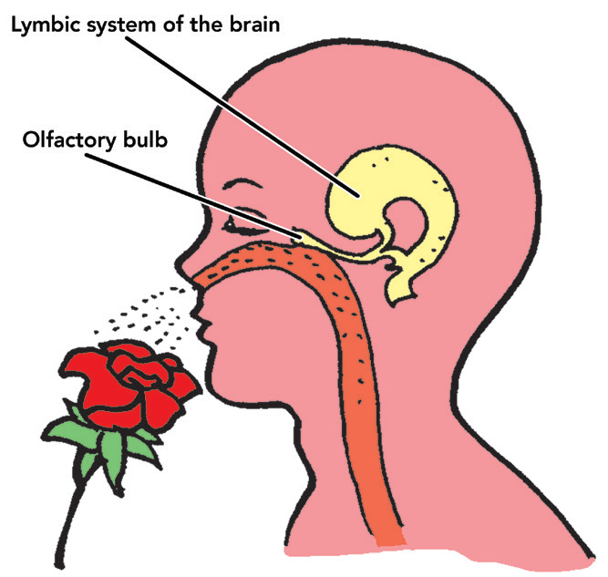
Internal parts of the nose

Slide 28
Common Nose Ailments
The most common nose ailment among children and adults is nosebleed. It is usually caused by an injury to any part inside the nose, head injury, high blood pressure, or weak blood vessels in the nose. Infections and blood disorders can also cause nosebleed.
To stop the bleeding, you should apply first aid. Have the patient sit down and lean forward with the head tilted a bit upward, so the blood does not ooze down the throat, which can possibly choke him or her. Loosen the clothing around the neck.
Let the patient gently pinch his or her nostrils with his or her thumb and forefinger for 10 minutes, then release the pressure of the pinch slowly. If bleeding continues, get him or her to repeat the pressure for another 10 minutes.
When the bleeding stops, warn the patient not to blow his or her nose. If the bleeding does not stop and an injury is suspected, get medical help immediately.

Slide 29
Proper Care for the Nose
Your nose is an important sense organ. It tells you whether things smell good or bad. It also warns you of possible dangers such as gas leaks, burning electrical wire, or the smell of smoke of something burning in the house.
You cannot smell when you have a cold because the infection inflames the mucus membrane of the nasal passages and blocks the passage of air to the center of smell.
Here are some tips on how to take care of your nose:
1. Cover your nose if you are in a dusty or stinky place.
2. Keep your nose clean. Use clean and soft cloth or handkerchief to clean it.
3. Avoid blowing your nose hard when you have colds to prevent nosebleed.
4. Avoid putting any of your fingers or any pointed object inside your nose.
5. Stay away from smoky areas.

Slide 30
D. Sense of Taste: Tongue
The tongue, aside from being an important structure in the formation of speech, is the organ of taste. The tongue aids in chewing and swallowing food.
Proper Care for the Nose
The surface of the tongue is covered with small projections called papillae. Within the papillae are the taste receptors or taste buds. Each taste bud consists of a number of sense cells that are responsible for receiving different taste sensations.
Papillae have taste buds so you can taste everything. People are born with about 10,000 taste buds. A young person like you may only have at least 5,000 taste buds. This is the reason why some food may taste stronger for you than an adult. Taste buds can distinguish the basic types of tastes: sweet, salty, bitt er, and sour. Only recently, a Japanese scientist discovered the fifth basic taste which is umami. Umami means pleasant and savory taste (examples are cheese and steak).

Slide 31
The food that you put into your mouth mixes with your saliva. The saliva wets and dissolves the food particles. The taste receptors react to the chemicals in the food. The taste receptors receive the message and send it to your brain. Then, the brain tells you what the taste is.
The sense of taste and the sense of smell are closely associated with each other. You probably experienced having difficulty tasting food when you had colds. The close association between the two senses is due to the location of the nose and the tongue. They are situated very near each other.
It is hard to taste food when you have a cold. This is because the sensation of taste is related with the sensation of smell. If the nose is blocked, you cannot easily detect the taste of food very well. Your nose is congested so your sense of smell is affected and so is your sense of taste.

Slide 32
Common Tongue Ailments
Cracks
These are splits or tears which can become inflamed and painful, resulting in ulcers of the tongue. These can be caused by biting your tongue. These can be treated by using oral anti septic.
White Mouth or Oral Thrush
Oral thrush is known as yeast infection in the mouth and tongue. This infection results in white patches on the tongue that look like cottage cheese. This white spot could spread to parts such as the gums, palate, throat, and other parts. Oral thrush is common among infants and elderly, especially those who wear dentures.
Stomatitis (singaw)
This is caused by wearing faulty braces, biting the tongue, or an infection. Using an oral antiseptic can treat it.

Slide 33
Sore Tongue
Sore tongue is characterized by inflamed and irritated taste buds that cause tiny bumps to form along your tongue. This can be painful. Tongue soreness may be a symptom of anemia, diabetes, and other health conditions. This can also be treated by oral antiseptic.
Proper Care for the Tongue
The tongue helps you enjoy the food you eat. It also helps you chew and swallow food. Like your other sense organs, it is also important to take care of your tongue.
Children younger than five have more taste buds than adults. They seem to be more sensitive to strong tastes and more inclined to like sweets.
1. When you brush your teeth, gently brush your tongue.
2. Avoid eating very hot or even very cold food. It harms your taste buds.
3. Eat a balanced diet.
4. Use your own toothbrush. Do not borrow or lend your toothbrush.

Slide 34
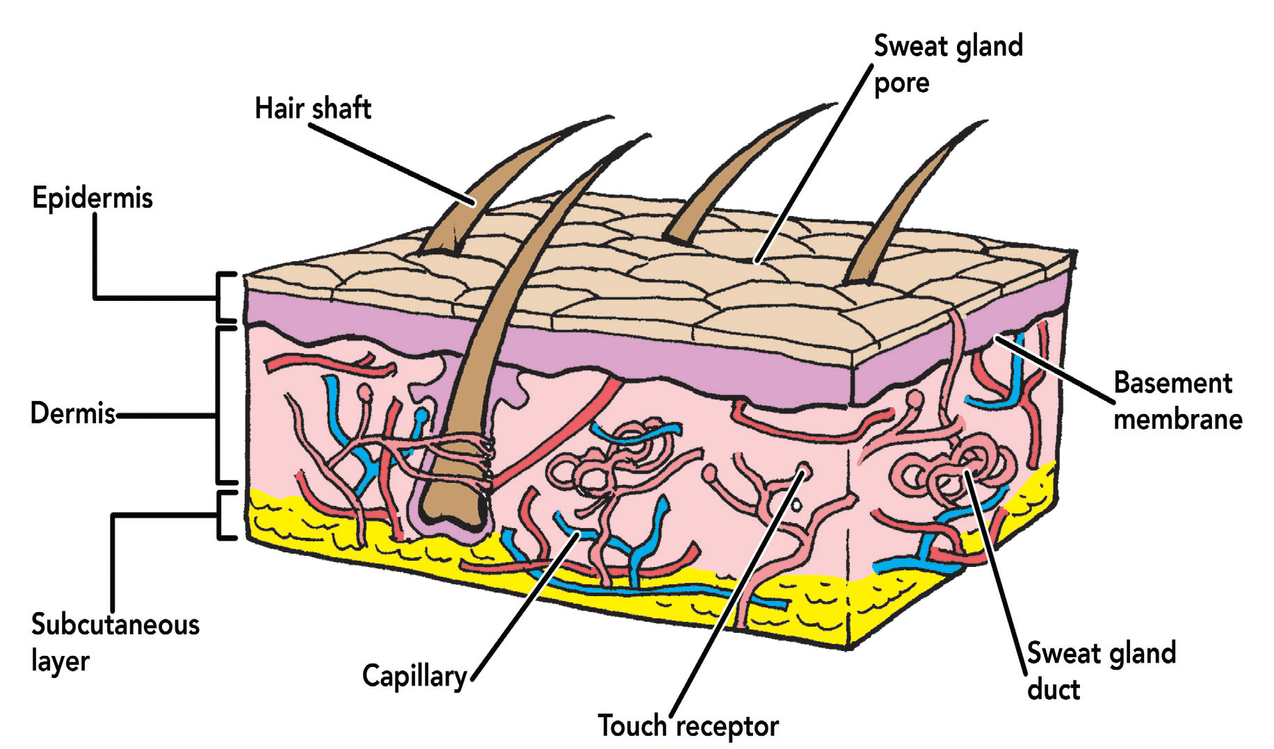
E. Sense of Touch: Skin
The skin can feel the heat and cold. It can feel pressure and pain, too. The nerve tissues in the skin allow you to feel these sensations.
Parts of the Skin and How Each Works
On some parts of your body, the skin is very thin. On other parts of your body, the skin is somewhat thick.

Slide 35
Outer Layer
The outer layer is the epidermis. The cells in this layer are tough and ﬂat. The top part of this layer is made up of dead cells. These cells fall off as they dry up and get ﬂaky. Living cells from the innermost part of the epidermis replace them. Your ﬁngernails and toenails are thickened and hardened epidermis. Since they are dead cells, you feel no pain when you cut the upper grown layer.
Inner Layer
The inner layer of the skin is called the dermis. The dermis is made up of living cells. It has blood vessels, oil glands, and sweat glands. The blood vessels help nourish your skin. The oil glands produce oil to make your skin shiny and keep it from drying. The sweat glands produce sweat or perspiration to keep your body cool. Sweat comes out through the pores of the skin. Sweating helps regulate your body temperature.
There are also fatty tissues in the dermis. Fatty tissues provide your body with heat and protect your internal organs.

Slide 36
Your skin has many nerve endings or receptors located in the dermis. These nerve endings pick up ﬁve skin sensations. These are the sensations of cold, heat, touch, pain, and pressure. These nerves carry messages to the brain. Then, the brain tells how the object feels.
Some parts of your skin are more sensitive than the other parts.
You can feel with any part of your skin at all times except when a certain part of your body is numb. In which case, you will not feel anything on that part of your body. However, not all parts of your body are equally sensitive to pressure, temperature, and pain. Example, the nerves in your ﬁngers are very close to each other. That is why your ﬁngers are good feelers. The nerves in other parts of the body are not equally spread. This is the reason why they are not so sensitive.

Slide 37
Work of the Skin
The skin provides a covering for your body.
Your skin protects the organs inside your body from cuts, bruises, and infection from microorganisms. It keeps water from entering your body, but the skin also prevents the ﬂuids inside your body from drying up. These ﬂuids are important, and your body cannot work without them.
The skin helps the body get rid of waste materials.
Perspiration or sweat is made up of water that has salt and nitrogenous wastes. People who perspire a lot should put back the minerals lost through perspiration by drinking plenty of liquid or water.

Slide 38
The skin changes color to prevent sun damage.
The skin contains a pigment called melanin, which gives color to the skin. Melanin darkens when exposed to sunlight to protect you from sunburn. Some people have less melanin than others and have to be more careful about the harmful effects of the sun.
The skin can feel changes in the environment.
There are many nerve endings all over the skin. They receive messages from outside the body. They let you “feel” or be aware of the presence of something. These nerve endings make you conscious about it.

Slide 39
The skin can feel changes in the environment.
Your skin is the outermost covering of your body. It can easily be infected by germs. Some common skin ailments are:
Scabies (galis)
This is caused by tiny parasitic mites living in the skin. The mites burrow under the skin and cause intense itching and inﬂammation. Infection occurs when you scratch your skin with dirty ﬁngers. Keep your skin always clean. Apply cream or ointment for scabies on the infected area.
Ringworm (buni) and Athlete’s Foot (alipunga)
These are caused by fungal infections. These infections are accompanied by itching, burning and stinging sensations, and releasing of fluids. Treatment generally involves the application of antifungal ointment or cream. Prevention involves keeping the skin always dry and clean.

Slide 40
Tinea flava (an-an)
This is a skin infection caused by another kind of fungus. A person with this skin problem has white spots on the infected area of the skin. Visit a dermatologist for checkup and treatment.
Boil (pigsa)
This is caused by bacterial infection. A boil is a reddish lump or swelling filled with pus (pus-ﬁlled cavity in the body around which redness and swelling usually occur). The swollen part of the skin is painful. But once the pus is removed, the pain is gone. Do not touch the swollen part with dirty hands to avoid further infection.
Acne
It is a disease of the oil glands of the skin. This is the most common skin problem of adolescents. It usually begins at puberty when the oil glands enlarge and become more active. During puberty, the oil glands secrete too much oil. This clogs the pores of the skin and makes the germs multiply faster. It is important to visit your dermatologist when acne starts to appear on your face.

Slide 41
Proper Care for the Skin
Because your skin is the covering that protects your body, it is one of your most valuable organs. You should give it the good care it needs.
Take a bath every day. Use gentle soap and water to remove the dust, dirt, and sweat from your body.
Sometimes, the oil glands make and give off more oil than what is needed by the skin. This extra oil, if left on the skin, blocks pores and causes acne or pimples to form. Washing helps prevent acne by removing the extra oil. Washing also removes perspiration which causes unpleasant odors if left on the skin.
Limiting your exposure to the sun’s ultraviolet rays is another way of protecting your skin. Too much exposure to ultraviolet rays can burn the skin. Too much sunburn is very painful. It makes your skin red and sore. It can even make you sick.
Eat food rich in vitamins A and B such as fruits and vegetables. They help keep your skin healthy.
Consult a doctor when you have skin problems.

