Slide 1
Sense Organs That Work Together

Slide 2

Look at the picture. The girl is reading aloud. Which sense organs work together as she reads aloud?
Her eyes help her see what she is reading. She uses her ears to know if her voice is loud enough to be heard by others. Her eyes, ears, and tongue work together when she reads aloud.

Slide 3
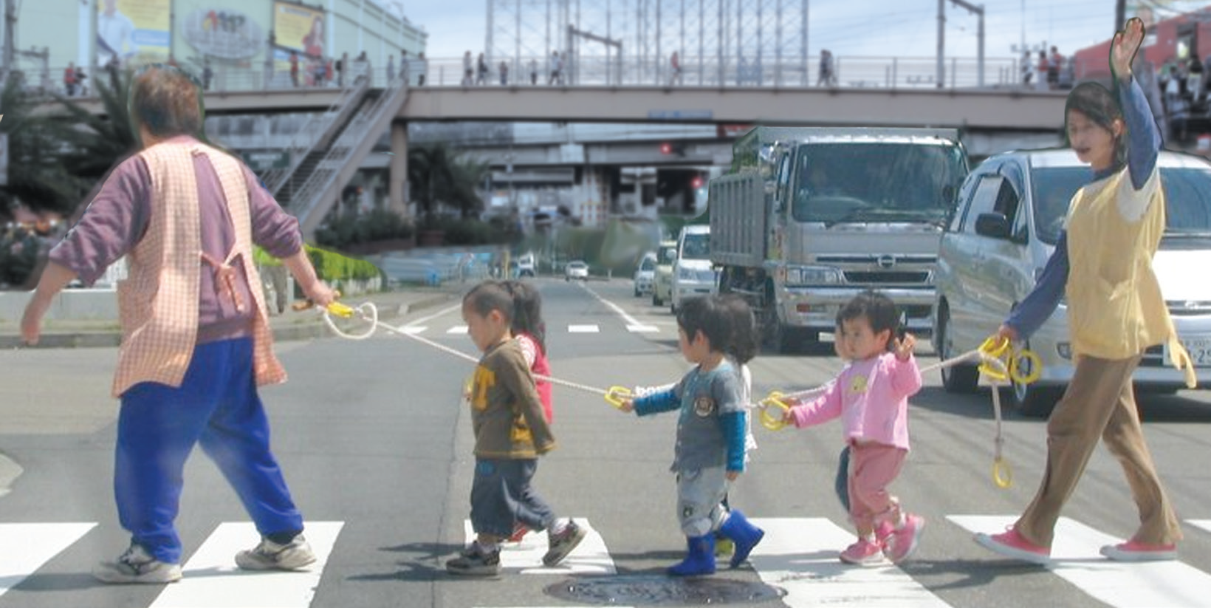
Can sense organs that work together help keep a child safe from harm? Look at the picture.
The children are about to cross the street. Many trucks, buses, and cars are on the road. The children can see the vehicles. They can hear the sounds of the engines and the blowing of the horns.
The children’s eyes and ears help keep them safe. Their legs keep them safe, too. How?
The eyes, ears, and legs work together to help keep you safe. Your senses work together every time you do something.

Slide 4
Importance of Your Senses
Your senses are very important.
Your sense of sight makes you see high or low places, as well as deep or shallow places.
Your sense of taste tells you if your food is good or bad.
Your sense of smell helps you detect that something is burning.
Your sense of hearing lets you hear the sound of a coming car or the barking of an angry dog so you can avoid them.
Your sense of touch allows you to feel pain, temperature, and pressure.
You see, hear, feel, taste, and smell with your brain.
Your brain knows what is going on around you by the means of your sense organs. You should take good care of your brain.

Slide 5
First-aid Treatment to Common Accidents Involving the Sense Organs
Children are sometimes careless when doing an activity or when playing. They get wounded or worst, they break a leg or an arm when they fall. When you do an activity, you should be careful. Do you know what to do when someone is hurt?
There are simple ways that can be done to lessen the pain or perhaps to prevent serious harm. The following are some of the first-aid treatments that everyone should be aware of:
Wash simple cuts and scratches with clean water. They must be dried with clean gauze and must be applied with prescribed antiseptics. For more serious wounds, cover them with gauze and bandage, then take the injured to the doctor immediately.
To lessen the pain and swelling of an ordinary bruise or sprain, immediately put something cold on the affected area. You may use a cloth with ice cubes.
For slight burn without blister, an ordinary baking soda and water may be applied. Then, loosely cover the burned skin by a bandage. If there is blistering, do not apply soda because it may cause more harm.

Slide 6
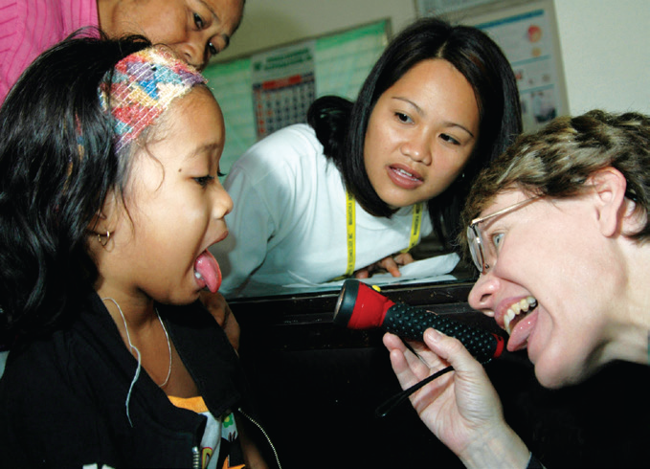
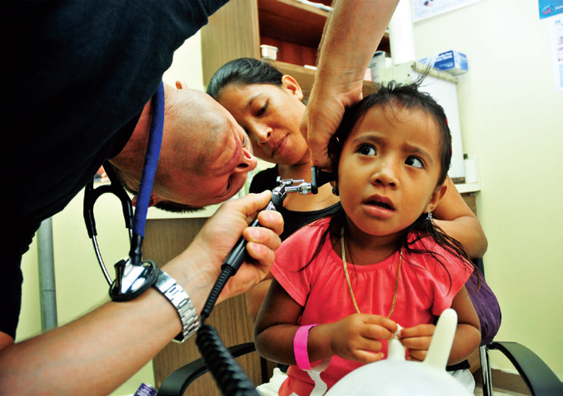
Health Workers/Medical Specialists for Sense Organs
Here are the health workers or medical specialists who help us in taking care of our sense organs:
A pediatrician is an expert in the developmental stage of children and medical treatment of childhood diseases.
An Ear, Nose, and Throat (ENT) doctor treats diseases of the ears, nose, larynx, and throat

Slide 7
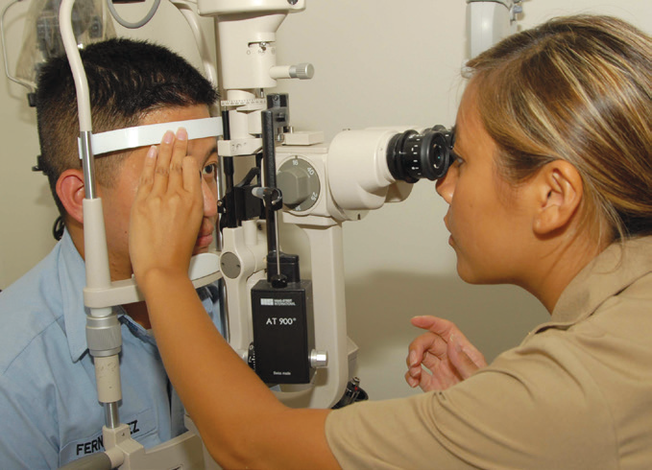
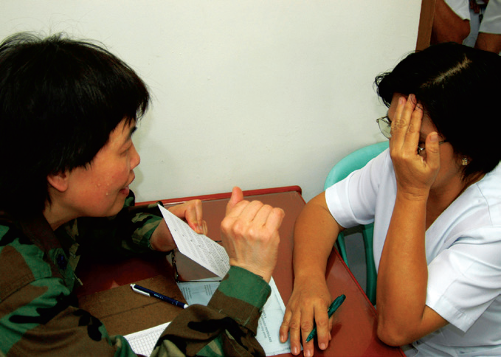
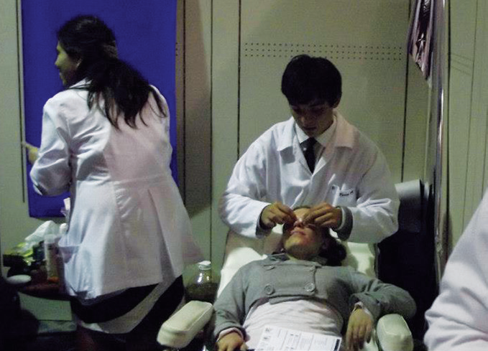
An ophthalmologist is a medical doctor who treats the eyes. He/she is trained to provide complete care for the eyes.
An optometrist is a health care professional who is licensed to examine and diagnose visual conditions and prescribe glasses and contact lenses.
5. A dermatologist is a medical doctor who treats skin diseases.

