Slide 1
Similarities and Differences of People

Slide 2
Similarities and Differences of People
As children like you grow, physical changes occur. For example, you become taller and bigger. As your body changes in size, your strength, ability, and interests also change. You would also notice that as you grow, you see similarities and differences among your classmates. You see new people and new environment in your community. You start to learn to adjust to different situations.

Slide 3
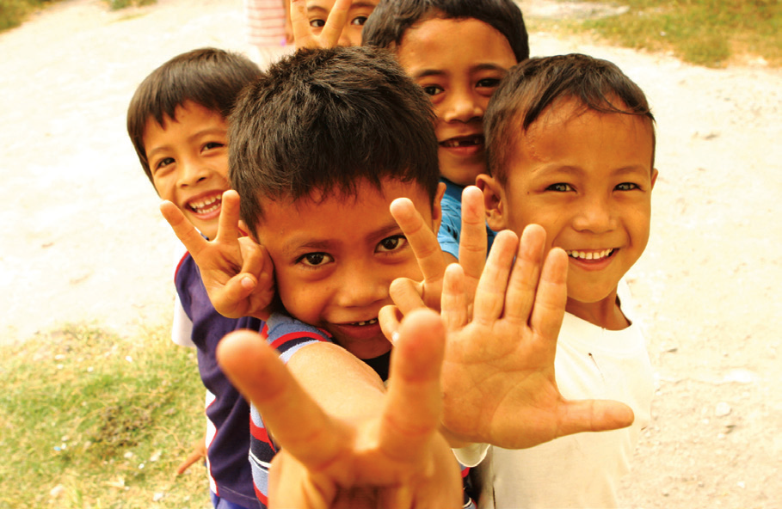
Observing Similarities and Differences
Is there anybody among your classmates who is exactly like you? No one in your classmates is exactly like you. No one thinks, feels, and acts exactly like you do. No one looks exactly like you, either. You are different from other children.
No two children are exactly the same. Even twins can have differences between each other. You should learn to accept your differences and similarities with others. You should also learn to be friendly with others, especially if your classmates are new in your school. You should also learn to behave properly in different situations.
Playing with new friends

Slide 4
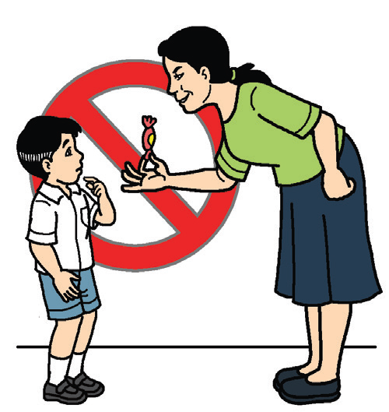
Appropriate and Inappropriate Behavior
Read the short story below:
Marie is a Grade 2 pupil. She usually walks home from school with her yaya. One day, a stranger asks her to eat in the canteen across the school. He is holding a big lollipop for her. What do you think should Marie do?
For young children like you, what appropriate behavior should you do in a strange and unfamiliar situation like this? Always remember to avoid talking to strangers or to people you do not know. Do not allow anyone to touch you or hurt you. You should protect yourself against unwanted behavior of other people. Report immediately to your parents, teachers, or proper authorities any unwanted behavior done against you or your classmates.
Appropriate behavior

Slide 5
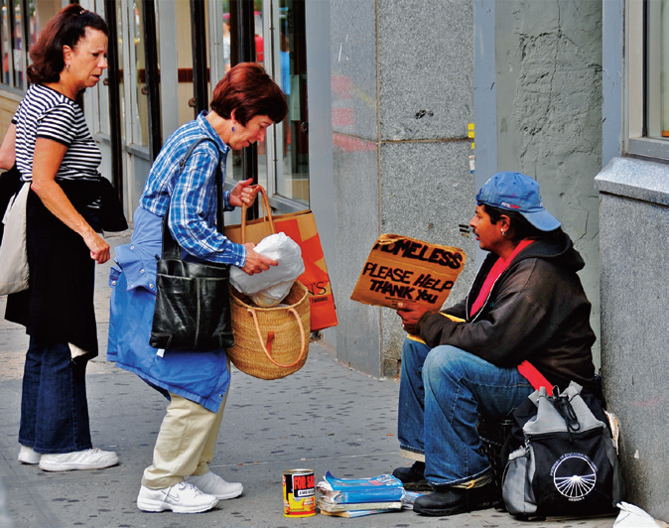
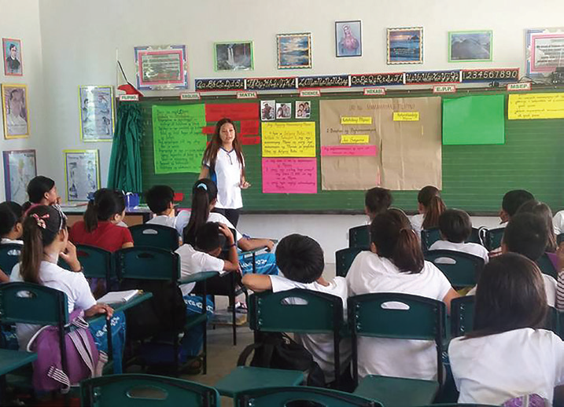
Appropriate and Inappropriate Behavior
One should also avoid situations like bullying. Bullying is unwanted or aggressive behavior among school children. You should avoid fighting with any of your classmates. You should listen attentively to your teacher while he or she is teaching a lesson.
Appropriate behavior

Slide 6
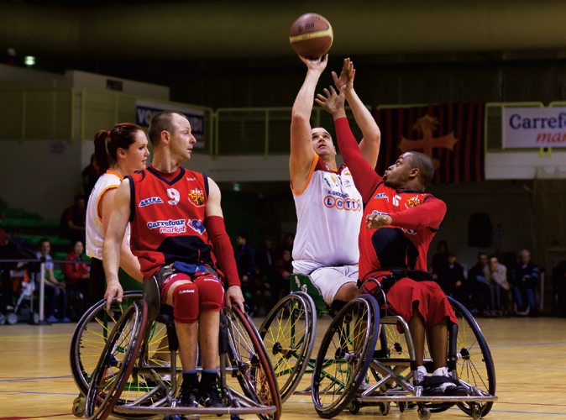
Care and Concern for the Differently Abled
Do you know someone who is differently abled? A differently abled child is someone who partially or totally cannot see, hear, or talk or someone who has no arms or legs.
Differently abled children may not look normal physically, but they can do many things like normal people do. Being differently abled is not a reason for people to stop trying to achieve their goals. We should help these people and be an instrument for them to be successful.
Only a part or some parts of their body are impaired, but other parts can be trained to make up for the part which they cannot use.
Differently abled athletes

Slide 7
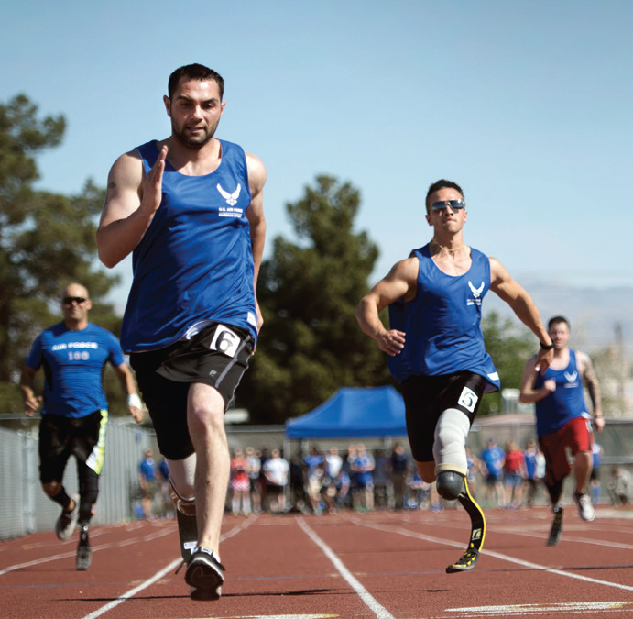
Care and Concern for the Differently Abled
Differently abled children who have only one arm can learn to use the other arm very well. They can make their one arm do the work of two arms.
At present, there are government programs which help them get jobs that will improve their lives. There are also some vocational schools that can give them training and skills for livelihood projects.
The talents of differently abled pupils are also recognized in different contests such as painting and singing contests.
Let us show proper attitude toward them. Let us make them feel that they are still part of the community. In this way, they will feel accepted and loved. They will feel that they are not different from other people. As such, they will do their best to show that they can also do what others can do.
0
Differently abled athletes

