Slide 1
Body Parts That Help Animals

Slide 2
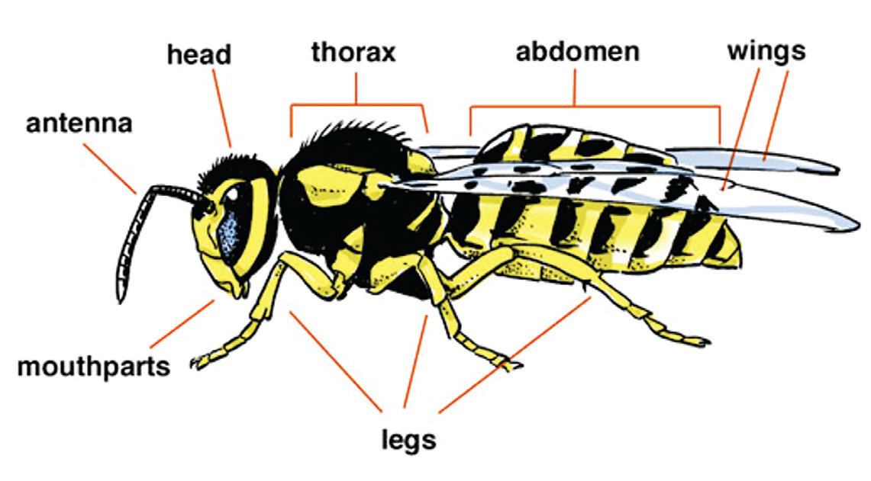
Body Parts That Help Animals
Insect
An insect like this bee has three main parts: the head, thorax, and abdomen. The head carries the eyes and the antennae. The antennae are used for feeling, hearing, smelling, and tasting. The three pairs of legs grow out from underneath the thorax. Most insects have either one or two pairs of wings on top of the thorax. Others lack wings.
All insects have three pairs of jointed legs. The insect’s abdomen contains organs like the stomach, intestine, and tubes for laying eggs.

Slide 3
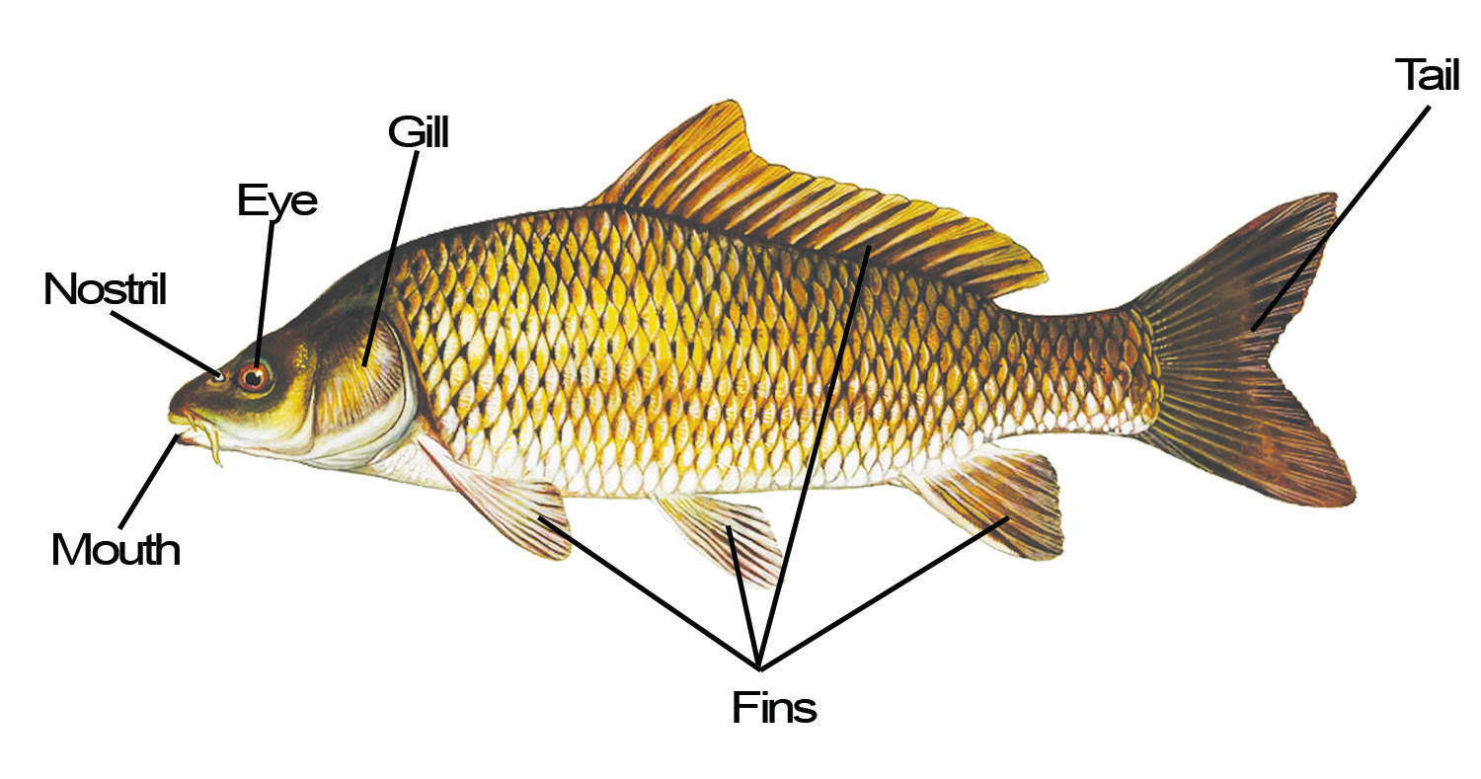
Fish
The living thing shown in illustration. The body of a fish is divided into the head and abdomen. A fish has tail and fins. The fins help the fish move forward in a straight line, turn left and right, and go up and down.
The fish is covered with scales or slippery skin for protection. It takes in water through its mouth and then pushes the water out through the slits located behind its head. Inside the slits are gills that look like red brushes. Gills take in oxygen from the water so that the fish can live. Some fish have small mouths while others have large mouths.

Slide 4
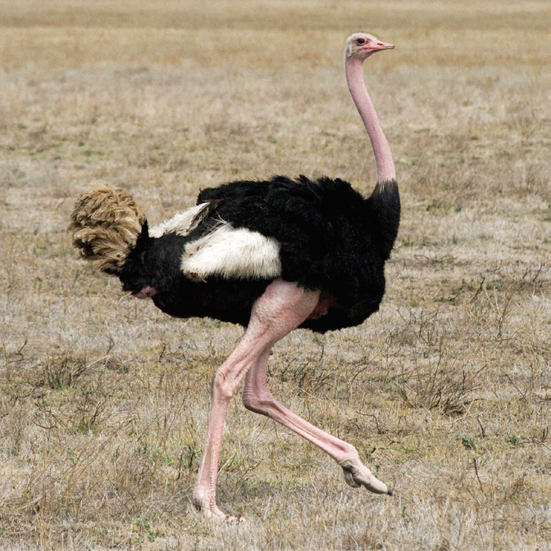
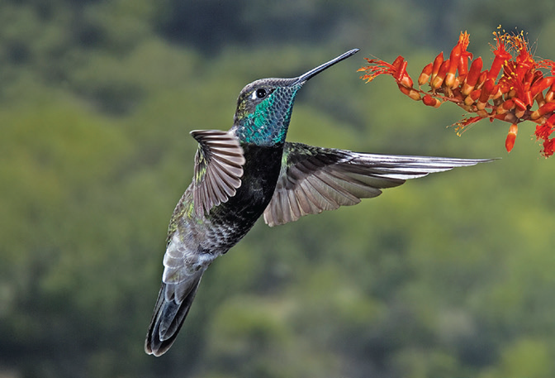
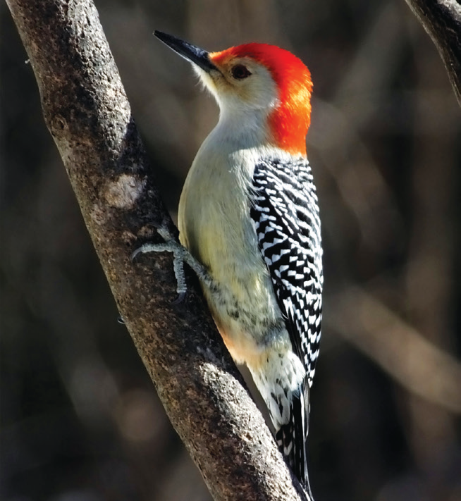
Bird
Birds are covered with feathers. Their bodies are held upright by two legs. All birds have wings, although some birds cannot fly.
An ostrich cannot fly but it can run very fast. A hummingbird can fly in all directions—backward, forward, sideways, up, and down.
Birds have beaks and claws. Birds that feed on insects have pointed beaks. Some birds have hooked beaks to rip the fish that they nibble in small pieces. Birds’ claws also help them get their food.

Slide 5
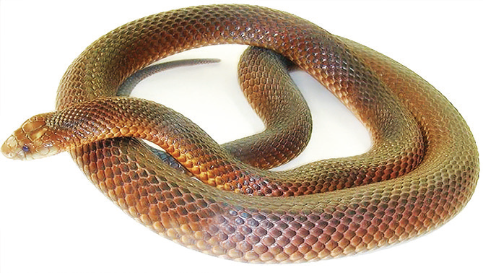
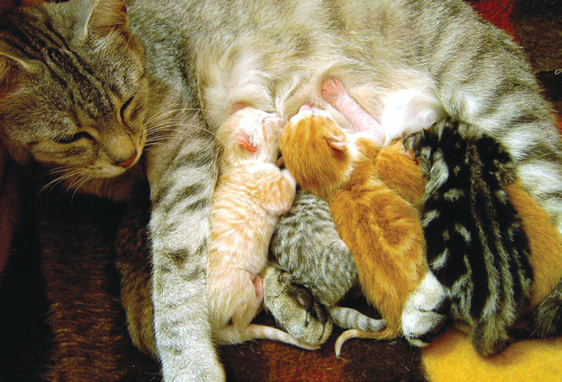
Snake
The body of a snake has two parts: a head and a long muscular trunk. The body is covered with scaly skin. A snake does not have feet. It moves by slithering. It does not chew its food but swallows it whole. Its body is stretchable. It uses its tongue to smell. It has a good sense of smell and uses it to find food.
Cat
Cats belong to the higher form of animals called mammals. The body of most mammals are covered with hair or fur. They have muscular bodies and have lungs that help them breathe. Most mammals have two pairs of legs for walking and running.

Slide 6
Young mammals are fed by their mother with the milk secreted from their breasts. Animals have different body parts. Each body part has its own use or function. Animals use some parts of their body for:
• moving around
• getting food
• breathing
• caring for their young
• protecting themselves

Slide 7
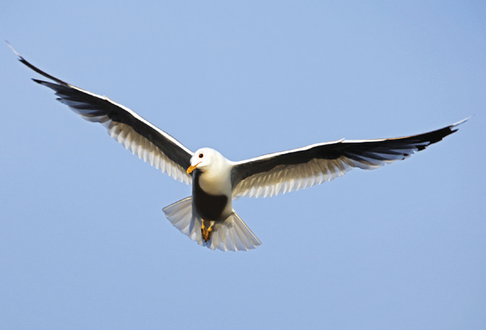
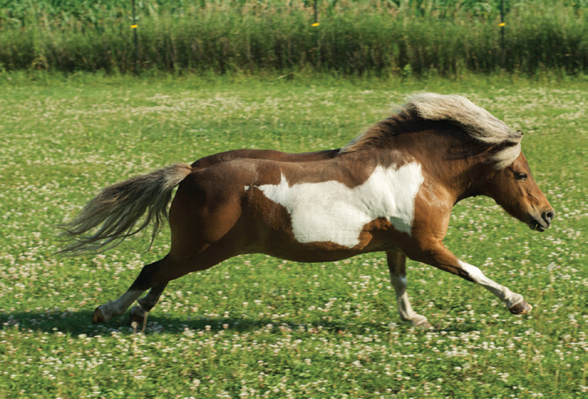
Body Parts Used by Animals for Moving
Animals move in many ways. They are equipped with body parts that enable them to move from one place to another. Animals move to look for food and to escape from their enemies.
Animals that have legs can walk, gallop, run, jump, and hop.
Examples of these animals are cats, dogs, horses, kangaroos, and rabbits.
Animals with long legs and strong feet can walk, jump, and run very fast. Horses, deer, and ostriches are examples of these animals.

Slide 8
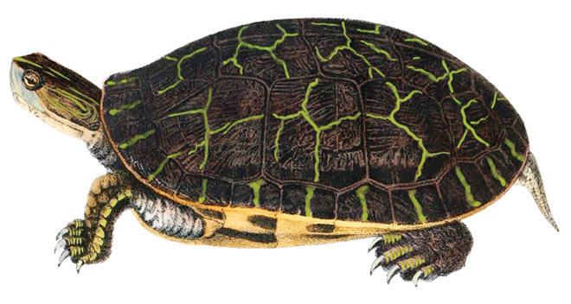
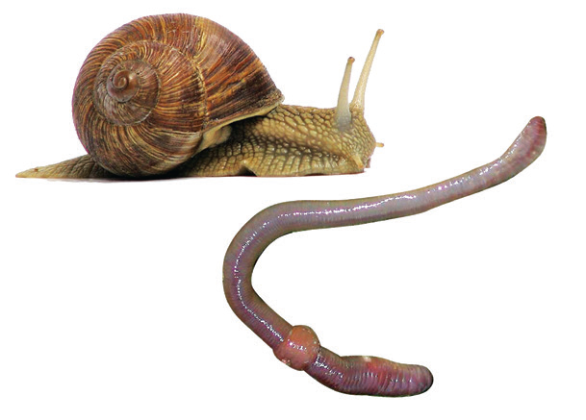
Some animals that have shorter legs cannot run fast. They walk slowly. Examples of these animals are turtles, crabs, and crocodiles.
Animals without legs crawl, slide, or slither using their muscular bodies. Examples of these animals are snakes, worms, and snails.

Slide 9
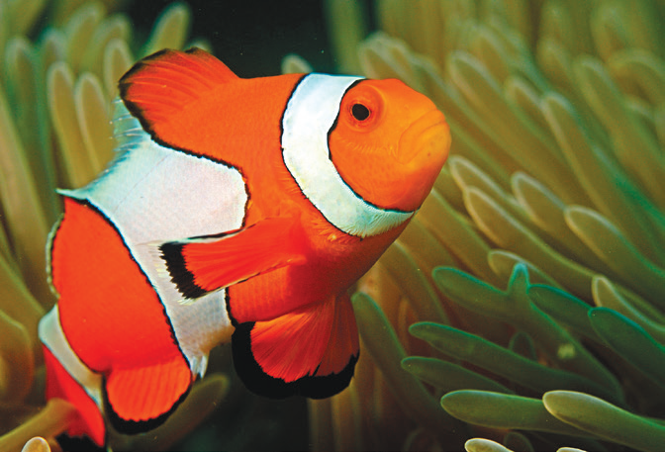
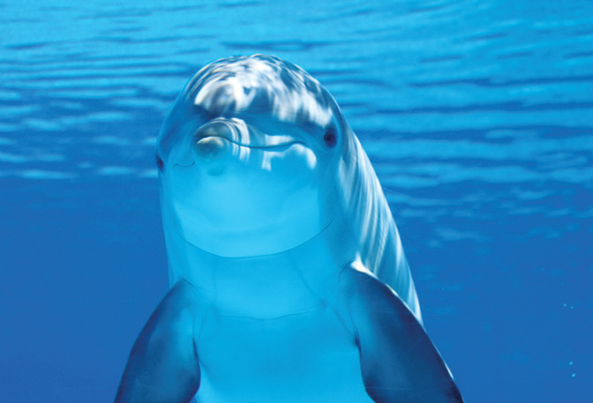
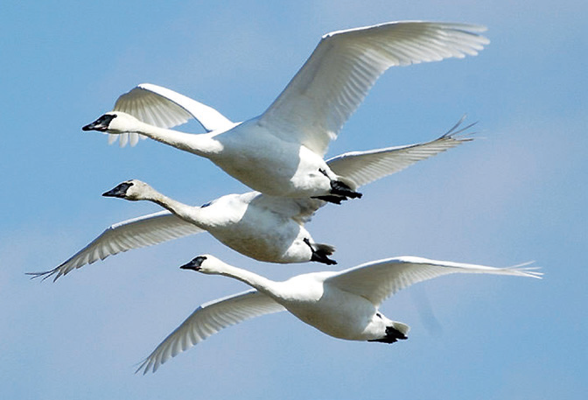
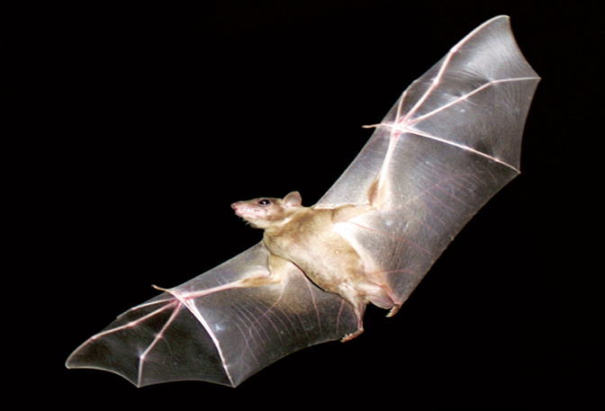
Animals that live in water have fins and tails for swimming. They have muscles on their backs that pull their tail so that it bends to the left and right. This pushes them through the water. Examples of these animals are dolphins and fish.
Birds, bats, and most insects have wings and feet. They fly using their wings and walk using their legs.

Slide 10
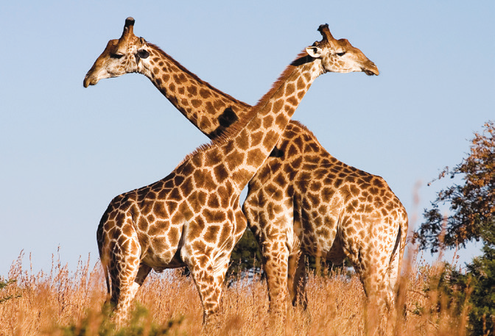
Body Parts Used by Animals for Getting Food
Animals use some of their body parts in getting their food. Getting food is very important for animals because it is their way to acquire energy for them to live.
Giraffes have flat and smooth set of teeth that they use to eat leaves and stems.
Squirrels grasp nuts with their front paws and crack the nuts open with their teeth.

Slide 11
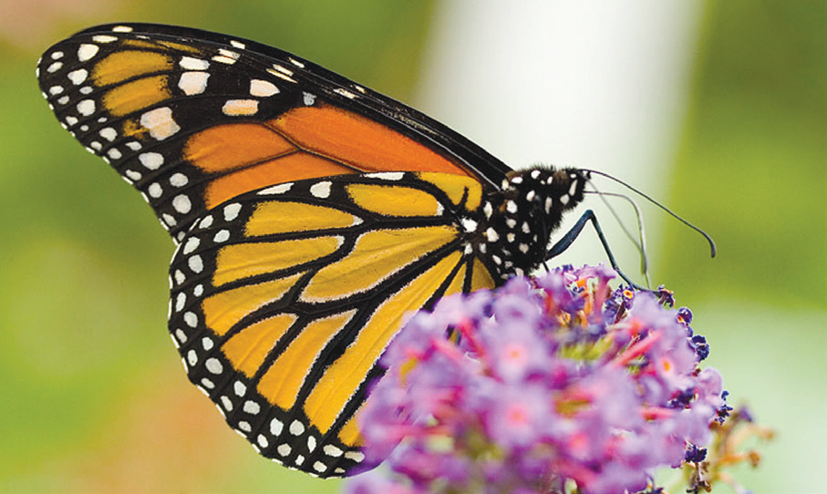
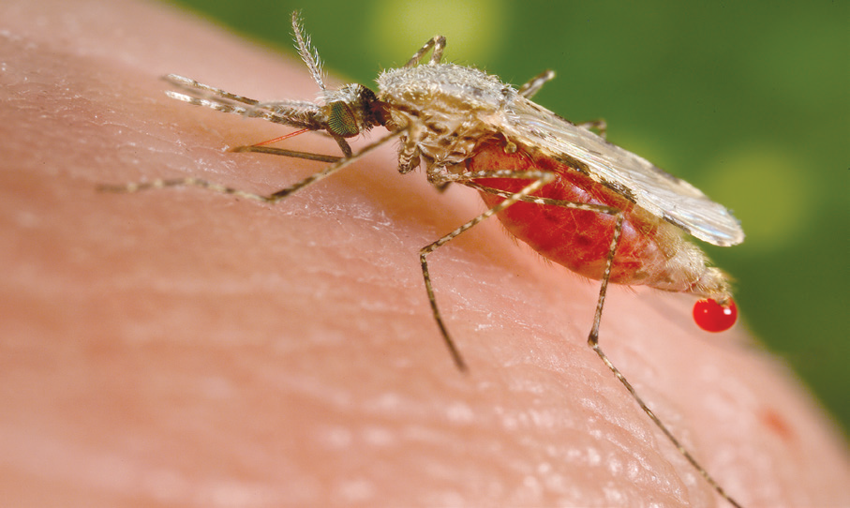
Birds use their beaks to pick up grains. Birds like hawks and eagles have hooked beaks and claws that help them catch fish and other small animals, then tear them up into small pieces to eat.
The long and sharp teeth of dogs and cats tear food to small pieces. The big and flat teeth of horses and carabaos cut and chew grass. Ants, flies, and bees have mouth parts which are good for biting.
A butterfly has a long sucking tube that sips nectar from flowers. This tube is called a proboscis. The mosquito also has a proboscis, which it uses in sipping fluid from leaves, soft stems, and fruits. The proboscis coils up when not in use.

Slide 12
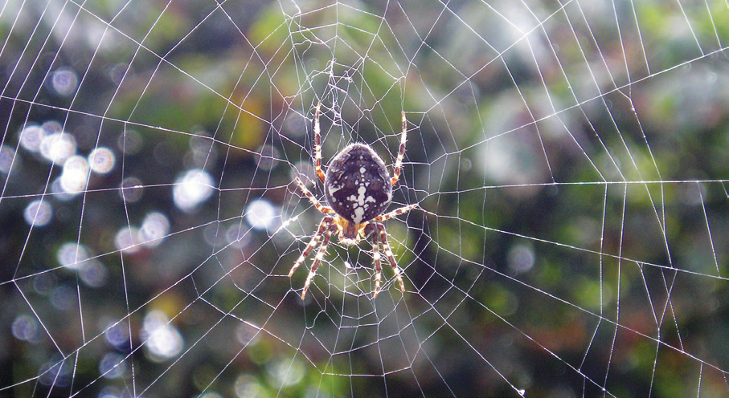
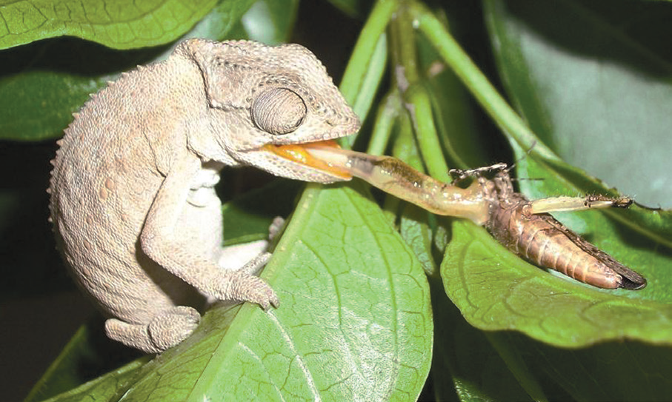
Many spiders spin webs to catch insects flying in the air. Some spiders do not spin webs. They just stay in a certain place. When an insect comes close to the spider, the spider bites it with its poisonous fangs.
A kind of lizard called chameleon can change its color to match its surroundings. This is called camouflage. This makes the lizard difficult to find. The chameleon flicks out its long tongue to catch insects and eat.

Slide 13
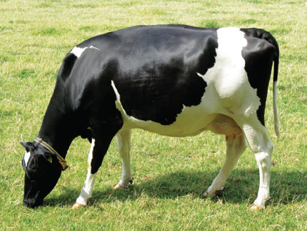
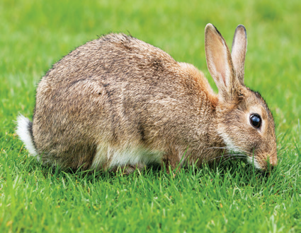
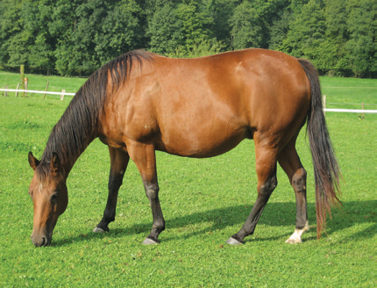
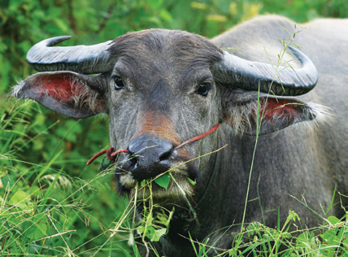
Food That Animals Eat
There are animals that eat plants. Carabaos, cows, horses, and giraffes eat grass and leaves. Rabbits eat grass, leaves, carrots, and beans. Bees and butterflies sip nectar from flowers for their food. Animals that eat only plants are called herbivores.

Slide 14
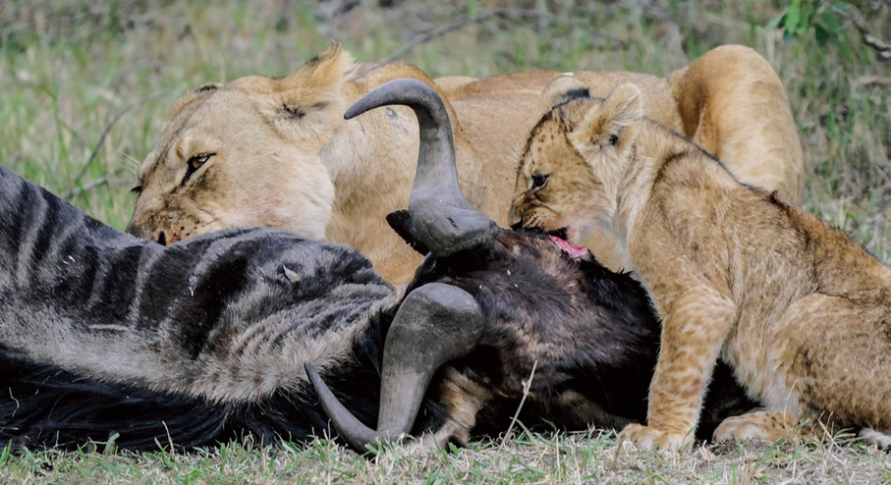
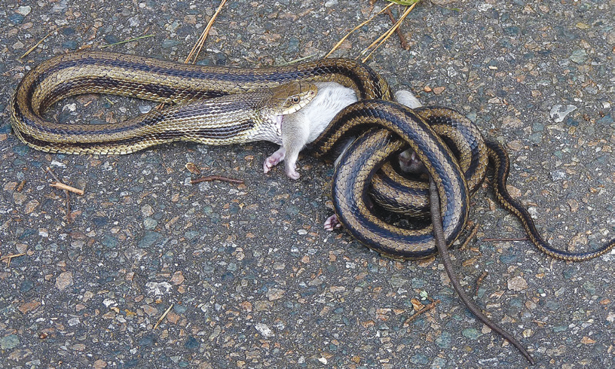
There are animals that eat the meat or flesh of other animals. These animals are called carnivores. Birds like eagles, hawks, and owls that eat insects are examples of carnivores. Spiders and frogs are carnivores, too.
However, most carnivores directly kill and eat other animals. These animals are called predators.
Lions, tigers, and snakes are examples of predators. The animal that is killed and eaten by a predator is called a prey.

Slide 15
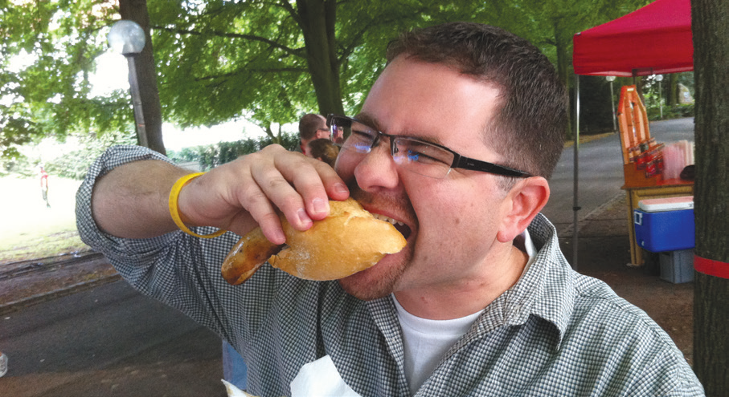
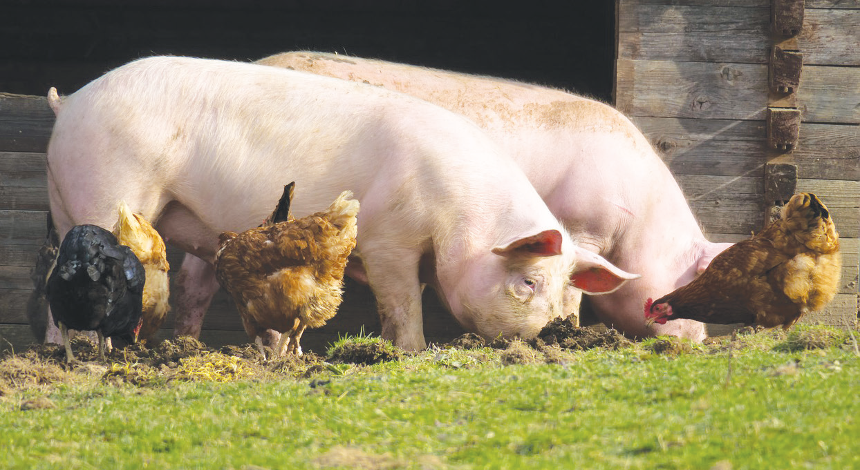
There are animals that eat both plants and animals. These animals are called omnivores. You eat plants when you eat fruits, vegetables, rice, and corn. You eat eggs, meat, milk, and cheese which come from animals. This means that you are an omnivore.

Slide 16
Body Parts That Help Animals Survive in Their Habitats
Animals need homes that will protect them from rain, storm, too much heat, and from their predators. Predators are animals that kill and eat other animals. To protect themselves, some animals build their own homes, while others do not.
Animals are found in different places like in the soil, garden or lawn, trees, ponds, rivers, and oceans. Some animals are found inside the caves and in burrows.
Animals live in different places. The place where animals live is called a habitat.

Slide 17
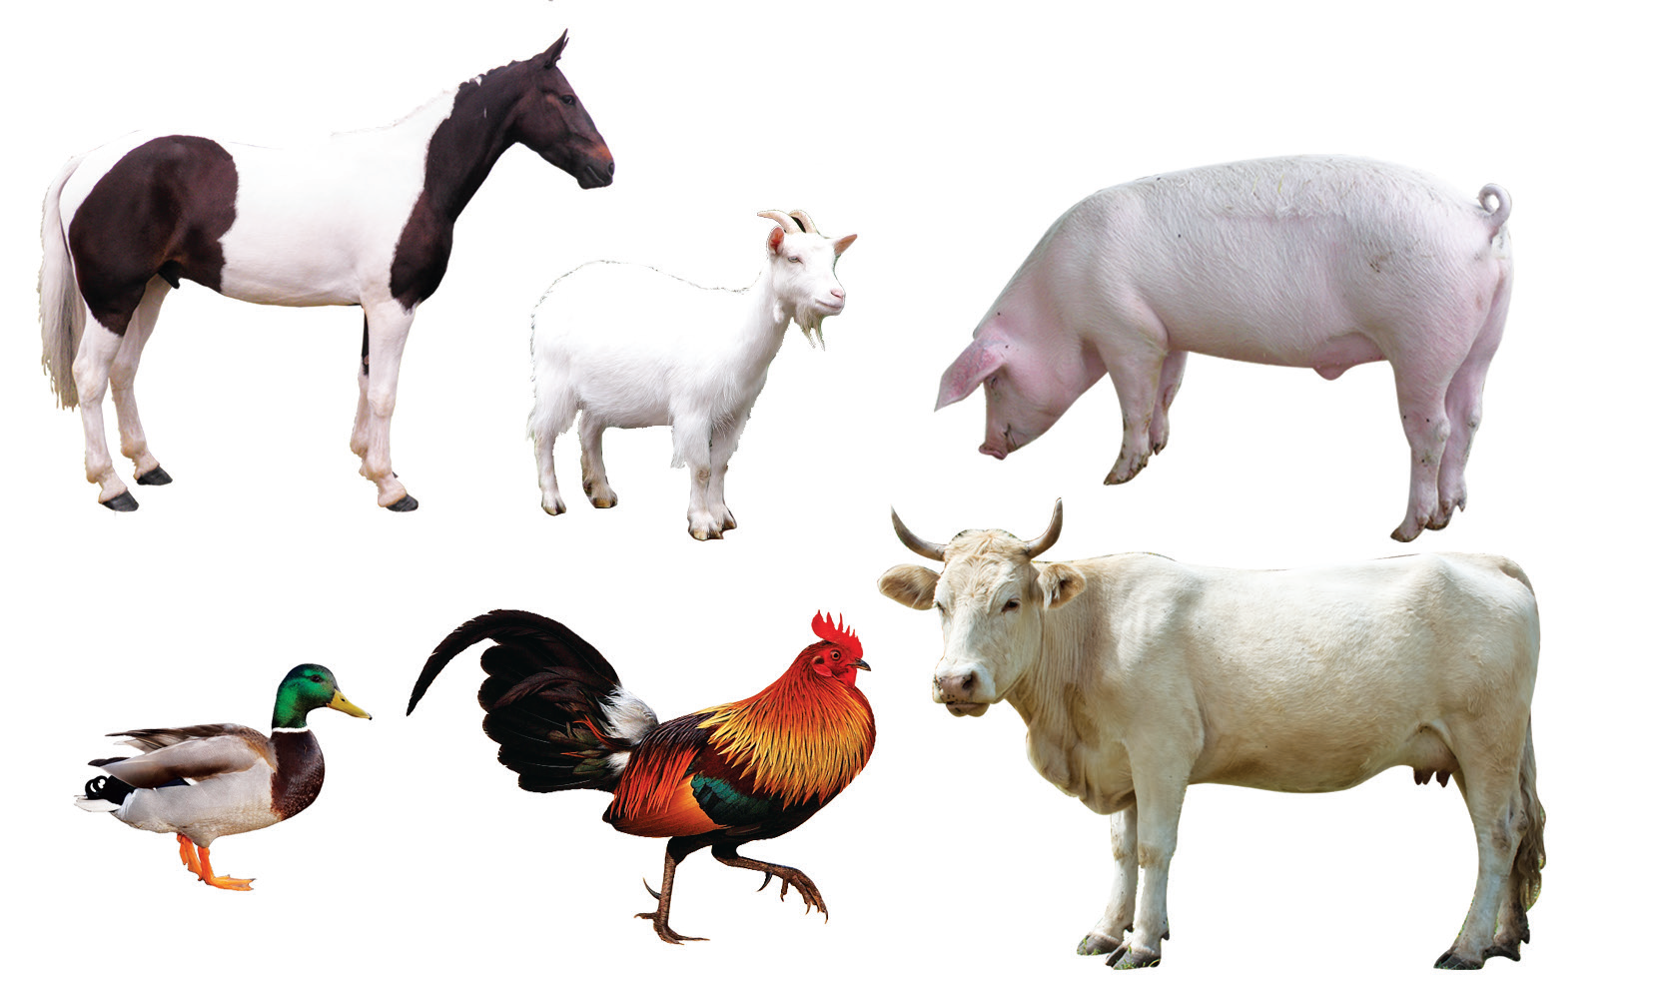
Animals That Live on Land
Most animals live on land. These land animals have lungs that enable them to breathe and legs or appendages that enable them to move around in their habitats.
Most domestic animals live in the farm. Their home is usually a barn or some forms of pen. Some of the animals that are raised in the farm are horses, chicken, cows, goats, and pigs.

Slide 18
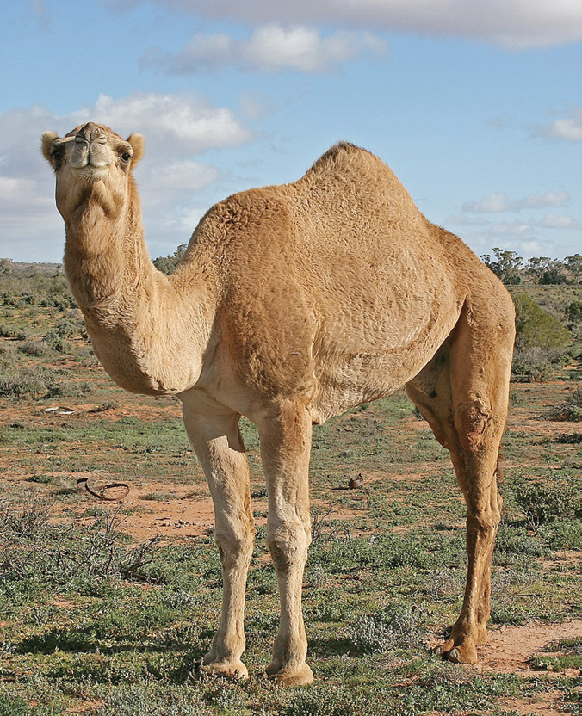
Animals that live in the desert have many adaptations because of the harsh conditions in the place. Adaptation is a change to become suited or fit to a certain environment. Some animals that live in the desert drink water from cactus, seeds, or blood tissue from animals that they hunt for food. They save water in different ways. For example, they spend most of their days underground to prevent moisture loss.
Some animals who spend most of the day underground because of the hot sun are rattlesnakes, kangaroo rats, and coyotes.
Camels could go up to seven months in the desert without drinking water. A thirsty camel can drink up to 20 gallons of water at a time. Its fur prevents it from sweating too much.

Slide 19
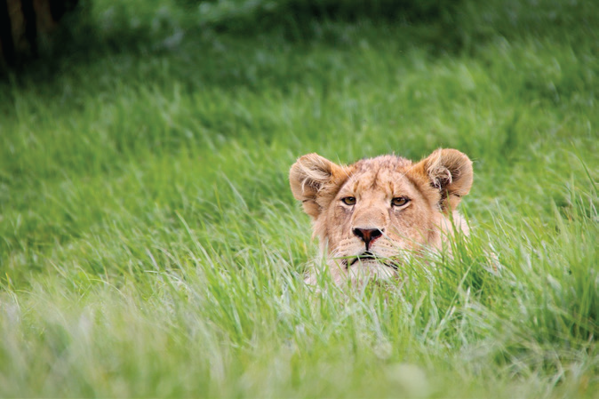
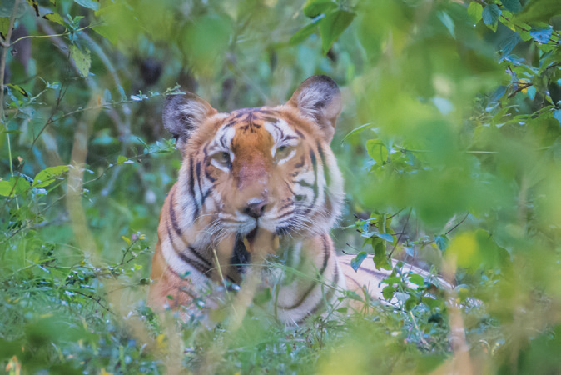
Some animals live in the forests and mountainous areas. They use the trees as a safe place away from predators on the ground.
Some of the animals in the forests use trees for their shelter. Birds after long hours of flying rest and stay in the branches of trees or in the hollows in their trunks where they build their nests. Lions and tigers live in thick bushes of the forest. Trees are also homes for rodents and squirrels.

Slide 20
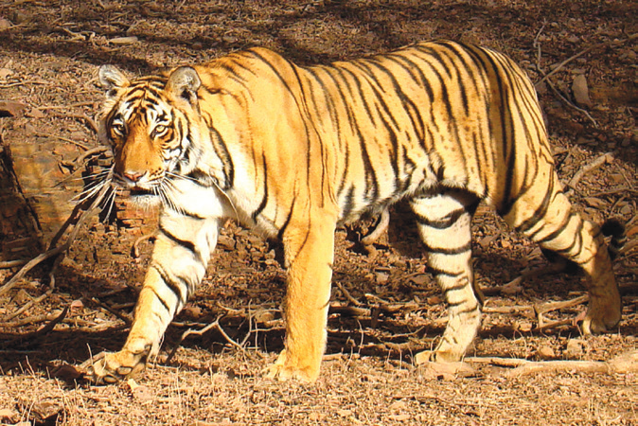
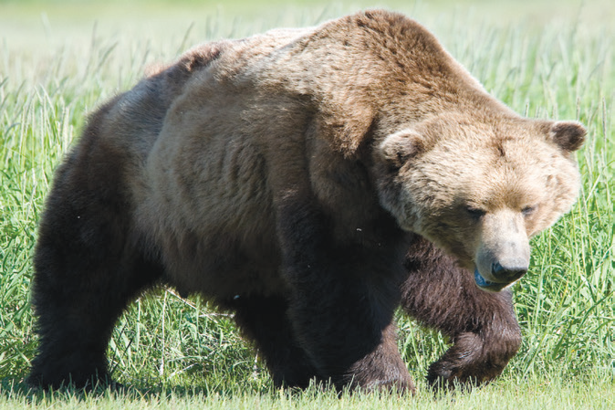
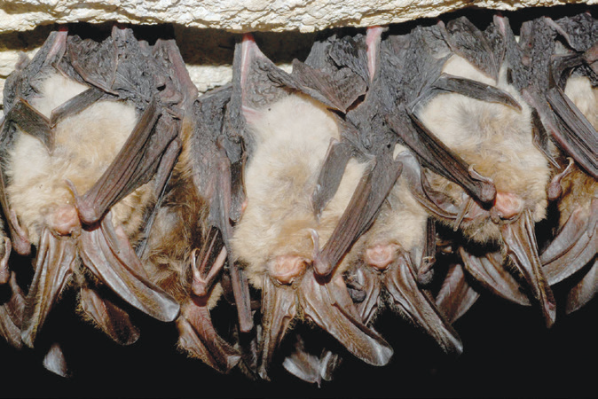
Other animals like the tiger, bear, and bats live in the mountainous areas where rock caves provide protection and shelter.

Slide 21
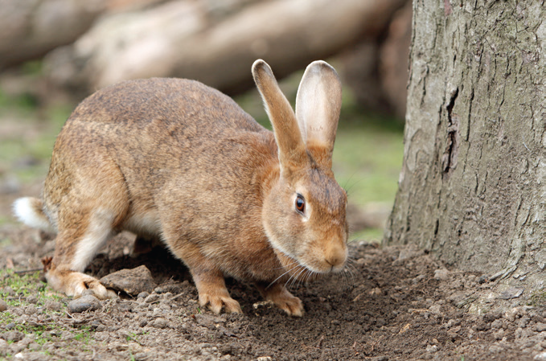
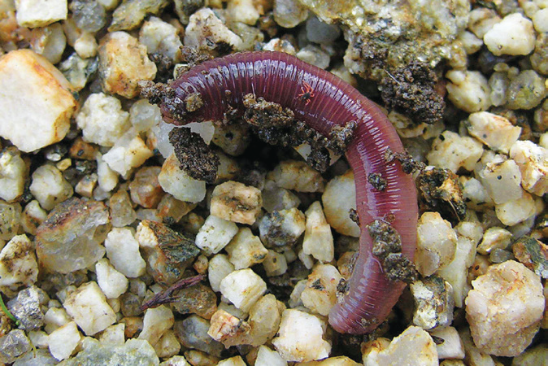
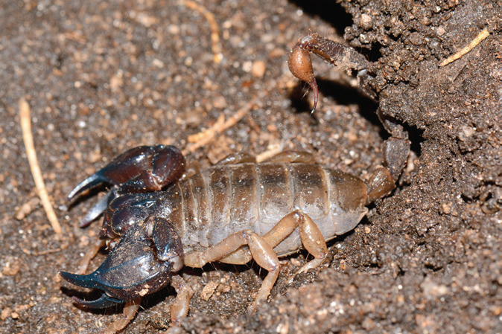
Many animals dig burrows in the ground for shelter. A burrow in the ground can provide shelter during hot and cold weather. Furthermore, it can also provide protection from their predators.

Slide 22
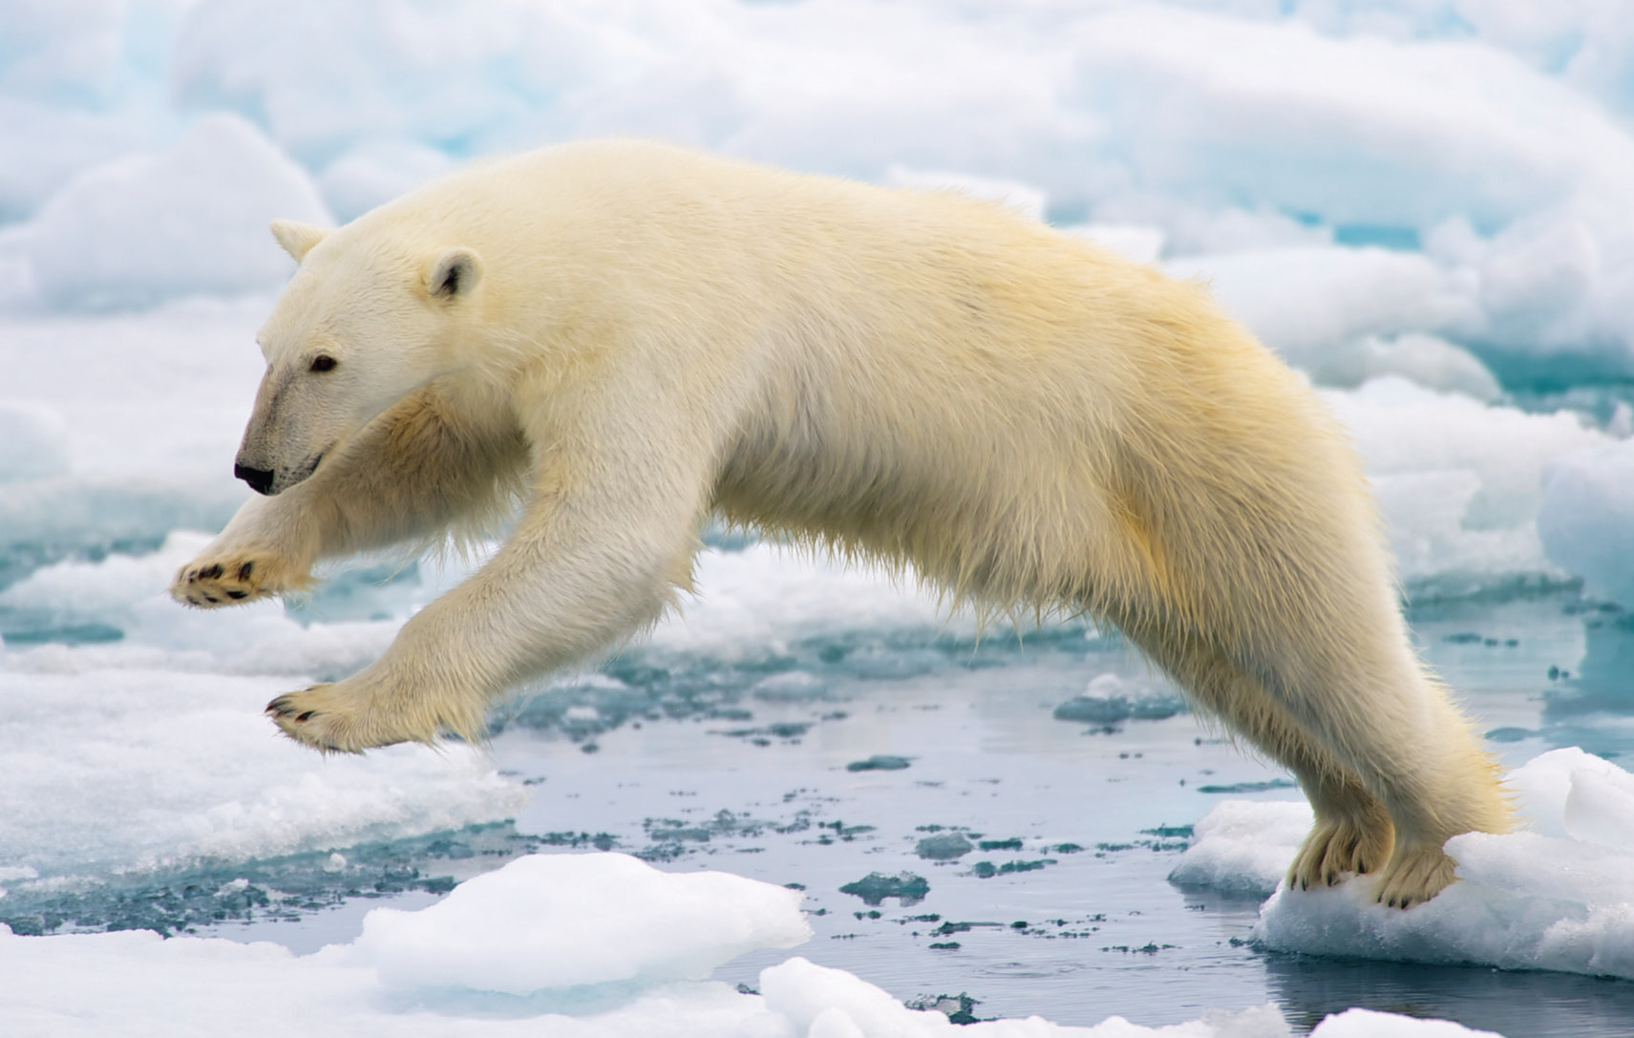
6. Some animals live in very cold places where snow covers the ground all-year round.

Slide 23
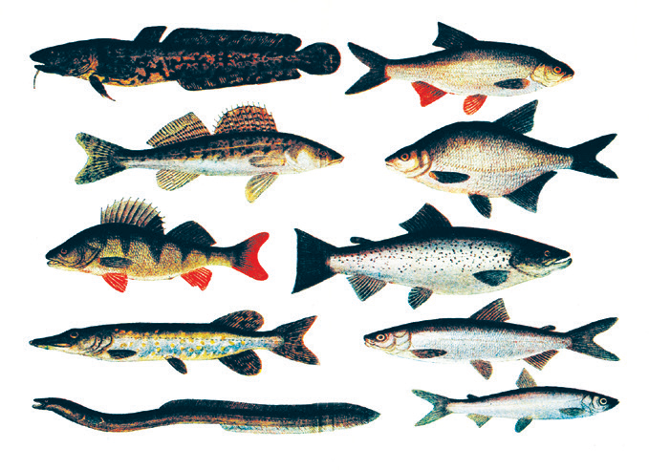
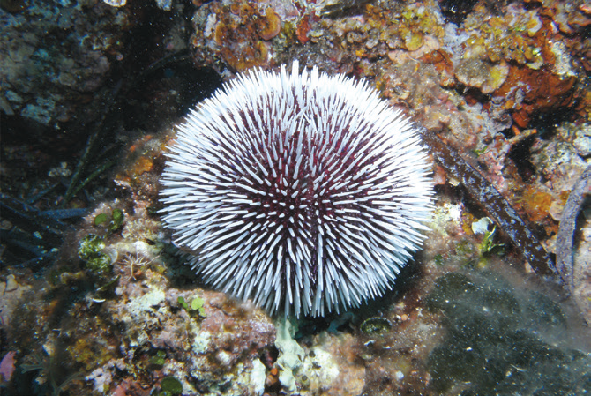
Animals That Live in Water
Many different kinds of animals live in water. A wide variety of fishes lives in the sea. Also, many types of fishes live in fresh water like rivers and lakes.
Other types of fishes live in the salt water of the oceans and seas. They use their gills for breathing, and fins and tails for swimming.
The water is not only the fishes’ home, but it also provides them with the food and oxygen that they need in order to live. Other animals that live in water are crabs, lobsters, jellyfish, and sea urchins.

Slide 24
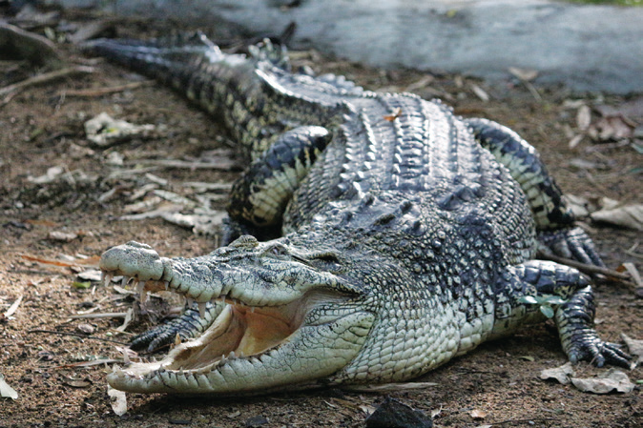
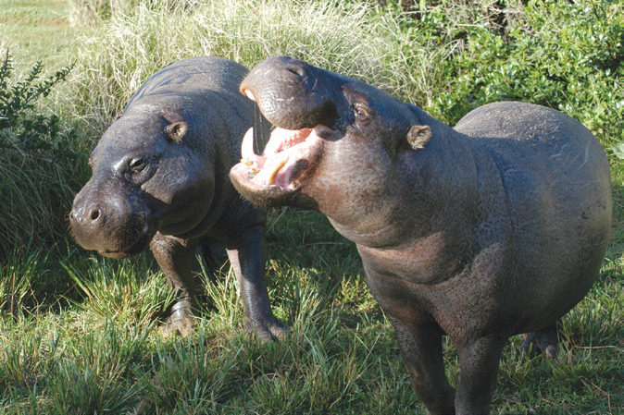
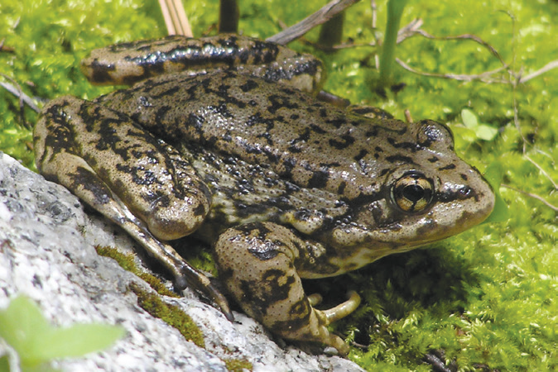
Animals That Live Both on Land and in Water
There are animals that live on land but can also stay in water because of their special body parts. They have nostrils that can close underwater. They have special eye covering that make them see clearly underwater. Some have specialized skin. It can absorb air (oxygen) in water. Frogs, crocodiles, and hippopotamuses are examples of animals that can live both on land and in water.

