Slide 1
Classifying Groups of Animals

Slide 2
Scientists have classified animals into two big groups. They are invertebrates and vertebrates.
Animals without backbones are called invertebrates.
Animals with backbones are called vertebrates. Their backbone is described as vertebral or spinal column. This bone houses the spinal cord.
They can be found just about everywhere—in oceans, rivers, forests, mountains, and the desert.

Slide 3
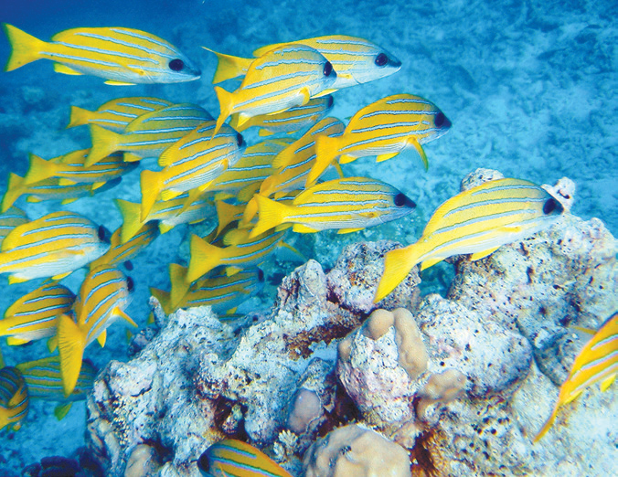
The Five Classes of Vertebrates
There are five groups of vertebrates: the fish, amphibians, reptiles, birds or fowl, and mammals. The fish are the simplest of the vertebrates, while mammals are the most complex.
Fish
They are the largest group of vertebrates. They come in many sizes and shapes. The body parts of fish are suited for life in water. The bodies of most fishes are covered with scales. They reproduce by laying eggs. Fish can breathe in water because they have gills. Gills take in oxygen from water so that the fish can live.
A fish is a cold-blooded animal. This means that its body temperature changes and adapts to the temperature
of its habitat.

Slide 4
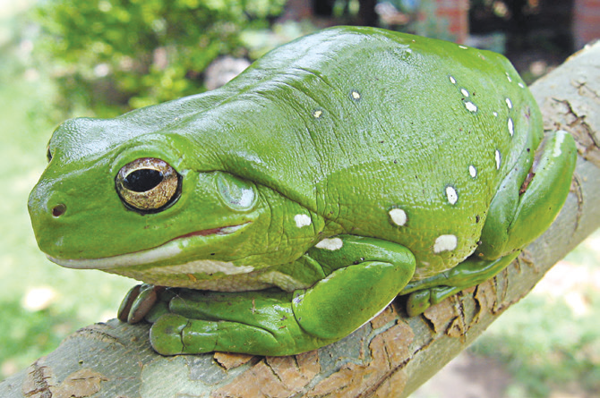
Amphibians
Amphibians can live on land and in water. As they grow, their gills disappear and lungs take their place. They take in oxygen in two ways: either through the lungs or through the skin. Amphibians are cold-blooded animals. Frogs, toads, and salamanders are the most common amphibians.
Amphibians have different body covering or skin. Frogs have smooth and moist skin. Toads have bumpy and dry skin. Salamanders have thin and moist skin. These amphibians live in creeks, ponds, and lakes.

Slide 5
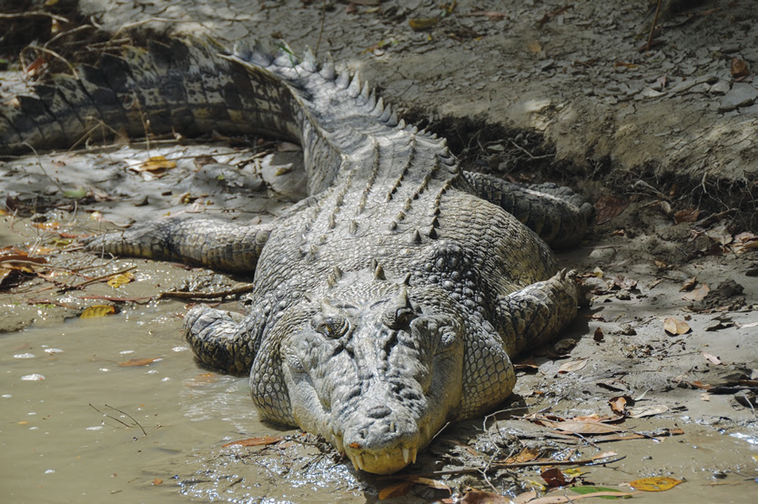
Reptiles
There are many species of reptiles. Some examples of reptiles are crocodiles, alligators, turtles, tortoises, lizards, and snakes.
The body of a reptile is covered with scales and hard, bony plates. Its skin is dry and cool. Like fish and amphibians, reptiles are cold-blooded animals. All reptiles have lungs. Many of them live on land. Some live in water and others in the desert.
Reptiles can move at various speeds. They lay their eggs on land. They live in hot, dry deserts and in warm, wet tropical rain forests.

Slide 6
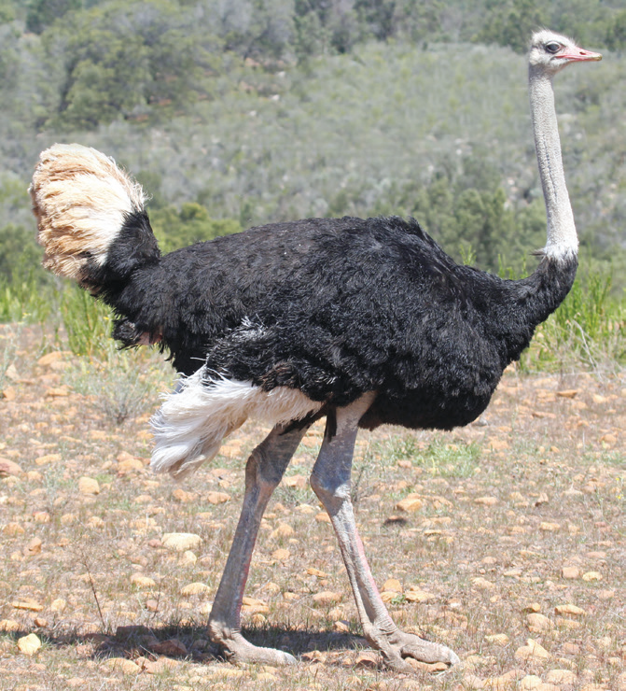
Birds or Fowl
All fowls are warm-blooded animals. Their body temperature does not change in any kind of weather. Their bodies are covered with feathers which keep them warm. They reproduce by laying eggs.
All birds have a pair of wings, although some birds do not fly. They also have two legs for walking. Some common birds are the chicken, ostrich, duck, and pigeon.

Slide 7
Mammals
Mammals are the most highly developed among the groups of vertebrates. Their bodies are covered with hair or fur. They have mammary glands that secrete milk which they use to feed their young. They are warm-blooded animals.
Mammals reproduce by giving birth to live young animals. Young mammals are fed with their mother’s milk. The carabao, goat, bat, horse, whale, and humans are examples of mammals.

Slide 8
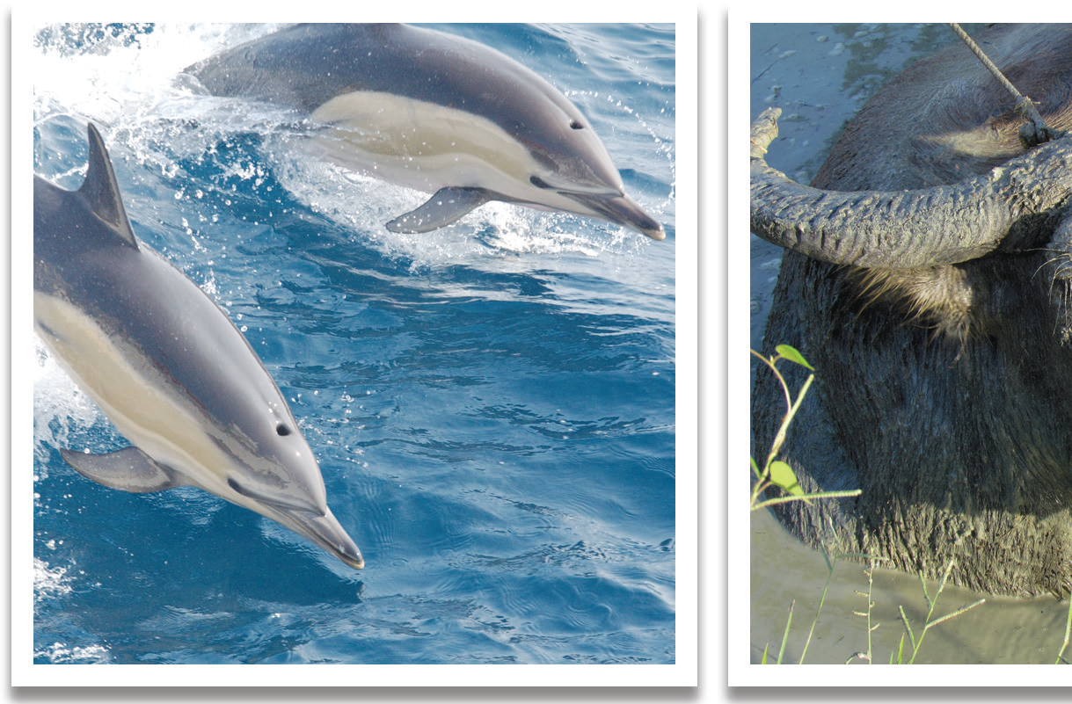
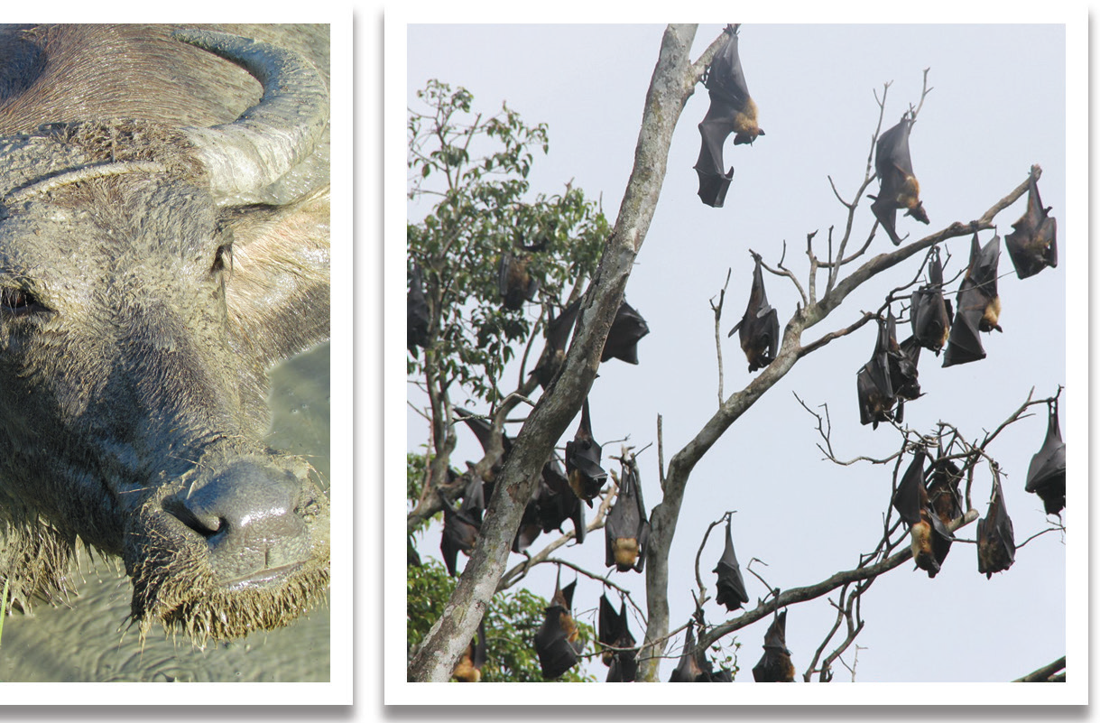

Slide 9
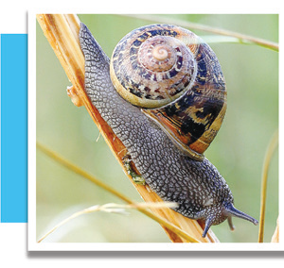
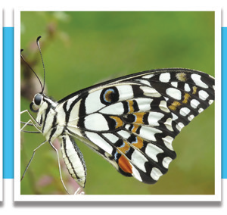
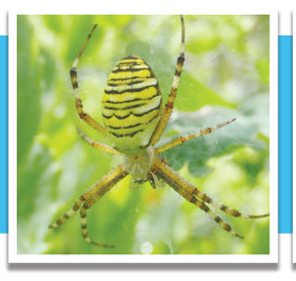
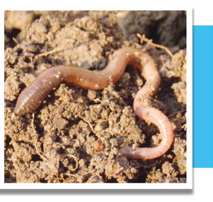
What Are Invertebrates?
Invertebrates are animals without backbones. You may have seen many animals without backbones. Most of these animals can take care of themselves as soon as they are hatched from eggs. Invertebrates live and grow in different ways.

Slide 10
Insects are the largest group of invertebrates. They are animals with six legs. They use their legs in moving around and capturing and holding their food. Most of them have one or two pairs of wings which they also use in moving about from one place to another.
Some insects live on the bodies of other animals. They live in almost all parts of the world. Many insects are found on land, and others live in water. Some kinds of butterflies and dragonflies live at the top of mountains. Some hide in the bodies of plants.

Slide 11
Social insects live together in groups and work together in colonies. Honeybees are social insects. They make combs from wax which come from their bodies. Combs are homes of honeybees. The bees make tiny chambers or rooms where they store their food called honey.
The bees make honey out of the nectar they get from flowers.
In a bee comb, we usually find three types of bees: the queen, the workers, and the male bees called drones.
The queen bee lays her eggs in little chambers or rooms in a comb. The worker bees take care of her and the grubs or larvae that hatch from the eggs. The worker bees’ work is to gather nectar for the colony. The male bees or drones have the sole work of mating with the queen. This is one of the many ways of maintaining balance in the insect world.

