Slide 1
Comparing Different Animals

Slide 2
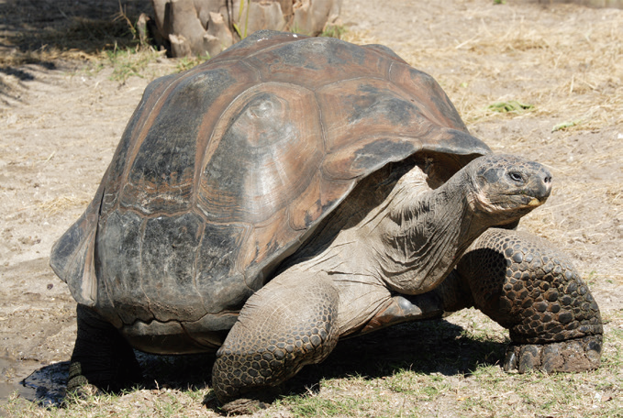
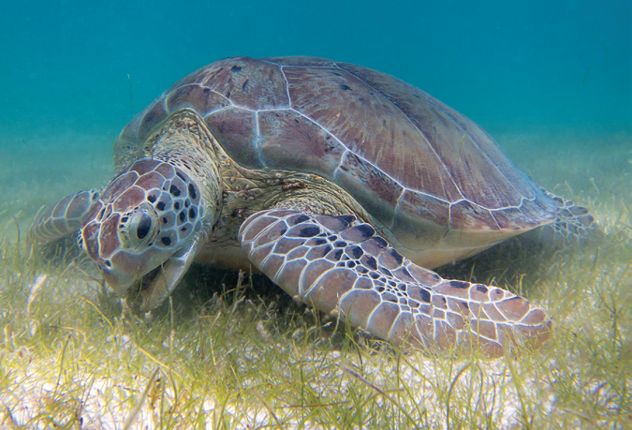
Animals of the Same Kind but Different in Some Ways/Characteristics
Tortoises and Turtles
Tortoises and turtles look very much alike. Tortoises live on land. Most turtles live in water. Both tortoises and turtles have a pair of toothless jaws with sharp edges for cutting food. Tortoises eat only plants, while some turtles eat plants and others eat mostly meat. Both of them have a hard shell for shelter and protection.
Other animals like snails and clams are also covered with shells.

Slide 3
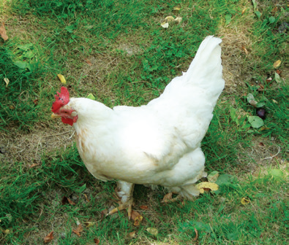
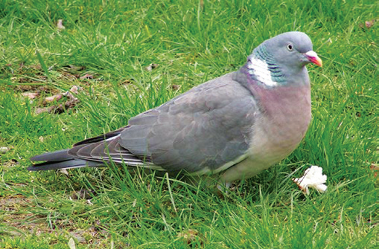
Chickens and Pigeons
Chickens and pigeons belong to the group of animals called birds. They both have beaks and claws which they use to get food. Both of them have a pair of wings. Pigeons can fly high from one place to another. Chickens have wings too, but they cannot fly high. Sometimes they flap their wings to fly over a short distance. Chickens cannot stay in the air for a long time.

Slide 4
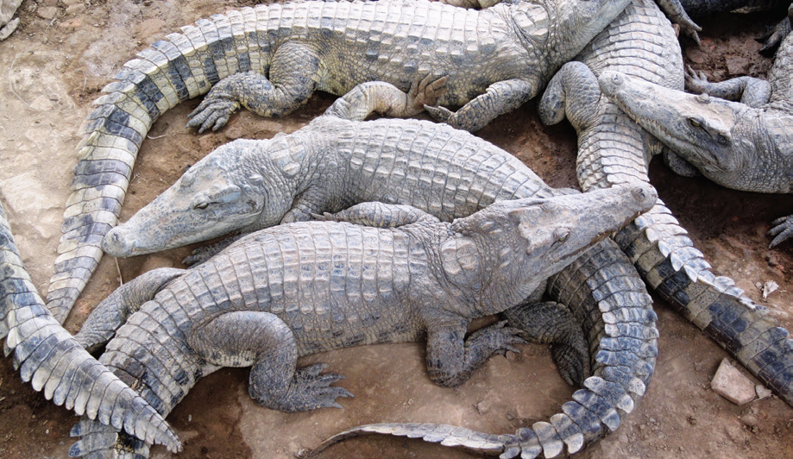
Crocodiles and Alligators
Crocodiles and alligators are large animals with bodies covered with dry and bumpy scales. They have long powerful tails, which they use in swimming and defending themselves. Their eyes, ears, and nostrils are found on top of their long head that projects slightly above the water when they float on the surface.
Alligators differ from crocodiles in having broad snouts and nostrils. The fangs of crocodiles stick out on each side of the lower jaw when their mouth is closed. Other animals that are also covered with scales are lizards and snakes.

Slide 5
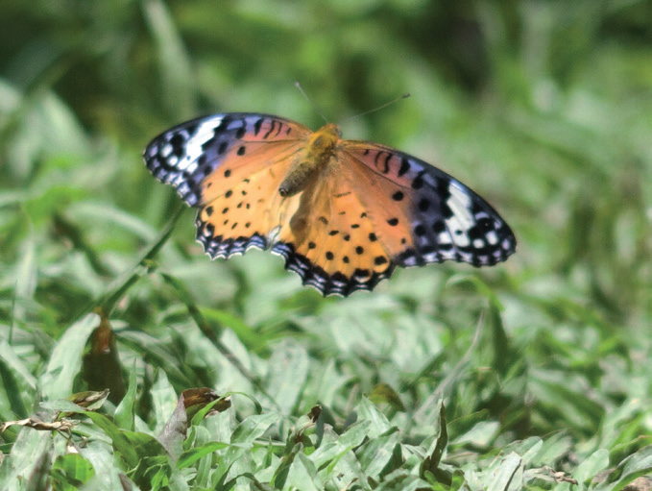
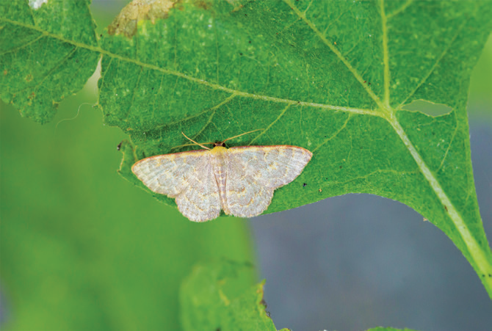
Butterflies and Moths
Butterflies and moths are both insects. They are so much alike that it is sometimes hard to distinguish one from the other. Both have pair of wings. They also have antennae which they use for touching and smelling. Both butterflies and moths become caterpillars as they pass through a stage in their life cycle called metamorphosis.
Butterflies and moths have differences, too. Butterflies have long, slender, and hairless bodies while moths have thick and furry bodies. Butterflies fly only during the day, and when resting, they fold their wings straight up. Moths usually fly at night, and when resting, they spread their wings flat.

Slide 6
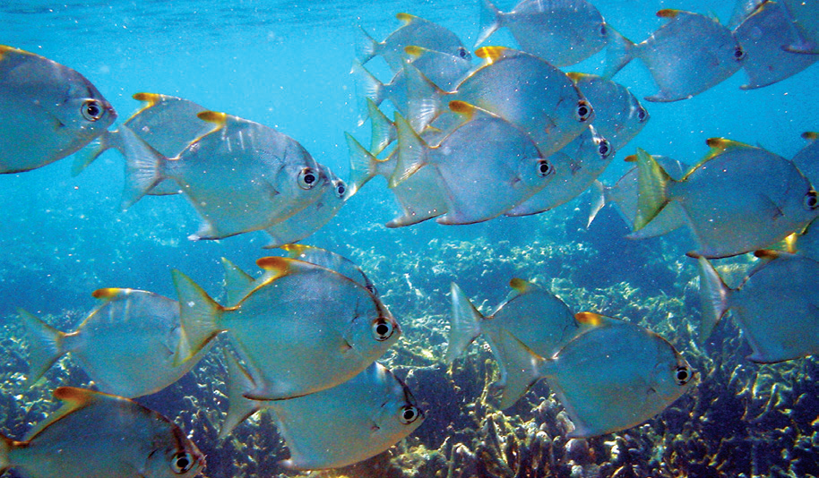
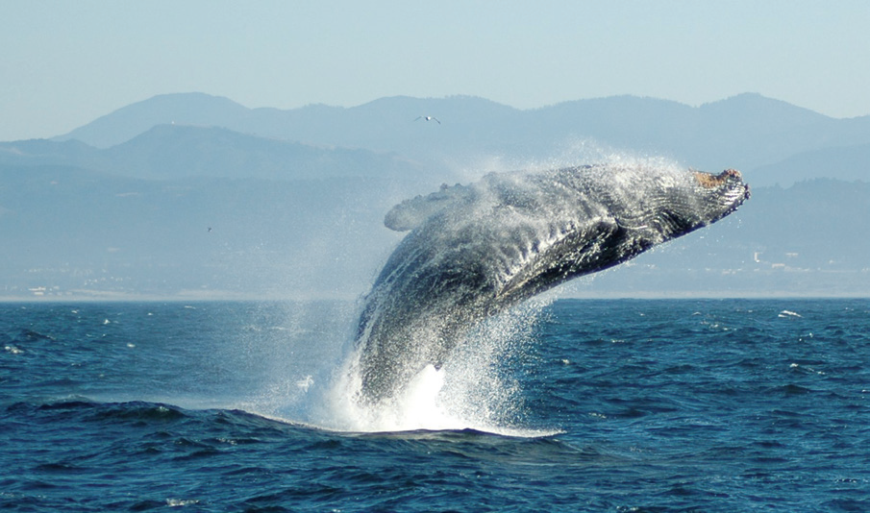
Different Animals That Are Similar in Some Ways
Fishes and Whales
Whales look a lot like fish. Both have tails and fins. But there are some differences between the two animals. Whales have smooth firm skin. Fish have scaly or slimy skin. Whales have tails called flukes that they move up and down when they swim. Fish have tails and fins that they swing from side to side. Whales breathe with their lungs and they must hold their breath underwater. They come to the water’s surface to breathe and can stay long in fresh water. Fishes, on the other hand, breathe and can stay long underwater using their gills.

Slide 7
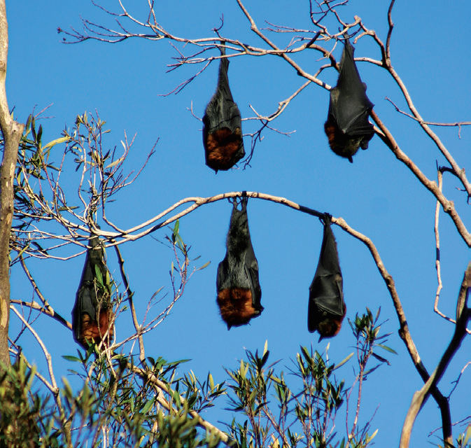
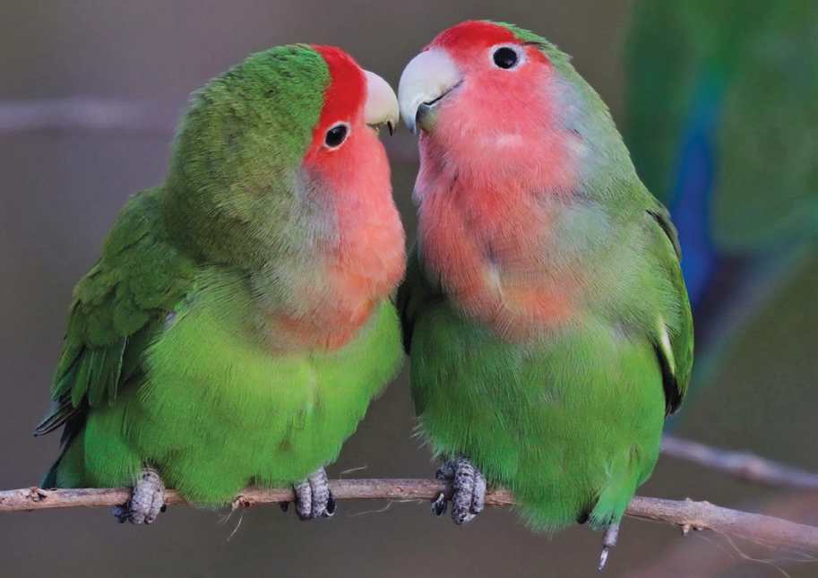
Bats and Birds
Before, people used to think bats were birds without feathers. We now know that there is no such thing as a featherless bird. Bats are mammals and birds are part of the bird group called aves.
Bats are covered with fur while birds are covered with feathers. Bats, cats, and dogs are born alive by their mothers. A bird hatches from eggs. Baby bats are called pups. Pups drink milk from their mothers. A baby bird eats bugs and worms that the mother brings.
Birds have wings but they do not have hands or fingers; instead, they have claws. Bats have arms and structures that look like long fingers connected by a thin membrane that forms into wings. They also have a pair of legs.

Slide 8
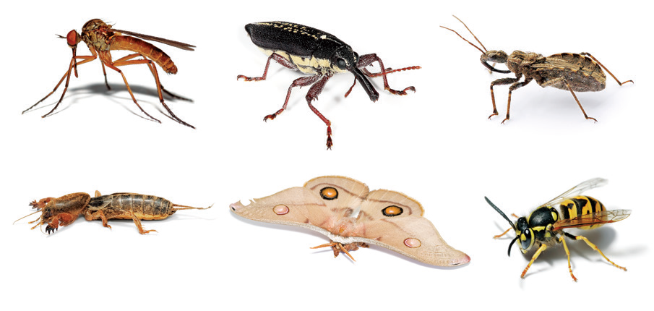
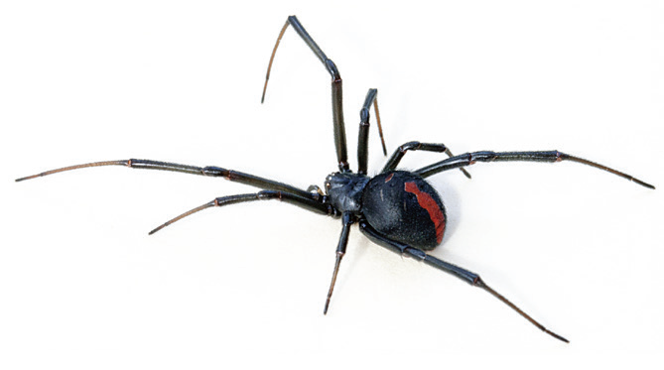
Spiders and Insects
Both spiders and insects are invertebrates; but there are several distinctive characteristics that separate spiders from insects.
If you will look closely at a spider and an insect, you can see how different they are. An insect has three main body parts: the head is in front; the thorax which is the middle part, and the abdomen. Most insects have wings. Insects also have six legs. Both wings and legs are attached to the thorax.
A spider has two main body parts. The head and thorax fused together into one part forming the cephalothorax. The abdomen is the next body part. A spider has eight legs and no wings.

