Slide 1
Body Parts of Animals and Their Functions

Slide 2
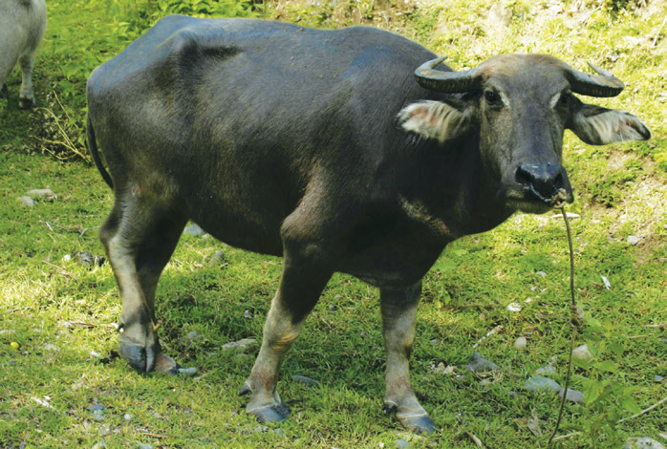
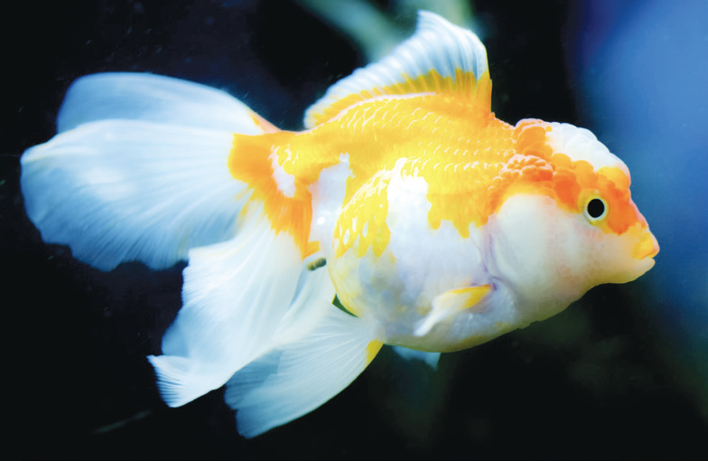
Body Parts Not Common to All Animals
Some animals have body parts which others do not have. For example, carabaos, cows, and goats have special body parts called horns. These animals use their horns for protection from bigger animals.
Unlike land animals, a fish does not have legs. Instead, it has fins and a tail. Fish use their fins for swimming. As the fish swims, the tail moves side to side. This action makes the
fish move forward.

Slide 3
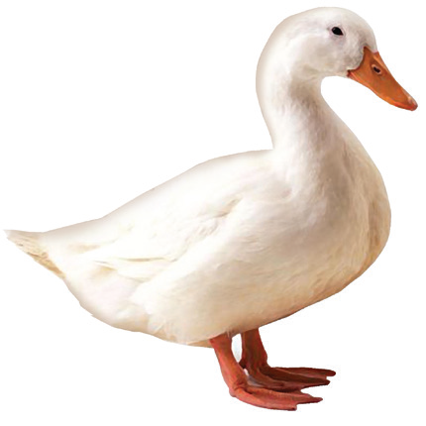
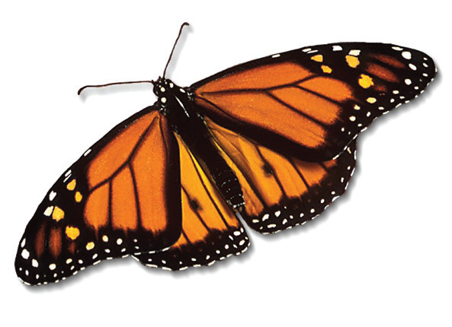
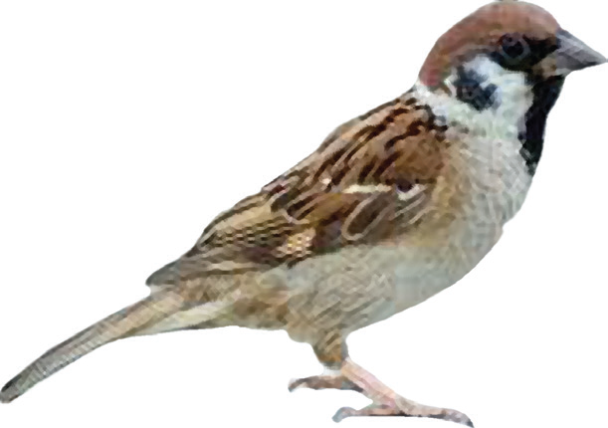
Birds like ducks, chickens, and eagles have wings. Insects are small animals with six legs. Most insects like the butterfly, mosquito, and bee also have wings.
A duck has wings but does not fly often.
An insect like the butterfly has wings so it can fly.
This bird has wings
and can fly high.

Slide 4
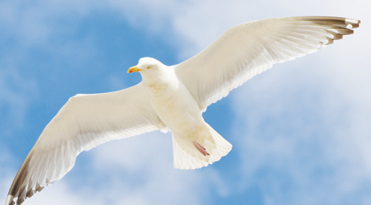
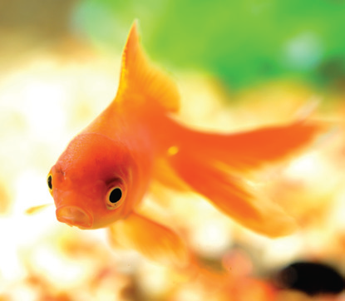
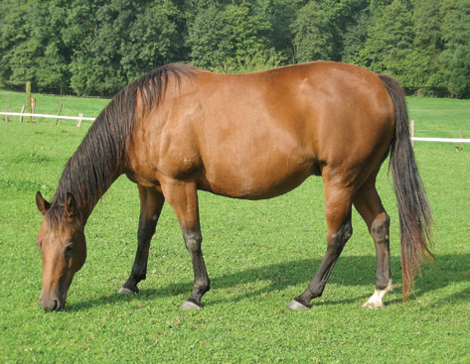
Uses of Each Body Part
The different body parts of each animal have a use or function.
Birds and insects have wings for flying.
Fish have tails and fins for swimming.
Land animals have legs for walking and running.
A horse has long and slim legs which helps it run fast.

Slide 5
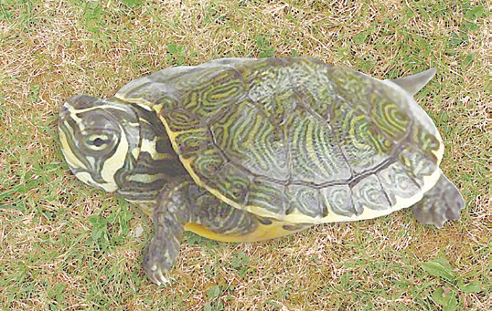
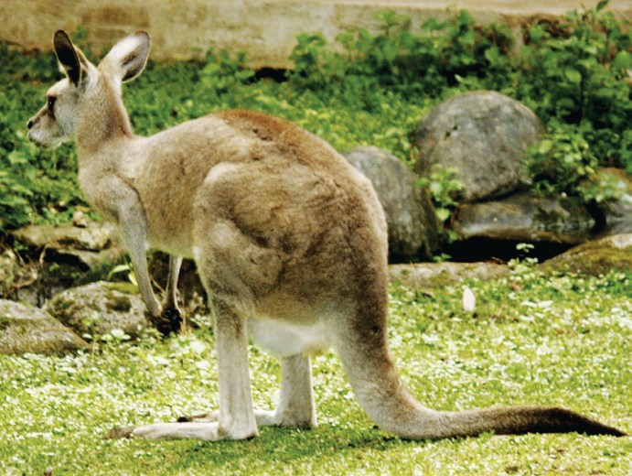
Animals with short legs, like penguins and turtles cannot run fast.
Some animals have short legs in front and long legs at the back.
The legs at the back or the hind legs are used for jumping. Frogs, grasshoppers, and kangaroos can jump high because of their long hind legs.

Slide 6
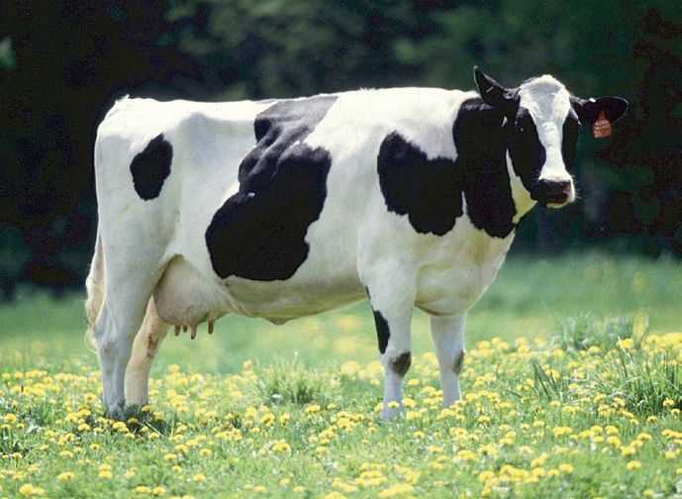
Many land animals, such as cows and zebras, have tails. They wag their tails to drive away insects from their bodies. Some animals like monkeys use their tails to hang onto branches as they swing from tree to tree. The tail has different uses for different animals.

Slide 7
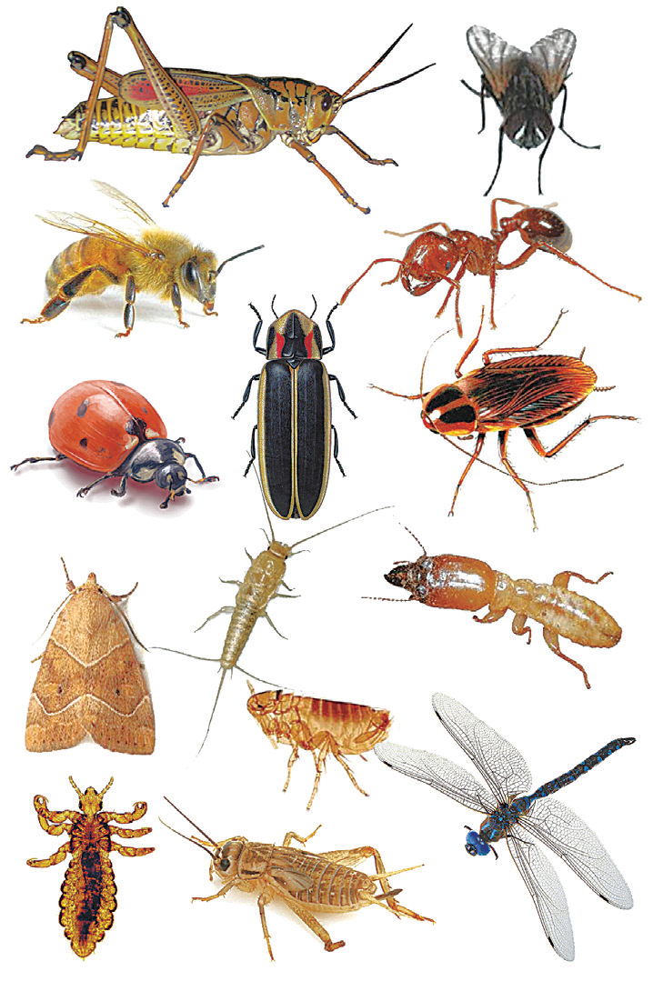
Almost all insects have a special body part that other animals do not have—the antenna. The antenna tells the insect whether a place is hot or cold. It can also feel things that are moving. Other insects use their antenna for smelling. For example, the antenna is also used by insects to follow sounds. The antennae of the male mosquito can detect the sound of female mosquitoes that are far away.
Insects have three main body parts: the head, the thorax, and the abdomen. The abdomen contains the different organs like the stomach and the reproductive parts of the insects.

Slide 8
Body Coverings of Animals
Animals have different body coverings. These body coverings protect the animals from the heat or cold. They also protect the animals from harm.
Look at the pictures of the animals on the next slide. Can you guess the kind of body covering each animal has?
Elephants and carabaos have thick skin covered with hair.
Cats are covered with soft hair called fur.
Birds’ bodies are covered with feathers.
Fish and alligators are covered with scales.
Frogs are covered with moist skin.
Turtles are covered with hard shells.

Slide 9
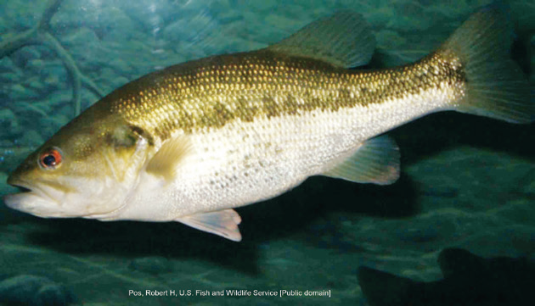
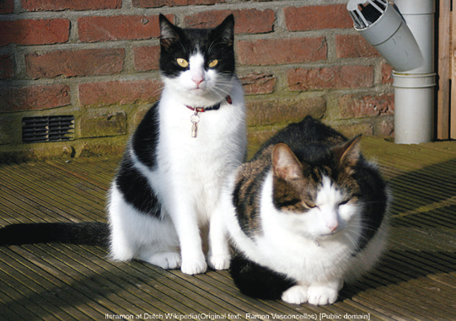
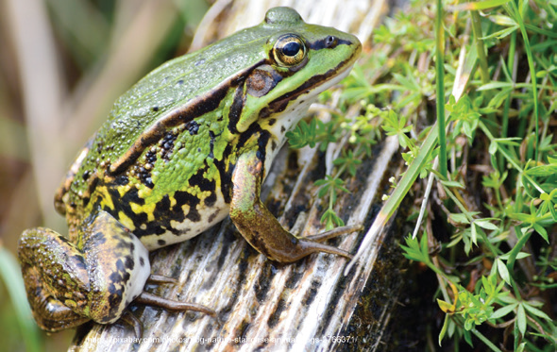
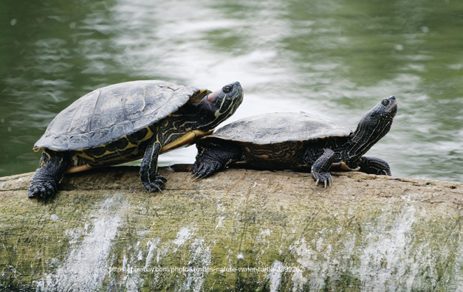
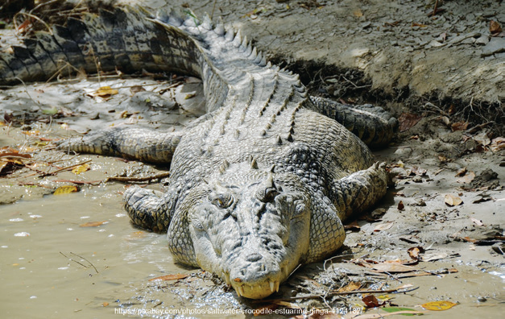
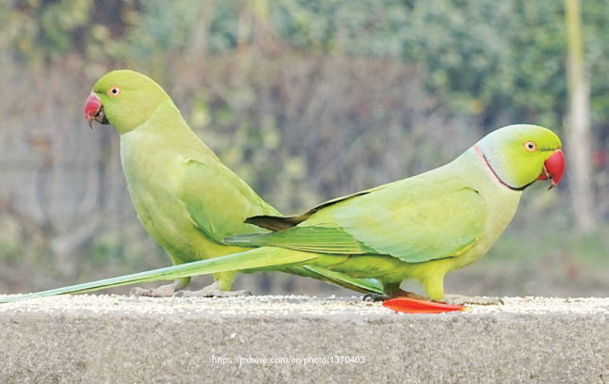

Slide 10
