Slide 1
Changes as Animals Grow

Slide 2
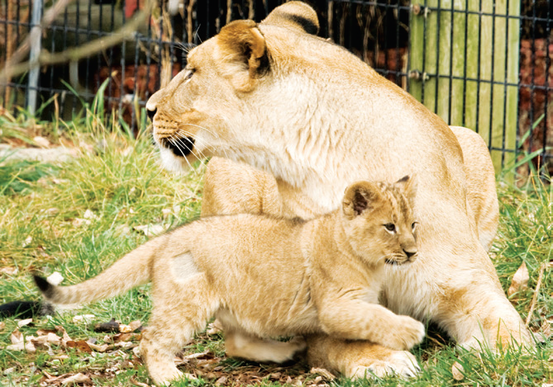
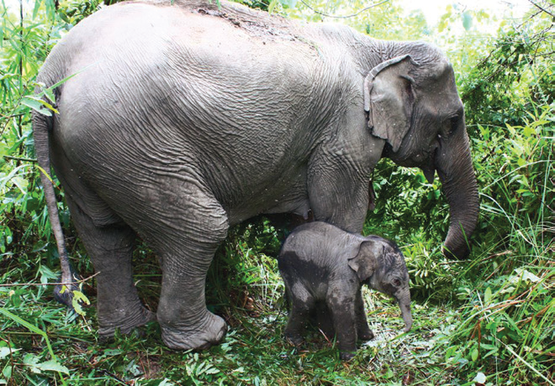
Animals That are Born Alive
Baby animals that are born alive have body parts similar to those of their parents. They are alike in body movement and in body covering. They look exactly like their parents.

Slide 3
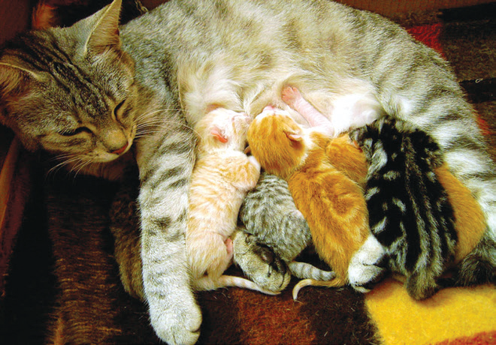
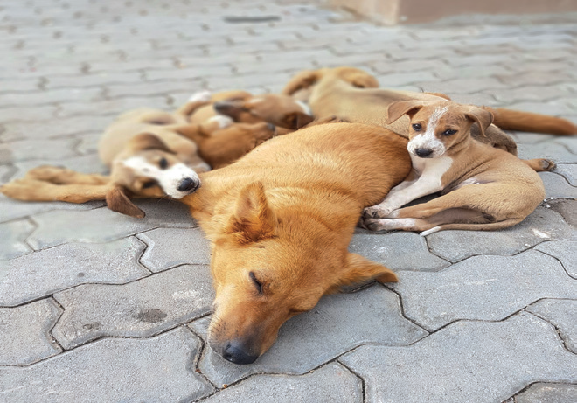
Changes That Take Place as Animals Grow
Most animals change in size. Observe how these animals grow.

Slide 4
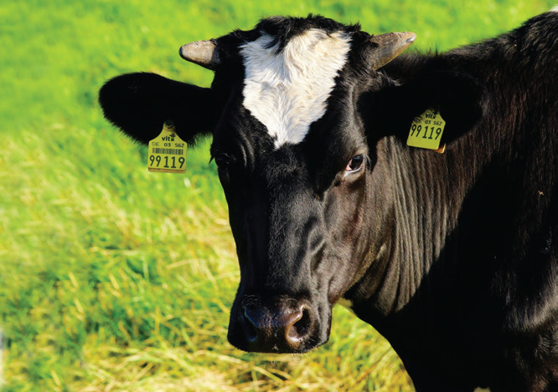
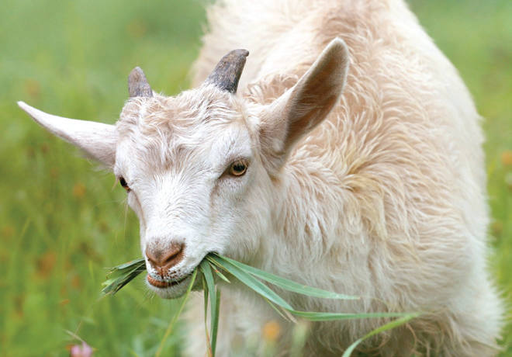
Some body parts grow and develop only as the young animal grows.
Newborn cows, goats, and carabaos do not have horns yet. They only develop horns as they grow older. The horns grow bigger and longer as the animals grow.

Slide 5
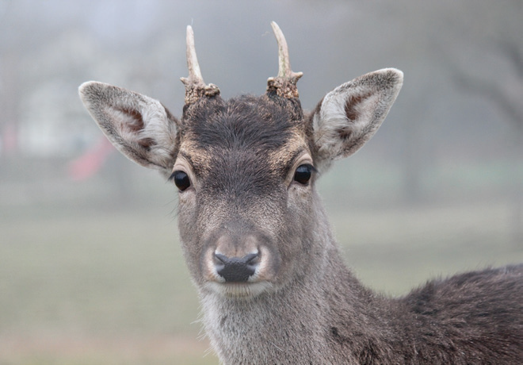
Among the deer, the first set of antlers or horns are usually short spikes. As the deer grows older, the antlers become longer and grow more branches. Only the male deer (stag) has antlers.

Slide 6
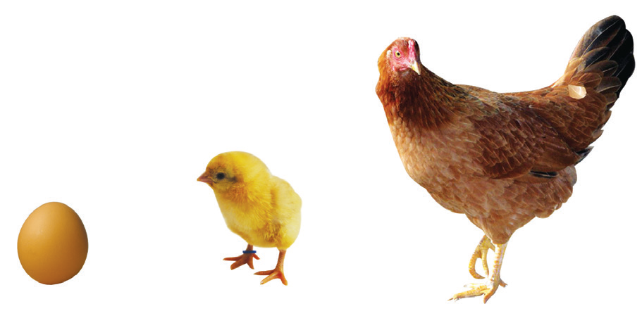
Animals That Are Hatched From Eggs
Some animals come from eggs. However, not all mother animals sit on the eggs they lay to hatch them.
Chickens are hatched from eggs.
A mother hen sits on her eggs to hatch them. After being hatched, a day old chick has yellow feathers. The color becomes darker after many days.
When the chick is about a month old, the color of the feathers changes into white and other colors.

Slide 7
Animals Hatched From Eggs That Become Completely Different as They Grow
Some animals that are hatched from eggs become completely different as they grow. They lose certain parts and develop new body parts as they grow. The growing baby animals look very different from the adult animals.
The young of the butterfly, frog, housefly, and dragonfly are alike in a way that they all start from eggs laid by the adult animal. The eggs develop into another form, such as caterpillar for the butterfly, tadpole for the frog, maggot for the housefly, and nymph for the dragonfly. These young animals continue to undergo more physical developments until they take the form or appearance of the adult animals.

Slide 8
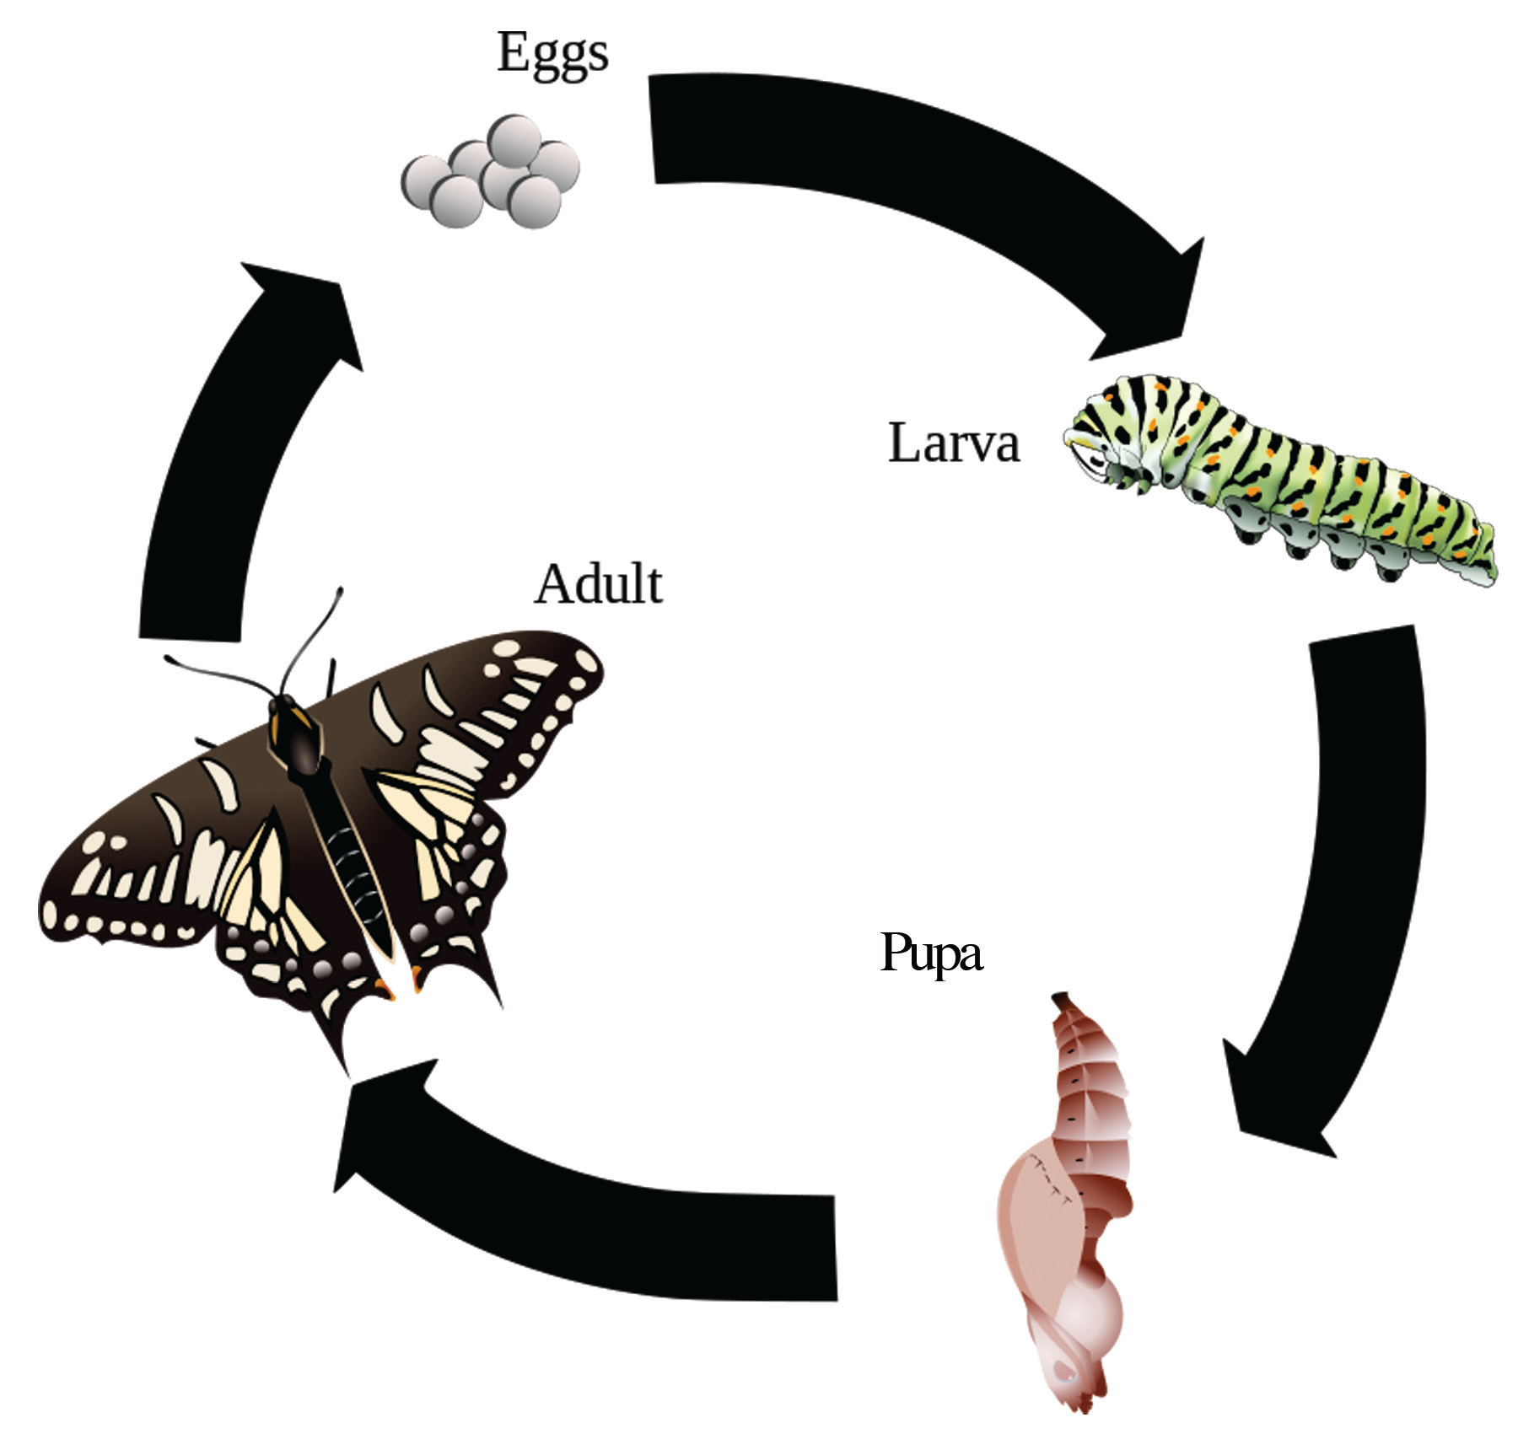
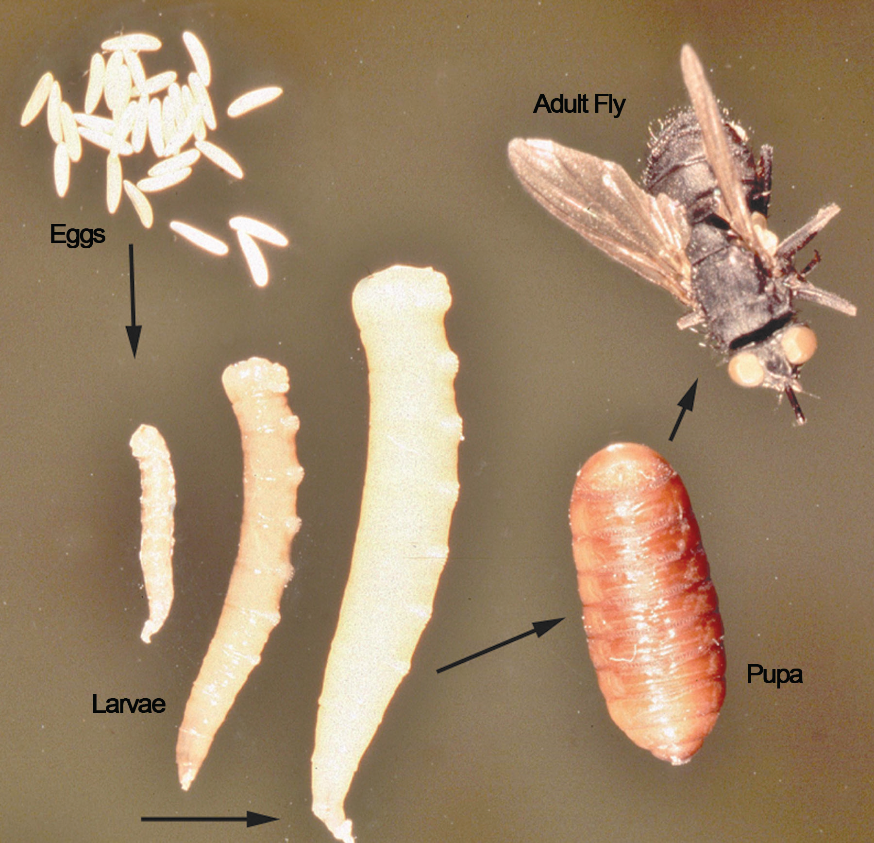
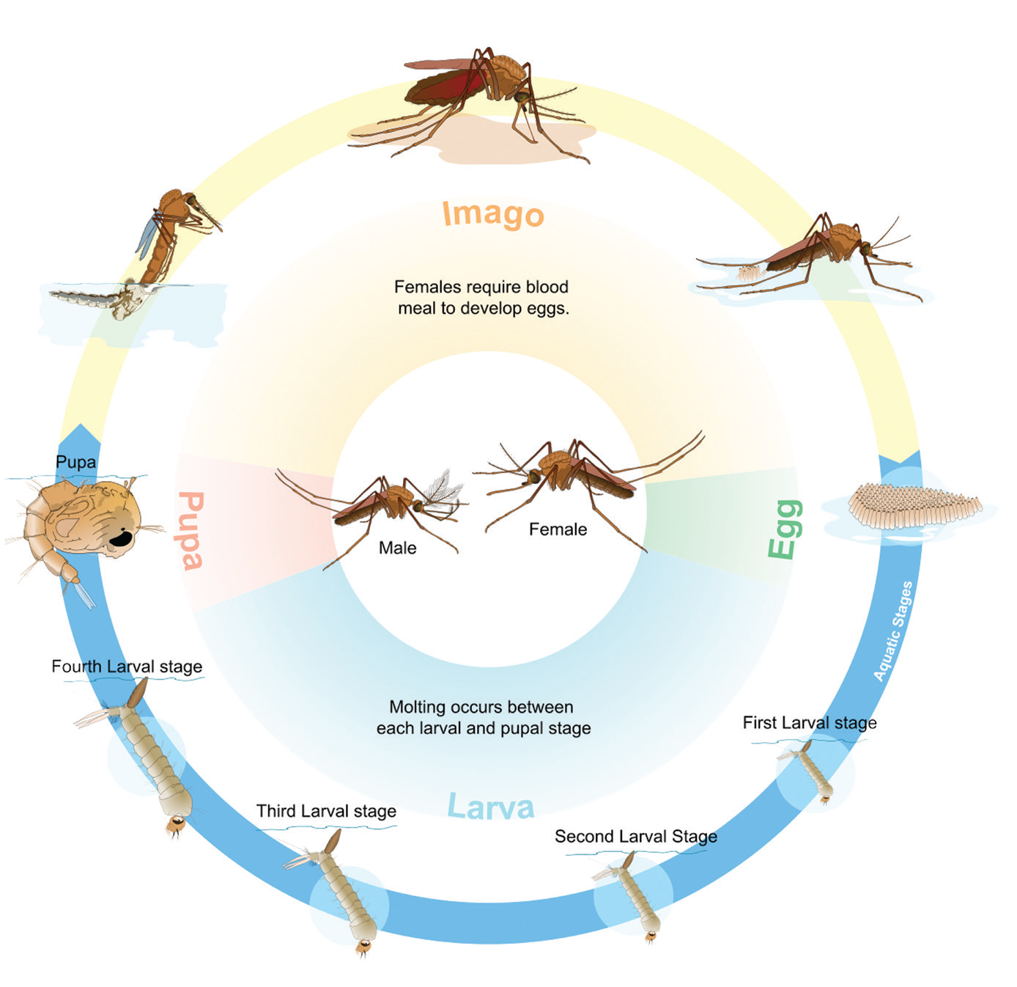
Look at the pictures of the stages in the development of some animals that are hatched from eggs.

