Slide 1
Needs of Animals to Live and Grow

Slide 2
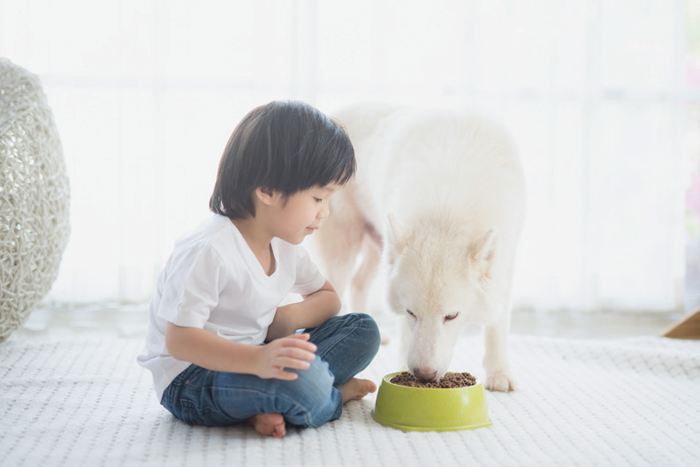
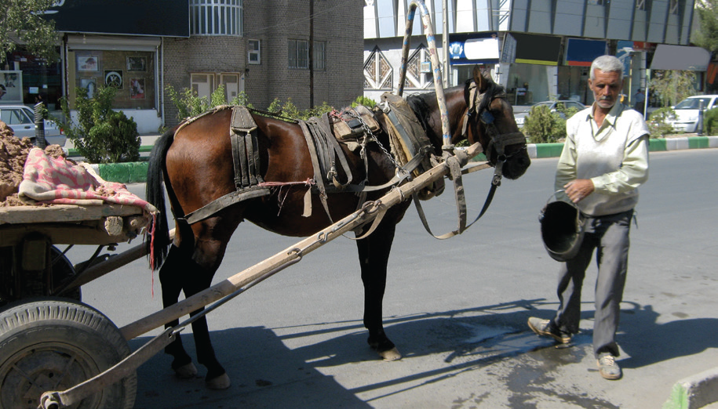
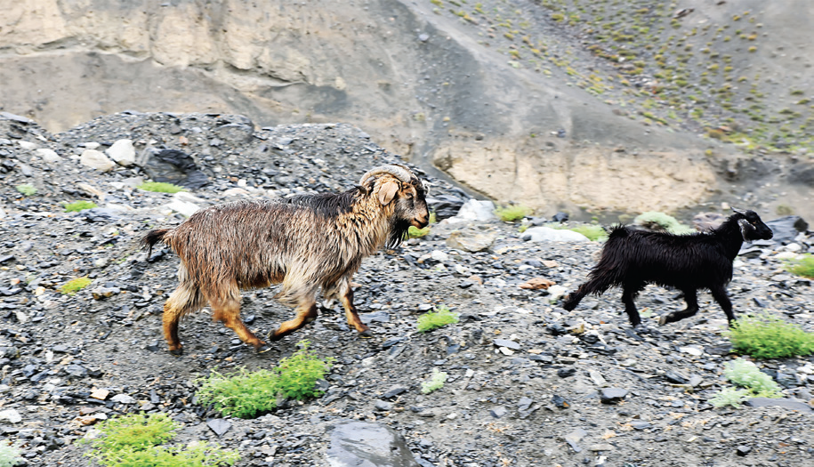
Needs of Animals
A. Food
Animals need food in order to live. Animals eat different kinds of food. They need food to sustain them.
B. Water
Animals drink water. They are refreshed when they drink water. Animals need water in order for their bodies to function well.
C. Air and Sunlight
Goats and other animals do not live inside a house. They live in open spaces. They need sunshine and air to grow and stay healthy.

Slide 3
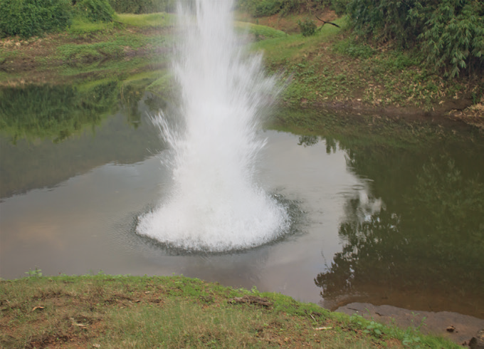
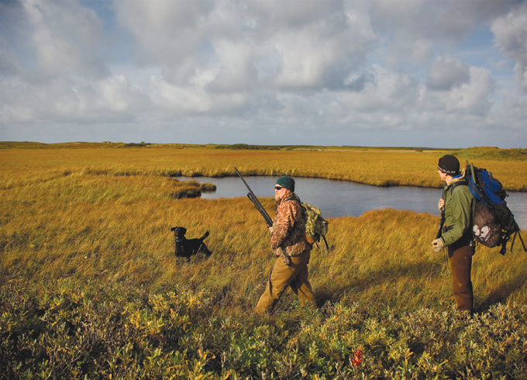
Ways to Show Concern for Animals
Here are some ways to show concern for animals:
• Give your pets enough food to eat and water to drink.
• Provide a clean place for your animals.
• When you play with your pets, do not hurt them.
• Help protect animals.
Harmful ways of fishing and hunting will lessen the number of animals on earth. Animals that live in water will be killed if fishers do not stop using dynamite in fishing. Animals in the jungle will all die if hunters do not follow the hunting laws.

Slide 4
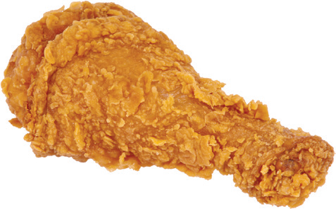


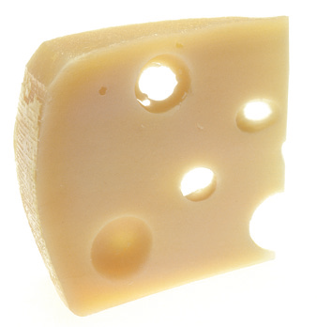
How Animals Help Us
Animals help us in different ways. That is why we should show our love and concern for them.
Animals give us food.

Slide 5
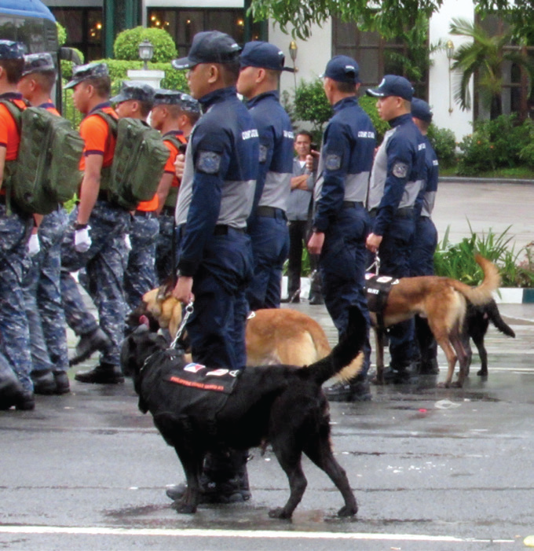
Some animals are trained to do a particular work. A dog is usually trained to guard a place. It barks when a stranger comes near. It may even attack the stranger.
A dog may also be used by a police officer to track people. Some dogs are trained to smell prohibited drugs.

Slide 6
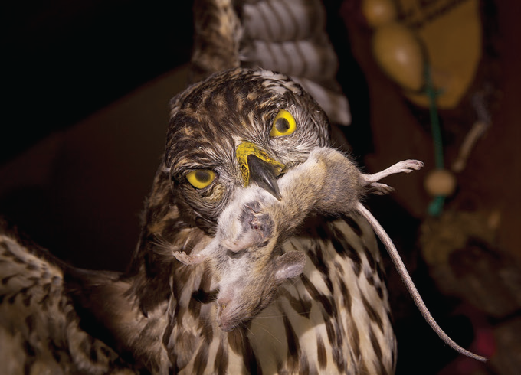
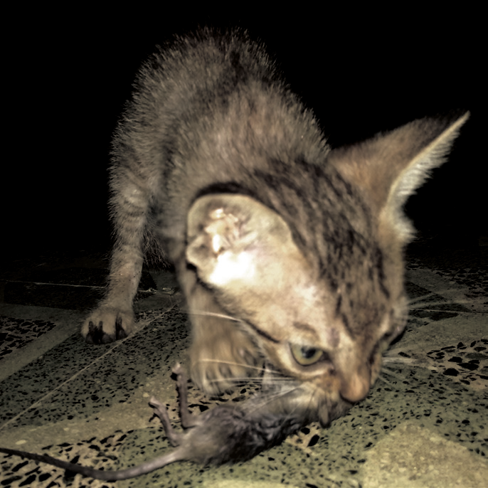
Other animals like the owl and the cat help people, too. The cat catches rat in the house. Owls eat rats that destroy plants.

Slide 7
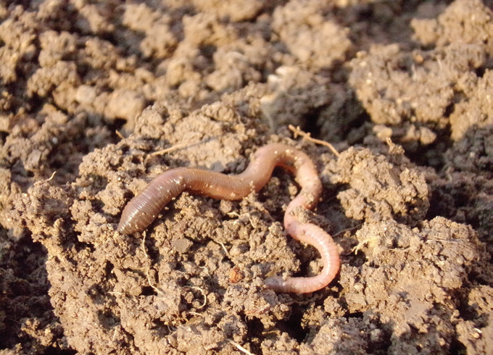
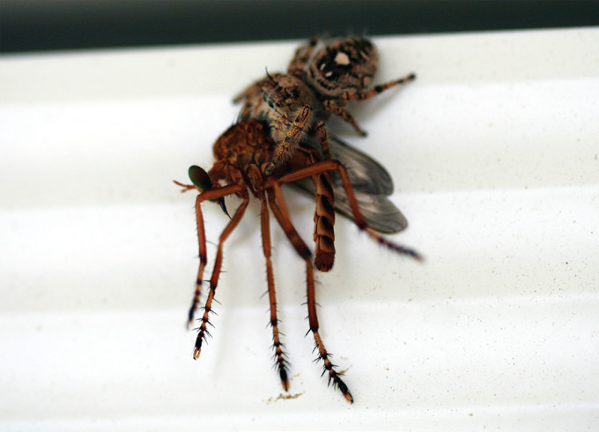
Even small animals like the earthworms are useful. They help make the soil fertile. Other animals such as spiders help people. They eat insect pests that harm the plants or even other animals. They eat harmful insects like mosquitoes inside the house.

Slide 8
Protecting Oneself from Harmful Animals
Some animals are harmful. They attack and bite people when someone mocks or hurts them. Animal bites can make you sick and you may die because of them.
Unvaccinated dogs may have rabies. When a dog bites you, the dog’s rabies can spread all over your body and cause death. Have your pet dog vaccinated against rabies so it cannot harm people.
Mosquitoes can cause dengue and malaria. A person with dengue has very high fever. He/She vomits and rashes come out of his/her skin. Blood can also come out from his/ her ears and nose.

Slide 9
Some animals such as ﬂies, rats, and cockroaches carry germs that can cause diarrhea, typhoid fever, and cholera.
Here are some things you can do to protect yourself from harmful animals:
Do not disturb animals. Do not touch or tinker with animal shelters like beehives and anthills. Do not touch newborn puppies, you can hurt them. The mother dog can also hurt you as a means of protecting her puppies.
2. Avoid going to places with tall and thick grass as grass snakes may be present there.
3. Always keep your surroundings clean. Cockroaches, flies, and rats breed in dirty places.

