Slide 1
Importance of Animals and the Proper Ways of Handling Them

Slide 2
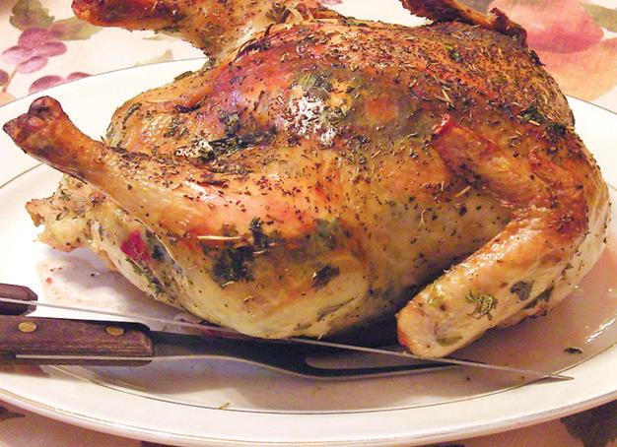
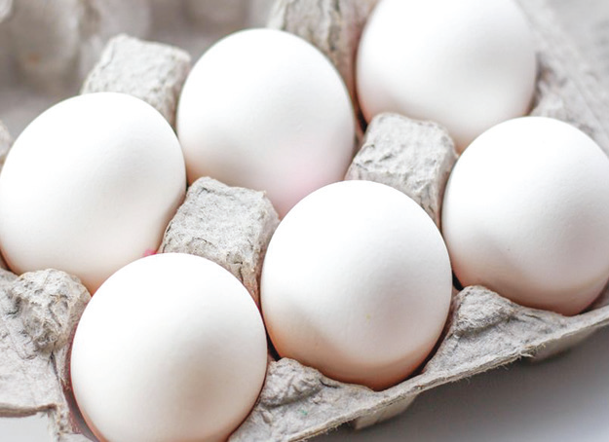
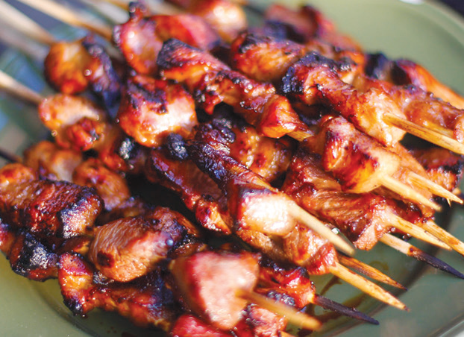
Benefits That Animals Give to Humans
Animals are very important to the other living things on Earth. Here are some ways in which animals can help us:
Animals are sources of food.
Can you imagine living without litson manok, pork barbecue, beef steaks, and hardboiled eggs? Where do you get all these food? They come from chickens, pigs, and cows. The eggs that we eat come from chickens, ducks, and other birds.

Slide 3
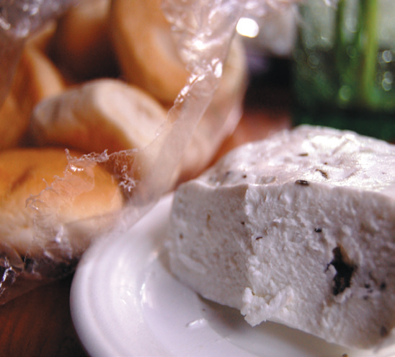
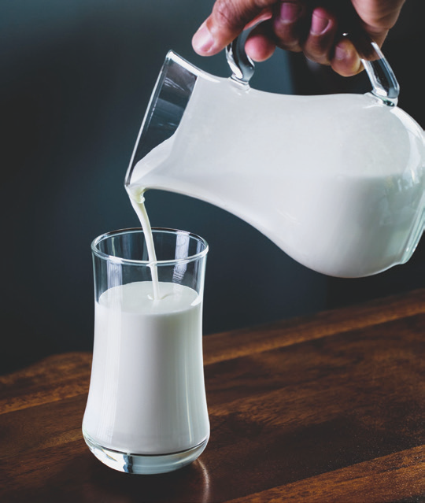
The milk that we drink every morning comes from carabaos, cows, or goats. The native cheese or kesong puti, fresh milk, butter, and other dairy products also come from them. Crabs, shrimps, clams, oysters, and squid are also sources of food.

Slide 4

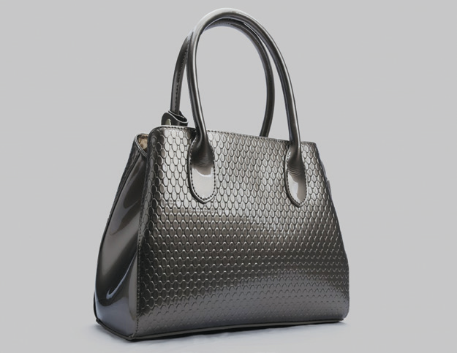
Animals are sources of useful things.
Animals give us clothing and leather goods. Wool comes from sheep. Silk comes from silkworm. Fur coats come from furry animals. Leather comes from the skin of some animals like snakes and crocodiles.

Slide 5

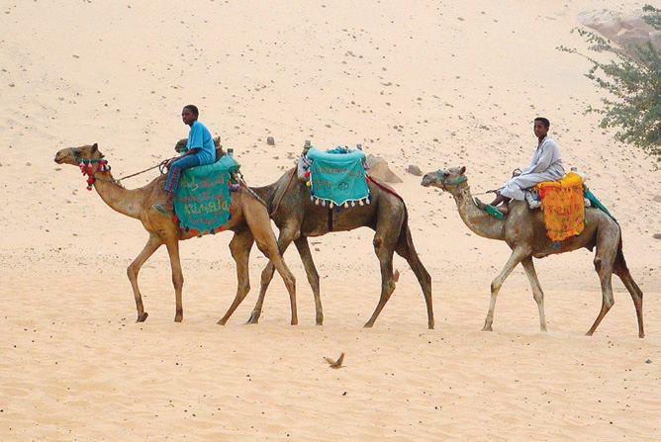
Some animals give us medicine.
Fish oil is extracted for medicinal purposes. It is known to cure many diseases.
Animals help us in our work.
Even with modern farming machinery, people still use animals as beasts of burden. Cows and carabaos are still used to plow the field. Carabaos are used to pull carts with farm products. Kalesa and karitela are still useful means of transportation.
In other countries, camels, elephants, and donkeys are used to transport people and cargo.

Slide 6
Caring for Animals
Provide the needs of your pets.
A pet is an animal friend that lives with you. Do not forget to give the care it needs. Feed and bathe it regularly. Provide a proper shelter for your pet. Consult a veterinarian when it gets sick.
Protect the habitats of animals.
One way of caring for animals is by protecting their habitats. Avoid disturbing the habitats of animals in parks where they are sheltered. Respect hunting laws for certain kinds of animals.
People should also protect the habitats of animals from pollution.

Slide 7
Protect endangered animals.
Endangered animals are those that are beginning to disappear. There are only a few of their kind left on Earth.
Endangered animals like the green sea turtles and whales should be protected. These animals, when found, should be taken care of and returned to their habitats.
Let us provide our pets and other animals with their needs. Let us protect their habitats. Let us protect endangered animals.

Slide 8
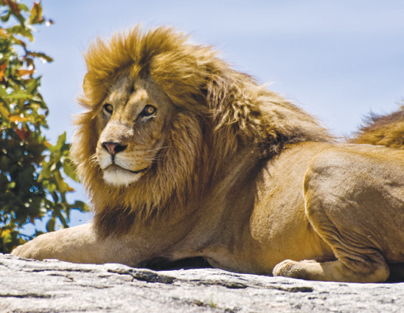
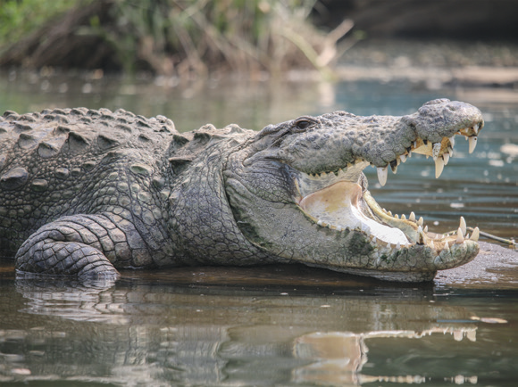
Safety Measures Against Harmful and Dangerous Animals
Some animals are useful to man; others are harmful. Harmful animals may attack and kill people. Therefore, people need to learn to be safe with animals.
Dangerous Animals
Crocodiles, Lions, Bears, and Tigers
They attack and kill people. When they are hungry, they hunt other animals for food. They have to be placed in a safe cage to avoid accidental escape which may cause injury to people. Avoid getting near them when visiting a zoo.

Slide 9
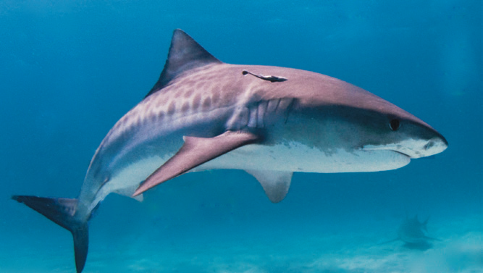
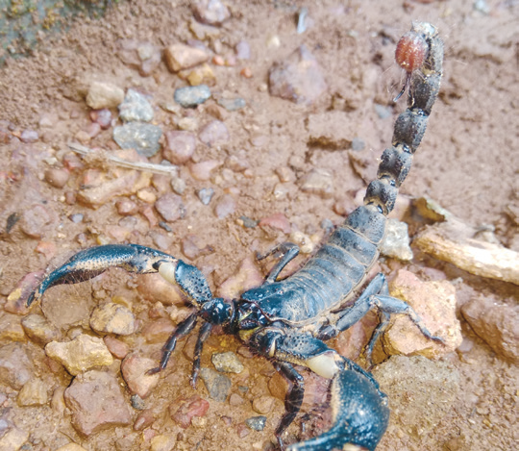
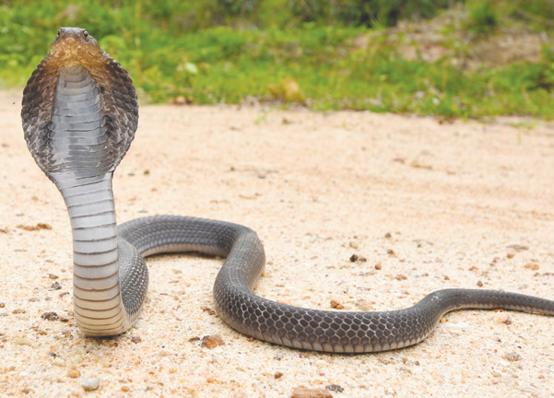
Sharks and Other Fishes
White sharks may sometimes attack swimmers. They may attack and eat people who are nearby, especially when they smell blood or mistake them for sea turtles, which are their common prey. Other dangerous fish include stingrays and stonefish which have poisonous spines that can injure or kill.
Snakes, Scorpions, and Some Insects With Venom and Sting
Not all snakes are poisonous, but there are snakes that are poisonous enough to kill a human. Dangerous snakes have venom that can kill.
Scorpions and some spiders, like the black widow spider, have a poisonous sting that paralyzes their preys.
When accidentally bitten by a snake, ask someone to tie a bandage around the bitten part of the body and go to the hospital for immediate treatment.

Slide 10
Harmful Animals
Dogs and Cats With Rabies
Bites from unvaccinated dogs and cats can cause rabies. Rabies is an infectious disease that affects the central nervous system. Rabies can be transferred to humans through the bite of an infected dog or cat. The rabies travels from the bite straight to the brain. To avoid this, take your pets to the veterinarian for anti-rabies vaccination. When someone is bitten by a dog, wash the wound thoroughly with soap and water. Then, bring the victim to a doctor immediately.
Rats
Black and brown rats carry the germs of several diseases like bubonic plague, food poisoning, and typhus. Rats also damage crops and other food products.

Slide 11
Harmful Insects
The favorite food of termites is wood. They eat the wood parts of houses and buildings and even furniture. Moths eat our woolen clothes and furs. Cockroaches eat our food and clothes. Ants are some of the most troublesome insects on Earth. They damage many of our things and food, too.
Insects cause various diseases in human beings in many ways. Some insects such as itch mites, can enter into our skin and cause skin irritation. Itch mites cause scabies, a skin problem. Insects carry disease-causing germs, too. Some of these insects are ants, cockroaches, flies, mosquitoes, lice, and fleas.

Slide 12
Some species of mosquito causes sickness to people. There are three types of mosquitoes known to us: the Culex, Aedes, and Anopheles.
The Culex mosquito is the most common type of mosquito. It is believed to transfer filarial worms that cause encephalitis, a rare brain inflammation.
The Aedes mosquito transmits yellow fever in some countries. In tropical countries like the Philippines, this mosquito transmits dengue fever.
The bite of a female Anopheles mosquito transmits protozoan that causes malarial fever.

Slide 13
Exercise Caution When Handling Animals
Never provoke carabaos, horses, goats, and other tame animals. These animals may harm or hurt you when they are disturbed or when they become frightened.
Cats and dogs must never be disturbed when sleeping or eating. Do not touch or get their young while they are nursing them. Never disturb bees and wasps in their nests. They will run after you and they will sting you.

Slide 14
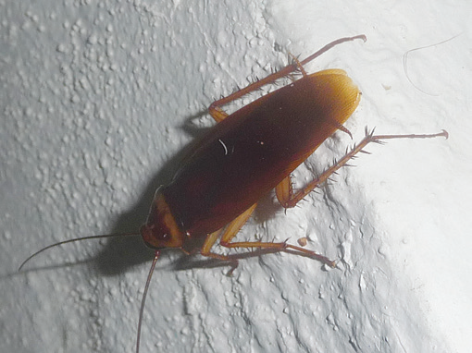
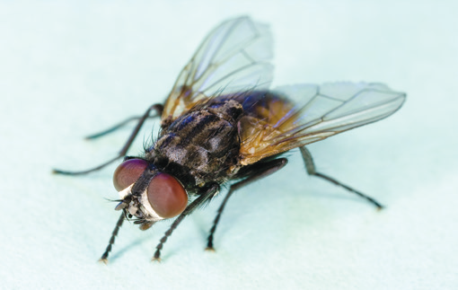
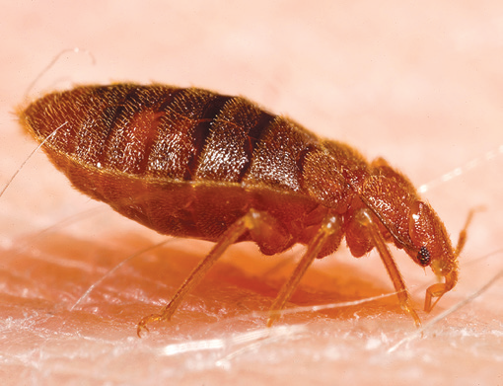
Get rid of flies, bedbugs, and cockroaches. Destroy their breeding places by spraying them with insecticides regularly.
Keep your place clean. Place a screen over your doors and windows to protect you from mosquitoes and other harmful insects.
Repair all openings where rats can enter your house. Use materials which they cannot gnaw or bite. Keep your backyard free from garbage. Keep house corners free from materials which can be used by rats as nests.

