Slide 1
Characteristics and Functions of Plant Parts

Slide 2
Characteristics and Functions of the Plant Parts
Roots
The roots of a plant grow downward into the soil. They get water and minerals from the soil. They also make plants hold on to the soil and make them stand upright.
Some plants have small and soft roots. Other plants have big and hard roots.

Slide 3
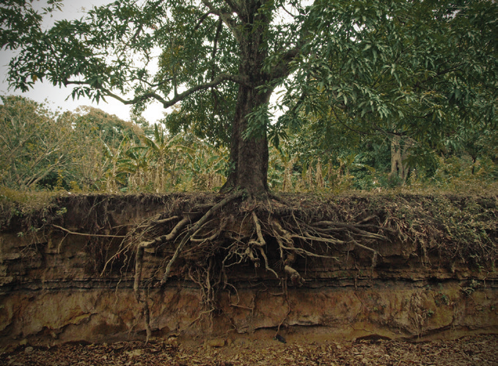

Slide 4
Stem
In a tree, the main stem is called a trunk. Branches are parts of the trunk. The trunk or stem grows above the soil. It is usually hard and strong, but some plants have soft stems.
The stem brings water and dissolved minerals from the roots to the leaves. The stem holds the leaves, flowers, and fruits. It also supports the plant so that it will not fall or drop.
The outer covering of the trunk is the bark. The inner part is the wood. Plants with soft stems do not develop bark and wood.

Slide 5
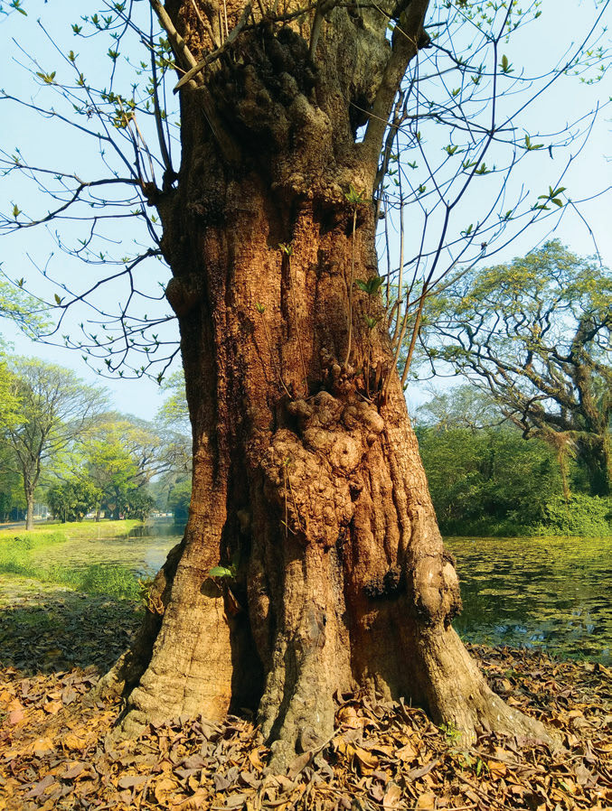

Slide 6
Leaves
Leaves grow from the plants’ stems or branches. The most important function of leaves is to make food out of water, air, and sunlight. The air gets into the leaves through tiny openings called stomata. The water enters the roots and goes to the stem until it reaches the leaves. The sunlight that shines on the leaves provides the energy that changes air and water into food.
The stalk of the leaf is called petiole. The petiole is attached to the stem. The margin is the side or edge of the leaf. The whole surface of the leaf is the blade. The network of lines in the blade of the leaf are called veins. The largest vein, found in the middle of the leaf, is the midrib.

Slide 7
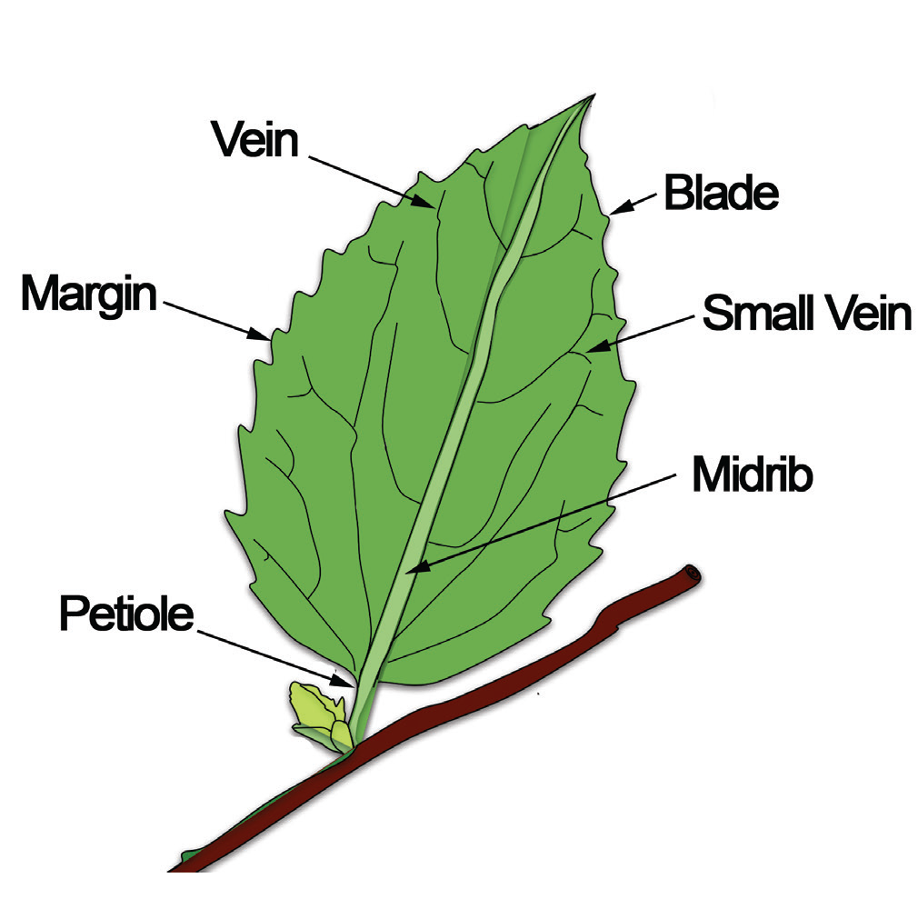

Slide 8
Flowers
The sepal is the leaf-like structure below the petals. All the sepals in the flower form the calyx. The calyx holds and protects the entire flower when it is still a bud. The petal is the most colorful part of the flower. The stamen is the male reproductive organ that produces pollens. The pistil is the female reproductive organ that produces the eggs. When fertilized, the eggs become seeds.
The flowers are the reproductive parts of plants. They produce the fruit and the seeds that grow into new plants.

Slide 9
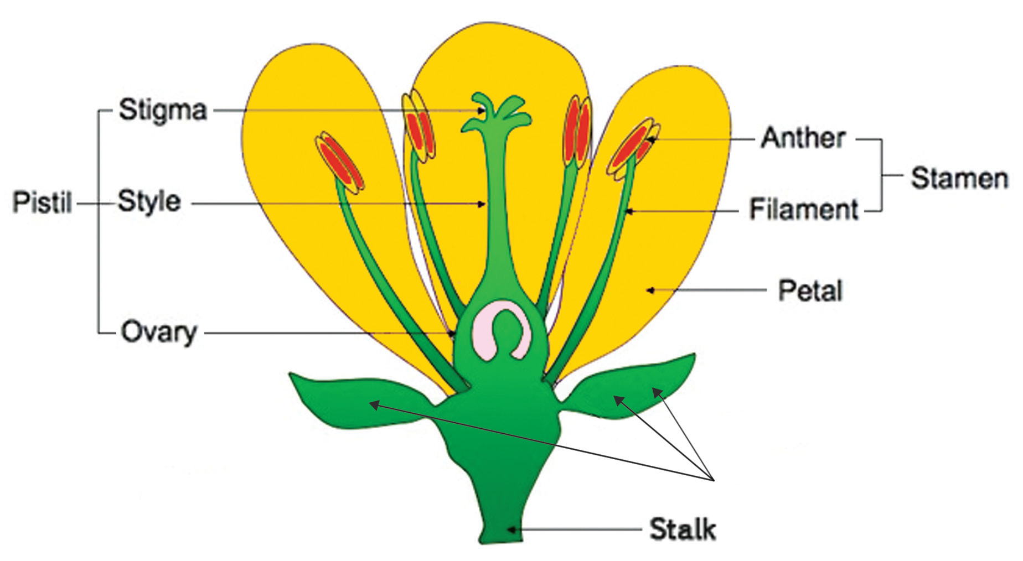

Slide 10
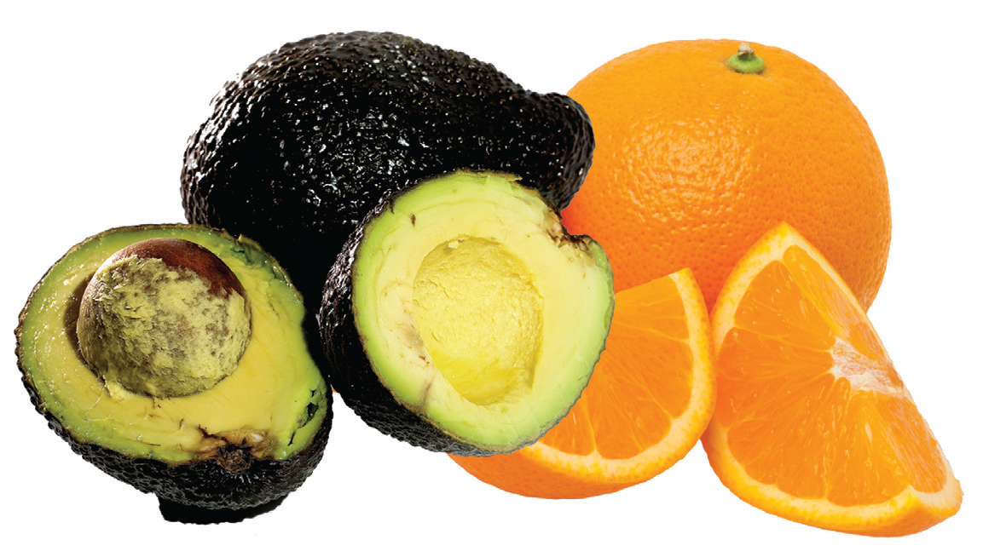
Fruits
Fruits come from the ovary of the flowers of plants. Fruits contain seeds. Some fruits are fleshy and with only one seed. Others have several seeds. Some fruits are dry and some are juicy.

Slide 11
Seeds
A seed carries a baby plant. It has stored food for this tiny dormant plant. A seed also has parts. They are the embryo, seed coat, and seed leaf. The embryo grows into a new plant. The seed coat protects the seed. The seed leaf or cotyledon contains food.
A seed encloses the young plant and carries stored food. The young plant uses this food to grow roots and leaves. As the young plant grows it can already make its own food.

Slide 12
