Slide 1
Comparing Parts of Different Plants

Slide 2
How Are Plant Parts Similar or Different?
Plants have different kinds of roots. Some plants have tiny and soft roots, while others have big, woody, and hard roots.
Some plants have primary roots that grow and become large fleshy roots. This type of root is called taproot. Examples of these plants are radish and carrots. Some plants have small and short primary roots where several secondary roots branch out and fully develop. This type of root is called fibrous root. Grass has fibrous roots.

Slide 3
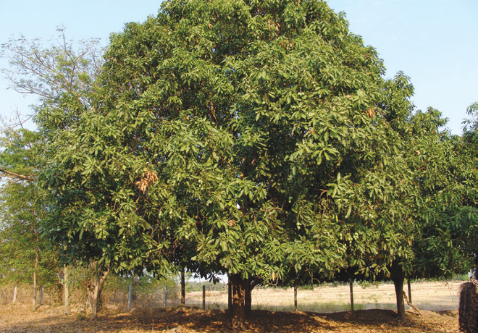
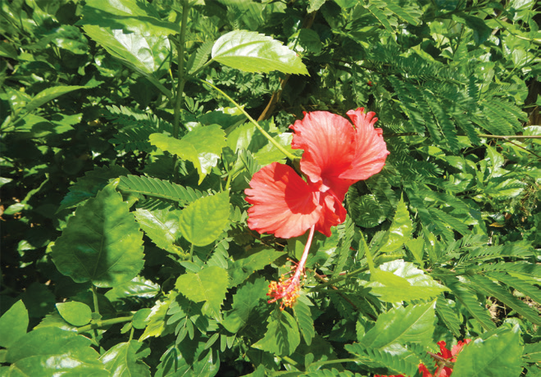
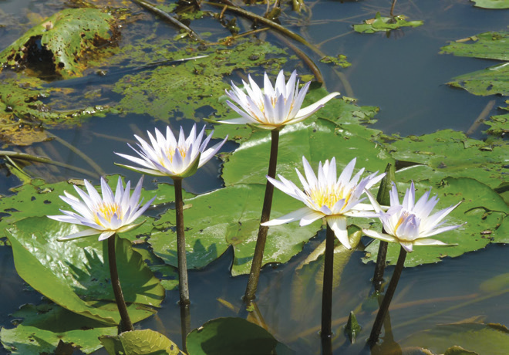
Plants have different kinds of stems. Some plants have hard stems, like gumamela and santan plants. Others have soft stems like water lily and pechay plants.
The main stem of a tree is very large, hard, and tough. The main stem is called trunk. A mango tree has a big trunk. Some stems grow underground or parallel to the ground. Examples of these are ginger, onion, and gabi.

Slide 4
Leaves differ in sizes, colors, and shapes. Some leaves are big, while others are small. Some leaves are round, oblong, and heart-shaped. Most plants have green leaves while a few have yellow or red in color. Leaves also differ in other factors such as texture, edges, and smell. The edges of the leaf blade differ among plants. Some may be smooth, others toothed, or zigzag. Some look torn or wavy. The texture may be fine, rough, velvety, or shiny.

Slide 5
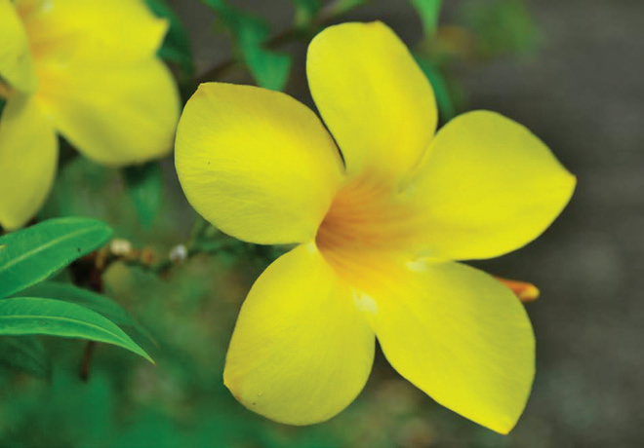
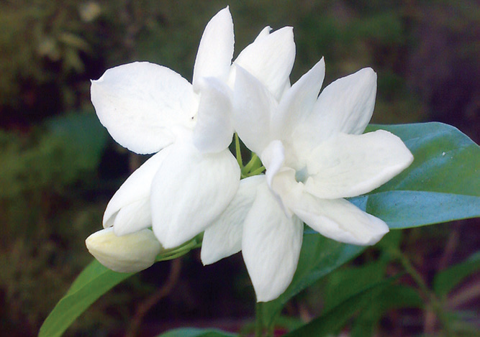
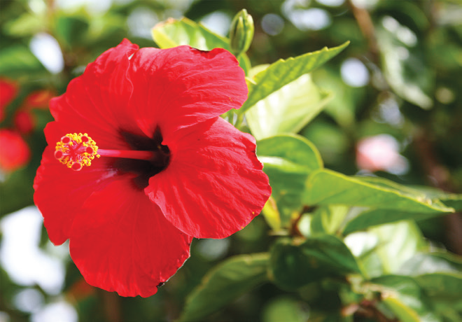
Some plants have flowers of different colors, smell, and sizes.

Slide 6
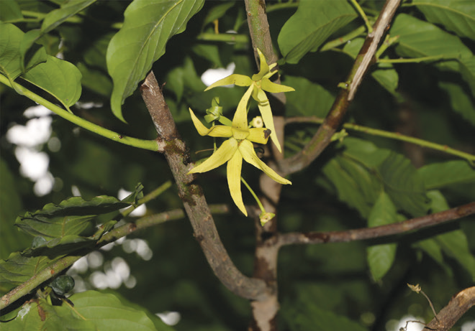
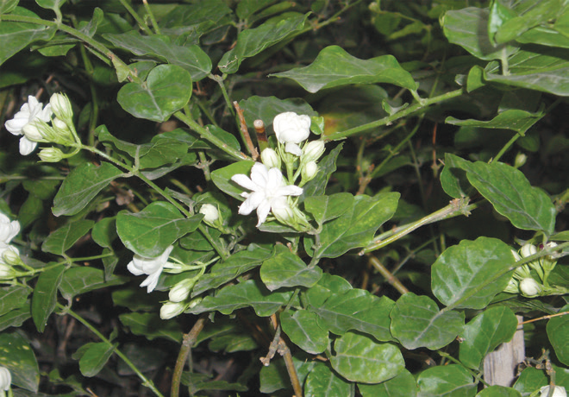
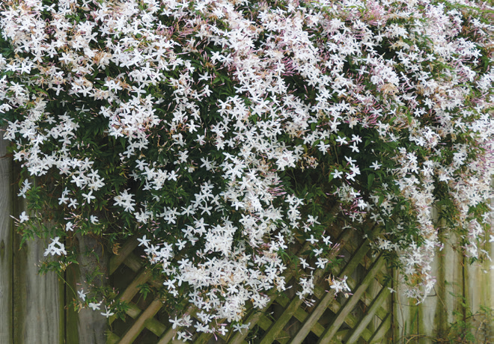
Some plants have fragrant flowers while others have flowers with unpleasant smell. Also, others are odorless flowers. Below are some fragrant flowers.
Most of these flowers are used in making perfumes, hand and body lotions, and shampoos. Plants that bear flowers are oft en visited by insects.

