Slide 1
How Plant Parts Help People and Animals

Slide 2
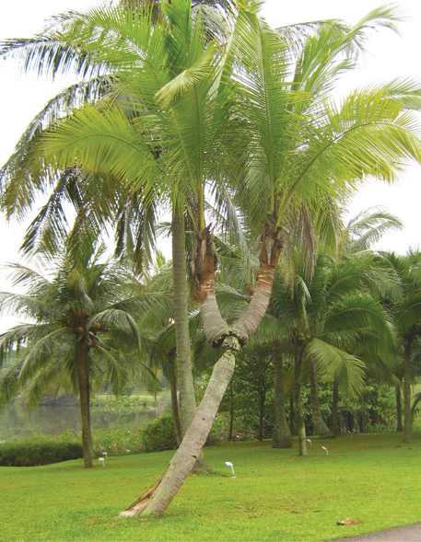
Importance of Plants to People
The coconut trunk is used for building small houses, boats, and furniture.

Slide 3
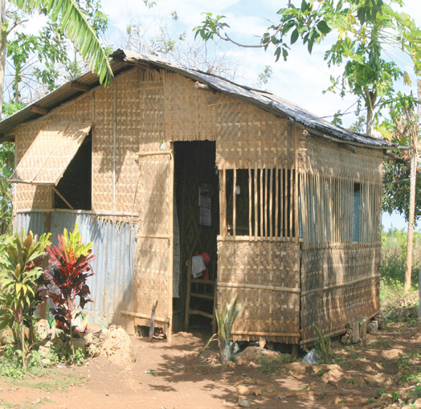
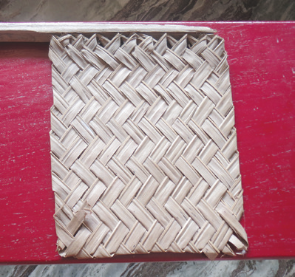
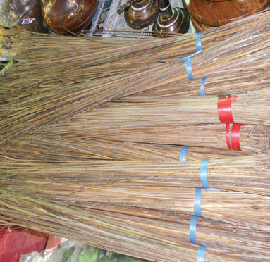
The coconut leaves can be used as temporary roofing materials. Their midribs can be made into brooms.

Slide 4
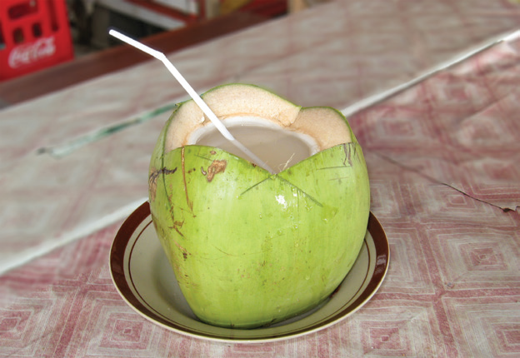
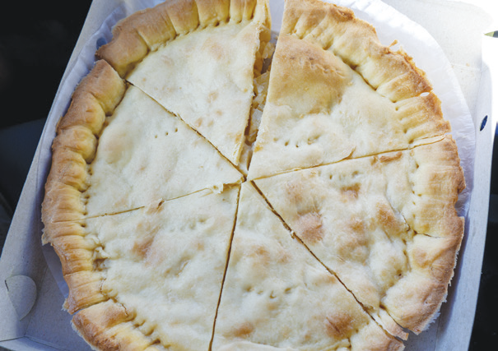
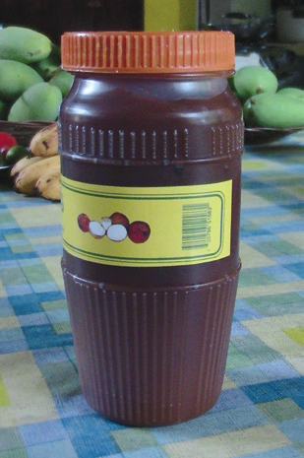
The young coconut fruit gives juice. The meat inside the coconut fruit can also be made into pie or jam. Then, the mature coconut fruit can be made into copra and oil.
Coconut water is a nutritious drink. It can also be used as therapeutic remedy for some illnesses.

Slide 5



Uses of Plants
Plants give people and animals food to eat. We eat root crops like carrots and sweet potatoes; the stems of kangkong and onion; the leaves of pechay and malunggay; fruits such as mango and atis; and the flesh and seeds of watermelons and squash. Animals need grass and other plant parts as food, too.
Plants, especially trees, give us wood for building materials. Examples of these trees are acacia, narra, and mahogany.

Slide 6
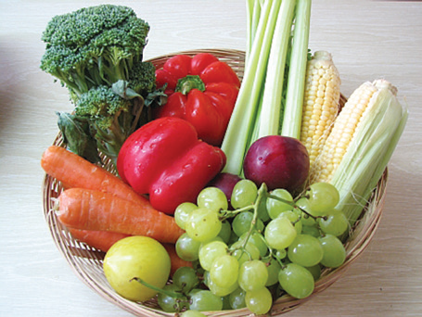
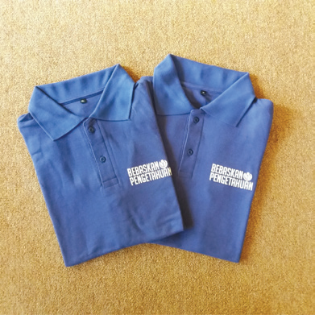
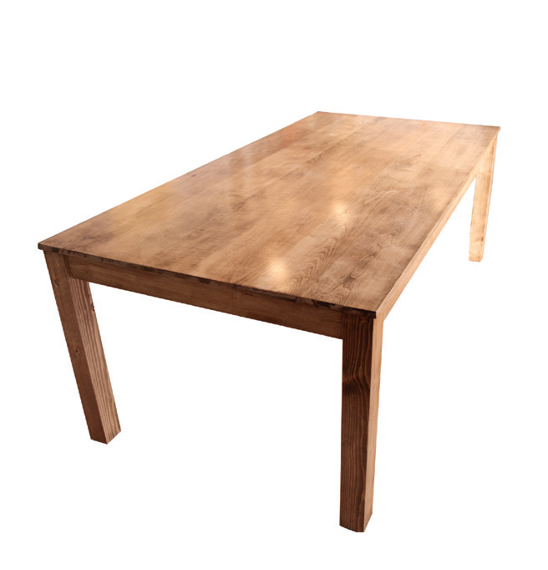

Slide 7
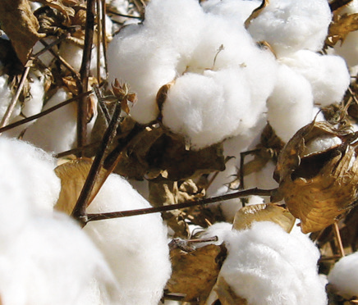


Some plants give us materials for our clothes. Cotton comes from the ripe fruits of the cotton plant. Piña cloth comes from pineapple fiber. This cloth is expensive. This is also exported to other countries.

Slide 8
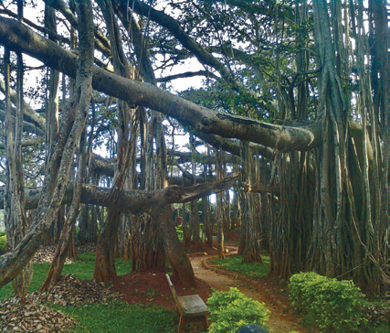
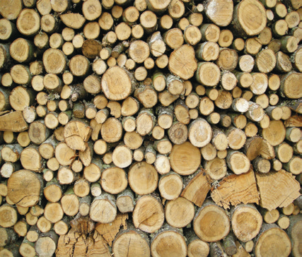
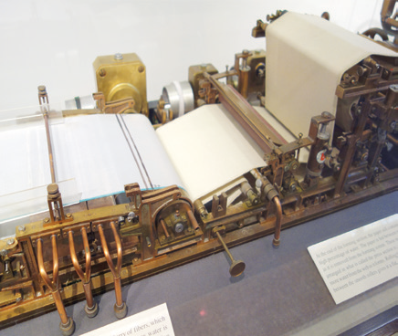

Other plants give us rubber and paper. Tires are made of rubber. Rubber comes from the latex of the rubber tree.
Another plant product is paper. Most paper is made from the pulp of trees.

Slide 9
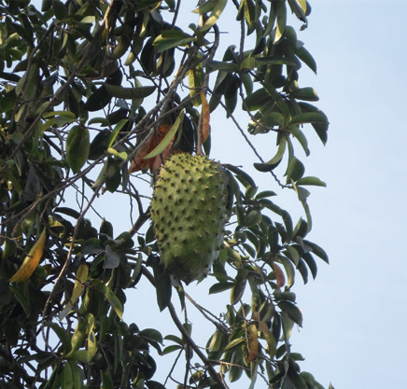
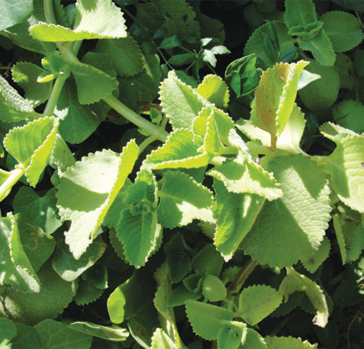
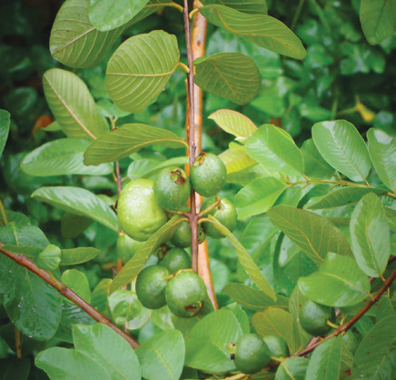
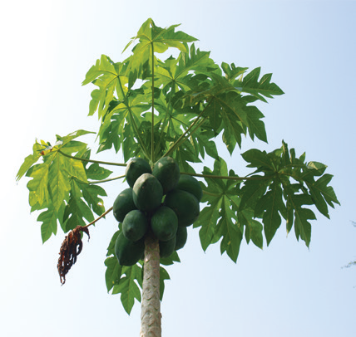
Some plants can also cure human diseases. These are called medicinal plants.

Slide 10

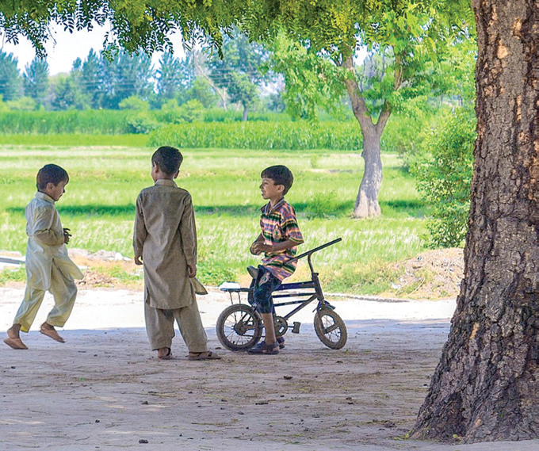
Trees give us shade. They also serve as homes to some animals.

