Slide 1
Proper Ways to Conserve Growing Plants

Slide 2
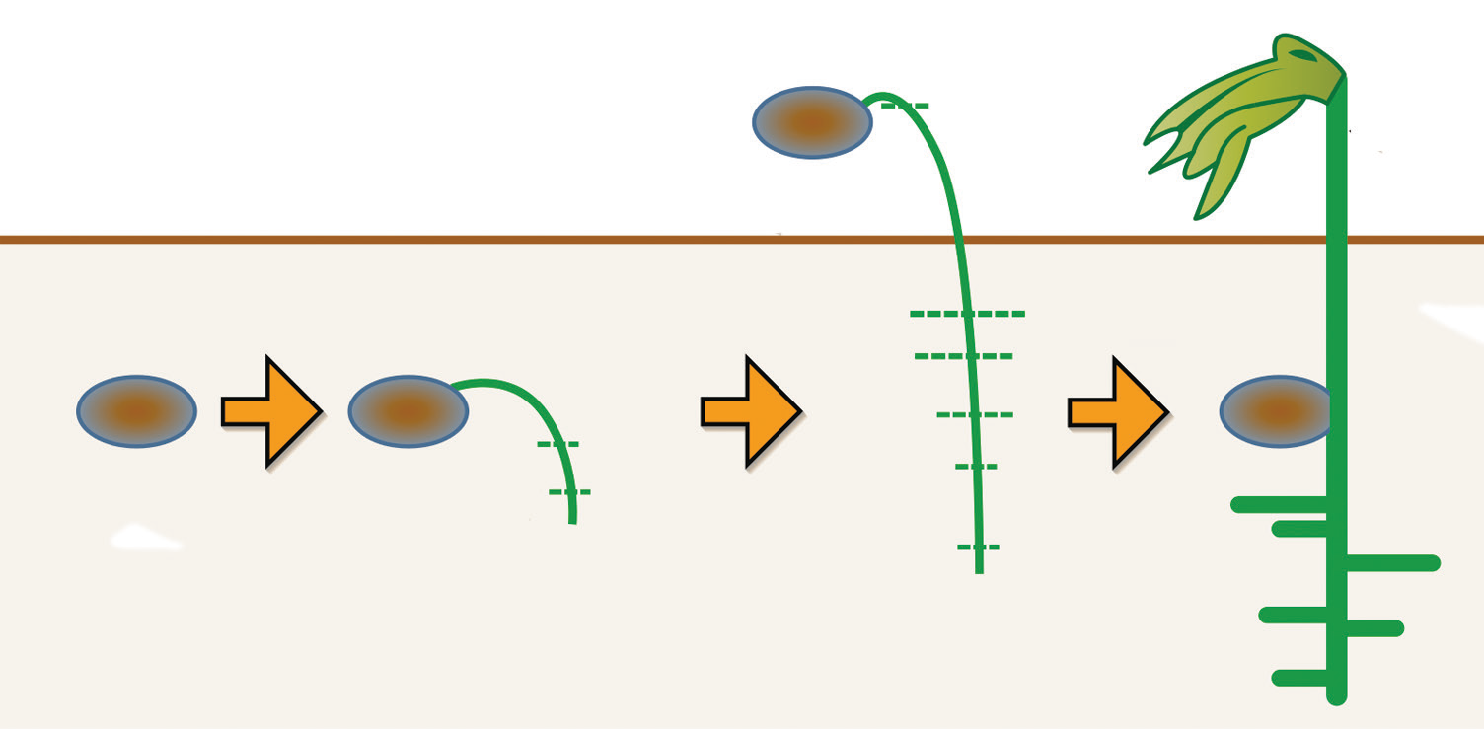
How Plants Grow
Plants grow. Their size and height change as they grow.
When a seed is planted under favorable conditions (good soil, enough water, and warmth), it grows roots, stems, and leaves. It becomes a small plant.
The plant undergoes changes as it grows. It changes in size and in height. The stem grows upward and spreads out in different directions. More branches come out. The size and the number of its leaves also change. Its roots continue to grow and develop. Some spread out sideward while the others grow deeper into the soil.

Slide 3
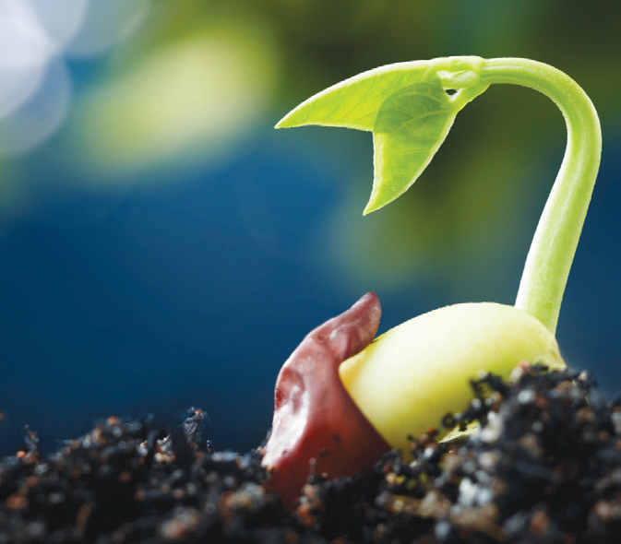
Ways of Growing Plants
Plants grow in different ways.
Most green plants grow from seeds. A seed contains a dormant or sleeping young plant. A seed has three main parts: the seed coat, seed leaves or cotyledon, and baby plant.
The baby plant uses the nutrients in the seed leaves as food. So, the seed leaves become smaller as the baby plant.

Slide 4
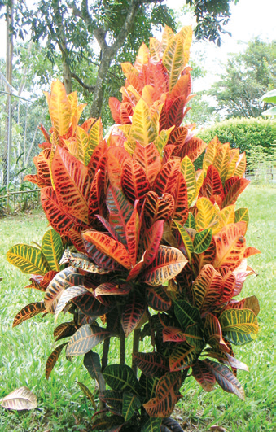
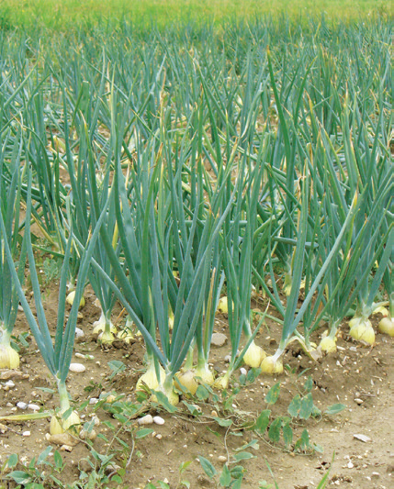
New plants can also grow from cuttings. Cutting is the process of trimming certain parts of the stem and then rooting them to produce new plants
The San Francisco, gumamela, and bougainvillea plants can be grown by cutting and planting a portion of their mature branches and planting them.
Some plants grow from bulbs. A bulb is a group of leaves that grows under the ground. Onions and lilies grow from bulbs.

Slide 5
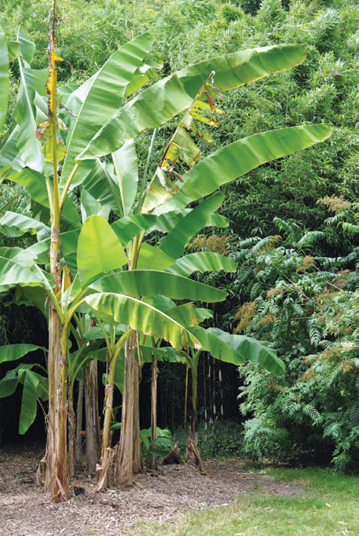
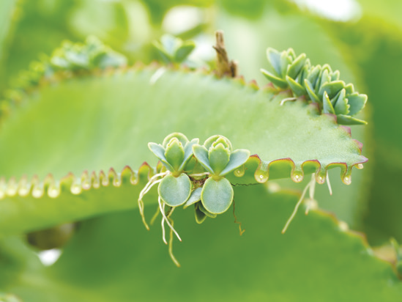
Some plants grow from shoots. Shoots are young plants that are not yet developed. Banana plants and bamboo plants grow from shoots.
New plants can also grow from leaves. A new plant can come out from a mature leaf. A new katakataka plant grows from the leaves of its mature plant. The katakataka plant is also called kalanchoe.

Slide 6
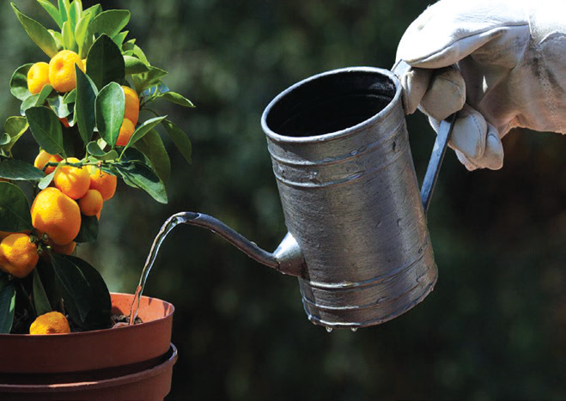
Needs of Plants to Grow
Like humans and animals, plants have needs in order to grow healthy. Plants need water, sunlight, soil, and air in order to live and grow healthy. They also need fertilizers. Fertilizers are plant nutrients which are added to the soil.
A healthy plant has fresh green leaves and has strong branches. Why? Water makes the leaves and stems of plants strong. The soil gives minerals which plants need in order to grow healthy.
Water is not enough to keep plants growing. Air helps the leaves, stems, and roots of plants grow strong and healthy, too.

Slide 7
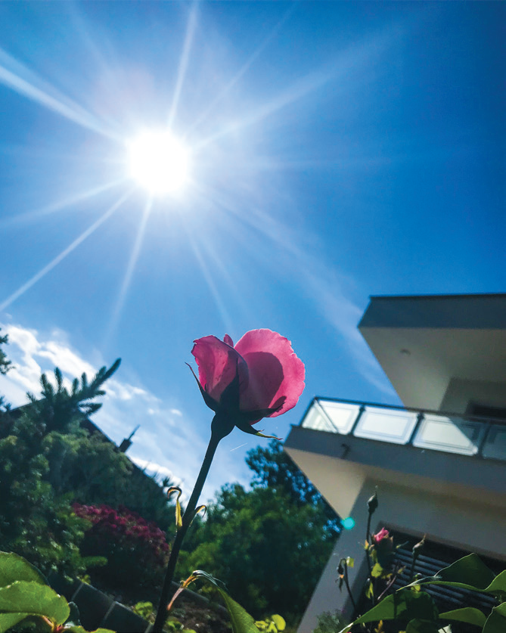
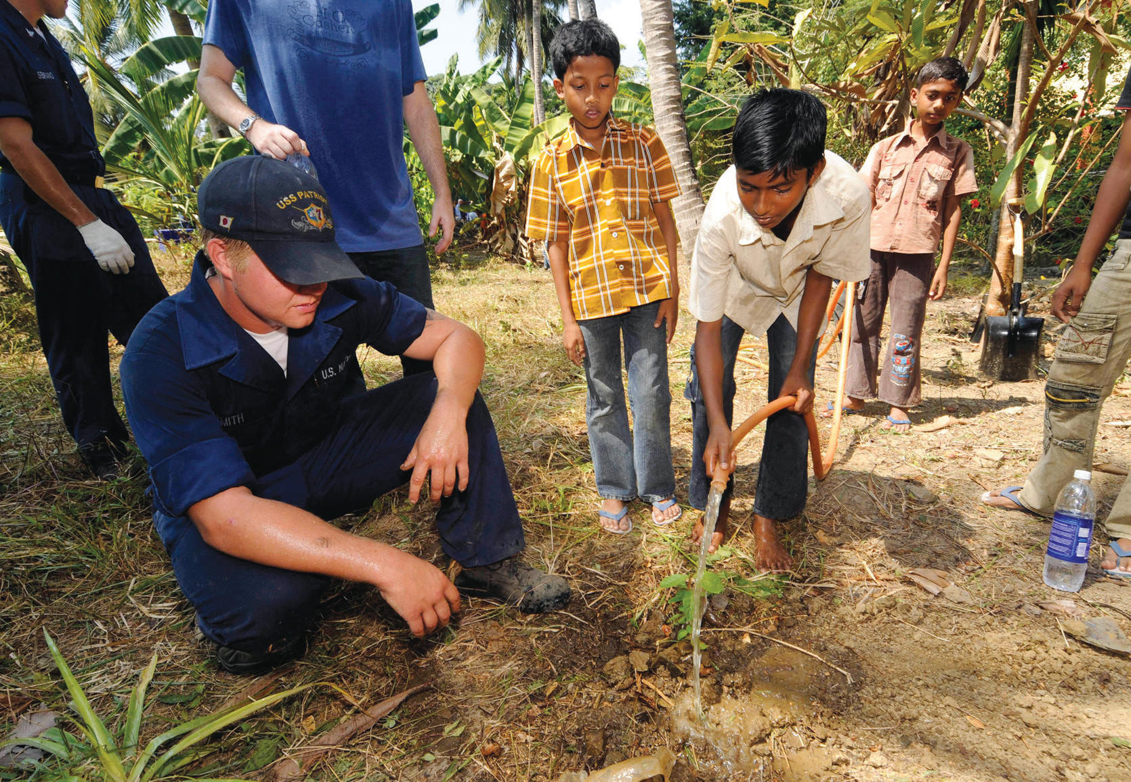
Sunlight helps plants manufacture food. The light is trapped by chlorophyll pigments that make the leaves green in color. Plants will die without water, air, soil, and sunlight.
Plants also need care. Plants grow better when we take care of them.

Slide 8
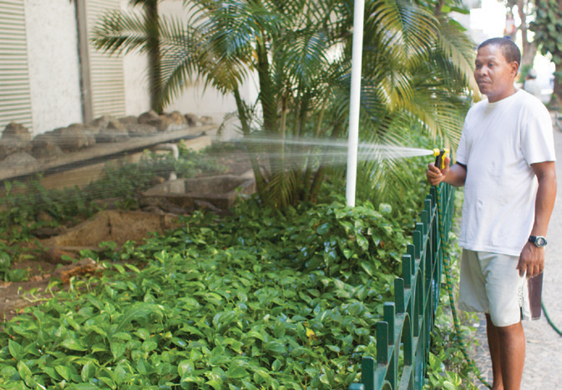
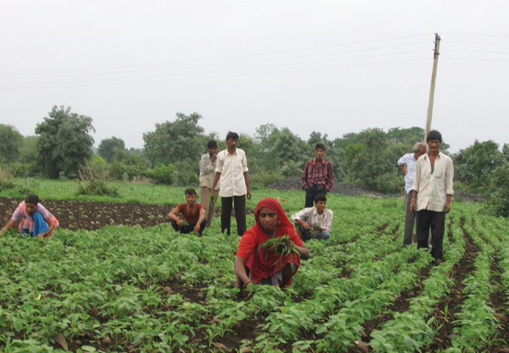
Ways to Show Love and Care for Plants
1. Water plants every day.
Pull out the weeds around and remove the pests from plants.

Slide 9
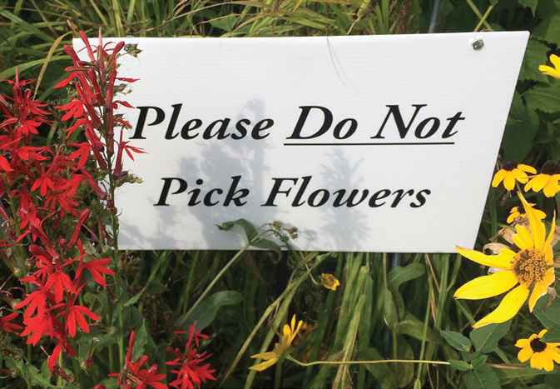
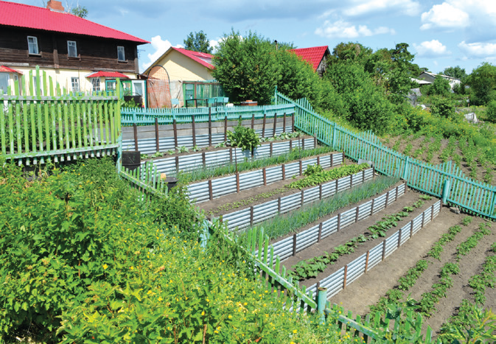
3. Avoid picking flowers.
Fence your vegetable garden to protect it from animals.

Slide 10
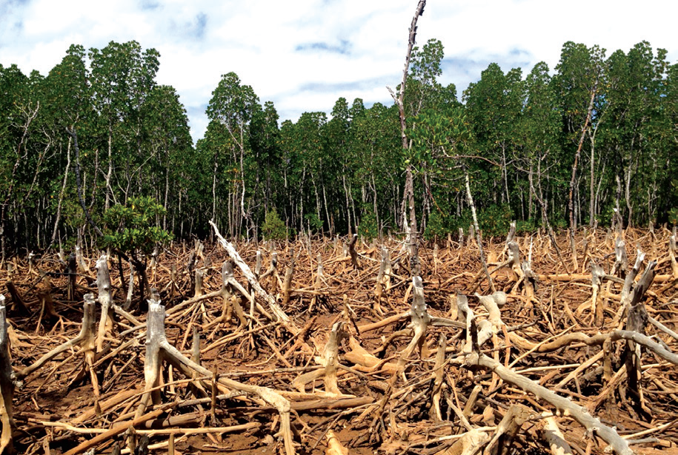
Plants and trees are very important to us and to animals because they provide materials for our shelter. They also protect the land by preventing soil erosion. However, some people cut down and burn down the big trees in the forests.

Slide 11
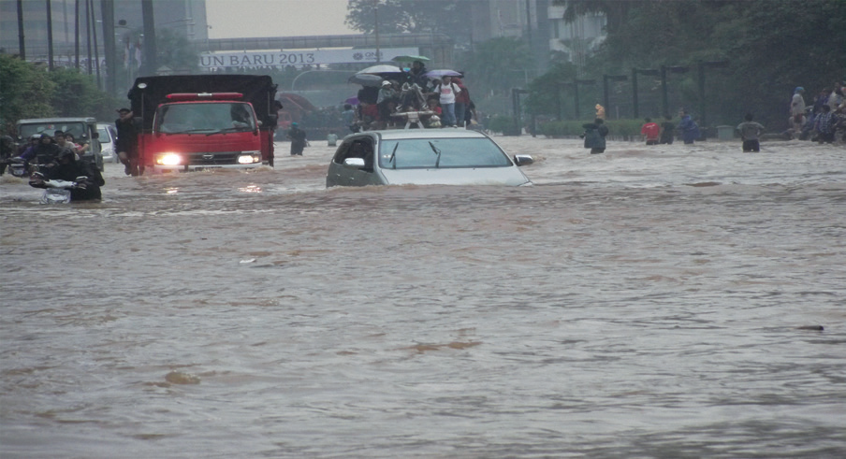
Animals in the forest will have no home. The lowlands will easily get flooded when heavy rains come.
Floods bring harm and destruction to people and properties. Crops, houses, and buildings may also be destroyed by floods.
Plants, especially trees, help prevent floods.

