Slide 1
Importance of Plants to Humans and the Proper Ways of Handling Them

Slide 2
Different plants have different uses. They are used as sources of food, clothing materials, building materials, and medicines. Plants are also used for decoration and beautification purposes.
Plants As Sources of Food and Oxygen
Plants are the only living things that can make their own food. They can do this because they have the green coloring pigment called chlorophyll. Plants need water and carbon dioxide to make food. As plants make food, they release oxygen which we breathe in. Without oxygen, people and animals will die. Without food, people and animals cannot live.

Slide 3
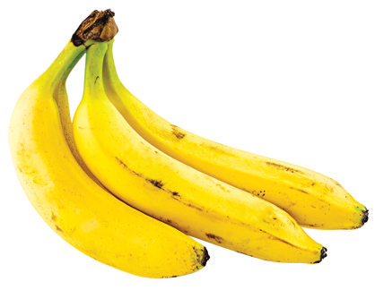
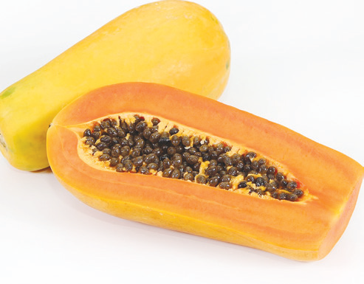
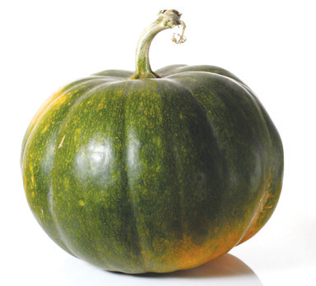
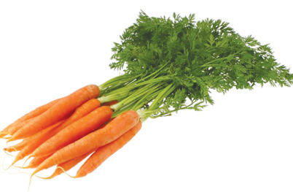
Most of the food you eat come from plants. The plant parts that can be eaten are the leaves, stems, roots, seeds, and fruits. Here are some foods that come from plants: rice, carrot, banana, papaya, squash, and kangkong.

Slide 4
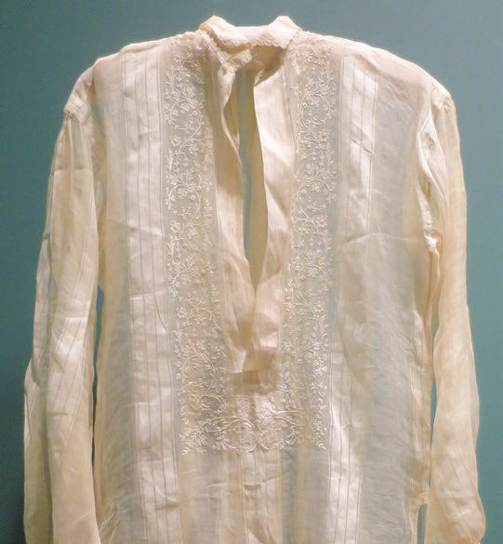
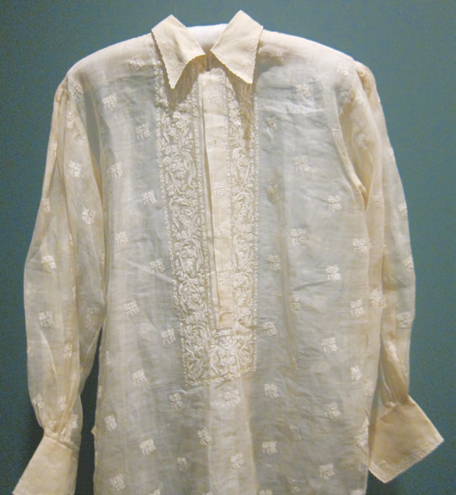
Plants As Sources of Clothing Materials
Many of the clothes that you wear are made of materials that come from plants. Cotton, piña, and abaca are good sources of fibers that are woven into clothing materials.

Slide 5
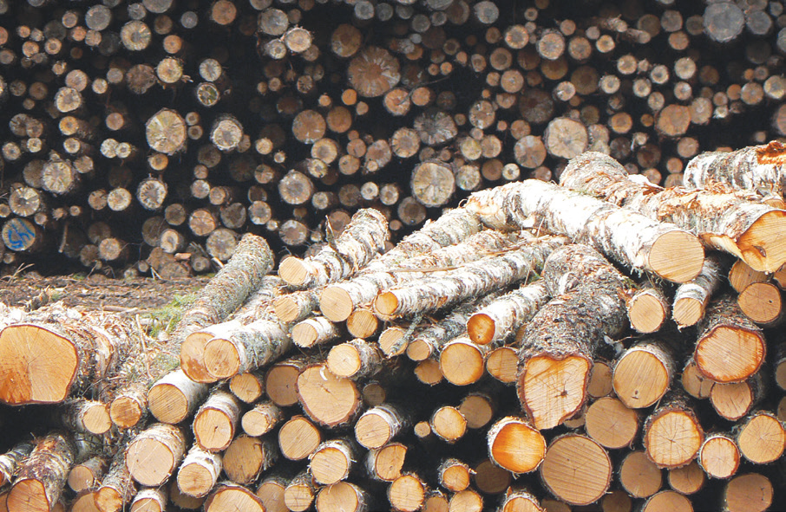
Plants As Sources of Building Materials
Wood comes from the stem or trunk of big trees. These trees are good sources of lumber or wood. Lumber is used as building material for housing and furniture. But the use of some big and sturdy trees for building materials are now restricted. Do you know why?
Other plants that are used for building purposes are bamboo, rattan, and coconut.

Slide 6
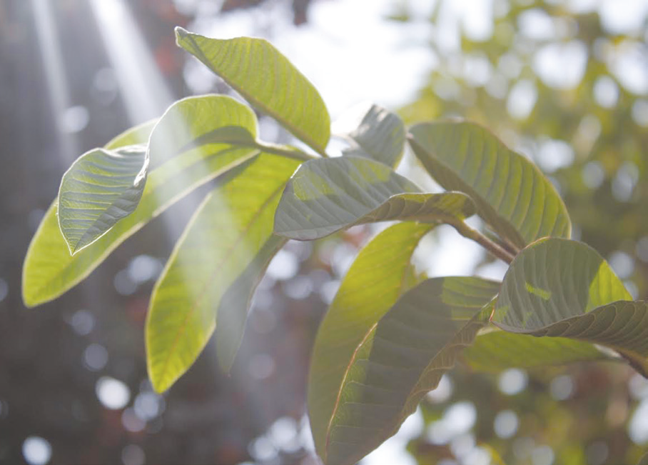
Plants As Sources of Medicines
Many plants have medicinal uses. They are used to cure common ailments. The leaves, stems, roots, flowers, and fruits of some plants are used as herbal medicines.
Here are some examples of medicinal plants:
Boiled guava leaves are good for cleaning wounds. They are also used for diarrhea and skin ulcers.

Slide 7
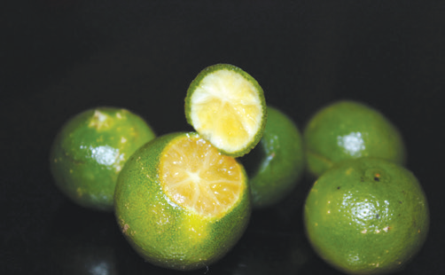
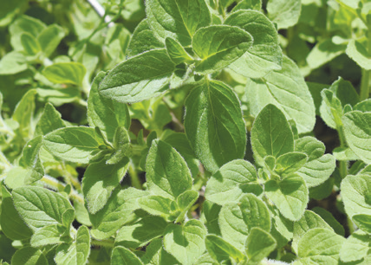
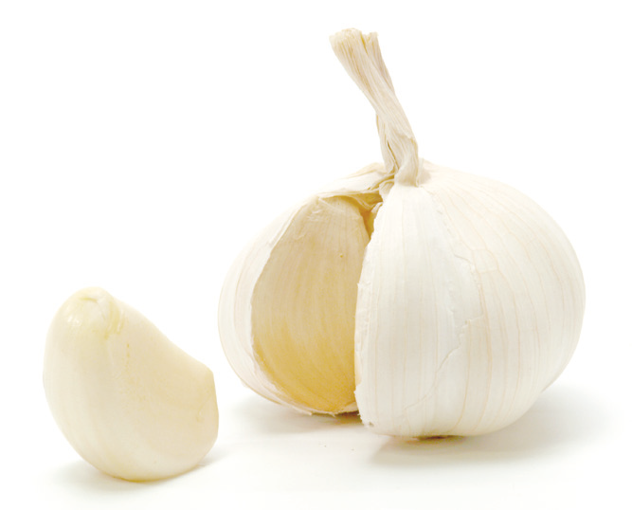
The juice and rind of calamansi are used for sore throat, cough, nausea, and fainting.
The juice of pounded oregano leaves is good for asthma.
Garlic is used for rheumatism, arthritis, headache, and insect bites. They are also good for the heart.

Slide 8
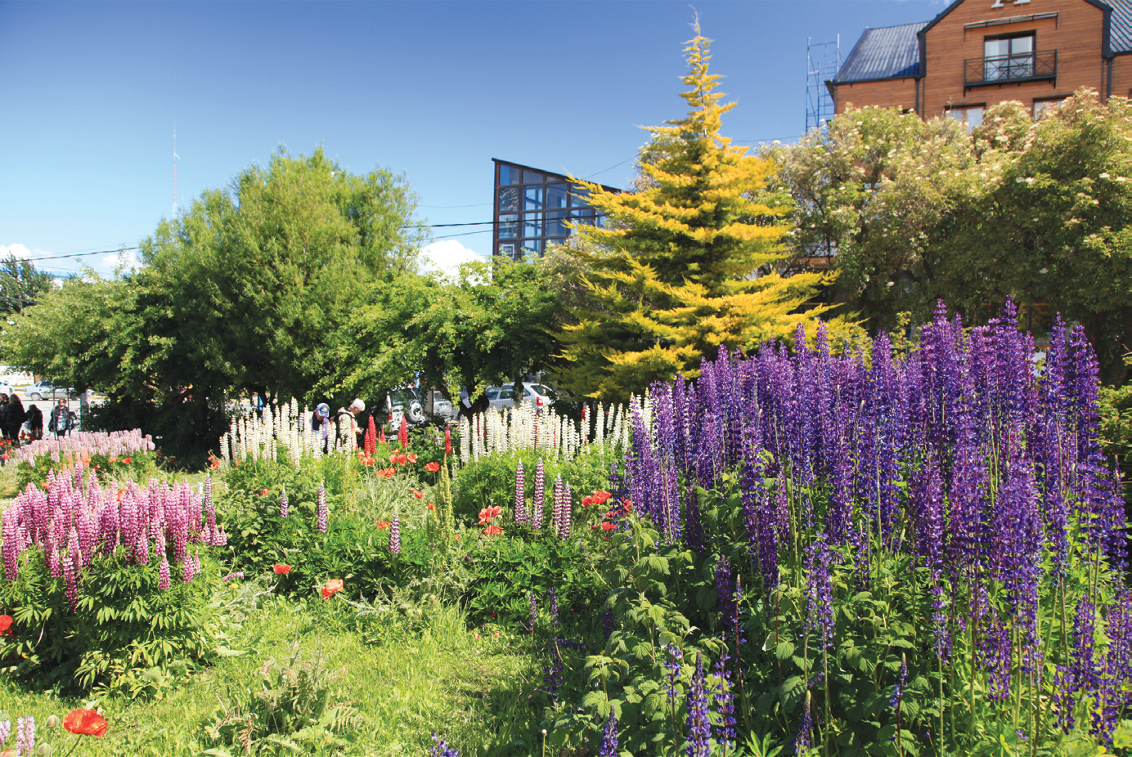
Plants Used for Decoration and Beautification Purposes
Flowering plants and ornamental plants are used for decoration and beautification of the surroundings. Gardens, parks, schools, offices, and houses are decorated with flowering and ornamental plants.

Slide 9
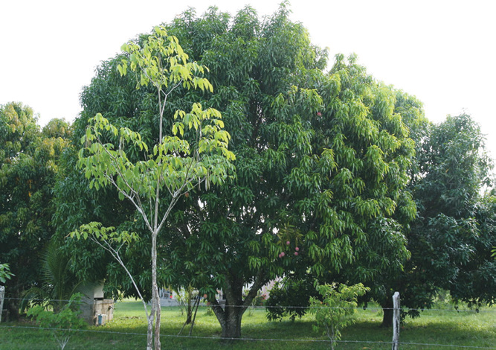
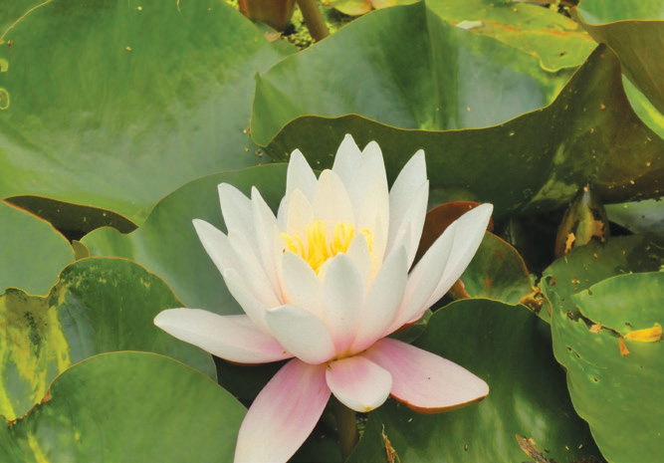
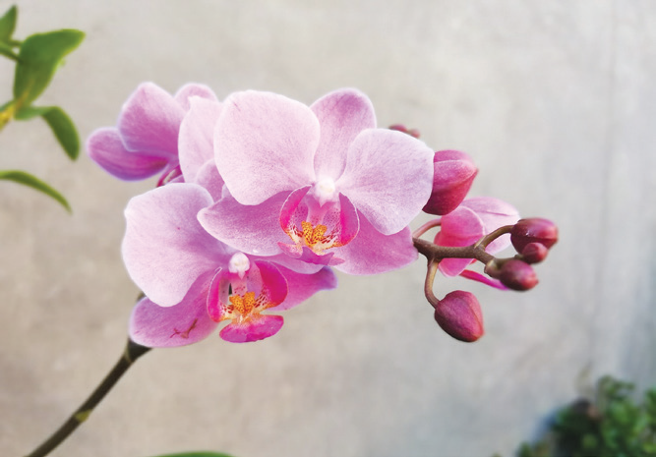
Caring for and Conservation of Plants
Plants grow in different places under different conditions. They have structures that help them adapt themselves to their habitat. Let us take care of the places where they live.
Do you know where plants live? Most plants live on land. They are called terrestrial plants. Some plants can live in the forests, deserts, mountains, or ground. Example of terrestrial plant is the mango tree. Other plants live in water. They are called water or aquatic plants. Examples of water plants are water lily, lotus, and duckweeds.
Other plants live on bark of trees like orchids.

Slide 10
Plants are very important to other living organisms. Without plants, other living things will die.
You should take care of plants by giving them what they need to grow. Do you know the needs of plants? They need rich soil, carbon dioxide, water, sunlight, and care. We must learn to take care of plants. And learn how to conserve them.
Here are some ways and suggestions on how to care of plants around you:
Provide plants with their basic needs. They need good soil, sunlight, air, and water. Plants get water and nutrients from the soil. They use water, air, and sunlight to make their food. Without them, plants cannot make their food. Without food, plants will die.
Put sufficient amount of fertilizer on the soil. Fertilizers contain important minerals needed for the growth and development of plants.
Remove unnecessary weeds around plants. Weeds compete with plants for space, nutrients, water, air, and sunlight.

Slide 11
4. Inspect the leaves and stems of plants for insect pests and dried leaves.
5. Keep animals away by surrounding them with a fence to avoid plants from being destroyed.
6. Till the soil around plants to allow air and other nutrients to pass through into the roots.
7. Conserve plants. Let us participate in tree planting activities.
8. Loggers should only cut down mature trees, and they must replace the trees they cut.

Slide 12
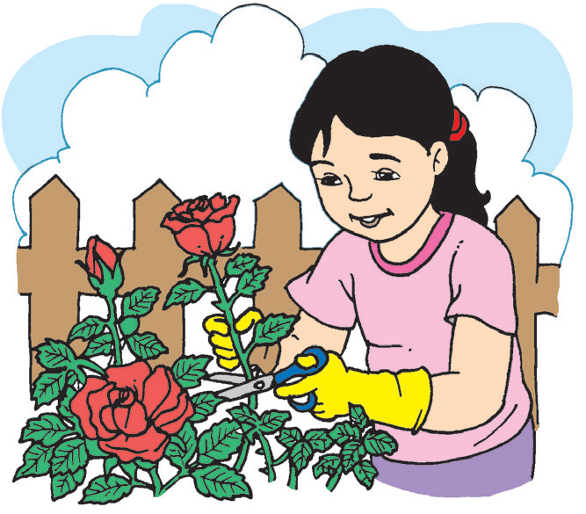
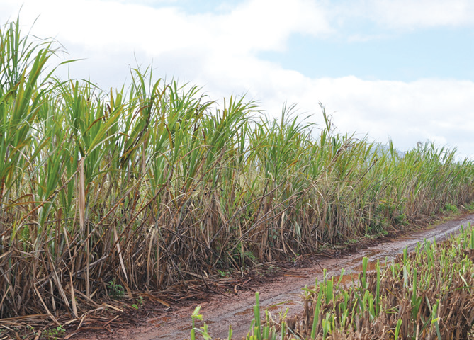
Safety Measures in Handling Harmful Plants
Not all plants are helpful to people. Some plants can harm you. Do you know which plants can be harmful?
Some plants like roses, bougainvillea, and cacti have thorns. They can prick your fingers. If you need to cut their stems, use a pair of scissors and wear gloves.
Other plants have sharp leaves. They can cut your skin if you are not careful in handling them.
Examples of these are the leaves of the cogon grass and sugar cane.

Slide 13
Some plants have fragrant flowers. Avoid placing these flowers close to your nose when you smell them. Scents sometimes contain chemicals that can irritate your nose.
There are poisonous plants like the lily of the valley, daffodil, and rosary pea. They can make you really sick and can lead to death when ingested. Do not touch them. If you accidentally hold them, wash your hands with soap and water.
The poison ivy is another poisonous plant. It has leaves that consist of three leaflets. It produces poisonous oil that irritates the skin. Its berry-like fruits are also poisonous. Avoid physical contact with this plant. Never touch this plant with bare hands.

Slide 14
First-aid Treatment for Skin Allergies and Irritations Caused by Plants
Clean the part of the skin which is itchy or reddish with soap and water. After washing the affected area, wipe it with a clean cloth and apply a thin coat of medicated ointment to relieve itching and swelling of the skin.
If the condition of the skin does not improve, see a doctor immediately. The doctor can prescribe some drugs for skin allergies and irritations.

