Slide 1
Plant Parts and Their Functions

Slide 2
There are many plants around us. Different plants have different characteristics. Some are big, some are small. Some are green, some have different colors. But all of them have leaves. Most of them are rooted in soil.

Slide 3
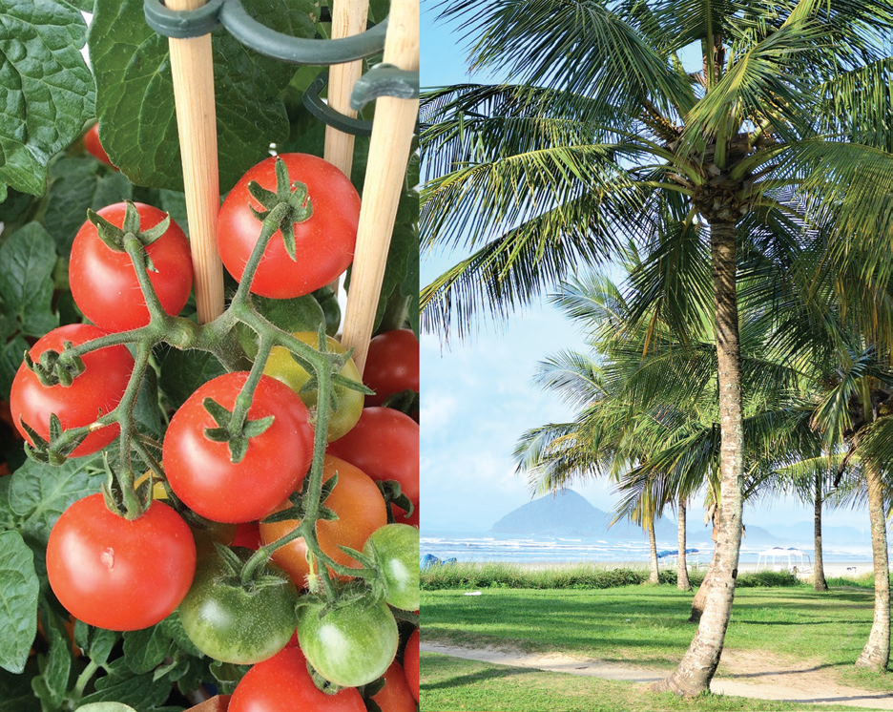
Plant Parts of a Tomato Plant and a Coconut Tree
The basic parts of plants are leaves, stems, and roots. However, there are plants that have other parts not common to all.
Here are two plants. One is big while the other is small.
A tomato plant is a small plant. It has roots, leaves, stems, flowers, and fruits.
A coconut tree is a big plant. It has a trunk, roots, leaves, flowers, and fruits. The trunk is the main stem of a tree. It is different from the branches.
The tomato plant and the coconut tree are examples of flowering plants.

Slide 4
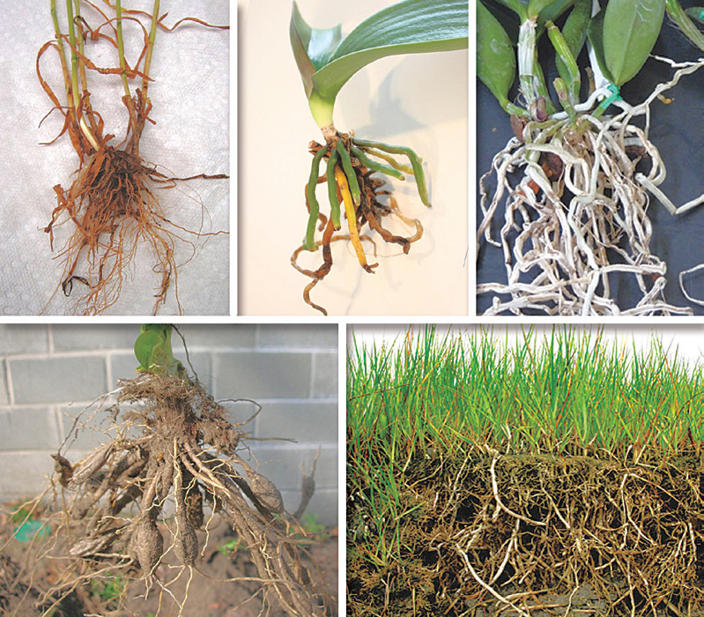
Plant Parts and Their Functions
The following are the plant parts and their functions.
Roots
All plants have roots. The roots hold the plants in the soil. The many tiny root hairs at the tip of each root get water and minerals from the soil. They absorb water and send it up to the stem and leaves. Most roots are brown. Some are green, others are white. Some are big, others are small. Plants need water and minerals to grow and stay alive.

Slide 5
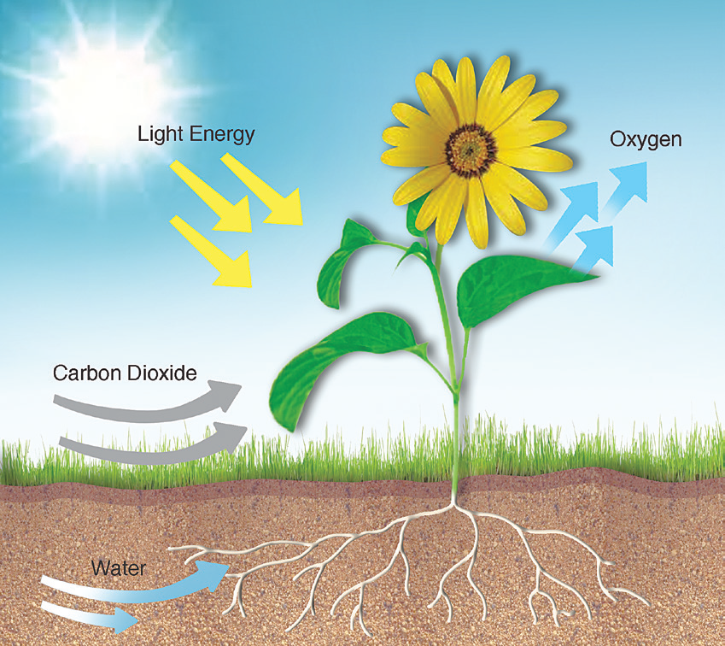
Leaves
Most leaves are green. Green leaves make food for the plant. Plants need water, air, and sunlight to make food. How does a plant get these things?
The water from the roots goes up to the stem then to the leaves. Carbon dioxide from the air enters through the very tiny holes in the leaves called stomata. Sunlight helps the green leaves change water and carbon dioxide to food for the plant. This food is sugar.

Slide 6
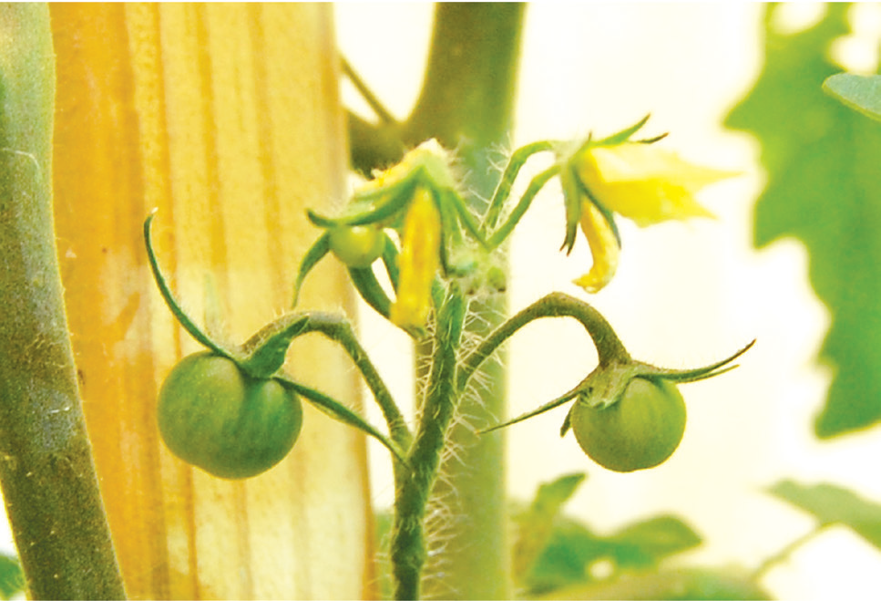
Stems
The stems support the leaves, flowers, and fruits. They also deliver food and water to all parts of the plant.
The stem is made up of many tiny tubes that extend to the leaves and roots of the plant. Some of the tiny tubes transport water from the soil to the leaves. Another group of tiny tubes transport food from the leaves down to the roots of the plant.

Slide 7
Flowers
Flowers help produce new plants. They have beautiful colors and some have fragrant smells. A part of the flower called ovary develops into a fruit.
Flowers have sweet juice called nectar at the base of their petals. The color and smell of flowers attract insects.
Fruits
Fruits contain the seeds of a plant. Some plants produce fruit. Other plants do not produce fruit. Some fruits are eaten by people and animals. Others are eaten by animals only.

Slide 8
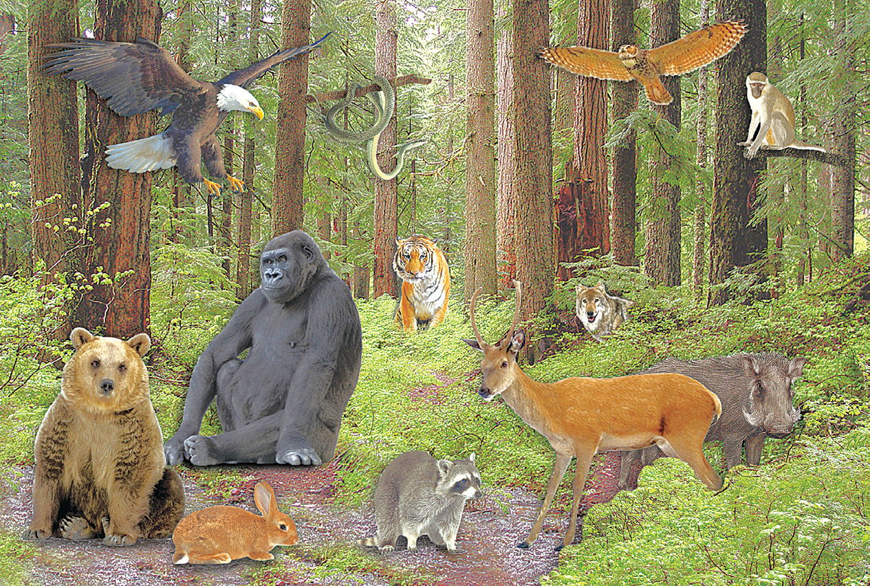
Plants in the Forest
Forests are useful to animals because they provide animals with much food. There are many kinds of nuts, berries, and leaves for them to eat. In the forest, there are plenty of insects for other animals to munch on too. Many animals make their homes in the trees. They can raise their young and rest there safely during cold days. They can also use the trees to hide from their enemies.

