Slide 1
Your Body Parts

Slide 2
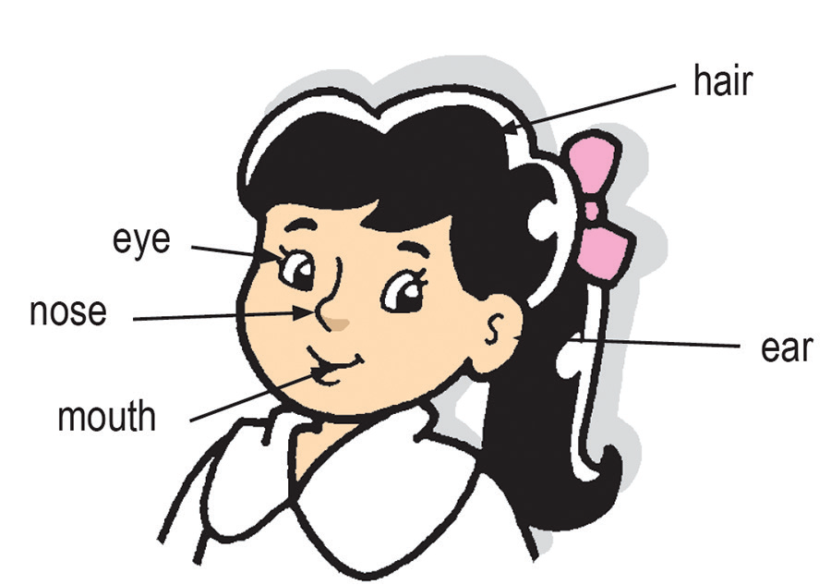
Main Parts of the Body and Their Functions
Your body has three main parts. These are the head, the trunk, and the limbs.
Head
Your head is at the very top of your body. The front part of your head is called the face. The face is made up of the forehead, cheeks, chin, eyes, nose, mouth, and ears. The tongue, lips, and teeth are parts of your mouth.
The different parts of the head.

Slide 3
The top and back parts of your head are covered with hair. Hair keeps your head warm. Each hair grows out from a tiny hole in the skin. The roots of your hair get food from the blood. This makes your hair grow. The hair on your head keeps on growing all the time.
The head has the eyes, ears, nose, and the tongue in the mouth. These are four of the five sense organs and they let you see, hear, smell, and taste, respectively. Can you point to these sense organs and name them?
The skull is the bone that supports these delicate organs or parts. The skull also protects the brain which is inside the head.
The head is connected to the trunk of the body by the neck. The neck allows the head to turn left and right. It also helps the head move upward and downward.

Slide 4
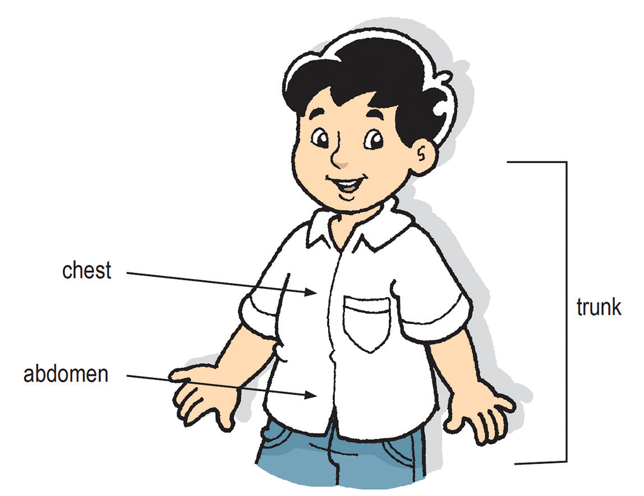
Trunk
Your trunk is also called the torso. Your trunk is made up of the chest and abdomen. Your head and limbs are connected to your trunk. It is supported by a number of bones. The bones in the trunk protect your internal organs.
The different parts of the human trunk.

Slide 5
The heart and lungs are inside your chest. The stomach and intestines are inside your abdomen.
The navel or the belly button is the part where your umbilical cord was once attached. The umbilical cord connects the unborn child to the mother during pregnancy.
A group of bones supports the whole trunk. These bones make up the vertebral column, the ribs, and the hip bones.
The ribs support the chest. The rib bones protect the lungs and the heart.
The trunk has many muscles that work in different ways. Some muscles hold the body in an upright position. Other muscles connect the backbones and the hips while other muscles make the arms and shoulders work together.

Slide 6
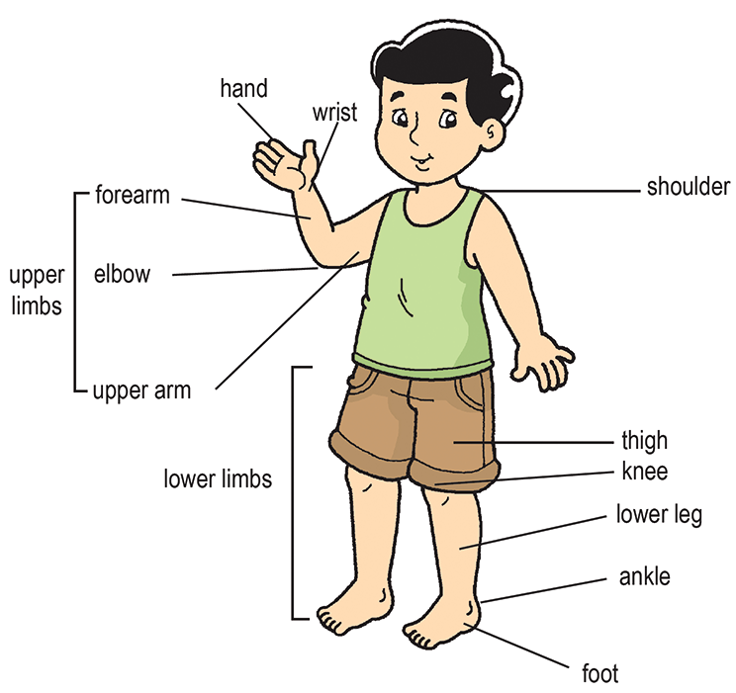
Limbs
The limbs are the most movable parts of the body. Your limbs are made up of two parts: the upper limbs and the lower limbs.
The upper limbs are composed of the upper arm, elbow, forearm, wrist, and hand. The hand consists of the palm and fingers. You can extend your arms and forearms to reach out. The fingers of your hands can pick up, grasp, and hold objects.
The lower limbs are composed of the thigh, knee, leg, ankle, and foot. They are used for running, walking, and jumping.
The upper limbs and the lower limbs.

Slide 7
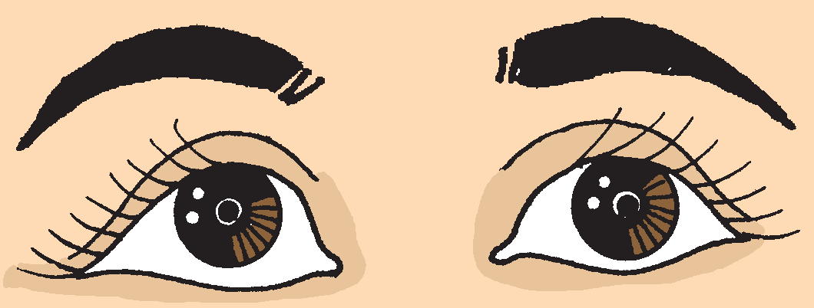
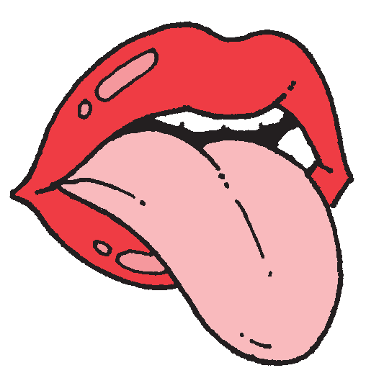
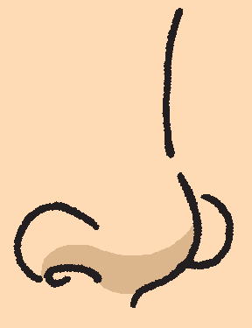
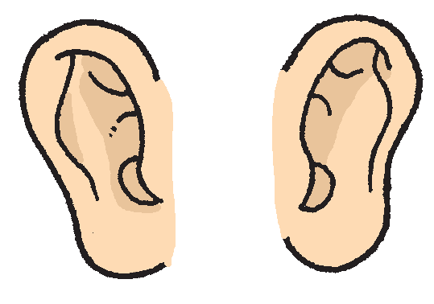
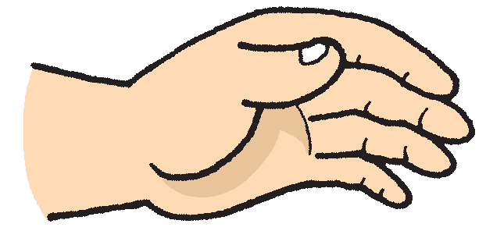
Your Active Sense Organs
The eyes, ears, nose, tongue, and skin are your sense organs.
The different sense organs of the body.

Slide 8
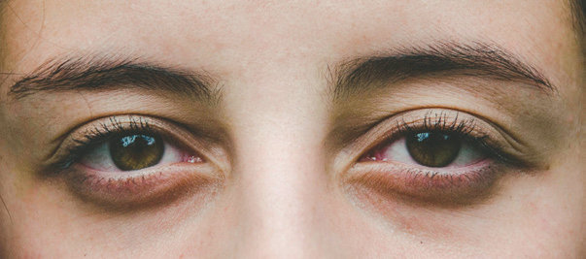
Your sense organs tell you about the things around you. Without these sense organs, it will be difficult to enjoy your surroundings.
Sense organs help you see, hear, smell, feel the things in your environment, and taste the different food you eat.
If you do not take good care of your sense organs, they can become weak and may not work properly. Germs can easily enter your body which can make you sick.
The Eyes
The eyes are the organs of sight that help us see things around us.

Slide 9
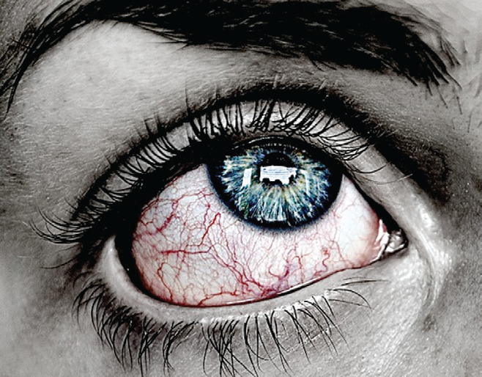
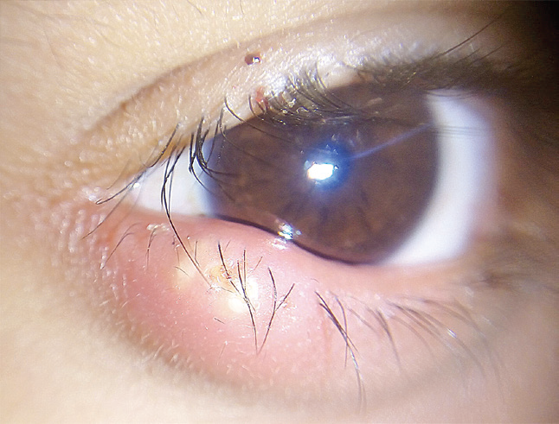
Common Diseases of the Eyes
Sore eyes – It is the redness and swelling of the covering of the inside of the eyelidsand the whites of the eyes. This disease causes itching and tearing of the eyes. Sore eyes can spread easily.
Sty (kuliti) – It is a painful swelling on the margin of the eyelids. It forms a lump that has a whitish or yellowish spot.

Slide 10
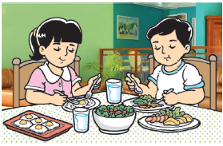
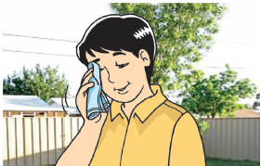
Care for the Eyes
The following are some ways to care for your eyes.
Eat food best for the eyes. Some examples of these food are eggs, carrots, sweet potatoes, and green leafy vegetables like spinach and kale.
Do not rub your eyes if they feel itchy. Wipe your eyes with a clean towel or handkerchief.

Slide 11


Make sure that you are not too close to the screen when you watch TV or use the computer or cellphone. You should also avoid reading in a moving car or in the dark.
Do not look directly at the sun. It can hurt your eyes and cause blindness. It can also lead to illnesses like cataract.
Rest your eyes from time to time. You can do this by looking at far and green objects. You can also rest by closing your eyes.
6. Visit an eye doctor or specialist regularly to avoid some diseases of the eyes.

Slide 12
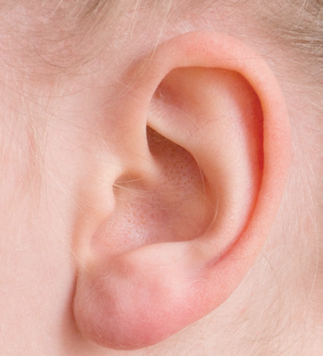
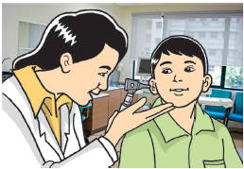
The Ears
Our ears help us hear the sounds around us. They are very important when you are studying or talking to others.
Common Disease of the Ears
One of the common diseases of the ears is ear infection. It is painful and causes difficulty in hearing.

Slide 13
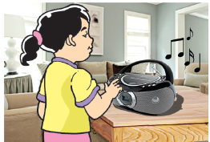
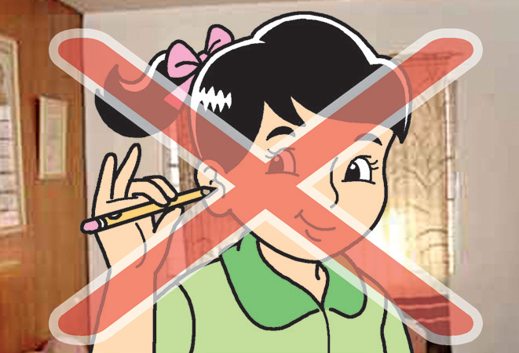
Care for the Ears
The following are some ways to care for your ears.
Protect your ears from the loud blowing of horns, shouting, and other loud noises. Avoid listening to the radio and watching TV on full volume.
Do not use or put any pointed or sharp objects, such as a hairpin, matchstick, and pencil, in your ear. Cotton buds can be used to clean only the outer part of your ear. Tell your parents if you feel any ear pain.

Slide 14
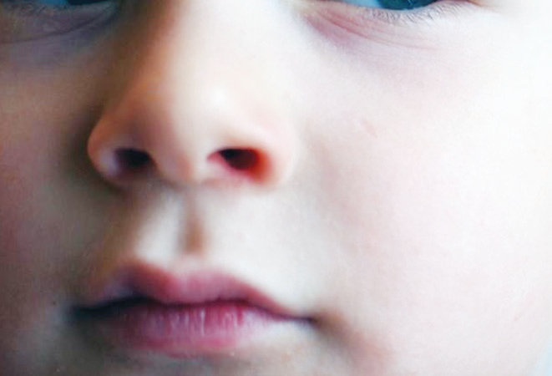
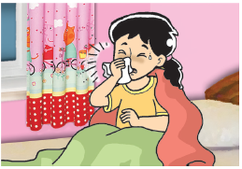
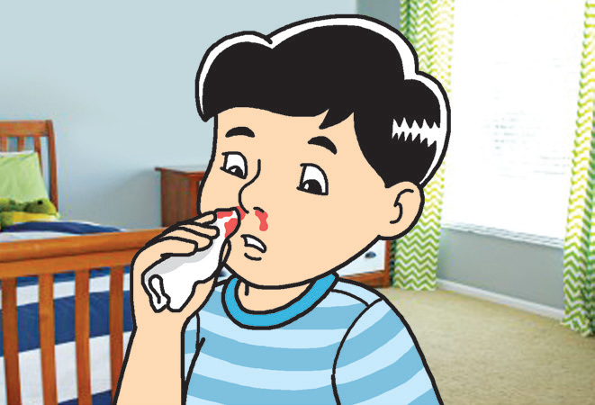
The Nose
Our nose is the sense organ for smell. It also helps us to breathe. We breathe in and breathe out through our nose.
Common Diseases of the Nose
Allergies and Common Colds – These two conditions may cause problems by producing too much mucus. This can lead to sinus infection if not treated immediately.
Nose Bleeding – Nose bleeding is when blood comes out of the nose. Picking the inside of the nose can cause it to bleed. Sudden changes in temperatures can also cause nose bleeding.

Slide 15
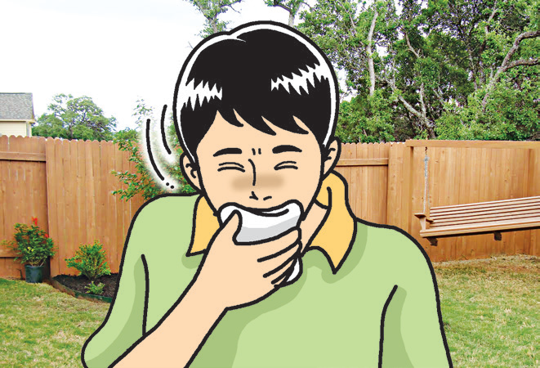
Care for the Nose
The following are some ways to care for your nose.
Cover your nose from dust, strong smells, and smoke from cigarettes and cars.
When sneezing or coughing, use a clean cloth or handkerchief to cover your nose and mouth. Avoid using your hands to cover your nose and mouth as you might transfer the germs to your hands.

Slide 16
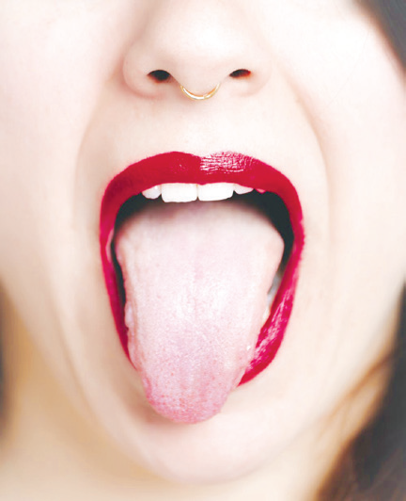
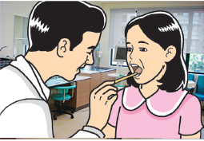
The Tongue
The tongue is the organ of taste. It helps us taste the food we eat. It also helps us in chewing food and in speaking.
Care for the Tongue
The following are some ways to care for your tongue:
Eating the right food keeps the tongue healthy.When the tongue is burned by drinking
very hot soup, sip ice cold water or suck on an ice cube. See a doctor if there is much pain or if the pain is not reduced.
Cleaning your tongue with your toothbrush or tongue cleaner is also recommended.

Slide 17
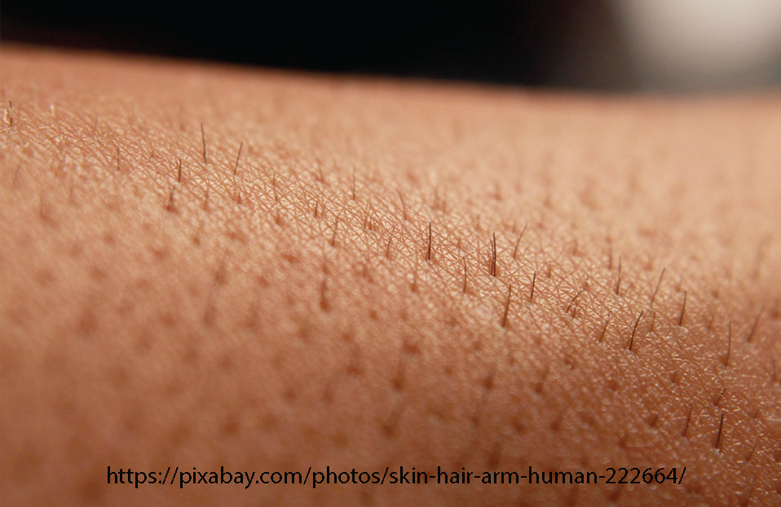
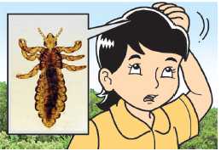
The Skin
The skin is considered to be the largest organ of the body. It protects and covers our whole body. Our skin allows us to feel the heat and cold.
Common Diseases of the Skin
Pediculosis – It is a disease of the scalp or the skin on the head where hair grows. It is caused by tiny insects called head lice. They live on the scalp and suck blood for nourishment. They are common among children. They can be passed throughsharing personal things like combs, hair ties, and head bands.

Slide 18
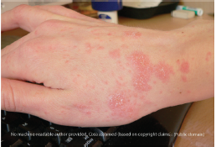
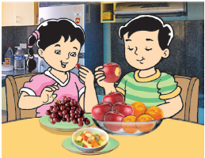
Scabies – It is caused by a tiny mite that enters the skin. It causes strong itching. Scabies can be passed through touching and sometimes through sharing personal things like towels and clothes.
Care for the Skin
1. Eat fruits and leafy vegetables.

Slide 19
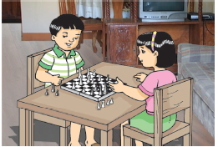
2. Apply skin products like lotion to avoid dry skin.
Avoid too much exposure to the sun especially if the sun is very bright. When going outside, apply sunblock and use an umbrella to protect your skin from the harmful rays of the sun.

