Slide 1
Body Parts That Work Together and How to Care for Them

Slide 2
Body Parts That Work Together
Each of your body parts has its own use. These parts work together when you move. When you play tag in the playground or write on your notebook, you use different parts of your body at the same time.
When you play jump rope, you use your eyes, upper limbs, and lower limbs. When you walk briskly, you use your eyes, arms, hands, legs, and feet.
Most of the time, you use your eyes together with the other parts of your body. Without your eyes, it will be hard to move.
You cannot move using only one part of your body. You cannot walk around without your thighs, legs, and feet working together. You cannot eat, brush your teeth, wash and comb your hair without your arms, forearms, and hands moving and working together.

Slide 3
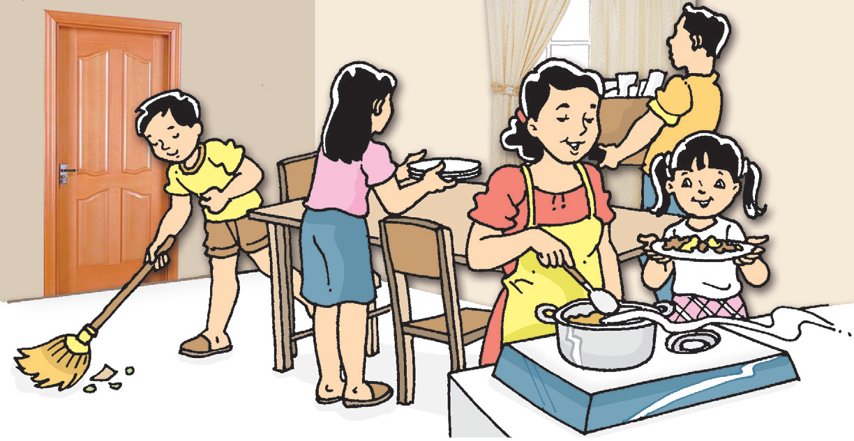
Look at the picture and read how the different body parts work together in doing an activity.
Each member of the family is doing a household chore. All of them are using their arms and hands as well as their legs and feet in doing the work. Working together makes work easier.

Slide 4
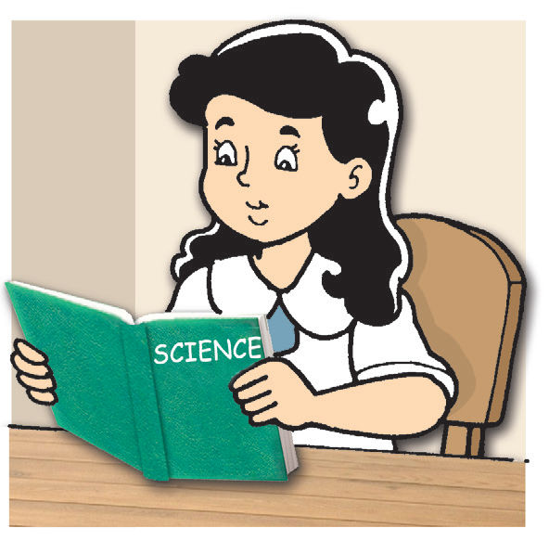
Study the picture of the girl on the right. The girl is reading a book using her eyes. She is also using her hands to hold the book.
Here are other examples of tasks that use different parts of your body:
1. Combing your hair
2. Holding objects and picking things up
3. Eating

Slide 5
Care for the Different Body Parts
Most children like you play a lot. Different parts of your body may get dirty especially when you play outside.
You should practice proper ways of cleaning and caring for your body to avoid illnesses. This is called personal hygiene.
Some children do not practice personal hygiene. They do not take a bath regularly. They do not comb their hair or get a regular haircut. They do not trim their fingernails. They do not wear slippers and shoes which makes their feet dirty. Children who do not take good care of their bodies become untidy and sickly. Dirt and germs can enter their bodies which can make them sick.

Slide 6
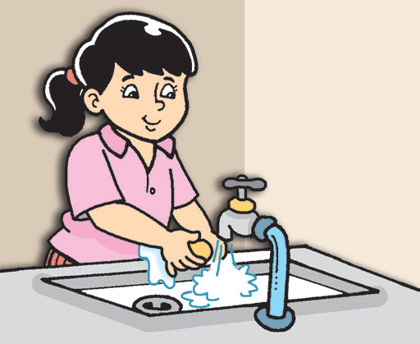
Personal Health Habits
Practice proper ways of taking care of the different parts of your body. Being clean is one way you can protect yourself from the harmful diseases caused by germs.
Here are some personal health habits you need to practice.
1. Wash your hands with soap and water properly:
a. before and after eating;
b. after using the toilet;
c. after coughing and sneezing;
d. after playing; and
e. whenever your hands get dirty.

Slide 7
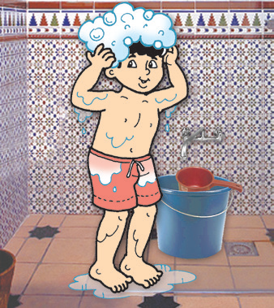
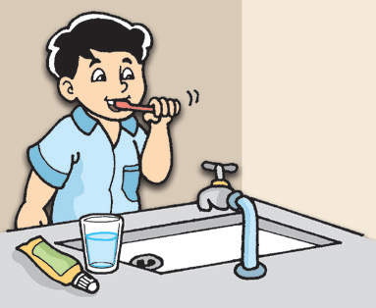
2. Take a bath to remove dirt from your body.
Brush your teeth after every meal. Practice proper brushing and flossing of teeth.

Slide 8
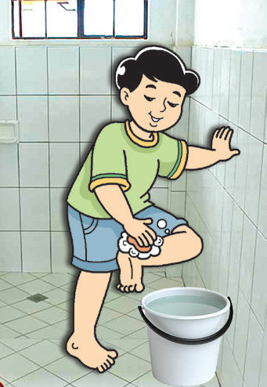
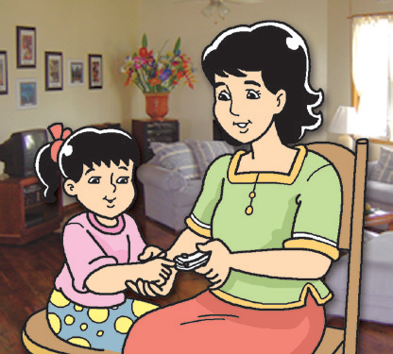
Wash your feet properly whenever they get dirty. Always wear slippers or shoes to protect your feet from harm.
Keep your nails short and clean. Ask an adult to help you trim your fingernails regularly.

Slide 9
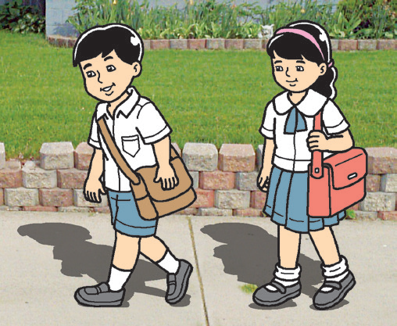
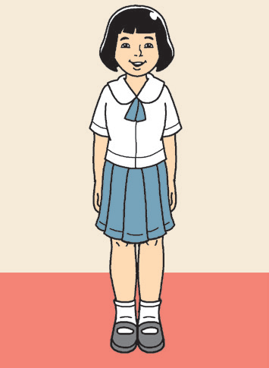
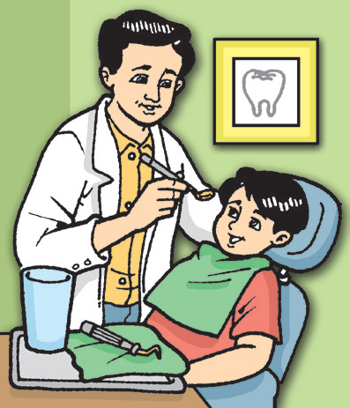
Wear clean clothes that suit the occasion and weather. You should also change to clean clothes before going to bed at night.
Observe proper posture. It allows you to stay healthy and move properly. You should learn the habit of standing straight, sitting properly, and walking with your head held up high.
Go to your dentist twice a year for dental checkups. See your doctor for regular checkups to avoid sicknesses.

Slide 10
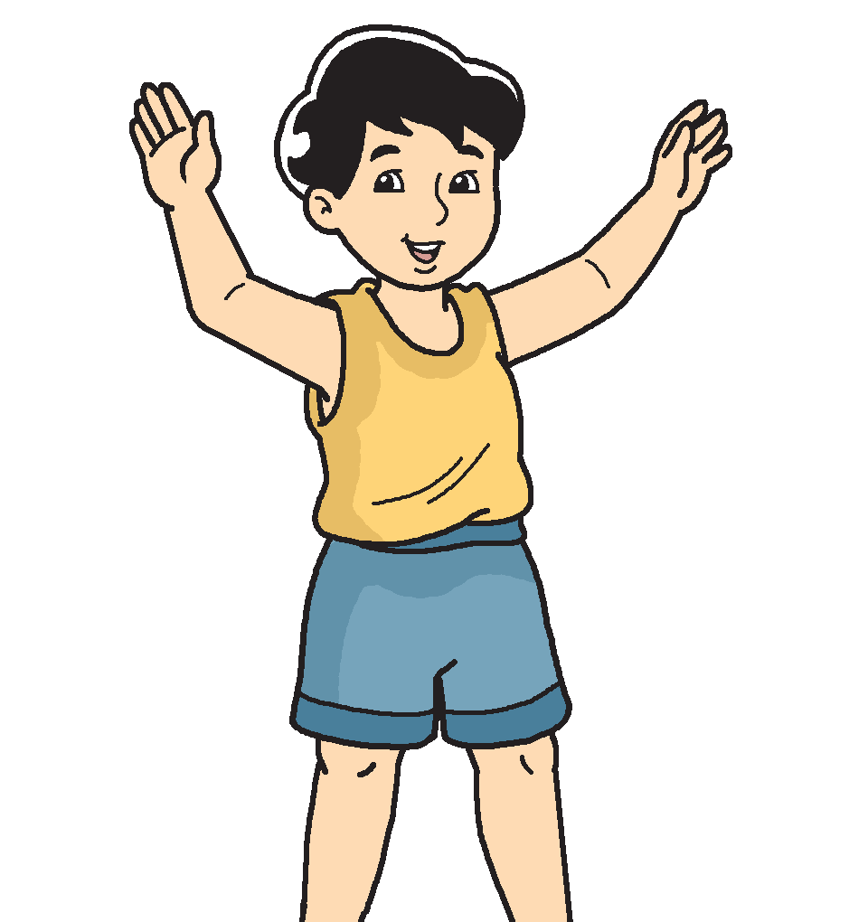

The following are the parts of the body that become dirty and sweaty easily:
• back of the ear
• neck and nape
• armpit
• elbow
• back of the knee
• crook of the arm
• groin
• the spaces between the toes
Because these parts are not easily seen, you might forget to clean them well. If they are not cleaned well, dirt and germs may cause body odor.
You can clean these parts of the body by using a face towel, water, and soap. Scrub behind your ears, neck, and nape. Do the same with your armpits, backs of the knees, crooks of the arms, groin, and the spaces between the toes.

Slide 11
First-aid Treatment for Common Accidents
Sometimes you get into accidents while playing or doing an activity. You may even need medical attention. It is important to know that you need to ask for help from adults when you get into any accident.
For simple wounds and burns, you can ask an adult to apply first-aid treatment. They can help you wash the wound or burn with clean water and soap before putting medicine.
Some wounds and burns need to be treated with more than just soap and water. In such cases, you need to go to the hospital. You may feel a little scared but you should not worry. The community health workers are there to help you get better.

Slide 12
How Health Workers Help You in Taking Care of Your Body
Health workers are people in your community who can help you keep your body healthy. Doctors tell you about your sickness and give you medicine to treat it. Nurses help doctors in treating people. There are doctors and nurses in hospitals, clinics, public health centers, and schools.
Midwives in public health centers take care of mothers who are about to give birth.
Caregivers care for old people, children, and people with disabilities. They can stay in the homes of their patients. They can also be employed in hospitals, health centers, or clinics.

Slide 13
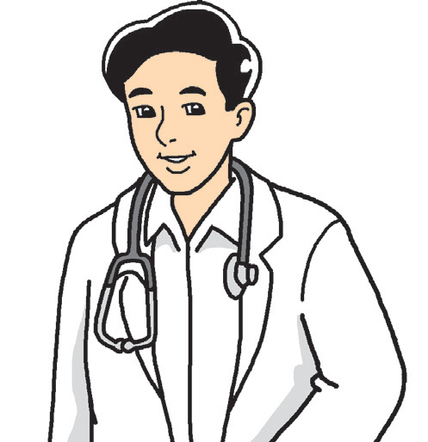
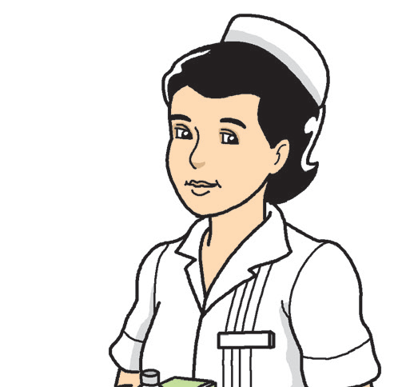
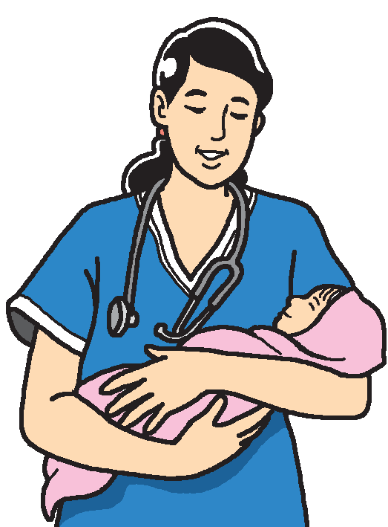
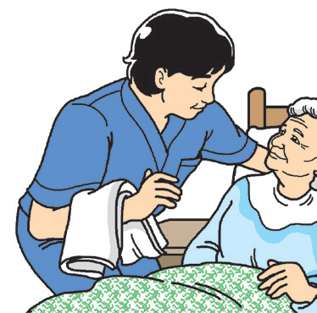

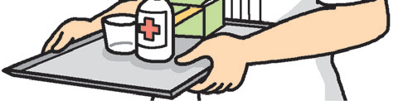
Health workers in the community.

