Slide 1
Your Body Changes As You Grow

Slide 2
Changes in Size, Height, and Weight
There are changes that take place in your body as you grow older. You grow taller as your height increases. Your weight changes too. You grow bigger and heavier. You are able to do more things with your body like walk, run, and dance.
As you grow, you can no longer use the things that you used when you were younger. You are bigger and taller now, so you may not be able to fit into your old clothes and shoes anymore.

Slide 3
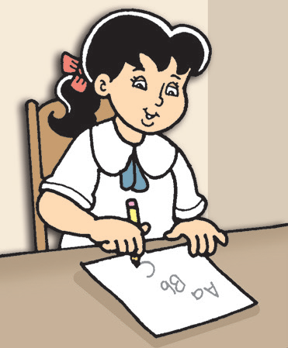
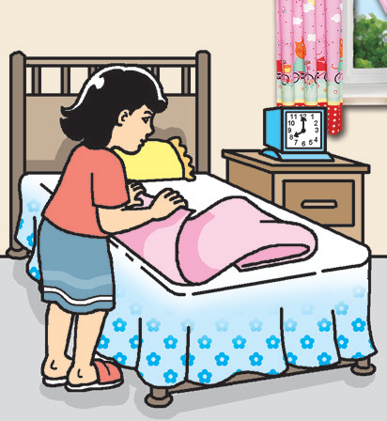
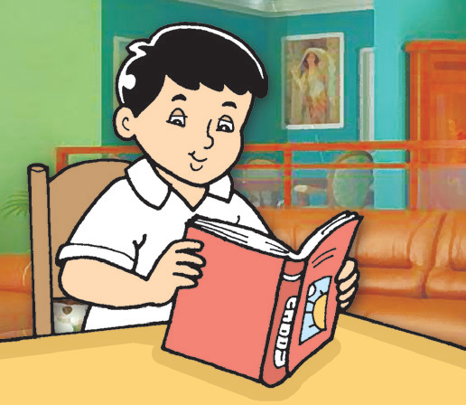
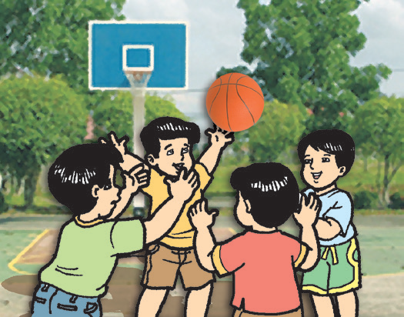
Changes in Things That You Can Do
There are also changes in the things that you can do now compared to when you were a baby.
Different activities of children.
You can read and write. You can recite poems and sing. You can talk and say what you want instead of just crying. You can make friends and share things with them. You can do things on your own without others helping you. These are just some of the things you can do now that you could not do when you were younger.

Slide 4
Children Grow Differently
Look at your classmates. Compare how you look with how your classmates look.
What do you observe? Some children are small. Others are big. They are different in size. There are children who are tall while others are short. They are different in height. Some children are heavy while others are not. They are different in weight.
Children have these different traits because of different reasons. It can be because of the food they eat. Some children who eat the right amount of food grow in size, height, and weight faster than other children. Other children are different in size, height, and weight because they got these physical traits from their parents. No two children are exactly the same.

Slide 5
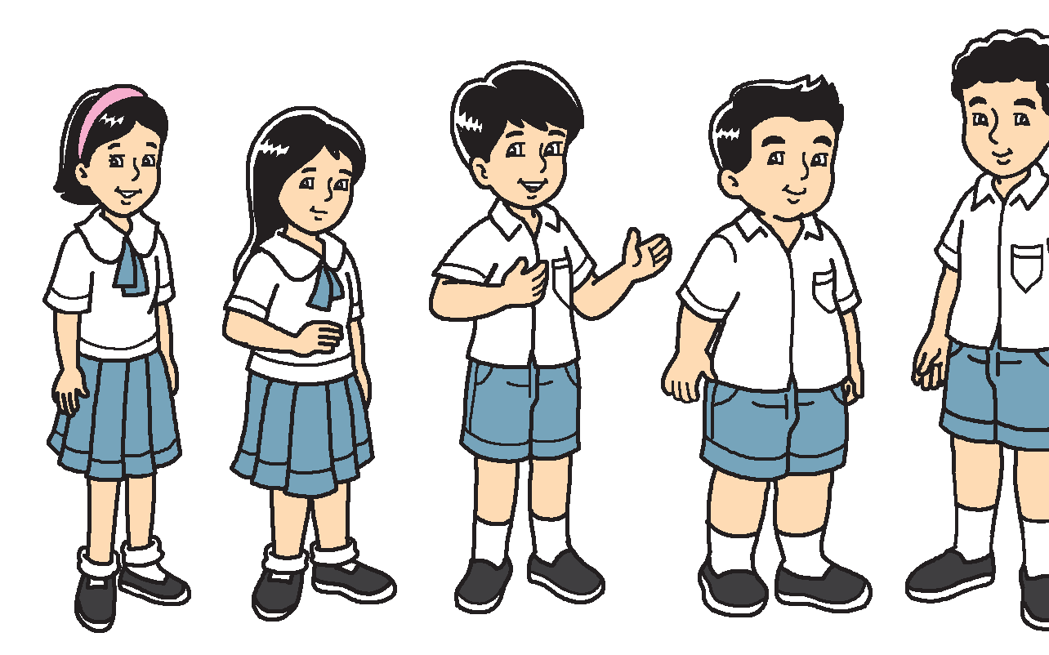

Different children of the same age.

