Slide 1
Your Body’s Needs As You Grow

Slide 2
Your body needs food. Food has nutrients that make you grow healthy and strong. These nutrients give the energy you need to work and play. Your body also needs enough exercise and rest.
Food
You need different kinds of food every day. Look at the food in the pictures on the next slide.
The Go Foods
Go foods contain nutrients called fats and carbohydrates. They give you energy to play, study, and work. Without Go foods, you will be weak. You will not have the energy to do anything. Rice, bread, and pasta are examples of Go foods. The other Go foods are butter, vegetable oil, and animal fats. Which of these go foods do you eat?

Slide 3
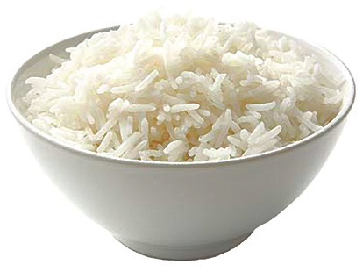
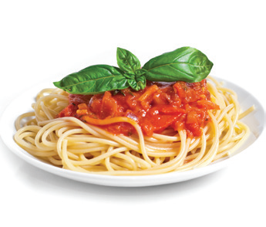
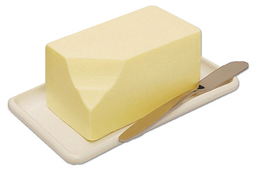
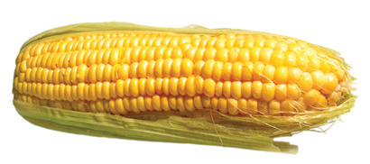
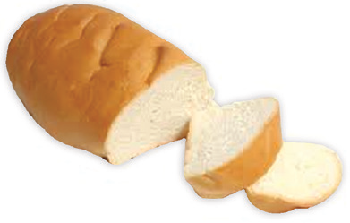
Go foods are rich in fats and carbohydrates.

Slide 4
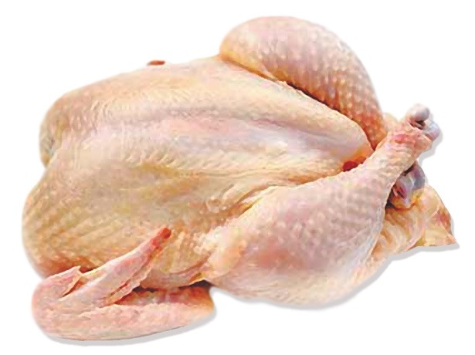
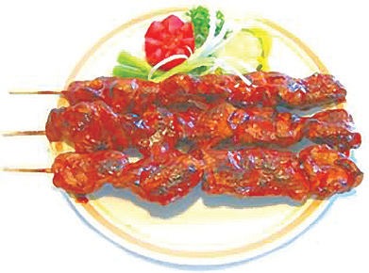
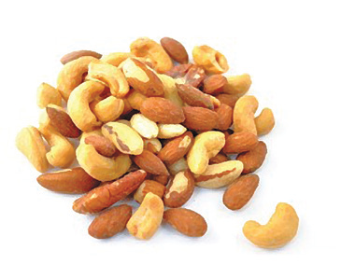
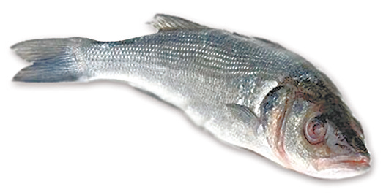

The Grow Foods
Look at the foods below. These are the grow foods. Grow foods contain protein. Protein is a nutrient that helps build your bones and muscles. It also helps heal wounds and cuts. Which of these grow foods do you eat?

Slide 5
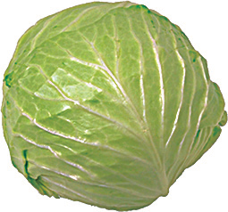
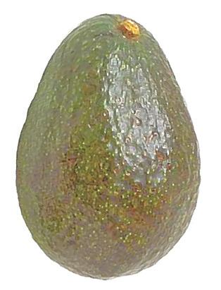
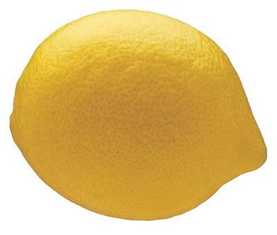
The Glow Foods
Glow foods contain vitamins and minerals. They help the different parts of your body work properly. For example, eating green and yellow vegetables makes your eyes see better. Eating fruits and vegetables also helps make your skin smooth and soft. Which of these glow foods do you eat? What are your favorite fruits and vegetables?

Slide 6

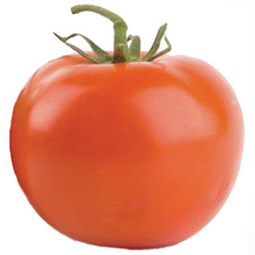
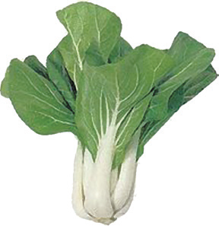
Glow foods are rich in vitamins and minerals.

Slide 7
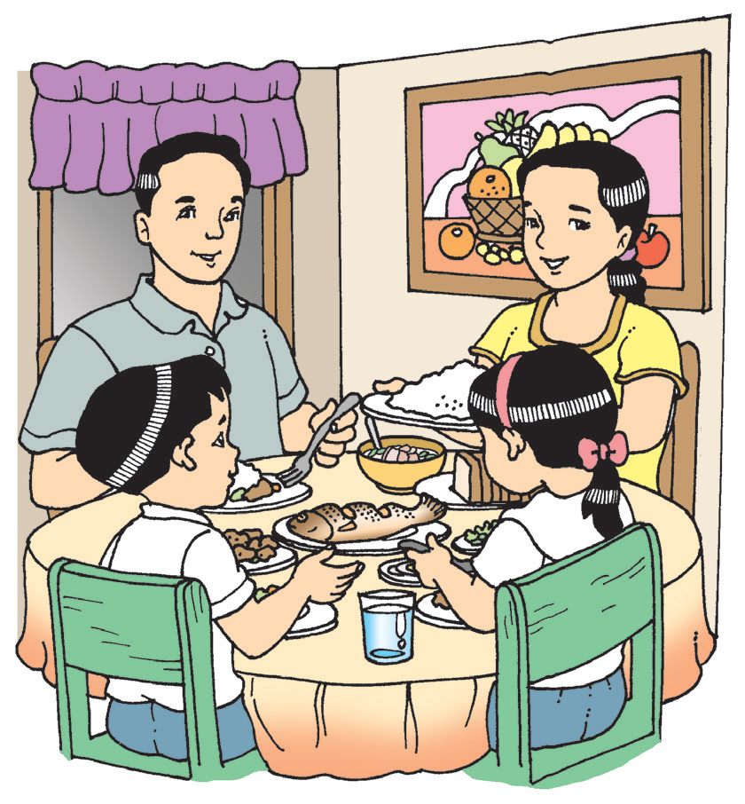
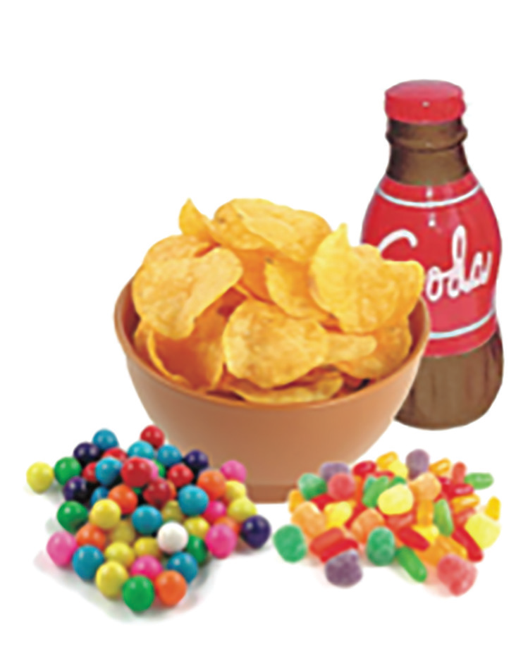
Good Eating Habits
Here are some good eating habits:
Eat breakfast, lunch, and dinner every day. Do not skip meals, especially breakfast. Breakfast is the most important meal of the day.
Eat Go, Grow, and Glow foods in every meal for a balanced diet.
Eat just the right amount of food. Eating too little or too much is not good for your health.
Drink plenty of water. You need to drink around five to seven glasses of water every day.
Some foods are not good for children. These are called junk foods. Junk foods are food with too much sugar, fat, and salt. Some examples of junk foods are candies, chewing gums, chips, and soft drinks. These foods are not good food for the body.

Slide 8
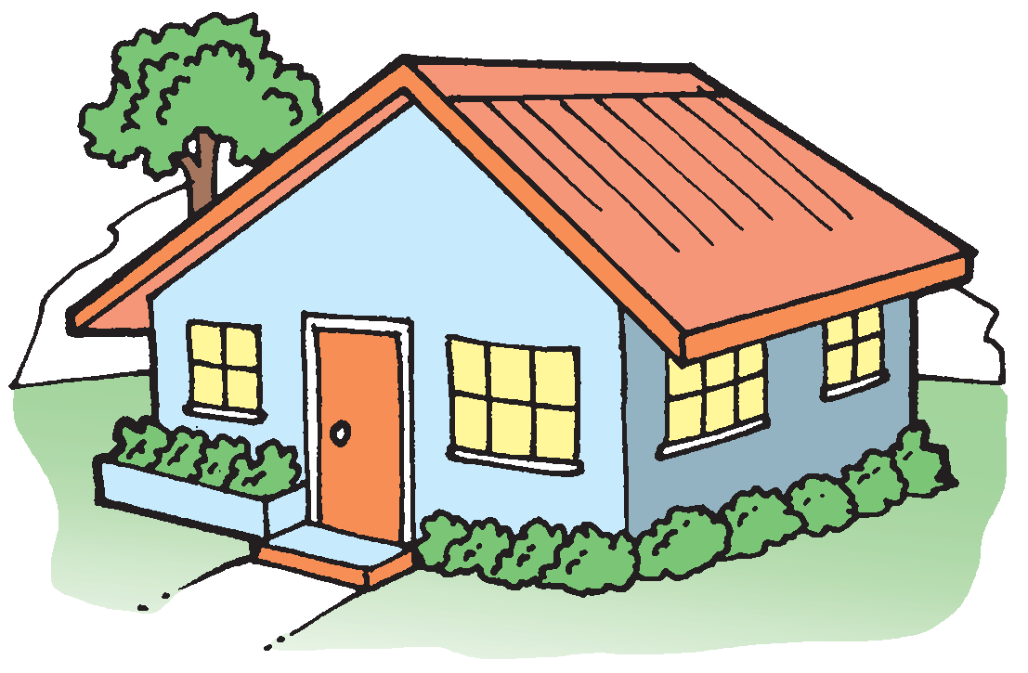
Shelter and Clothing
A house is a kind of shelter where people live. It protects people from the wind, rain, heat, and cold. It is important that your house is clean. Make sure you help your parents in keeping your house clean.
You need clothes to keep you warm. Clothes protect you from the cold and heat. They also protect you from insect bites because they cover your skin. You need clean clothes every day.

Slide 9

Fresh Air and Sunlight
People and other living things need oxygen in order to live. Oxygen is found in the air. It is important that people have fresh air to breathe.
The early morning sunlight is a good source of vitamin D that helps strengthen the bones. Staying under the sun is safe before 9 o’clock in the morning and after 4 o’clock in the afternoon. Staying under the sun for a long time can be dangerous because it is too hot. Too much heat and light from the sun can cause sunburn, heat stroke, or even skin cancer.

Slide 10
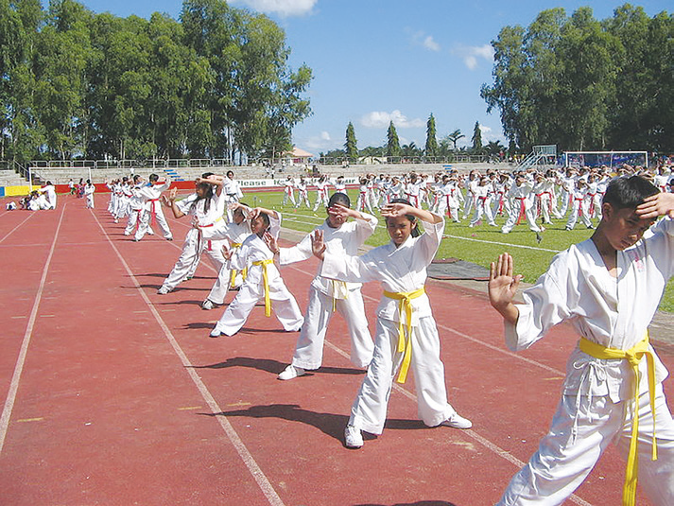
Regular Exercise
Children need exercise. It makes the muscles and bones stronger. It also keeps the heart and lungs healthy. Children who do not exercise become weak easily. Helping with the chores at home and playing outdoors are also forms of exercise.

Slide 11
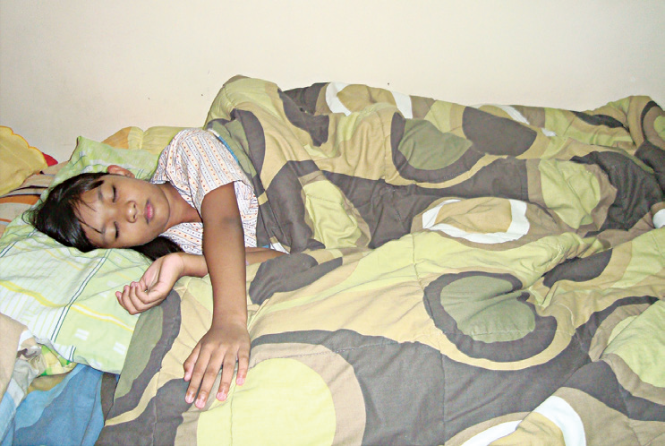
Enough Rest and Sleep
Everybody needs rest. Rest is good for tired muscles. As you rest, your muscles and bones grow. Sleeping is the best kind of rest for your body. You need at least 10 to 12 hours of sleep every day. It is also good to change clothes or take a bath before sleeping to keep you clean and fresh. Make sure to use a clean bedsheet.
Children like you have to go to bed early. When you sleep early, you wake up early the next day feeling strong and full of energy. Your body will work better when you get enough sleep.

Slide 12
Safe Water to Drink
Water is the body’s most important component. It regulates body temperature. When you perspire a lot, you need to replace the lost fluid in your body by drinking water. In order to maintain enough water in your body, you need to drink around five to seven glasses of water a day.
Water cleanses your body by taking away wastes and poisonous substances. You also need to drink milk and other nutritious fruit beverages.

Slide 13

Clean Surroundings
Clean and healthy surroundings are free from garbage and other wastes. These wastes are sources of germs that can cause sickness. Children like you need an environment that is clean and healthful.

Slide 14
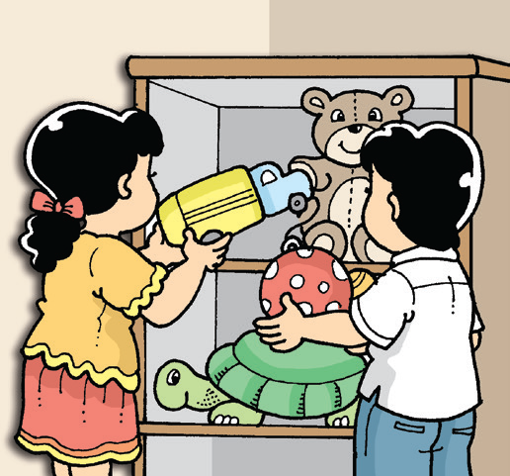
Keeping Yourself Safe
As you grow, you need to practice safety habits to protect your-self from harm.
You should know where you live, your phone number, and whom to call during emergencies. Do not give strangers your personal information. You should also know what to do to keep yourself safe at home, in school, and on the streets.
Here are some safety habits that you should practice.
At Home
Never leave your toys on the stairs of your house. You or other people can trip on them and get hurt. After playing with your toys, put them back in their proper place.

Slide 15
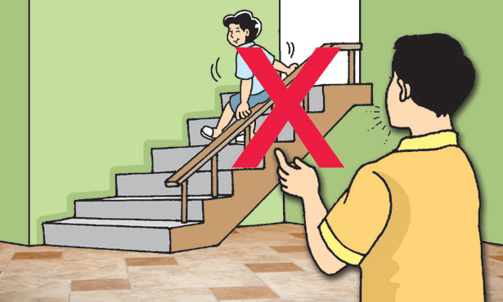
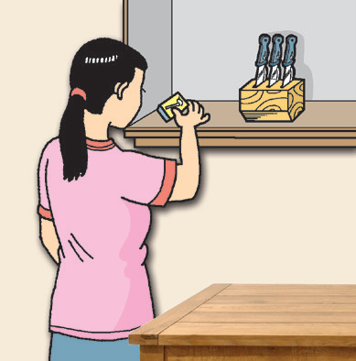
Do not slide down the handrails of the stairs. Go down the stairs properly by holding onto the handrail.
Never play with matches and sharp objects. They can hurt you and other people around you.

Slide 16
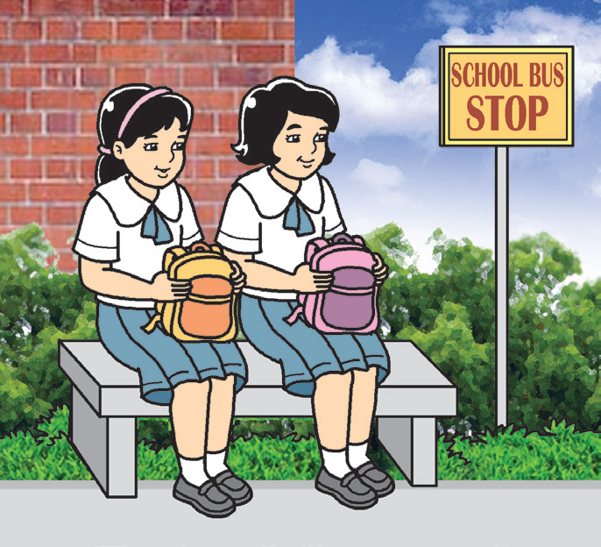
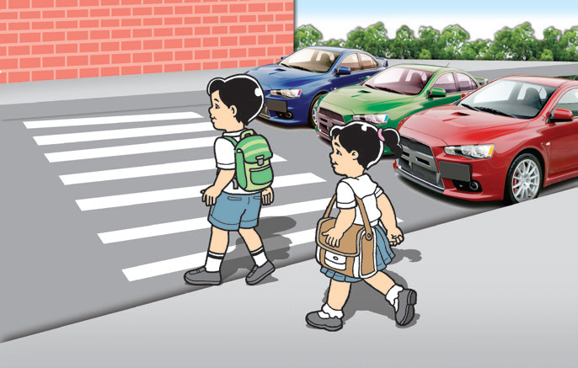
In School
Wait for your fetchers in school. Do not leave with anyone you do not know.
Check the play area for any sharp objects. Make sure the floor is not slippery or wet to avoid accidents.
Put your bags in the proper place in the classroom. Other children can trip on your things and get hurt.

Slide 17
Here are some ways to protect yourself from strangers:
Stay away from people you do not know.
Do not talk to strangers and do not let them touch you and your belongings.
When you are away from home, always stay with your parents or guardians.
Tell your parents and teachers immediately if somebody is trying to hurt you or your schoolmates.
Tell your teachers if you see a stranger acting odd in school.

