Slide 1
Classifying Animals Based on Their Habitat, Movement, and Ways of Getting Food

Slide 2
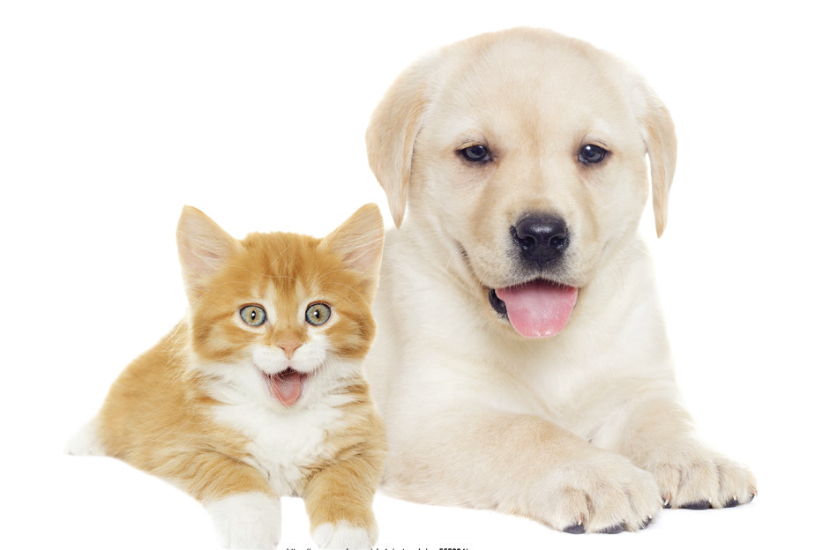
Animals and Their Habitat
Animals live in places where they can survive and breathe properly. These places are called habitats. Animals can be classified according to their habitats. There are animals that live only on land. There are animals that live only in water. There are also animals that live both on land and in water.
Animals That Live on Land
Animals like horses and sheep are land animals because they spend most of their time on land. Pets like dogs and cats live in our houses. They are also land animals.

Slide 3
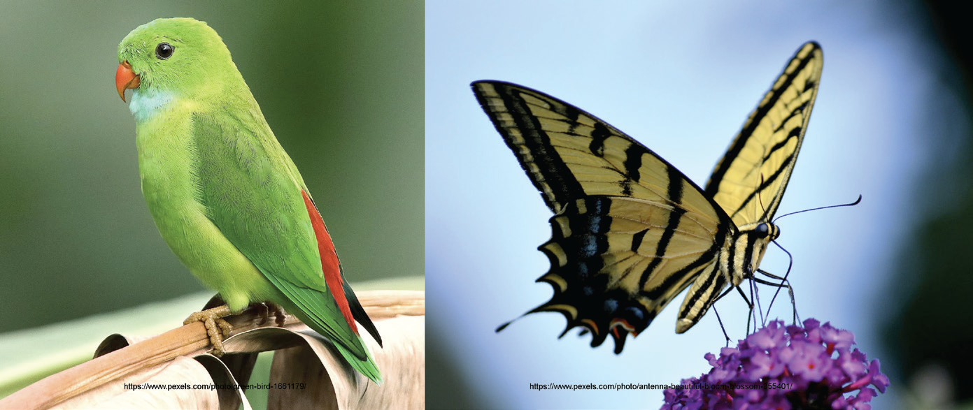
Birds and insects with wings like bees and butterflies live in trees and plants. They fly in the air most of the time. They perch on trees and other plants to eat and rest.

Slide 4
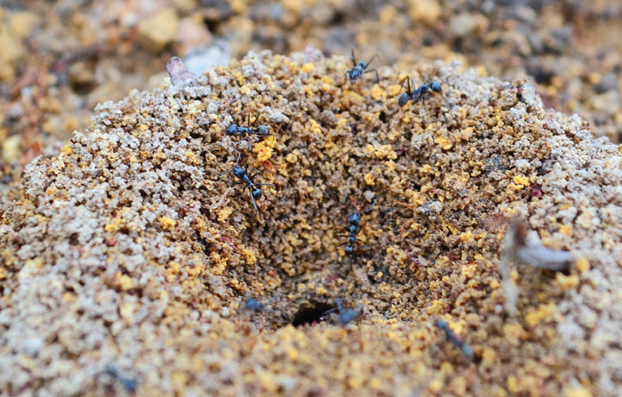
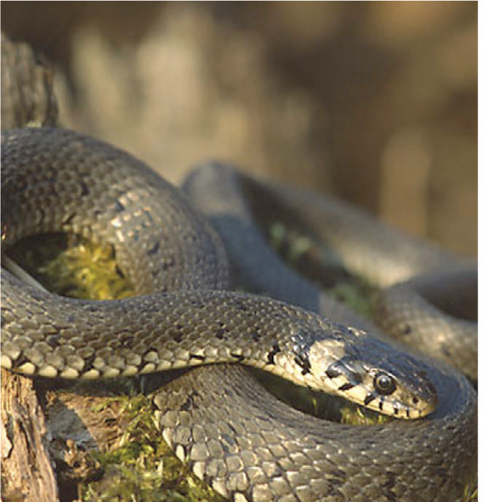
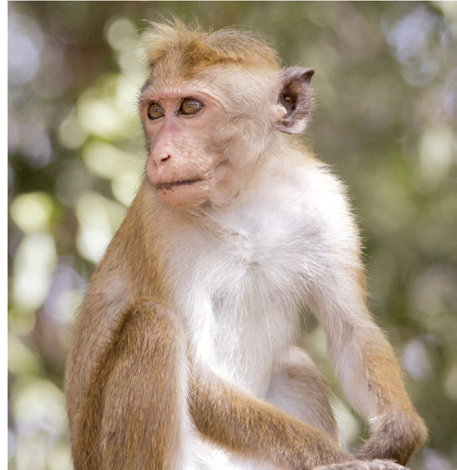
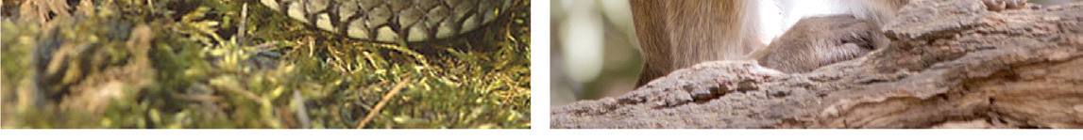
There are animals that live underground. Earthworms live in the soil. Clams burrow into soft and wet soil which serves as their shelter. Crabs live in between rocks and in the sand. Ants dig tunnels underground. This is where they make their nests.
Snakes and monkeys are animals that live in the forest.

Slide 5
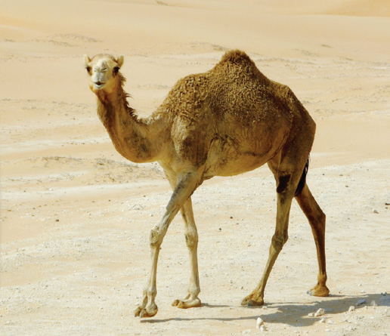
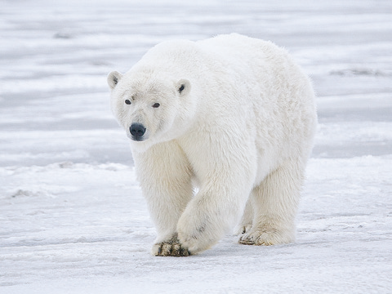
Some animals live in the hot and dry desert. Animals that live in the desert, like the camel, can store water in their bodies for a long time.
Some animals live in very cold places where snow covers the ground all year round. Animals that live in these places have thick fur.

Slide 6
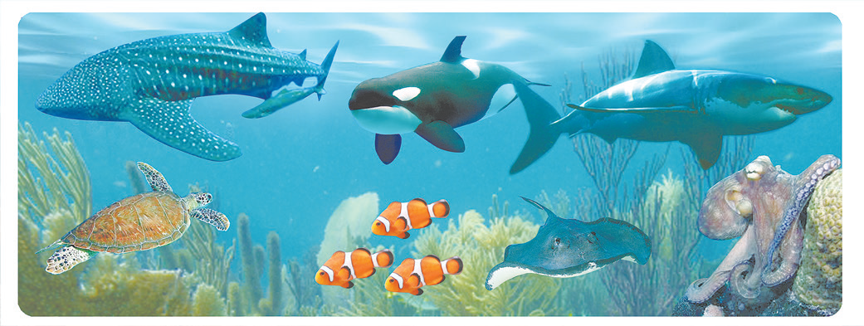
Animals That Live in Water
Animals like fish, octopuses, shellfish, shrimps, and squids spend most of their time in water. They are called water animals.

Slide 7
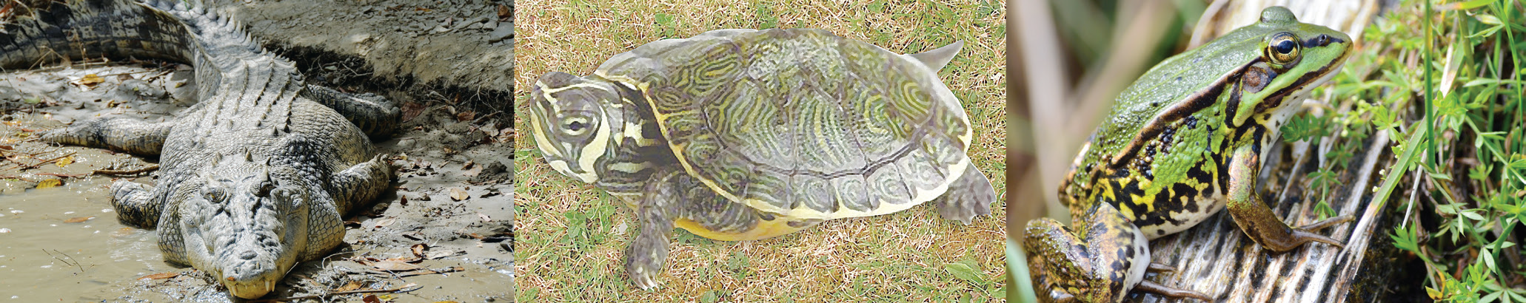
Animals That Live Both on Land and in Water
Turtles, alligators, crocodiles, and frogs live both on land and in water. These animals need to spend enough time on land and in water in order for them to live. Because they cannot breathe underwater, they need to come up to the surface for air.

Slide 8
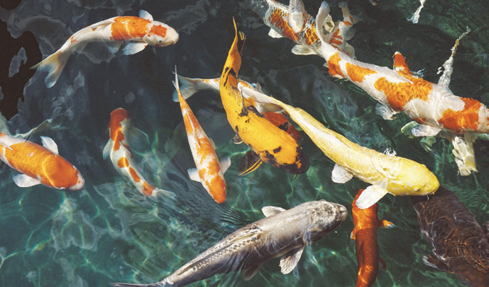
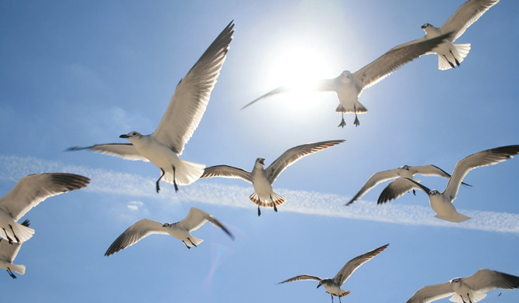
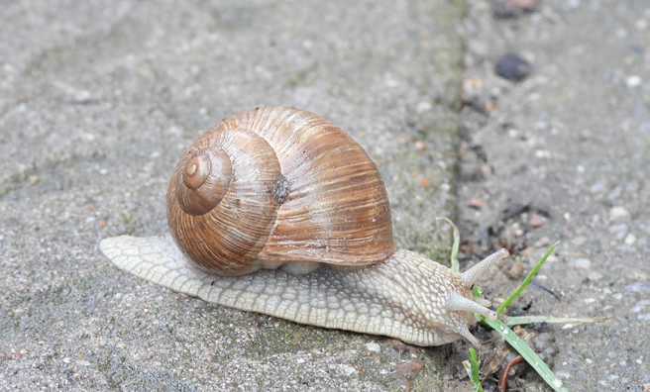
How Animals Move
How animals move depend on where they live. Water animals move around their habitat by swimming. They are able to live and breathe in water through special body parts.
Animals with wings like birds and insects fly and glide in the air. They fly to move around their habitats. There are also animals that crawl on the ground.

Slide 9
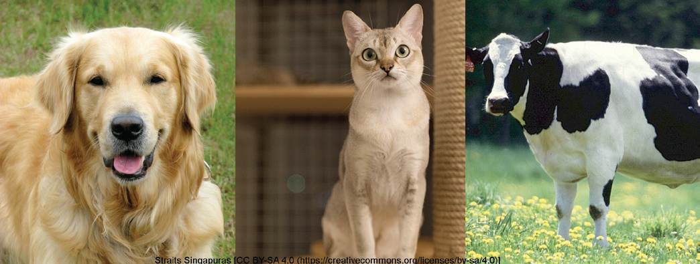
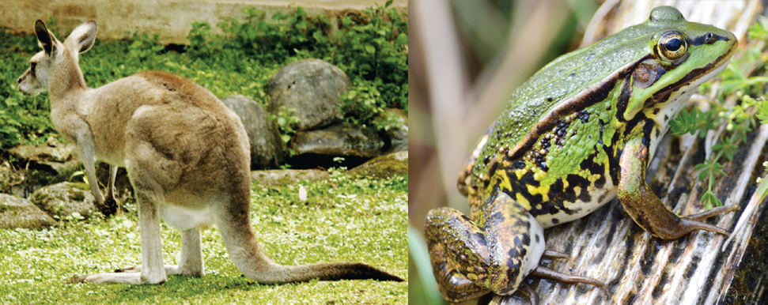
Land animals have legs that allow them to walk and run. Some animals such as frogs, kangaroos, and rabbits jump or hop using their strong hind legs.

Slide 10
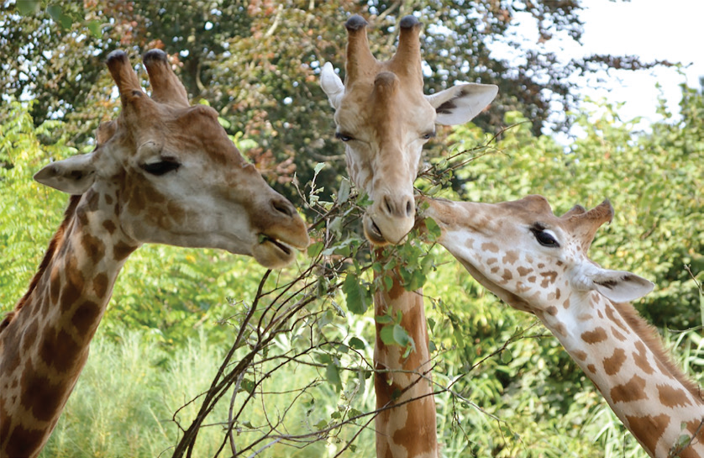
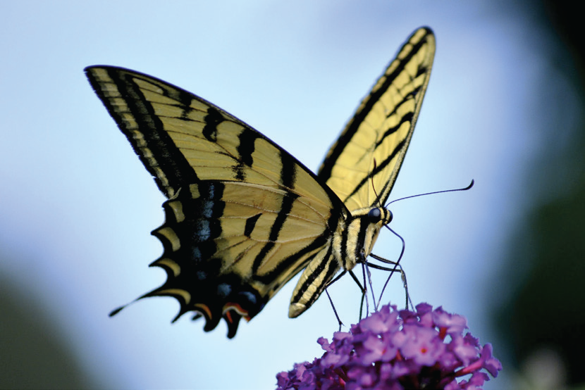
How Animals Get Their Food
Animals have different ways of getting their food. Most of them get their food with the use of their mouths. Giraffes use their long necks to reach tall trees. They use their mouths to get leaves from trees. Squirrels grasp nuts and crack them with their teeth.
A butterfly has a long sucking tube that sips nectar from flowers. The mosquito also has a sucking tube, which it uses in sipping fluid from leaves, soft stems, and fruits. This sucking tube coils up when not in use.

Slide 11
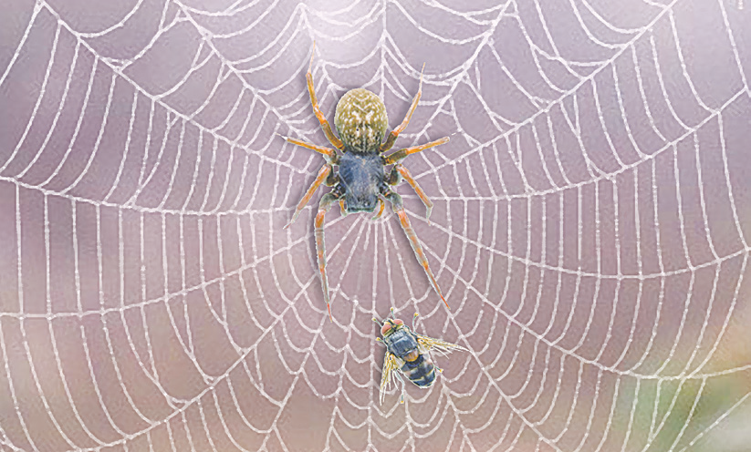
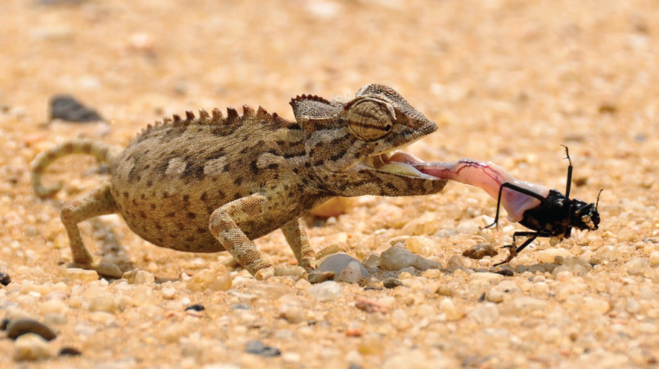
Many spiders spin webs to catch insects flying in the air. Spiders eat the insects that get trapped in the sticky web. Not all spiders spin webs. Some of them hide and wait in the surroundings, near plants and flowers. When an insect comes close, the spider bites it with its poisonous fangs.
Lizards like to eat insects. To catch insects, the lizard sticks out its long tongue.

Slide 12
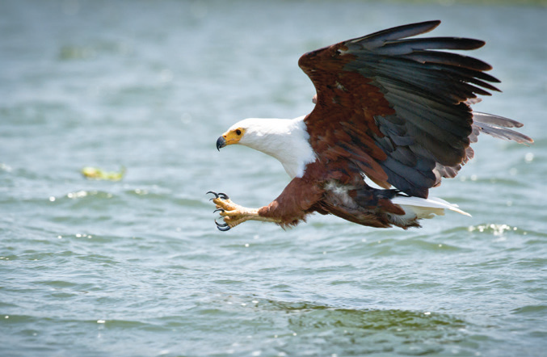
Birds use their beaks to pick up grains and to catch worms and small insects. Birds like hawks and eagles have hooked beaks and claws that help them catch fish. The shape of their beaks and their sharp claws help them tear up their food into smaller pieces.

