Slide 1
Needs of Animals and How to Care for Them

Slide 2
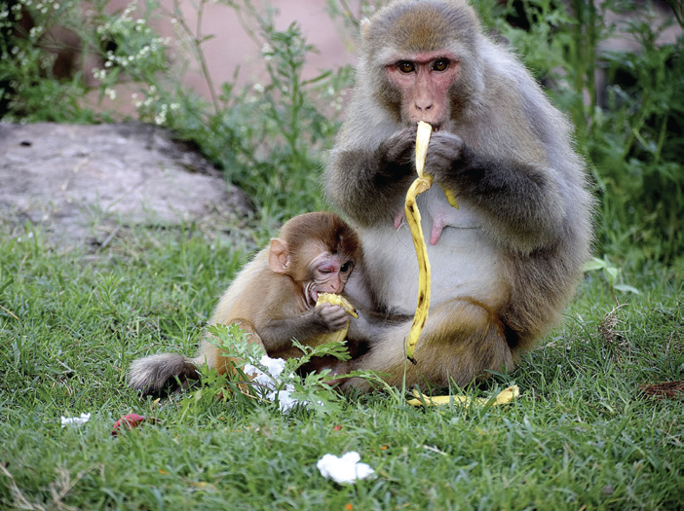
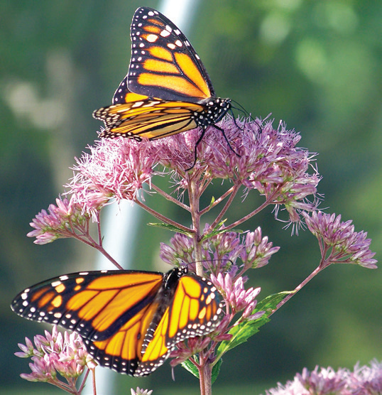
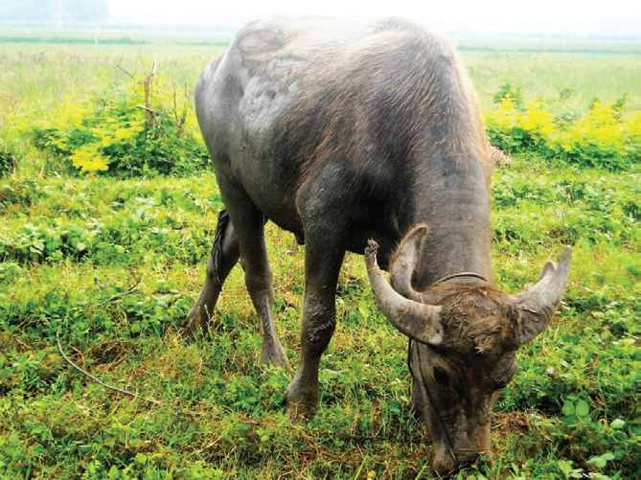
Needs of Animals
Food and Water
Animals need food in order to live. Without food, they will die. Read about what different animals eat.
Monkeys eat fruits.
Butterflies sip the nectar found inside the flowers.
Carabaos eat grass.

Slide 3
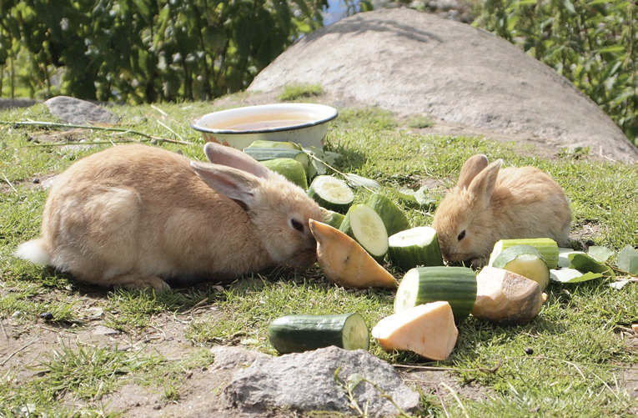
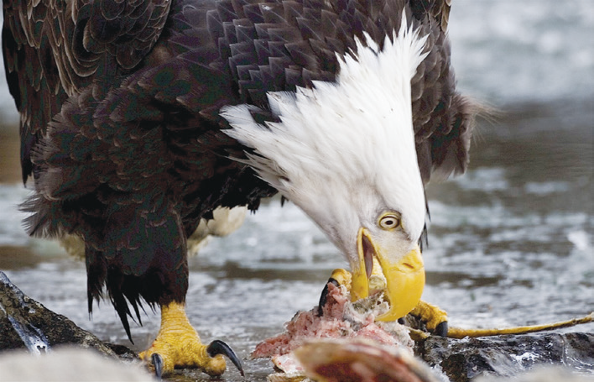
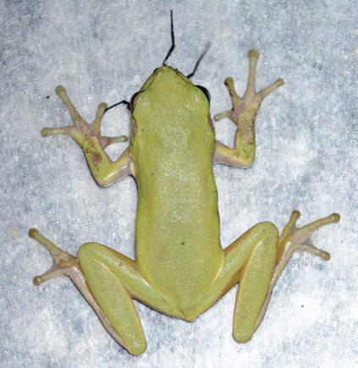
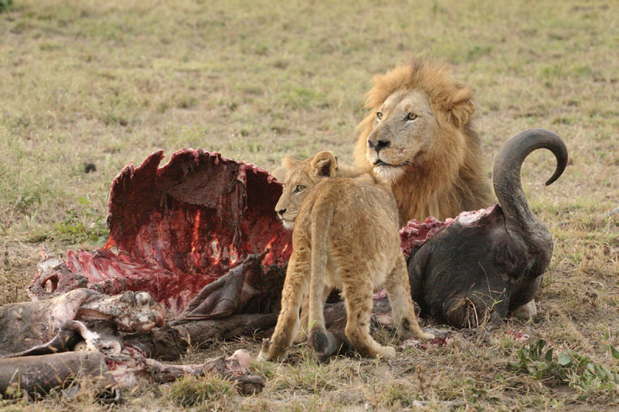
Rabbits eat vegetables.
Eagles eat chicks, rats, and other small animals.
Frogs eat insects.
Lions eat other animals.

Slide 4
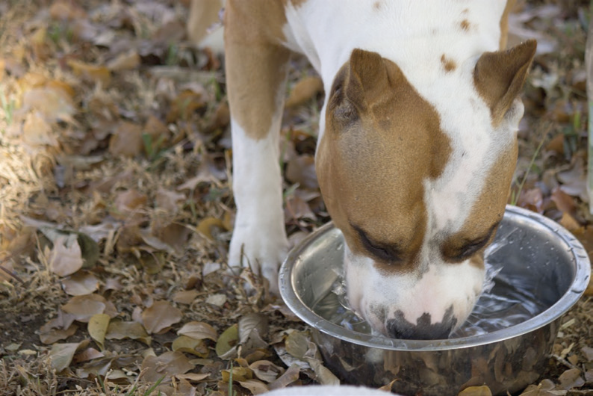
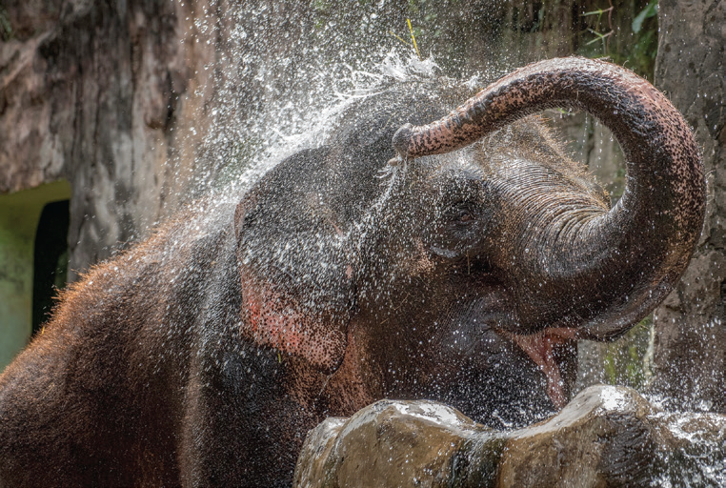
Animals need water to drink. Water prevents their bodies from drying and also keeps them cool.
During the dry season, many rivers and springs dry up.

Slide 5
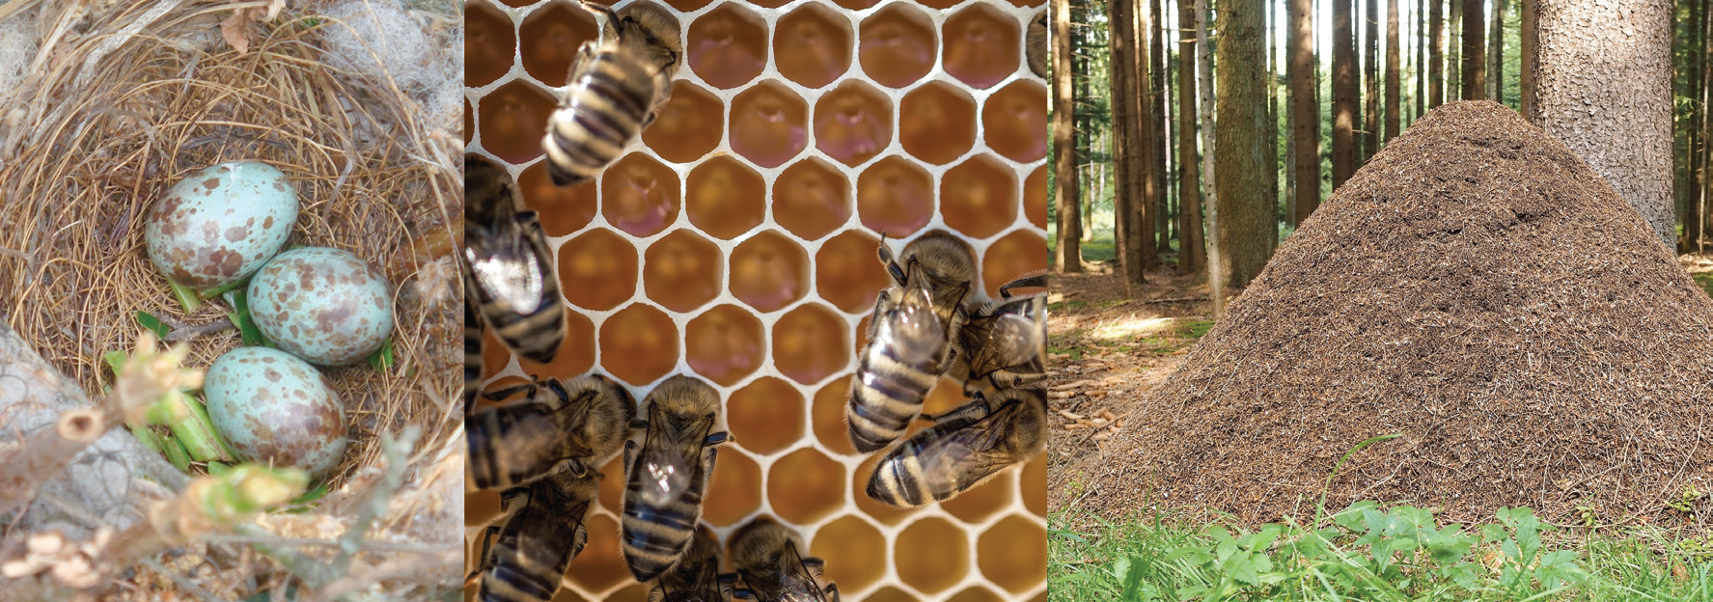
Fresh Air
Another important thing that animals need is fresh air. People and animals need to breathe fresh air. Without air, animals will die. That is why cages, aquariums, and fishbowls have openings where air can pass. Do not put animals in containers that are completely closed. Make sure the container has holes for air to enter.
Shelter
Some animals make their own homes. Shelters protect animals from bad weather and from their enemies.

Slide 6
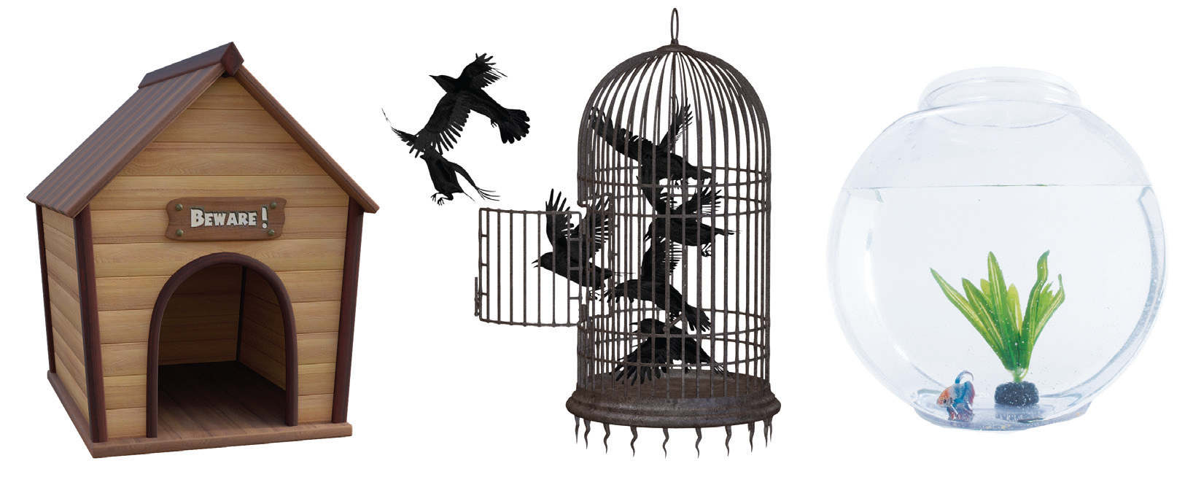
People make homes for their pet animals. These homes should be kept clean. The coop is a home for chickens. The pigpen is where pigs live. The stable is a home for horses.

Slide 7
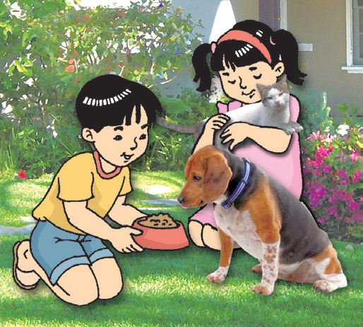
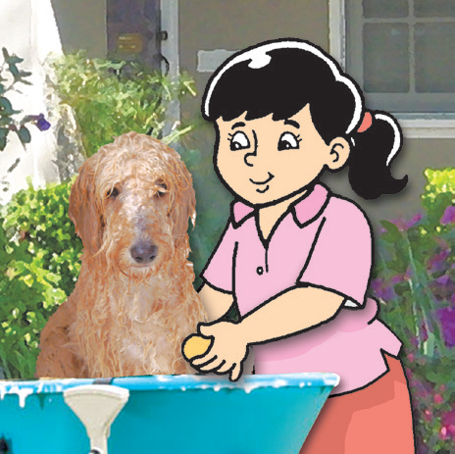
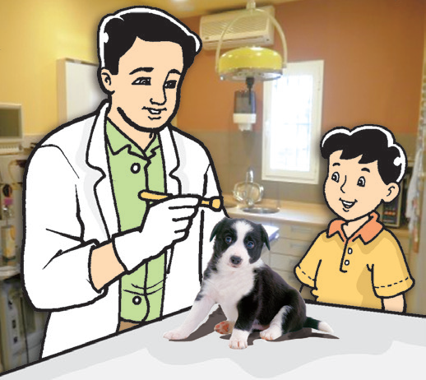
Care for Animals
Animals have feelings too. They can feel happy, sad, and angry. Animals need to be taken care of. Most animals become loyal to their caretakers. If you give a dog food and water, it will wag its tail. This means that it is happy. If you play with your pets, they become happy too. Look at the pictures below. How can you show care to animals?
Pet owners feed their pets with proper food and show love and care.
Pet owners keep their pets clean.
Pet owners bring their pets to the veterinarian for checkups.

Slide 8
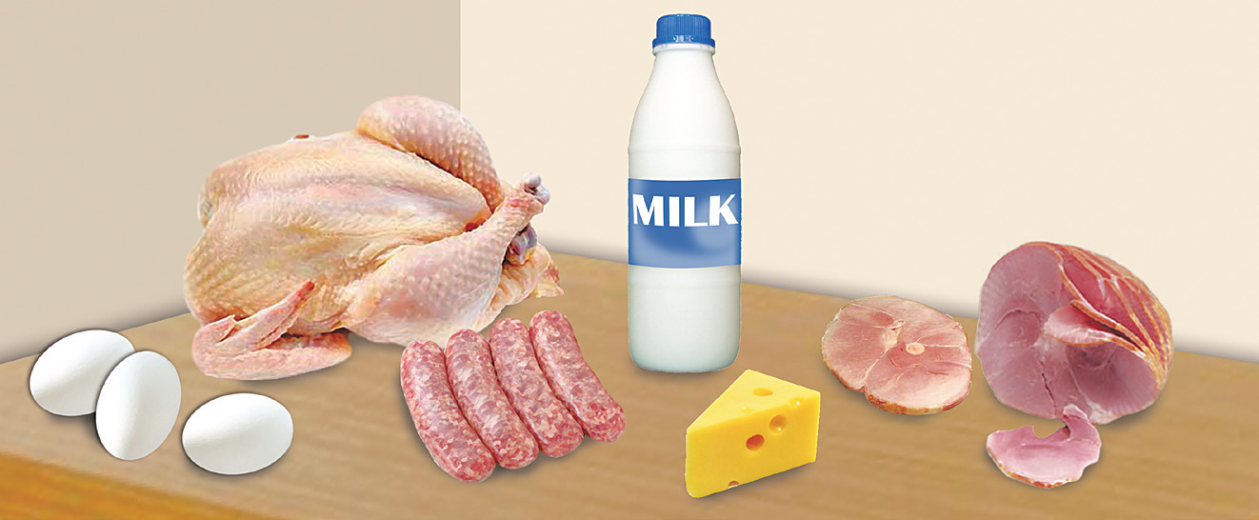
Importance of Animals
Animals help in different work fields. Carabaos help farmers plow the field. Horses help people carry heavy things to far places. Dogs guard our homes. They also help the police in catching criminals.
We get food from animals. We get meat from cows, pigs, and goats. We get meat and eggs from chicken. Milk, cheese, and butter are products that also come from animals.

Slide 9
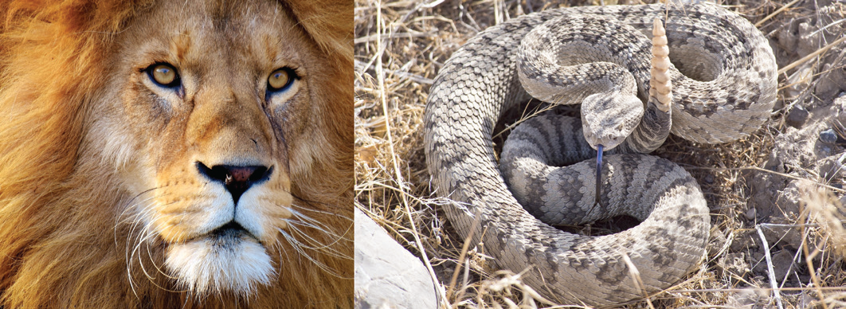
Be Safe From Harmful Animals
Dangerous Animals
Many animals are helpful. But there are also harmful animals. Snakes, lions, and tigers are dangerous animals. Sharks in the sea are also dangerous. They can kill people. Stay away from them. Do not go near them when you see them in a wild park or zoo.

Slide 10
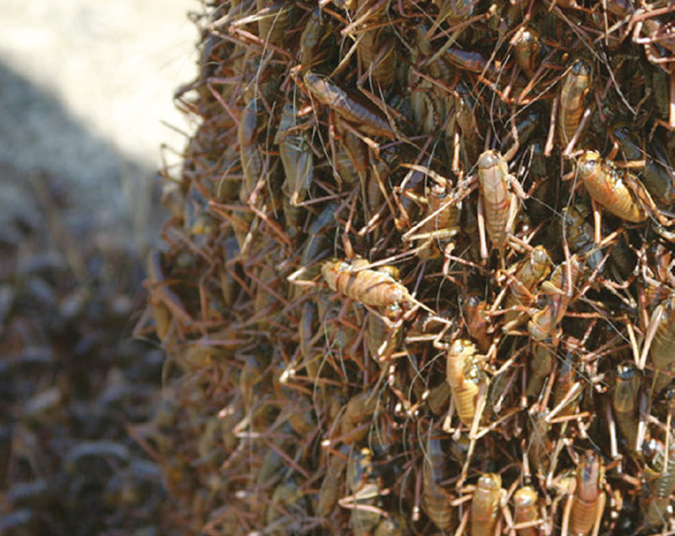
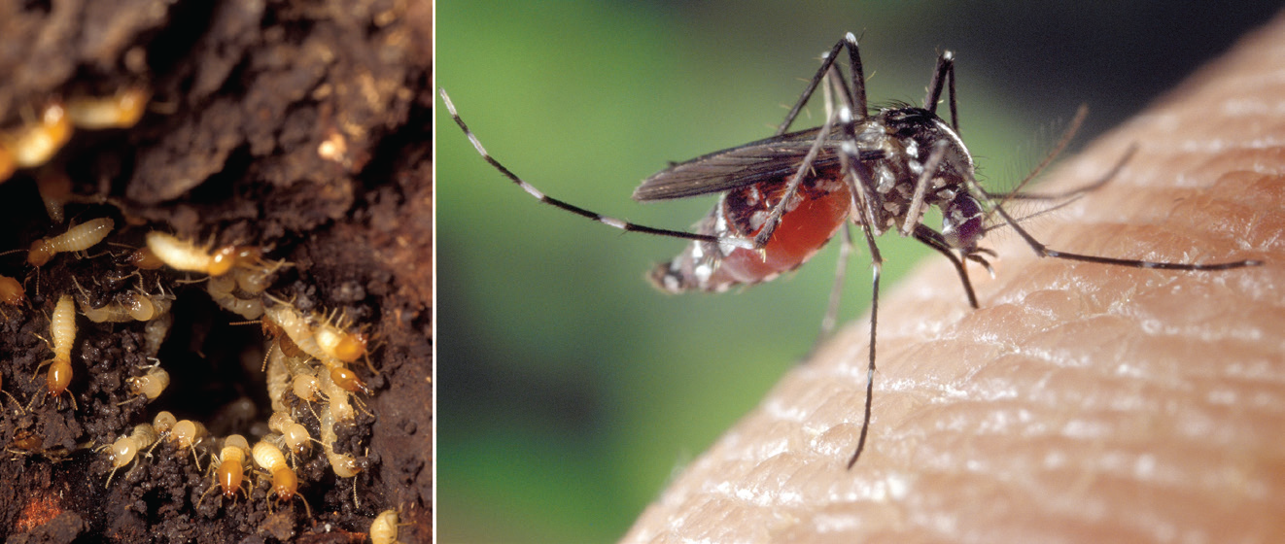
Harmful Animals
Locusts are pests. They destroy crops in the field. Termites are harmful. They destroy wooden furniture and the wooden parts of the house.
Female mosquitoes suck blood from people and animals. You may get sick if a mosquito bites you. Harmful animals like locusts, termites, and mosquitoes should be eradicated to prevent the destruction of crops and furniture and to prevent the spread of getting serious illnesses.

Slide 11
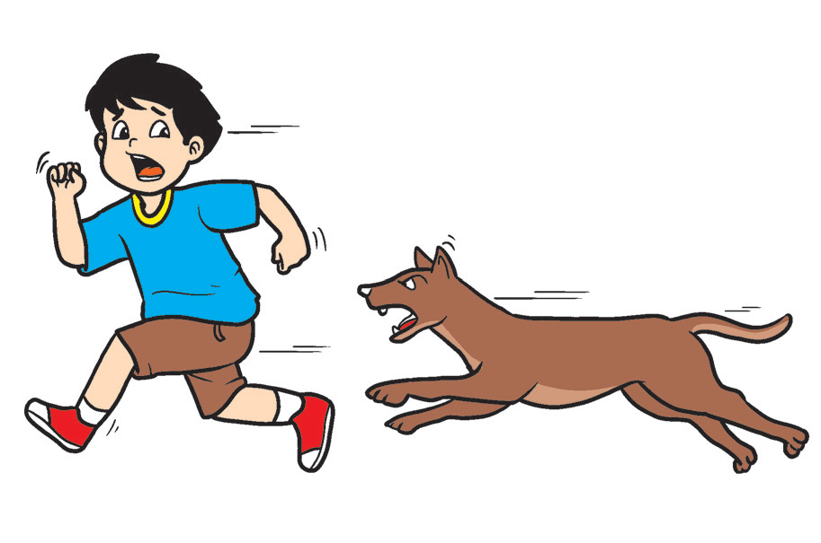
Infection Caused by Some Animals
Children can get infections from:
• bites and scratches;
• handling birds; and
• eating food that has been infected by flies.
How to avoid animal-related injuries:
1. Avoid playing with stray or strange animals.
2. Do not play with pets without the supervision of an older person.
3. Do not go near the pet when it is sleeping or eating.
4. Do not tease pets.

