Slide 1
Changes in Growing Animals

Slide 2
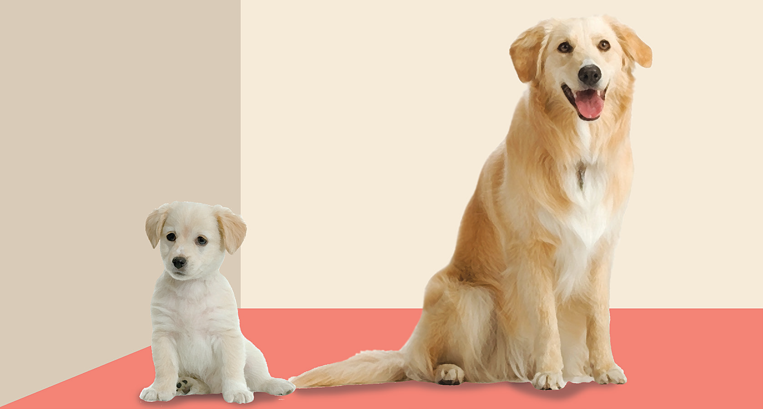
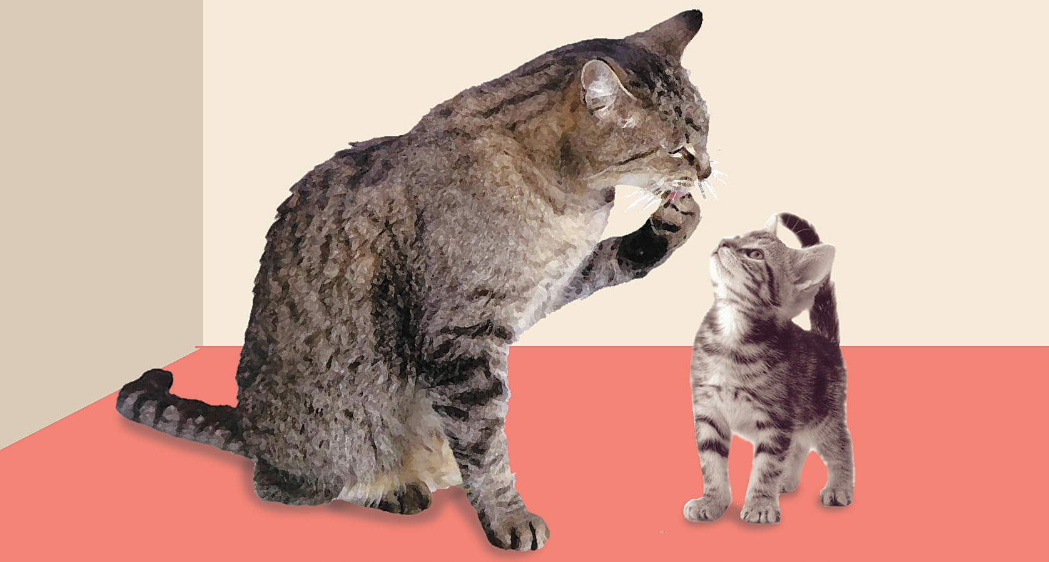
Changes Animals Undergo
Animals That Grow in Size
All animals increase in size as they grow. A puppy grows into a dog. A kitten grows into a cat.
Puppies and kittens grow bigger as they grow older but their body coverings stay the same. Some of them grow colored spots or stripes. Some of them change in color.

Slide 3
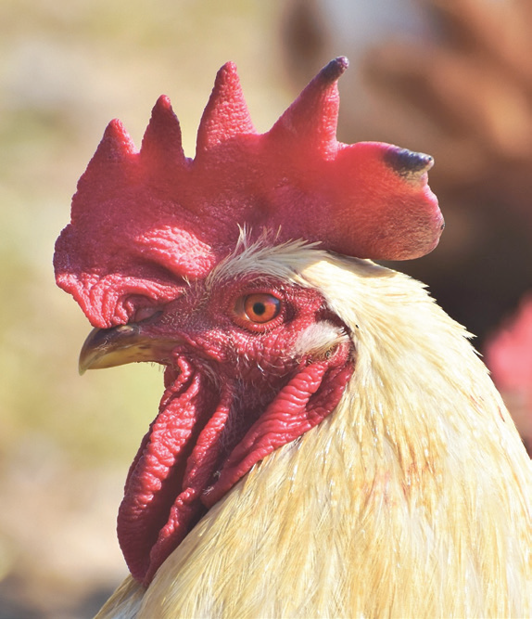
Animals That Grow Other Body Parts
Some baby animals develop other body parts as they grow.
A chick has no comb. The comb is the thick, red, fleshy part on the top of the head of chickens. The chick develops a comb as it grows. Its wings also get bigger.
A rooster has a larger comb than a hen. A rooster also develops a claw behind its legs. Its feathers become bigger and more defined.

Slide 4
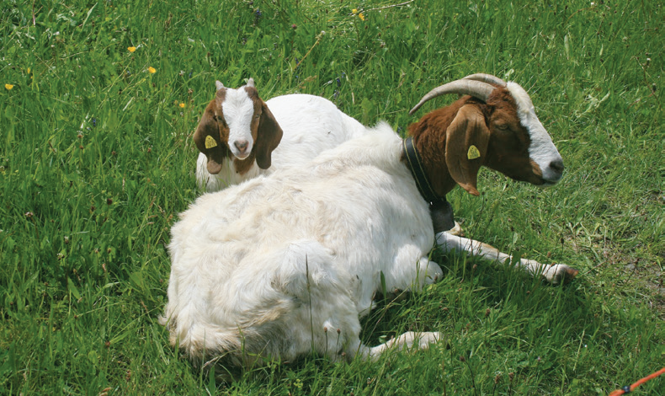
A baby goat is called a kid. A kid has no horns. The horns develop as the kid grows bigger. A baby cow is called a calf. It has no horns at birth. The horns develop as the calf grows into a cow.

Slide 5
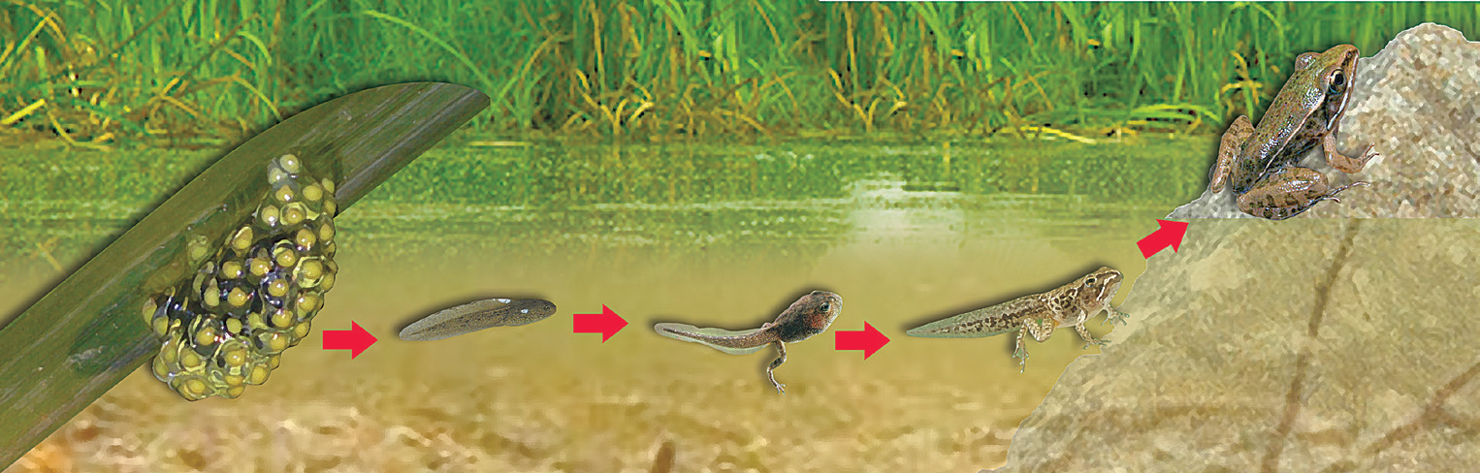
Animals That Undergo Many Changes
Some animals undergo many changes as they grow. They lose some body parts and grow new ones. The adult animal looks entirely different from the baby animal. Look at the picture of the life cycle of a frog below.
A baby frog is called a tadpole. A tadpole has a tail. As it grows, it loses its tail and grows legs.

Slide 6
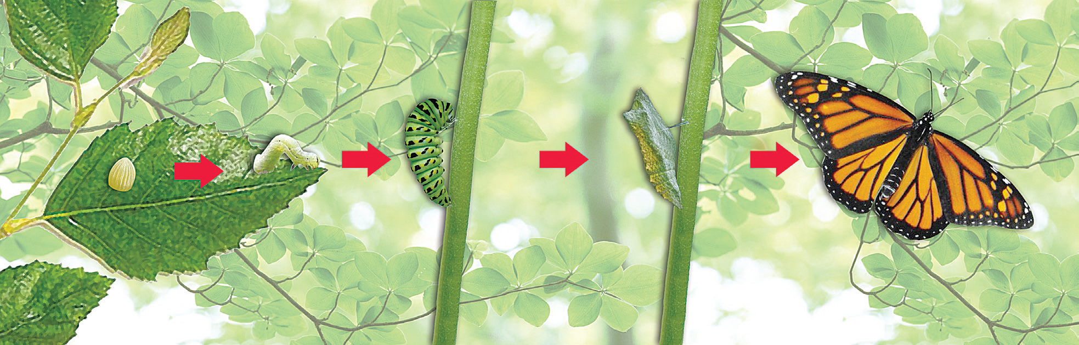
A baby butterfly is called a caterpillar. It looks like a worm with many legs. A caterpillar crawls and eats leaves. As the caterpillar grows, it covers itself with silk, making a hard covering around itself called a cocoon. In this stage, it is called a pupa. When it comes out of the cocoon, it turns into a beautiful butterfly. It looks entirely different from a caterpillar.

Slide 7
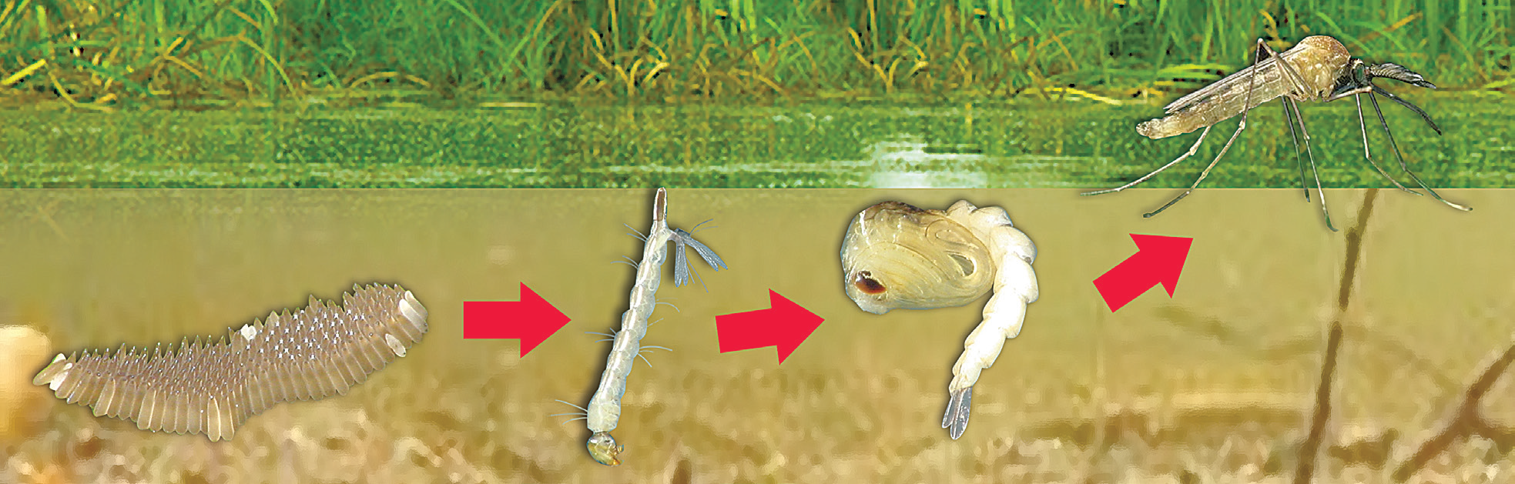
A baby mosquito is called a wriggler. It looks like a worm with a small head. Wrigglers live in water and they move around by twisting and turning.
As the baby mosquito grows, its head becomes smaller while its legs and wings develop. An adult mosquito looks completely different from the wriggler that it used to be.

