Slide 1
Comparing Plant Parts

Slide 2
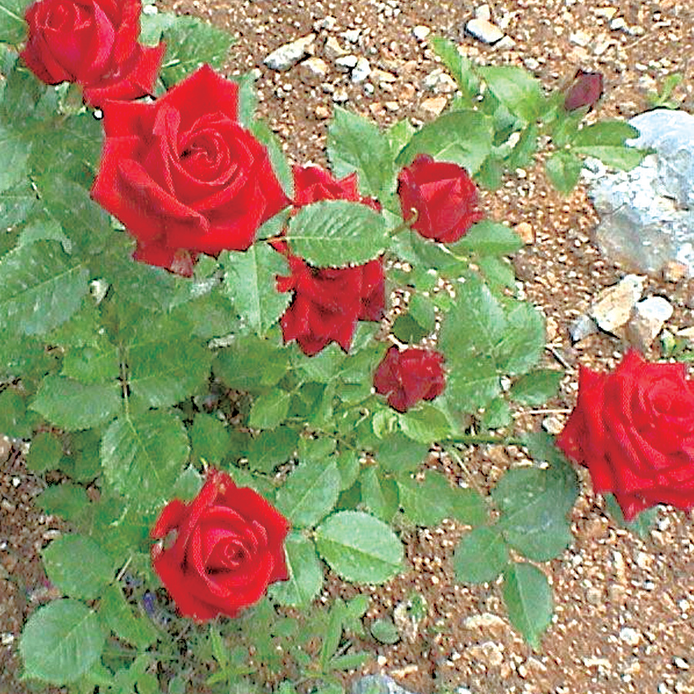
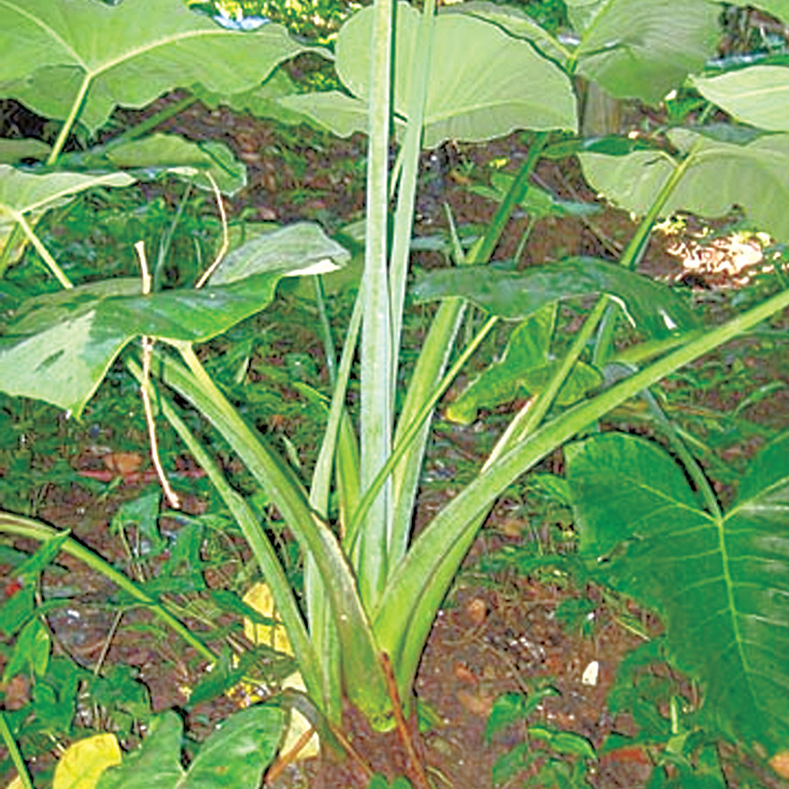
All plants have roots, stems, and leaves. Some plants are the same in color, size, and shape of their parts.
Although plants have the same basic parts, plants differ from each other in other ways. For example, the leaves of the rose plant and gabi plant are green, but they differ in size and shape. The leaves of the rose plant are small and oval shaped with sharp edges. The leaves of the gabi plant are big and heart-shaped.

Slide 3
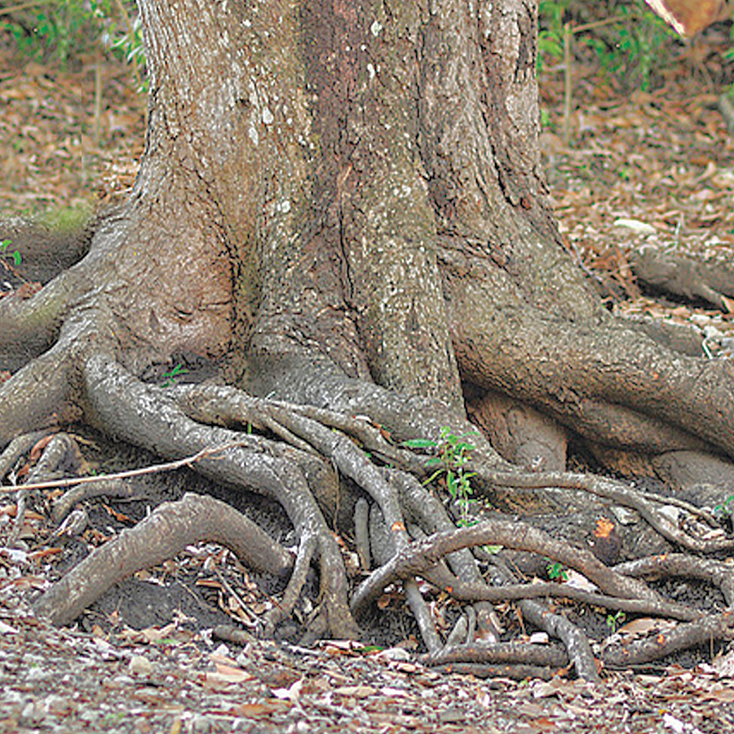
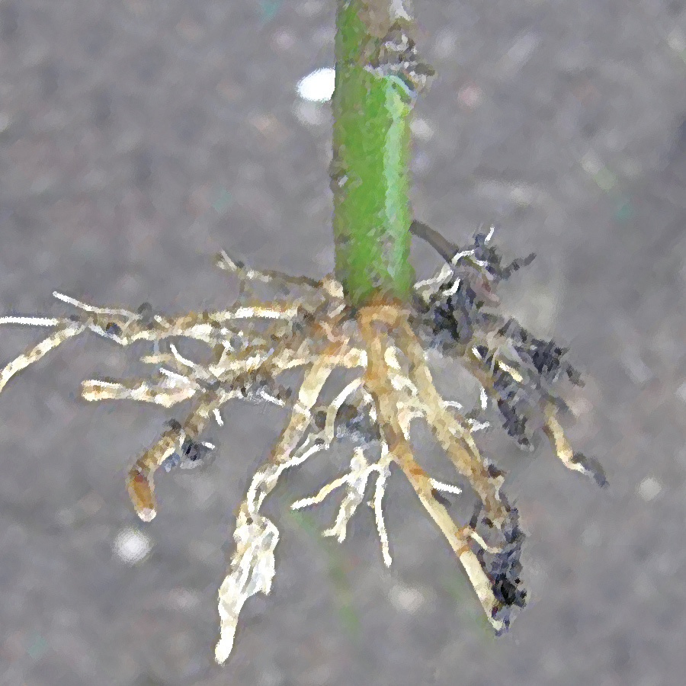
Comparing Plant Parts
Comparing Roots
Plants have different kinds of roots. Look at the pictures of roots below. Some plants have tiny and soft roots, while others have big and hard roots.

Slide 4
Most roots are brown. All roots grow downward into the soil. When a seed begins to grow, its roots grow fast, pushing their way into the soil. The root that comes out first is called the primary root. After a while, secondary roots branch out from the primary root.
Comparing Stems
Some plants have soft, juicy, and hollow stems. The stem of kangkong is soft and hollow. The stem of pechay is soft and juicy.

Slide 5
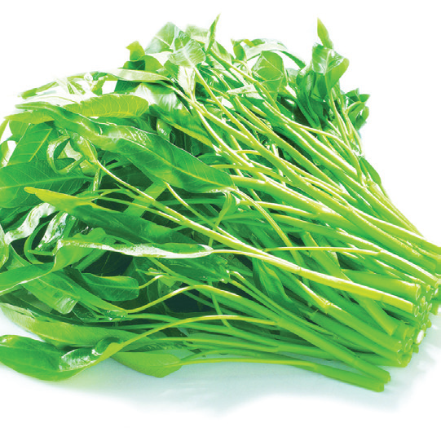
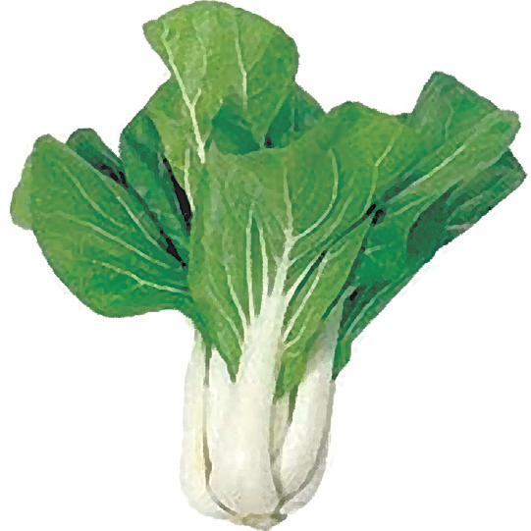
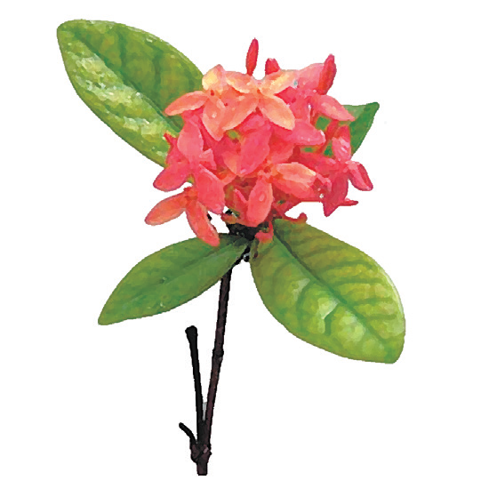
Other plants like santan and gumamela have tough and woody stems.

Slide 6
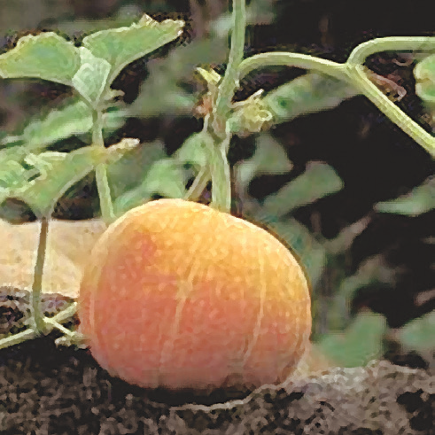
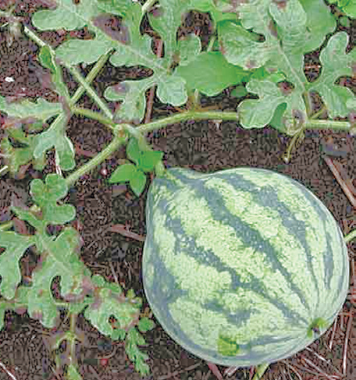
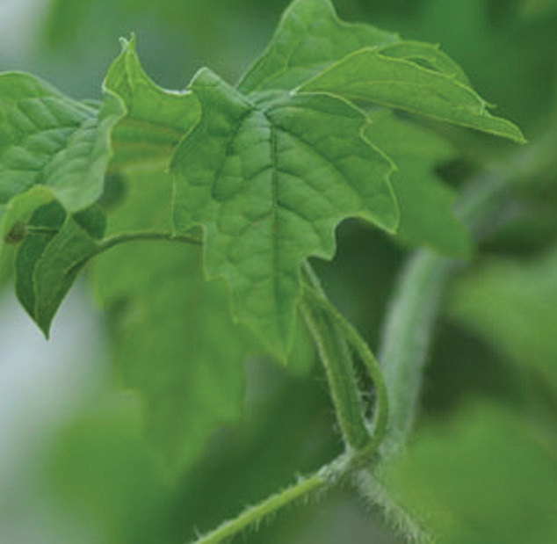
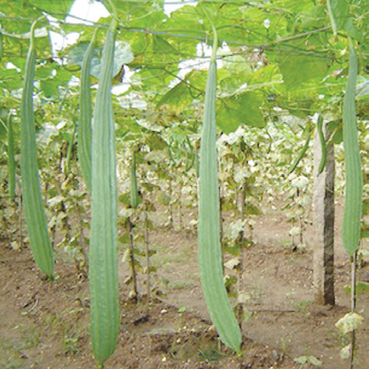
Some plants such as squash and watermelon have creeping stems. Creeping stems are long and slender, and they grow close to the ground. Some plants such as bitter gourd (ampalaya) and ridged gourd (patola) have climbing stems. Climbing stems are thin and very long. They grow upward and climb around a pole or trellis. Creeping and climbing stems are specialized stems.

Slide 7
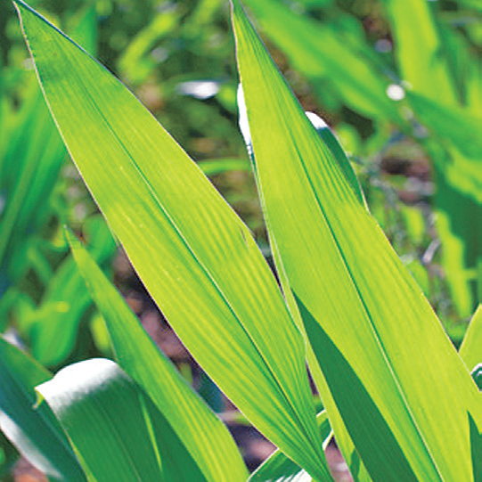
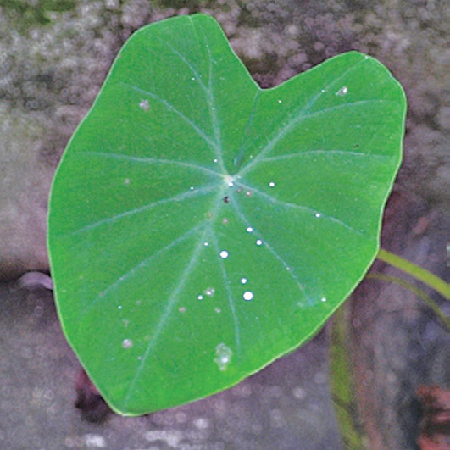
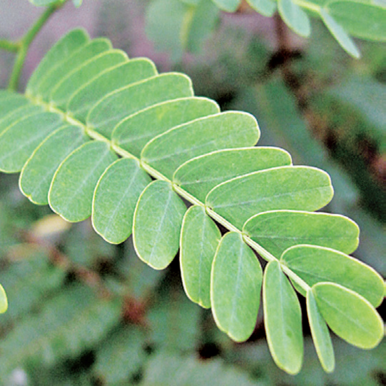
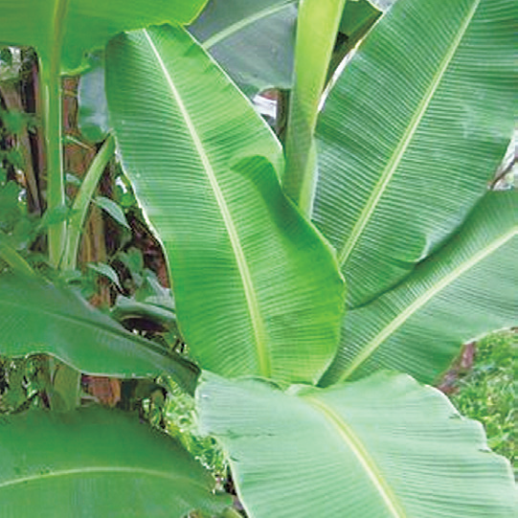
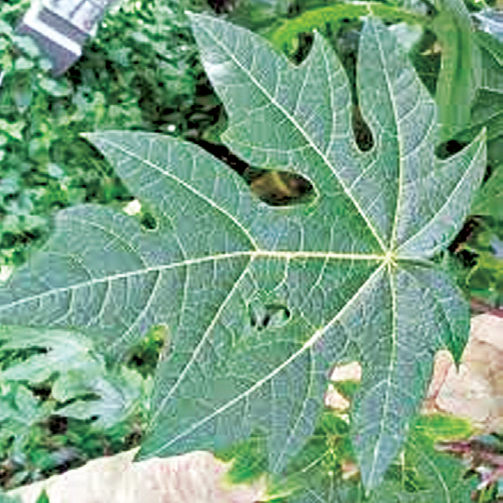
Comparing Leaves
Leaves of plants may be similar or different. Look at the colors, sizes, and shapes of the leaves in the picture below.

Slide 8
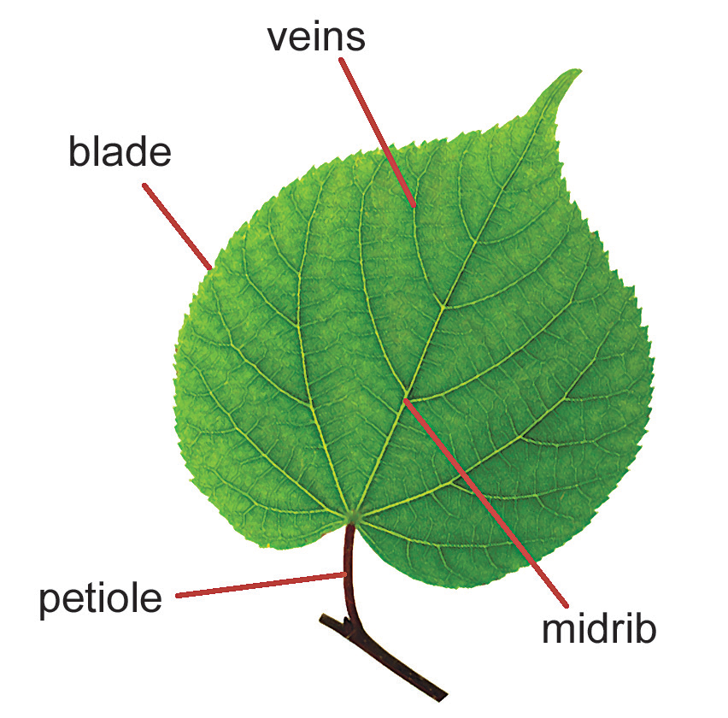
Some are long and thin like the corn leaf. Others are heart-shaped like those of the gabi. Some leaves are small like those of the tamarind and the lead tree (ipil-ipil). Other leaves are big like those of the banana. Still, other leaves have irregular edges like those of the papaya. Why do plants have different leaves?
Most leaves have a flat, thin, green part called the blade. The stalk of a leaf is called the petiole. The petiole is attached to the stem. The lines on the blade of the leaf are called veins. The largest vein is called midrib.

Slide 9
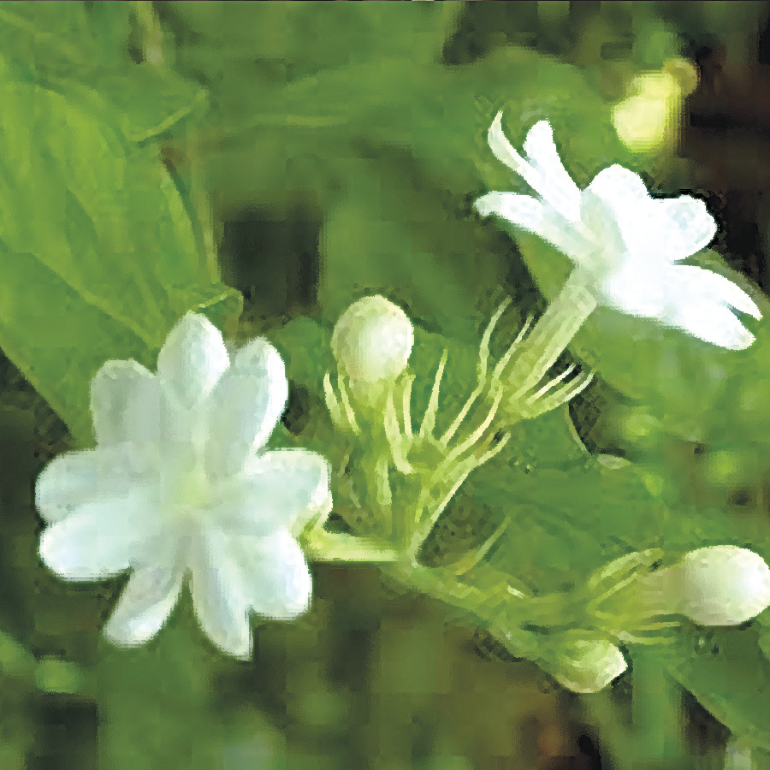
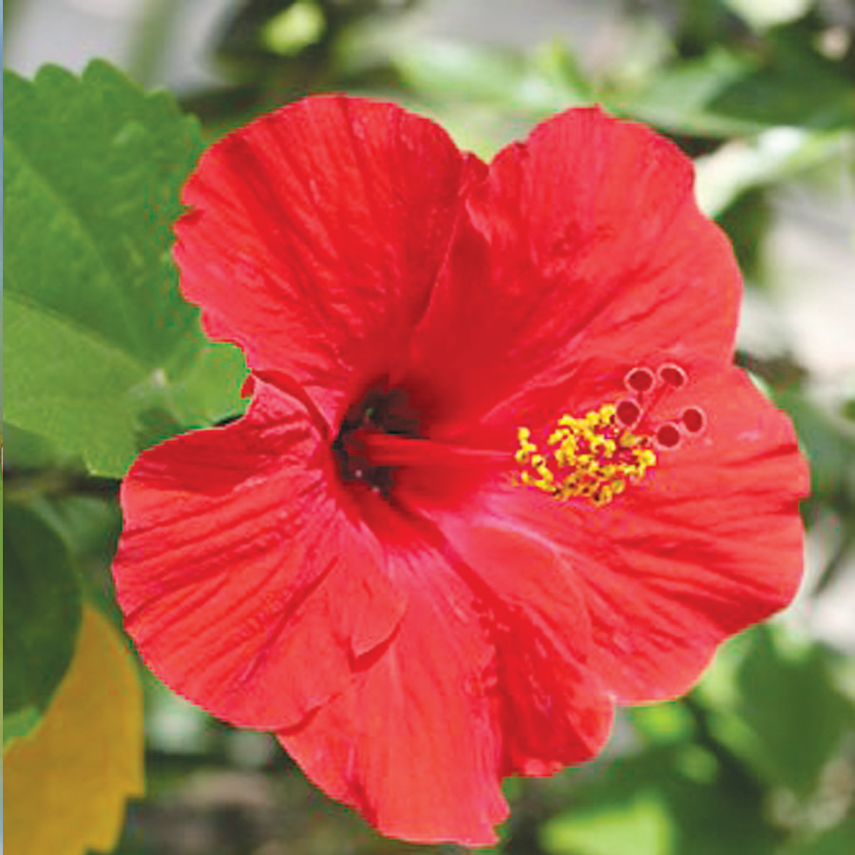
Comparing Flowers
Flowers also differ in their characteristics. Flowers differ in color. Some flowers have a fragrant smell. Others do not smell as good. Some flowers do not have any scent at all. Flowers differ in size. Some are big while others are small.

Slide 10
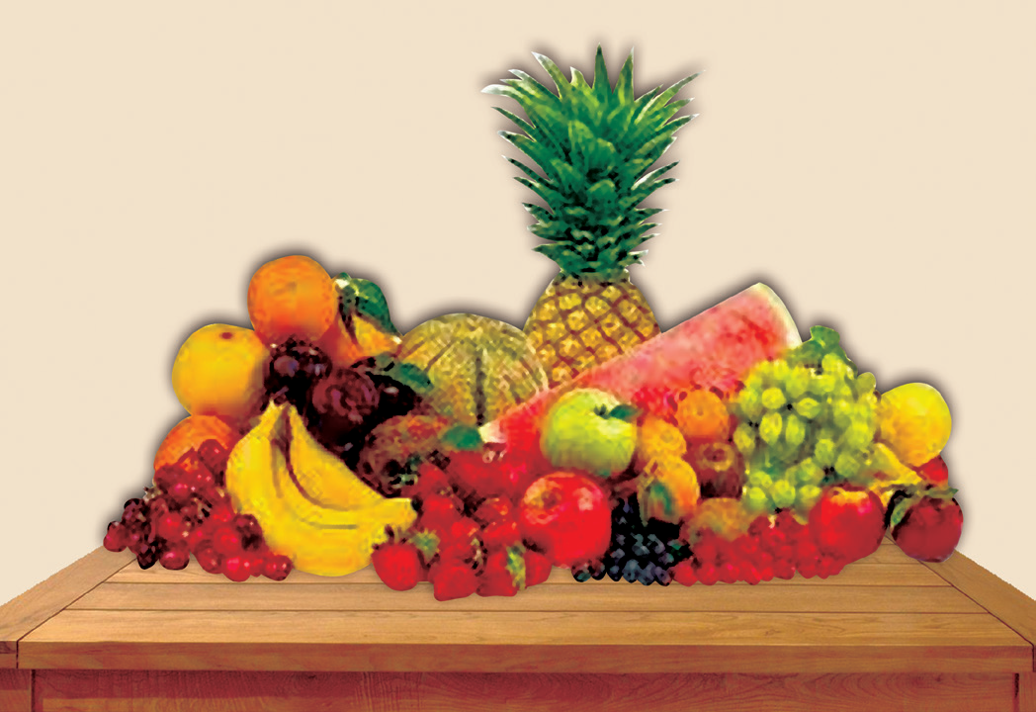
Comparing Fruits
Fruits come from the part of a flower called the ovary. The ovary grows and later ripens.
Fruits differ in many ways. They differ in shape, size, color, texture, and taste. Many fruits can be eaten.

Slide 11
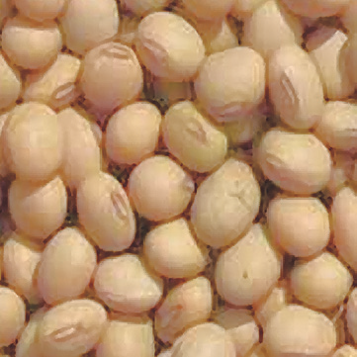
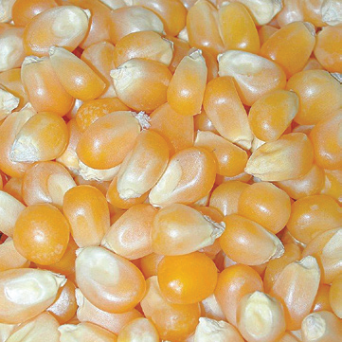
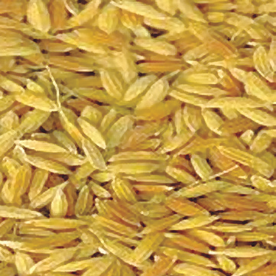
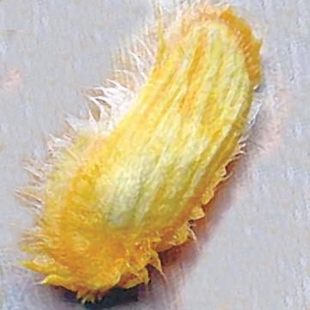
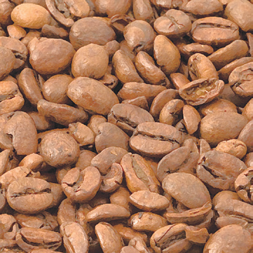
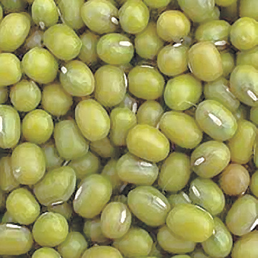
Comparing Seeds
Fruits produce seeds. Some fruits have one seed. Others have many seeds. The seeds contain a small, sleeping young plant inside.

Slide 12
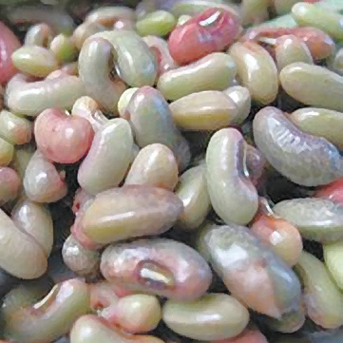
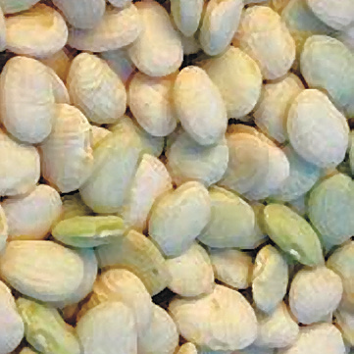
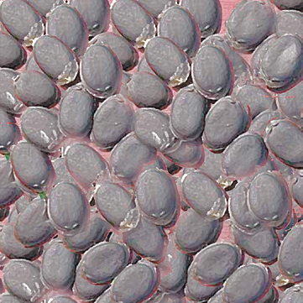
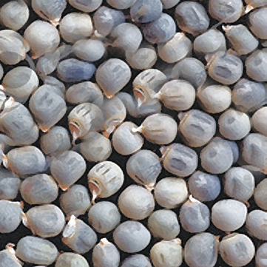
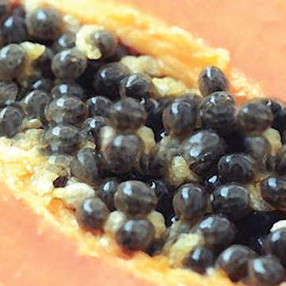
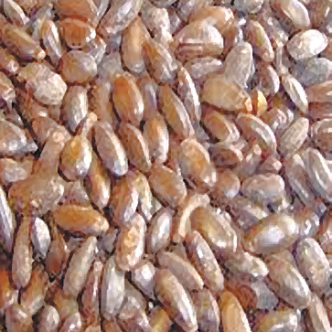

Slide 13
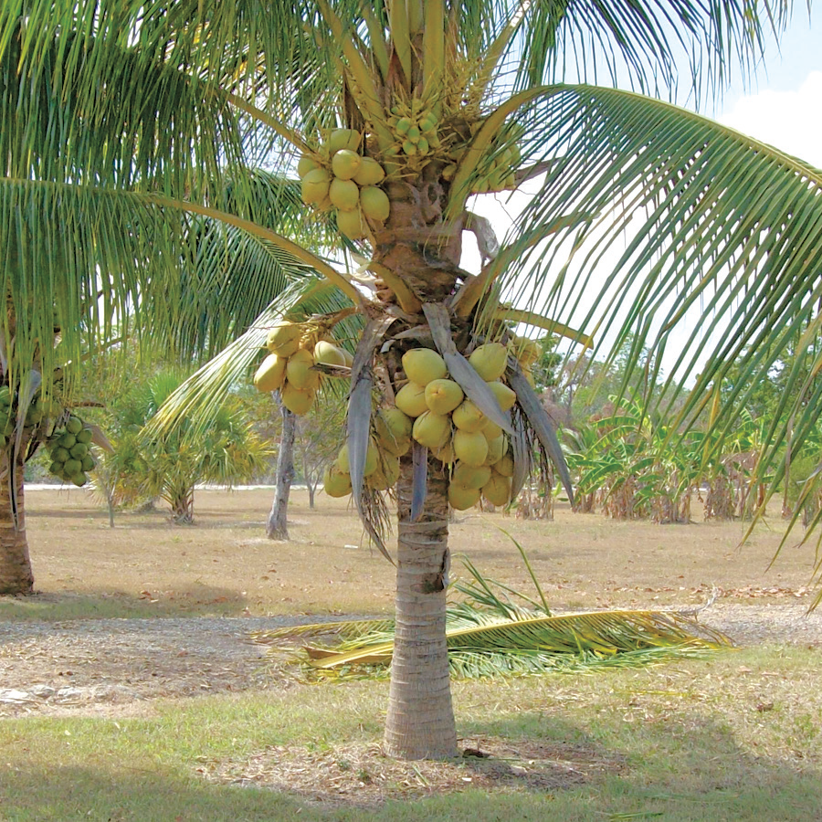
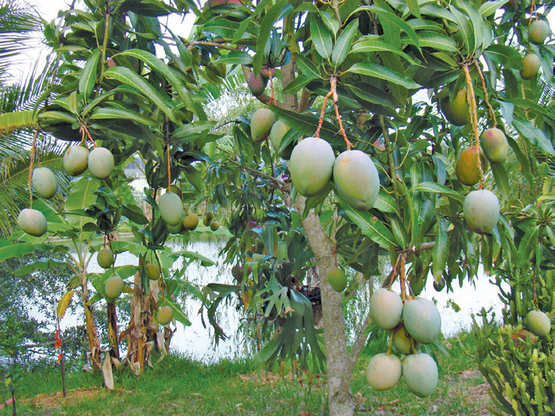
Classifying Plants According to Where They Grow
Plants grow in different places or habitats. Most plants grow on land or in plains, mountains, and hills. Some grow in forests, while others grow in deserts. Some plants like the lotus grow in water. Other plants grow on trees. They cling to the trunk and branches of trees.
Terrestrial Plants
The plants shown below grow on land.
A. coconut tree.
B. mango tree.
The plants that grow on land like the coconut tree and the mango tree are called terrestrial plants.

Slide 14
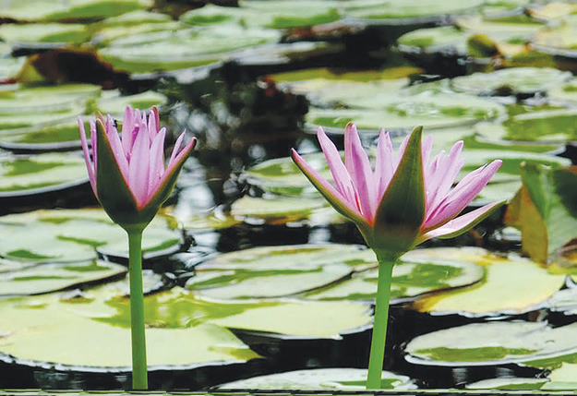
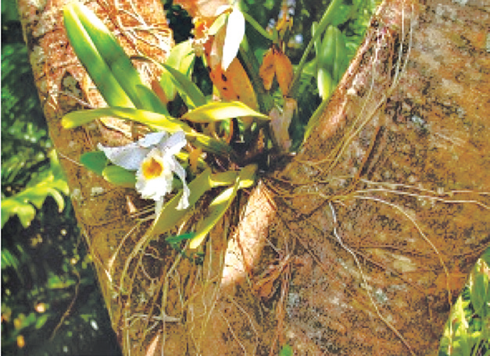
Aquatic Plants
Some plants grow in water. They are called aquatic plants. A water lily is a plant that grows in water.
Aerial Plants
Some plants live and grow on the trunks and branches of trees. They are called aerial plants. Aerial plants have sponge-like roots that get food and water from the air.

